Slide 1
Research Methods for the Behavioral Sciences
Gregory J. Privitera
St. Bonaventure University
Privitera, Research Methods for the Behavioral Sciences, 3rd Edition. © SAGE Publications, 2020.

Slide 2
Chapter 5: Sampling From Populations
SPSS Screencasts:
5.6 SPSS in Focus: Estimating the Standard Error of the Mean
5.9 SPSS in Focus: Identifying New Populations Using the One-Sample t Test
Privitera, Research Methods for the Behavioral Sciences, 3rd Edition. © SAGE Publications, 2020.

Slide 3
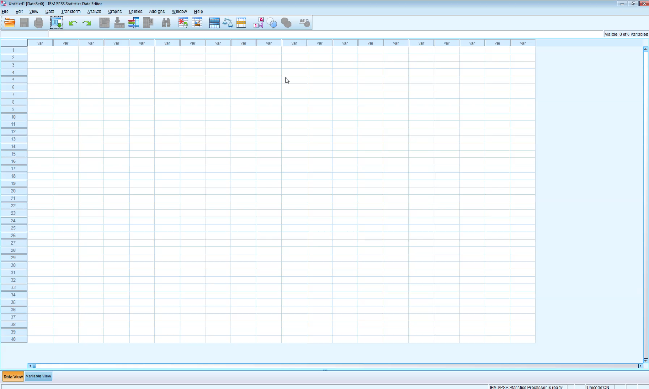
Screencast 5.6
Privitera, Research Methods for the Behavioral Sciences, 3rd Edition. © SAGE Publications, 2020.

Slide 4

Screencast 5.9
Privitera, Research Methods for the Behavioral Sciences, 3rd Edition. © SAGE Publications, 2020.

