Slide 1
Clark, Foundations of Comparative Politics, Edition 2 Chapter 3: What is Politics?

Slide 2
The Exit, Voice, and Loyalty (EVL) Theory of Politics (1 of 7)
Changes to the environment.
Three possible responses.
Example: policy negatively affects environment.
Notes:
L.O. 3-1 Identify what makes a situation political.
L.O. 3-2 Explain where power comes from. Who has it? Why do they have it? How and when is it used?
Changes to the environment
Throughout our lives, we’ll all experience changes to our environment we don’t like.
Examples of what some people might consider negative changes to their environment:
The government increases taxes.
The state imposes a ban on handguns.
The Supreme Court rules that prayer in public schools is unconstitutional.
The national currency drops in value.
Fuel-efficient cars are imported from a foreign country.
The quality of peaches at your local fruit stand declines.
Note that although some people won’t like these changes and will see them as bad, others will see them as improvements.
Political situations nearly always involve some individuals or groups benefiting at the expense of other individuals and groups.
When bad things happen, though, who has the power to reverse them?
Who has the power to stop bad things happening to them in the first place?
Three possible responses
You have three possible responses —you can exit, use voice, or demonstrate loyalty.
Choosing to exit means accepting the negative change in your environment but altering your behavior to achieve the best possible outcome in your new environment.
Choosing to use voice means not accepting the negative change in your environment and instead seeking to “persuade” the government through protesting, lobbying, or other forms of direct action to reinstate your original environment.
Choosing to demonstrate loyalty means accepting the negative change in your environment but not altering your preexisting behavior.
In Table 3.1, we illustrate what it means to use exit, voice, or loyalty in response to several potentially negative changes in your environment.
Example: policy negatively affects environment
To put some specifics on things, let’s consider the situation in which the government introduces a policy that negatively affects the environment of one of its citizens.
How should the citizen respond? When should the citizen choose to exit, use voice, or remain loyal?
The problem facing the citizen and government is complicated because the citizen’s choice of what to do depends on what they think the government will do, and the government’s choice of what to do depends on what it thinks the citizen will do.
It can be useful when thinking about a strategic situation like this one to map out the sequence of choices available to the actors involved.
This is what we’ve done with the help of a game tree in Figure 3.1. A game tree is a map of the possible outcomes of a series of related choices.
Recall that the government has introduced a policy the citizen doesn’t like—perhaps a tax hike that increases the government’s revenue but reduces the citizen’s income.
Think about how the citizen and government value the possible outcomes in the game tree.
Table 3.2 shows how the actors value each of the five possible outcomes
Think of the values in Table 3.2 as the “payoffs” that each of the actors receives from reaching a particular outcome.
Put these payoffs together to see how the citizen and government each value the five possible outcomes in our game tree.
We can now add these payoffs to the game tree shown in Figure 3.1. The new game tree with the payoffs is shown in Figure 3.2.

Slide 3
The Exit, Voice, and Loyalty (EVL) Theory of Politics (2 of 7)
Table 3.1: Exit, Voice, and Loyalty
Stimulus | Exit | Voice | Loyalty
The government increases taxes. | Reallocate portfolio to avoid tax increase | Organize tax revolt | Continue to pay taxes, keep your mouth shut
There’s a decline in the quality of peaches at the local fruit stand. | Buy mangoes, or buy peaches somewhere else | Complain to the store owner | Continue to eat peaches, keep your mouth shut
Notes:
L.O. 3-1 Identify what makes a situation political.
L.O. 3-2 Explain where power comes from. Who has it? Why do they have it? How and when is it used?

Slide 4
The Exit, Voice, and Loyalty (EVL) Theory of Politics (3 of 7)
Table 3.1: Exit, Voice, and Loyalty (cont’d)
Stimulus | Exit | Voice | Loyalty
The Supreme Court rules that prayer in public schools is unconstitutional. | Homeschool your children | Lobby the government to change the Constitution | Keep your children in the public school system, keep your mouth shut
Your state outlaws handguns. | Move to a different state | Join the NRA or a militia group to put pressure on the state to allow handguns | Turn in your handguns, keep your mouth shut
Notes:
L.O. 3-1 Identify what makes a situation political.
L.O. 3-2 Explain where power comes from. Who has it? Why do they have it? How and when is it used?

Slide 5
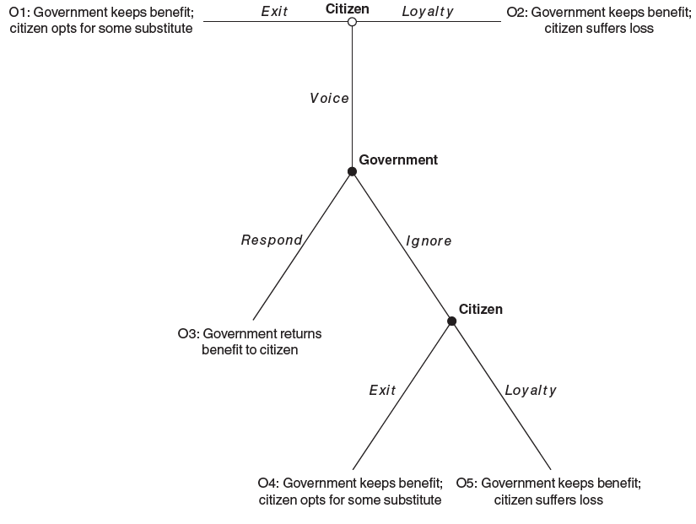
The Exit, Voice, and Loyalty (EVL) Theory of Politics (4 of 7)
Figure 3.1 The Game Tree for the EVL Theory
Access the long description for image.
Notes:
L.O. 3-1 Identify what makes a situation political.
L.O. 3-2 Explain where power comes from. Who has it? Why do they have it? How and when is it used?

Slide 6
The Exit, Voice, and Loyalty (EVL) Theory of Politics (5 of 7)
Table 3.2: Turning Outcomes into Payoffs
Outcome | Description | Citizen | Government
O1 | The government keeps the benefit but loses the support of the citizen. The citizen opts for some substitute. | E | 1
O2 | The government keeps both the benefit and the support of the citizen. The citizen suffers their loss in silence. | 0 | 1 + L
O3 | The government returns the benefit to the citizen and keeps their support. | 1 – c | L
Notes:
L.O. 3-1 Identify what makes a situation political.
L.O. 3-2 Explain where power comes from. Who has it? Why do they have it? How and when is it used?
Note: E = citizen’s exit payoff; 1 = value of benefit taken from the citizen by the government; L = government’s value from having a loyal citizen who does not exit; c = cost of using voice.

Slide 7
The Exit, Voice, and Loyalty (EVL) Theory of Politics (6 of 7)
Table 3.2: Turning Outcomes into Payoffs (cont’d)
Outcome | Description | Citizen | Government
O4 | The government keeps the benefit but loses the support of the citizen. Having used their voice, the citizen opts for some substitute. | E – c | 1
O5 | The government keeps both the benefit and the support of the citizen. Having used their voice, the citizen suffers their loss. | 0 – c | 1 + L
Notes:
L.O. 3-1 Identify what makes a situation political.
L.O. 3-2 Explain where power comes from. Who has it? Why do they have it? How and when is it used?
Note: E = citizen’s exit payoff; 1 = value of benefit taken from the citizen by the government; L = government’s value from having a loyal citizen who does not exit; c = cost of using voice.

Slide 8
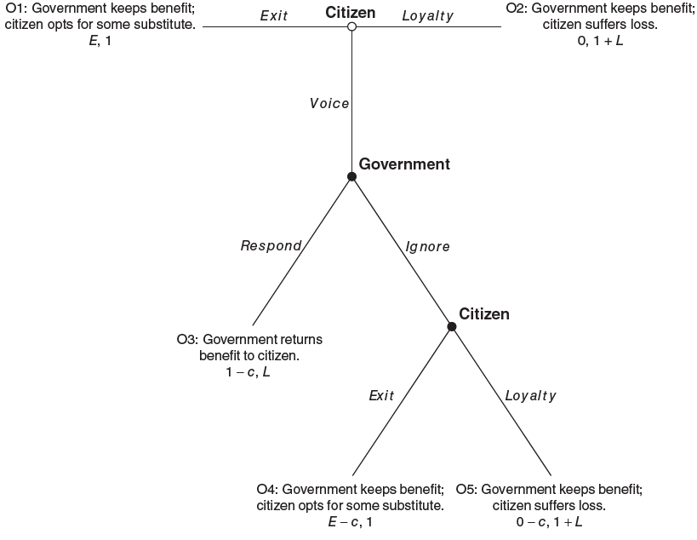
The Exit, Voice, and Loyalty (EVL) Theory of Politics (7 of 7)
Figure 3.2 The Game Tree for the EVL Theory With Payoffs
Access the long description for image.
Notes:
L.O. 3-1 Identify what makes a situation political.
L.O. 3-2 Explain where power comes from. Who has it? Why do they have it? How and when is it used?
Note: E = citizen’s exit payoff; 1 = value of benefit taken from the citizen by the government; L = government’s value from having a loyal citizen who doesn’t exit; c = cost of using voice. It’s assumed that c, L > 0, and that
E < 1 – c. The citizen’s payoffs are shown first because they’re the first player to make a choice; the government’s payoffs are shown second. A comma separates the payoffs for the two actors.

Slide 9
What Happens in the EVL Theory? (1 of 7)
Think about consequences of choices.
Backward induction.
Credible exit threat.
Notes:
L.O. 3-3 Explain the strategic situation described in the Exit, Voice, and Loyalty theory.
Think about consequences of choices
Actors in a strategic situation like the one shown in Figure 3.2 typically don’t make choices at random.
Instead, they think about the consequences of their choices and therefore think ahead.
They try to think about and anticipate how the other actors they’re interacting with will respond to their choices.
Backward induction
An actor might ask themselves how some other actor would respond if they choose action A and how the same actor would respond if they choose action B.
The actor then chooses the action A or B that’s expected, in light of the anticipated reaction of other actors, to give them the highest payoff.
The logical extension of this thought process leads players to begin at the end of the game and reason backward.
This process is called backward induction and is probably something that most of us do unconsciously when making decisions in our everyday lives.
In the context of our particular strategic situation in Figure 3.2, backward induction requires starting at the bottom of the game tree and working our way to the top.
We indicate this choice by making the exit branch at the bottom choice in the game tree bold. This is shown in Figure 3.3.
Now we move backward, up the game tree, to the previous choice, which is made by the government.
We indicate this choice by making the respond branch at this point in the game tree bold. This is shown in Figure 3.4.
Now we move backward to the very top of the game tree.
We indicate this choice by making the voice branch at the top of the game tree bold. This is shown in Figure 3.5.
Thanks to our use of backward induction, each of the choices shown in bold are the best available to the actor making the choice (citizen or government) given how that actor anticipates the other actor will respond further down the game tree.
It's worth spending a moment to think through exactly why the government is responsive to the citizen in this scenario.
The government responds positively because it anticipates the citizen will exit further down the game tree if it ignores them, an outcome it wishes to avoid.
Think theoretically about things that might have happened but didn’t, things that weren’t observed.
Credible exit threat
Our analysis of the EVL theory so far has focused on the scenario where the citizen has a credible exit threat (E > 0) and the government is dependent (L > 1). What happens if we change the scenario?
What happens, for example, if we retain the assumption that the government is dependent (L > 1), but now assume the citizen lacks a credible exit threat (E < 0)?
Let’s assume that, as unhappy as the citizen may be with the policy the government has introduced, remaining loyal is preferred to exiting.
The decision tree for this particular scenario is shown in Figure 3.6.
Let’s now look at a third scenario where we assume the citizen has a credible exit threat (E > 0) but the government is autonomous and doesn’t depend on the citizen (L < 1).
An autonomous government is one that values what it took from the citizen (1) more than the citizen’s loyalty (L).
The game tree for this particular scenario is shown in Figure 3.7.
Let’s look at the last possible scenario. What happens if we assume the citizen lacks a credible exit threat (E < 0) and the government is autonomous (L < 1)?
The game tree for this fourth scenario is shown in Figure 3.8.

Slide 10
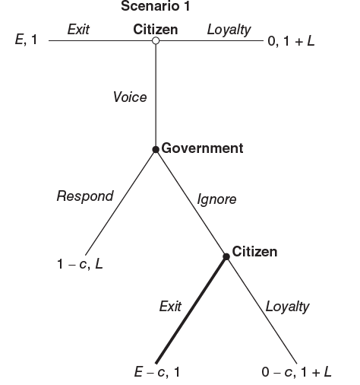
What Happens in the EVL Theory? (2 of 7)
Figure 3.3 The EVL Theory When the Citizen has a Credible Exit Threat (E > 0): Step 1 of Backward Induction
Access the long description for image.
Notes:
L.O. 3-3 Explain the strategic situation described in the Exit, Voice, and Loyalty theory.
Note: E = citizen’s exit payoff; 1 = value of benefit taken from the citizen by the government; L = government’s value from having a loyal citizen who doesn’t exit; c = cost of using voice. It’s assumed that c, L > 0; E < 1 – c; E > 0.

Slide 11
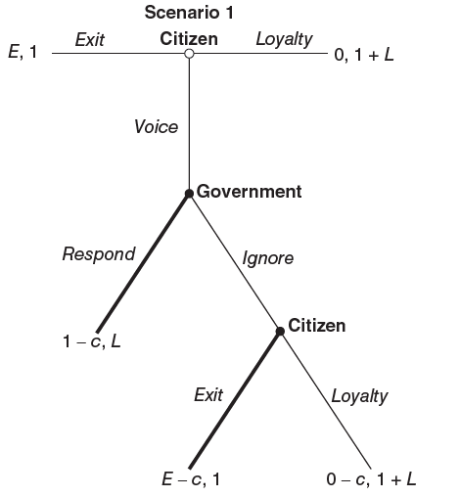
What Happens in the EVL Theory? (3 of 7)
Figure 3.4 The EVL Theory When the Citizen Has a Credible Exit Threat (E > 0) and the Government Is Dependent (L > 1): Step 2 of Backward Induction
Access the long description for image.
Notes:
L.O. 3-3 Explain the strategic situation described in the Exit, Voice, and Loyalty theory.
Note: E = citizen’s exit payoff; 1 = value of benefit taken from the citizen by the government; L = government’s value from having a loyal citizen who doesn’t exit; c = cost of using voice. It’s assumed that c, L > 0; E < 1 – c; E >
0; L > 1.

Slide 12
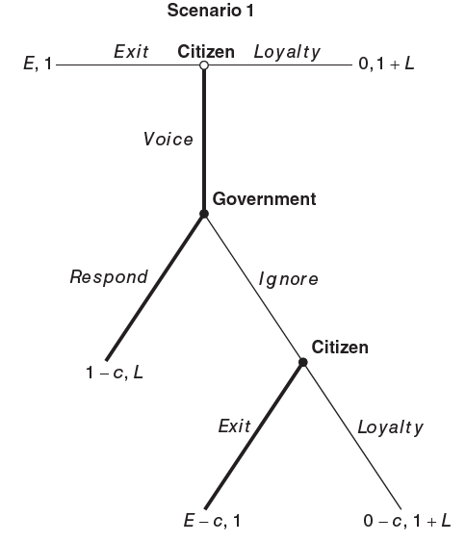
What Happens in the EVL Theory? (4 of 7)
Figure 3.5 The EVL Theory When the Citizen Has a Credible Exit Threat (E > 0) and the Government Is Dependent (L > 1): Step 3 of Backward Induction
Access the long description for image.
Notes:
L.O. 3-3 Explain the strategic situation described in the Exit, Voice, and Loyalty theory.
Note: E = citizen’s exit payoff; 1 = value of benefit taken from the citizen by the government; L = government’s value from having a loyal citizen who doesn’t exit; c = cost of using voice. It’s assumed that c, L > 0; E < 1 – c;
E > 0; L > 1.

Slide 13
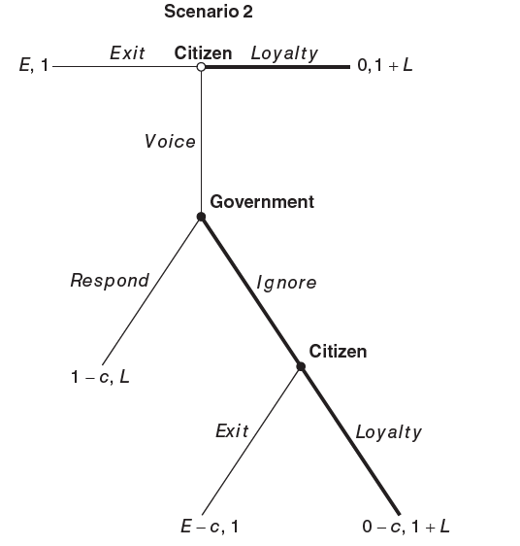
What Happens in the EVL Theory? (5 of 7)
Figure 3.6 The EVL Theory When the Citizen Does Not Have a Credible Exit Threat (E < 0) and the Government Is Dependent (L > 1)
Access the long description for image.
Notes:
L.O. 3-3 Explain the strategic situation described in the Exit, Voice, and Loyalty theory.
Note: E = citizen’s exit payoff; 1 = value of benefit taken from the citizen by the government; L = government’s value from having a loyal citizen who doesn’t exit; c = cost of using voice. It’s assumed that c, L > 0; E < 1 – c; E < 0; L > 1.

Slide 14
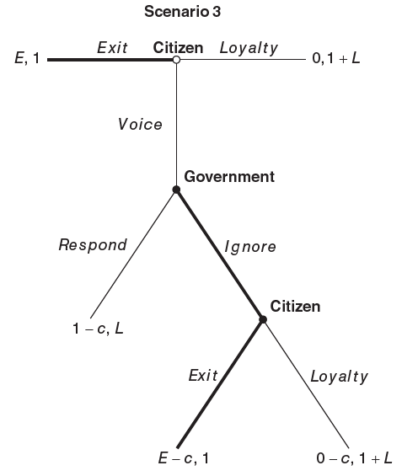
What Happens in the EVL Theory? (6 of 7)
Figure 3.7 The EVL Theory When the Citizen Has a Credible Exit Threat (E > 0) and the Government Is Autonomous (L < 1)
Access the long description for image.
Notes:
L.O. 3-3 Explain the strategic situation described in the Exit, Voice, and Loyalty theory.
Note: E = citizen’s exit payoff; 1 = value of benefit taken from the citizen by the government; L = government’s value from having a loyal citizen who doesn’t exit; c = cost of using voice. It’s assumed that c, L > 0; E < 1 – c; E > 0; L < 1.

Slide 15
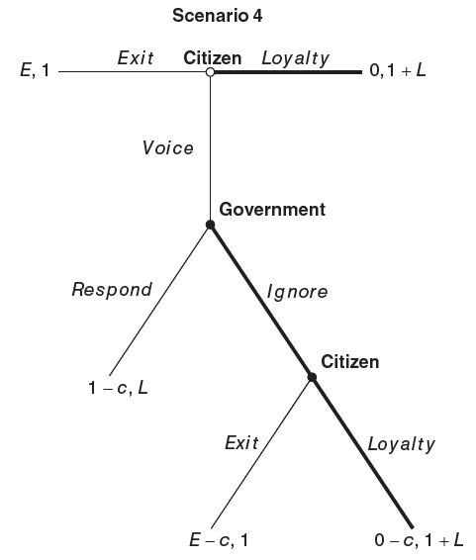
What Happens in the EVL Theory? (7 of 7)
Figure 3.8 The EVL Theory When the Citizen Doesn’t Have a Credible Exit Threat (E < 0) and the Government Is Autonomous (L < 1)
Access the long description for image.
Notes:
L.O. 3-3 Explain the strategic situation described in the Exit, Voice, and Loyalty theory.
Note: E = citizen’s exit payoff; 1 = value of benefit taken from the citizen by the government; L = government’s value from having a loyal citizen who doesn’t exit; c = cost of using voice. It’s assumed that c, L > 0; E < 1 – c; E < 0; L < 1.

Slide 16
Insights from the EVL Theory (1 of 2)
Outcomes associated with the scenarios.
Insights regarding the power relationship.
Notes:
L.O. 3-4 Assess the insights from the Exit, Voice, and Loyalty theory.
Outcomes associated with the scenarios
The outcomes associated with each of the four scenarios we’ve examined are summarized in Table 3.3.
As we’ve already seen, what happens in the EVL theory depends on whether the citizen has a credible exit threat or not (rows) and whether the government is autonomous or dependent (columns).
Insights regarding the power relationship
The first is that the citizen is able to exert power over the government only when two conditions are met: (1) the citizen must have a credible exit threat (E > 0) and (2) the government must be dependent on the citizen (L > 1).
The second important insight is that in the absence of a credible exit option, E < 0, the citizen is a sitting duck.
A third insight from our EVL theory is that it’s often difficult to learn very much from observing real-world political situations.
A fourth important point. If the government is responsive to those citizens on whom it depends for loyalty whenever those citizens possess credible exit threats, why would the government ever take a benefit away from these citizens in the first place?
The important point to note here is that those citizens who have credible exit options wield considerable power without ever needing to open their mouths (use voice) whenever the government depends on them.
Finally, the EVL theory of politics is as noteworthy for what it doesn’t explain as for what it does. Notice that in the theory as it stands, citizens use voice only when they expect it to be effective.
This means that the theory can’t explain why we sometimes see governments being unresponsive to the demands of their citizens.

Slide 17
Insights from the EVL Theory (2 of 2)
Table 3.3: A Summary of the Expected Outcomes in the Four Scenarios of the EVL Theory
 | The Government
The citizen | Is Autonomous (L < 1) | Is Dependent (L > 1)
Has a Credible Exit Threat (E > 0) | O1: The citizen exits. | O3: The citizen uses their voice and the government responds positively.
Has no Credible Exit Threat (E < 0) | O2: The citizen remains loyal. | O2: The citizen remains loyal.
Notes:
L.O. 3-4 Assess the insights from the Exit, Voice, and Loyalty theory.
Note: Only in the shaded cell, where the citizen has a credible exit threat and the government is dependent, can the citizen exert power over the government.

Slide 18
Appendix: Accessibility Content, Long Descriptions for Images

Slide 19
Figure 3.1: Long Description
The root note is labeled Citizen. A branch from Citizen labeled Exit points to O 1: Government keeps benefit; citizen opts for some substitute. A branch from Citizen labeled Loyalty points to O 2: Government keeps benefit; citizen suffers loss. A branch from Citizen labeled Voice points to a node labeled Government. A branch from the Government node labeled Respond points to O 3: Government returns benefit to citizen. A branch from Government labeled Ignore points to a node labeled Citizen. A branch from Citizen labeled Exit points to O 4: Government keeps benefit; citizen opts for some substitute. A branch from Citizen labeled Loyalty points to O 5: Government keeps benefit; citizen suffers loss. The nodes Government and Citizen are in bold.
Access the corresponding image.

Slide 20
Figure 3.2: Long Description
The root note is labeled Citizen. A branch from Citizen labeled Exit points to O 1: Government keeps benefit; citizen opts for some substitute; E, 1. A branch from Citizen labeled Loyalty points to O 2: Government keeps benefit; citizen suffers loss; 0, 1 plus L. A branch from Citizen labeled Voice points to a node labeled Government. A branch from the Government node labeled Respond points to O 3: Government returns benefit to citizen; 1 minus c, L. A branch from Government labeled Ignore points to a node labeled Citizen. A branch from Citizen labeled Exit points to O 4: Government keeps benefit; citizen opts for some substitute; E minus c, 1. A branch from Citizen labeled Loyalty points to O 5: Government keeps benefit; citizen suffers loss; 0 minus c, 1 plus L. The nodes Government and Citizen are in bold.
Access the corresponding image.

Slide 21
Figure 3.3: Long Description
The root note is labeled Citizen. A branch from Citizen labeled Exit points to E, 1. A branch from Citizen labeled Loyalty points to 0, 1 plus L. A branch from Citizen labeled Voice points to a node labeled Government. A branch from the Government node labeled Respond points to 1 minus c, L. A branch from Government labeled Ignore points to a node labeled Citizen. A branch from Citizen labeled Exit points to E minus c, 1. A branch from Citizen labeled Loyalty points to 0 minus c, 1 plus L. The nodes Government and Citizen and the branch Exit from Citizen are in bold.
Access the corresponding image.

Slide 22
Figure 3.4: Long Description
The root note is labeled Citizen. A branch from Citizen labeled Exit points to E, 1. A branch from Citizen labeled Loyalty points to 0, 1 plus L. A branch from Citizen labeled Voice points to a node labeled Government. A branch from the Government node labeled Respond points to 1 minus c, L. A branch from Government labeled Ignore points to a node labeled Citizen. A branch from Citizen labeled Exit points to E minus c, 1. A branch from Citizen labeled Loyalty points to 0 minus c, 1 plus L. The nodes Government and Citizen are in bold. The branches Respond from node Government and Exit from node Citizen are also in bold.
Access the corresponding image.

Slide 23
Figure 3.5: Long Description
The root note is labeled Citizen. A branch from Citizen labeled Exit points to E, 1. A branch from Citizen labeled Loyalty points to 0, 1 plus L. A branch from Citizen labeled Voice points to a node labeled Government. A branch from the Government node labeled Respond points to 1 minus c, L. A branch from Government labeled Ignore points to a node labeled Citizen. A branch from Citizen labeled Exit points to E minus c, 1. A branch from Citizen labeled Loyalty points to 0 minus c, 1 plus L. The nodes Government and Citizen are in bold. The branches Voice from the root node Citizen, Respond from node Government, and Exit from node Citizen are also in bold.
Access the corresponding image.

Slide 24
Figure 3.6: Long Description
The root note is labeled Citizen. A branch from Citizen labeled Exit points to E, 1. A branch from Citizen labeled Loyalty points to 0, 1 plus L. A branch from Citizen labeled Voice points to a node labeled Government. A branch from the Government node labeled Respond points to 1 minus c, L. A branch from Government labeled Ignore points to a node labeled Citizen. A branch from Citizen labeled Exit points to E minus c, 1. A branch from Citizen labeled Loyalty points to 0 minus c, 1 plus L. The root node Citizen and the nodes Government and Citizen are in bold. The branches Loyalty from the root node Citizen, Ignore from node Government, and Loyalty from node Citizen are also in bold.
Access the corresponding image.

Slide 25
Figure 3.7: Long Description
The root note is labeled Citizen. A branch from Citizen labeled Exit points to E, 1. A branch from Citizen labeled Loyalty points to 0, 1 plus L. A branch from Citizen labeled Voice points to a node labeled Government. A branch from the Government node labeled Respond points to 1 minus c, L. A branch from Government labeled Ignore points to a node labeled Citizen. A branch from Citizen labeled Exit points to E minus c, 1. A branch from Citizen labeled Loyalty points to 0 minus c, 1 plus L. The root node Citizen and the nodes Government and Citizen are in bold. The branches Exit from the root node Citizen, Ignore from node Government, and Exit from node Citizen are also in bold.
Access the corresponding image.

Slide 26
Figure 3.8: Long Description
The root note is labeled Citizen. A branch from Citizen labeled Exit points to E, 1. A branch from Citizen labeled Loyalty points to 0, 1 plus L. A branch from Citizen labeled Voice points to a node labeled Government. A branch from the Government node labeled Respond points to 1 minus c, L. A branch from Government labeled Ignore points to a node labeled Citizen. A branch from Citizen labeled Exit points to E minus c, 1. A branch from Citizen labeled Loyalty points to 0 minus c, 1 plus L. The root node Citizen and the nodes Government and Citizen are in bold. The branches Loyalty from the root node Citizen, Ignore from node Government, and Loyalty from node Citizen are also in bold.
Access the corresponding image.

