Slide 1
Chapter 9 Excel Extension: Now You Try!
Using Data Analytics to Understand Performance

Slide 2
Background
In this Excel Extension tutorial, you will learn how to use data analytics (specifically, multiple linear regression analysis) to understand performance.
For the purposes of this exercise, imagine that you want to identify factors/variables that might predict employee performance. Accordingly, you assess a group of 20 employees on their product knowledge, extraversion, time management, cooperativeness, and their job performance. Using multiple linear regression analysis, you will identify which factors/variables are significant predictors of job performance for these employees.

Slide 3
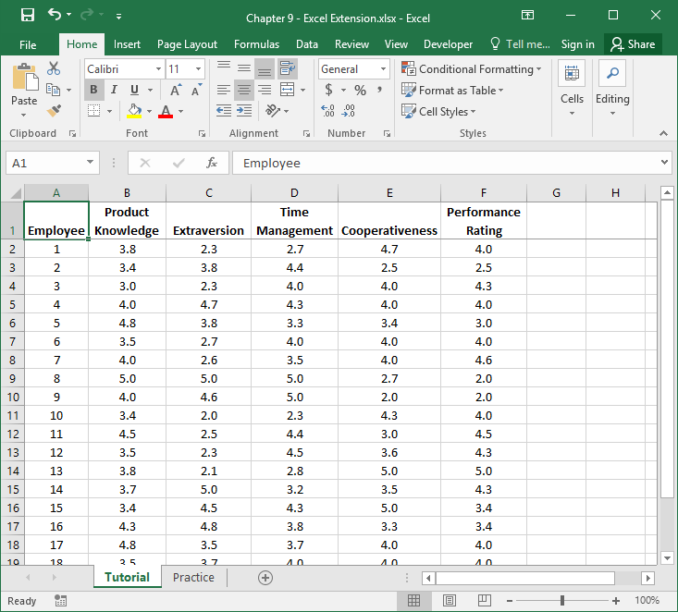
Step 1
Open the Excel workbook titled “Chapter 9--Excel Extension.xlsx”.
Click on the sheet called Tutorial. You will use the data contained in this sheet to learn how to run a multiple linear regression analysis.
Note that the sheet includes three fields/columns/variables:
Employee (unique employee identifier)
Product Knowledge (1 = poor, 5 = good)
Extraversion (1 = low, 5 = high)
Time Management (1 = poor, 5 = good)
Cooperativeness (1 = low, 5 = high)
Performance Rating (1 = low, 5 = high)
Note that there are 20 employees in this sample.

Slide 4
Step 2
If you haven’t already, be sure to add in the Analysis ToolPak feature in Excel, which requires the following steps.
First, click on the File tab.

Slide 5
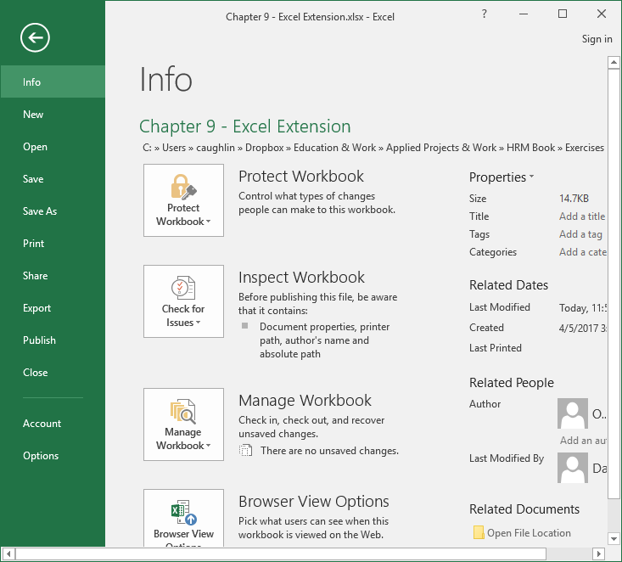
Step 3
Select Options.

Slide 6
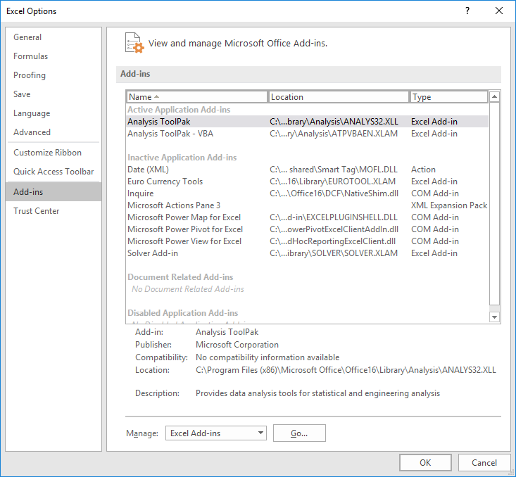
Step 4
When the Excel Options window opens, select the Add-Ins tab on the left, and then select the Analysis ToolPak in the Excel Add-Ins list, which appears next to Manage at the bottom of the window, and click Go…. A window will open, and simply check the box next to Analysis ToolPak.
If you already have the Analysis ToolPak application activated, it will appear in the Active Application Add-ins list, as shown in the image.
Click OK.

Slide 7
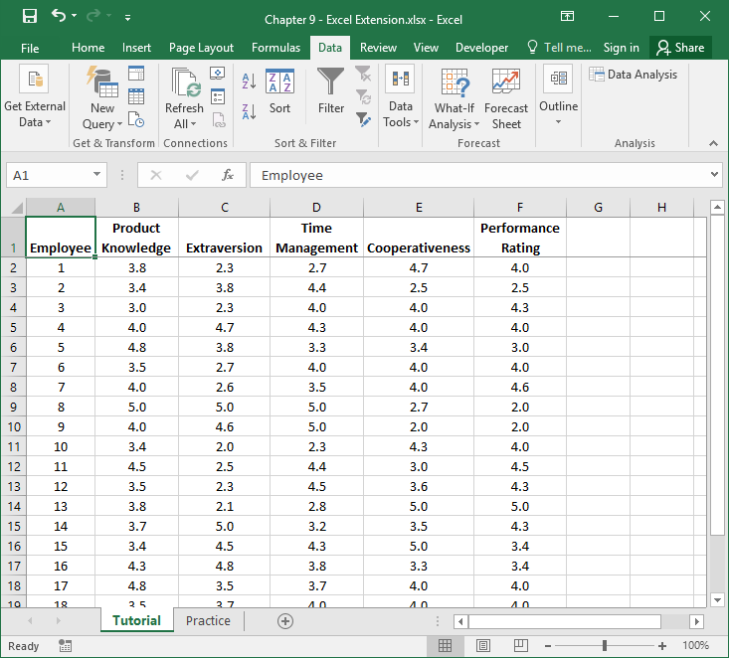
Step 5
Click on the Data tab.
Click on the Data Analysis button.

Slide 8
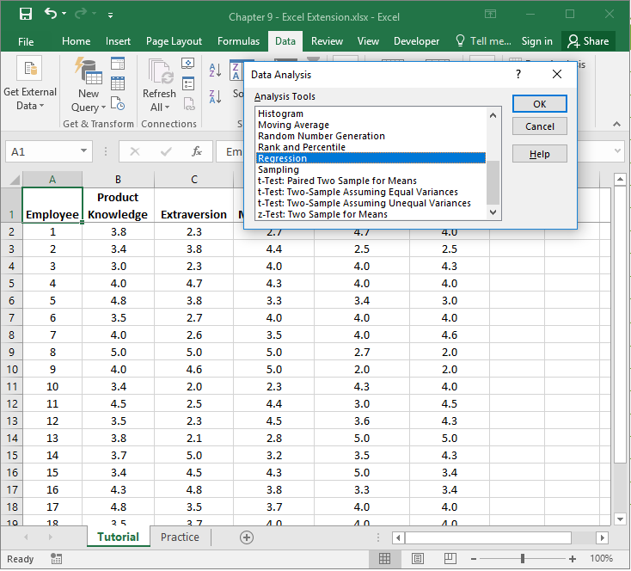
Step 6
Let’s begin by specifying a multiple linear regression model in which we regress Performance Rating on Product Knowledge, Extraversion, Time Management, and Cooperativeness.
To specify our multiple linear regression model, in the Data Analysis window, select Regression.
Click OK.

Slide 9
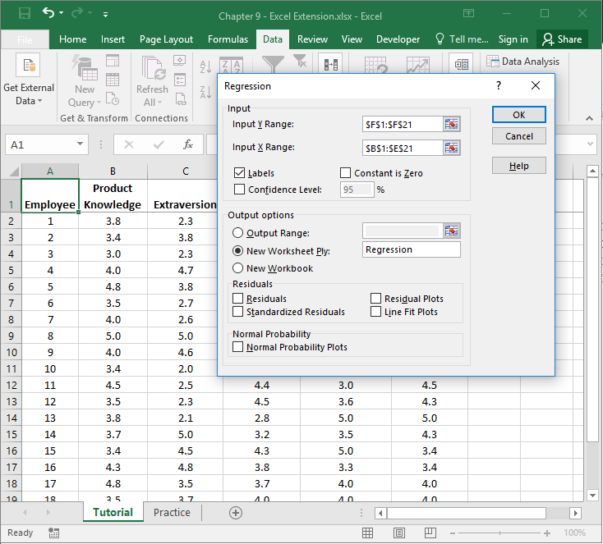
Step 7
1
When the Regression window opens, in the field next to Input Y Range: enter the range of cells that contains our outcome variable (Performance Rating) and associated values, including the variable labels. Next, in the field next to Input X Range: enter the ranges of cells that contain our predictor variables (Product Knowledge, Extraversion, Time Management, Cooperativeness) and associated values, including the variable labels.
Check the box next to Labels.
Click the bubble next to New Worksheet Ply.
If you would like, next to New Worksheet Ply:, type in what you would like to name the new sheet. Here, “Regression” is entered in the field.
Click OK.
6
2
3
5
4

Slide 10
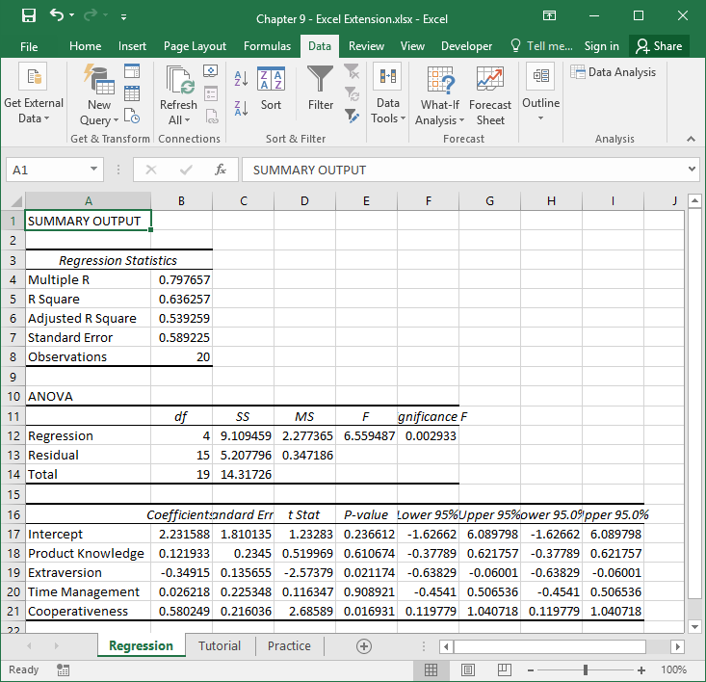
Step 8
A new sheet should appear in your workbook that is named Regression (or whatever you named the new sheet in the previous step). This sheet contains your multiple linear regression model output.
Note that the number of digits after the decimal point varies.

Slide 11
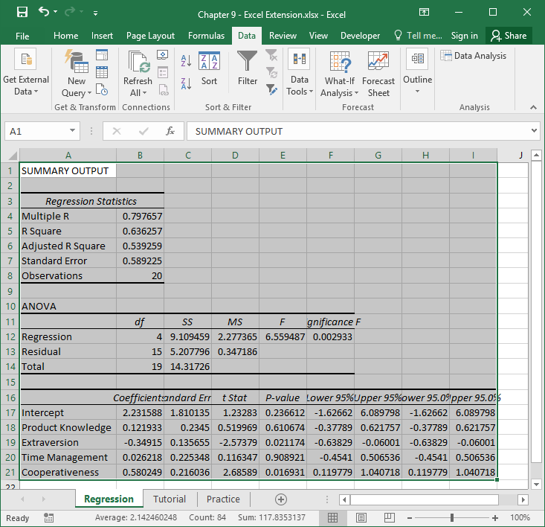
Step 9
To make your output easier to read, consider formatting the values to have two or three digits after the decimal.
To do so, first, select all of the cells in the output.

Slide 12
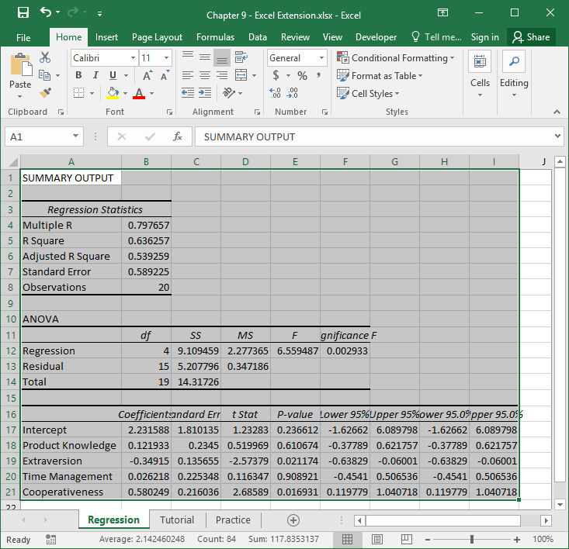
Step 10
Second, click on the Home tab, and click the small box with the arrow in the Number section.

Slide 13
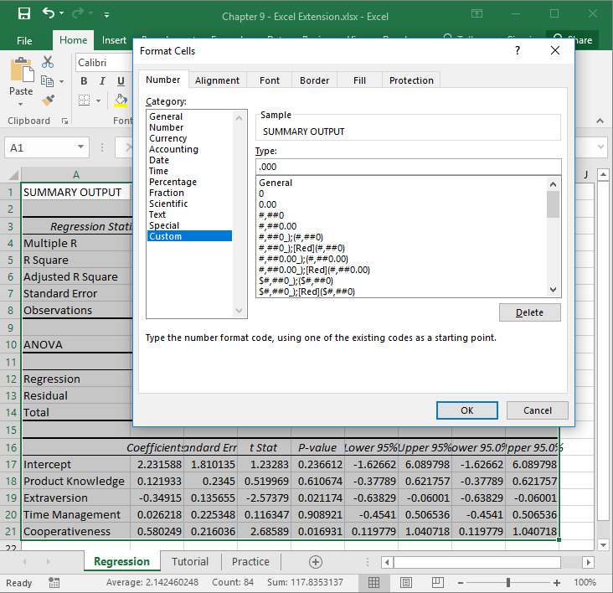
Step 11
Third, in the Number tab of the Format Cells window, click Custom from the Category: list.
In the field under Type:, enter the following format .000 to designate that you do not want a zero before the decimal point and only want three zeroes after the decimal point.
Click OK.

Slide 14
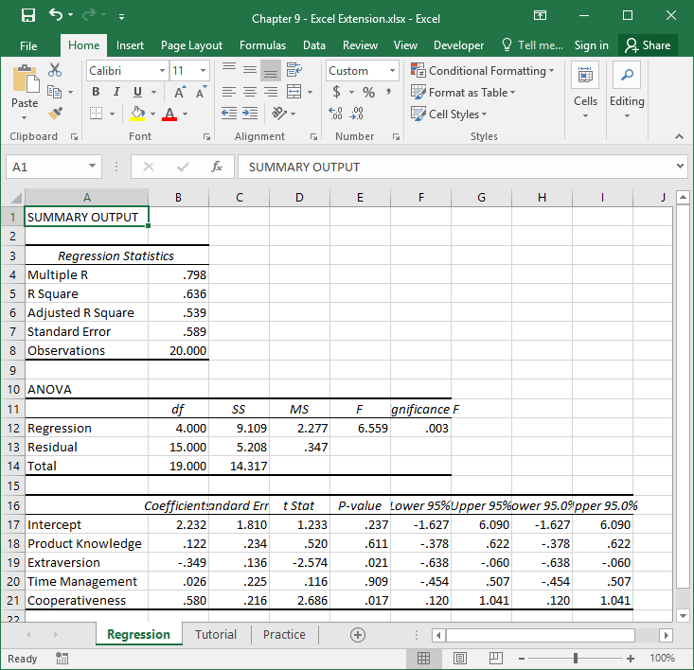
Step 12
Now the output is a bit easier to read.
In the Regression Statistics table, note that the R Square value is .636, which means that the predictor variables in the model (Product Knowledge, Extraversion, Time Management, Cooperativeness) explain 63.6% (.636 × 100) of the variance in the outcome variable (Performance Rating).

Slide 15
Step 13
In the table at the very bottom, you will find your regression model estimates. The second column contains the regression weights (coefficients). The fifth column contains the p values associated with the regression weights.
As you can see, the regression weights for Product Knowledge and Time Management are positive (.122 and .026, respectively) and have p values that are greater than the conventional two-tailed cutoff (α level) of .05 (p = .611 and p = .909, respectively), which means we can treat these regression weights as not significantly different than zero. The regression weight of –.349 for Extraversion is negative and the p value of .021 is less than .05, so its association with Performance Rating is statistically significant and negative. Finally, the regression weight of .580 for Cooperativeness is positive and the p value of .017 is less than .05, so this relation is also statistically significant.

Slide 16
Step 14
Overall, the findings of this multiple linear regression analysis indicate that when controlling for all other predictor variables in the model, Extraversion and Cooperativeness are predictive of Performance Rating. Specifically, the negative relation between Extraversion and Performance Rating implies that those with higher levels of extraversion tend to perform at a lower level than those with a lower level of extraversion. The positive relation between Cooperativeness and Performance Rating indicates that those with who are more cooperative tend to perform at a higher level. When statistically controlling for Extraversion and Cooperativeness (which is what happens in a multiple linear regression model), Product Knowledge and Time Management are not associated with Performance Rating.

Slide 17
Questions
You just learned how to use multiple linear regression analysis to understand the potential factors/variables that predict performance in a particular job. Next, using a different data set, you will determine which personality dimensions (Agreeableness, Extraversion, Neuroticism, Conscientiousness) are predictive of performance on a particular job. Using data found in the “Practice” sheet of the Excel workbook, do and respond to the following:
Run a multiple linear regression analysis with Performance as the outcome variable and Agreeableness, Extraversion, Neuroticism, and Conscientiousness as the predictor variables.
Based on this sample of employees and this particular job, which personality dimension(s) is/are significantly associated with performance? Did the results align with your expectations? Why or why not?

