Slide 1
Chapter 8 Excel Extension: Now You Try!
Evaluating a Training Program

Slide 2
Background
In this Excel Extension tutorial, you will learn how to apply an independent-samples t test to evaluate the effectiveness of a training program with regard to an outcome or multiple outcomes.
For the purposes of this exercise, imagine that you are concerned about employees in your construction firm wearing their personal protective equipment and engaging in other safety behaviors. There is an existing safety training program, but its content is outdated. As such, you develop a new safety training program. To evaluate the effectiveness of the new program, you randomly assigned a subset of employees to participate in the new safety training program and another subset to the old safety training program. After both groups complete the training, you administer a safety knowledge test. This can be described as a posttest-only, with control group experimental design, and an independent-samples t test can be used to evaluate whether the mean score for participants in the new safety training program is significantly different than the mean score for participants in the old safety training program.

Slide 3
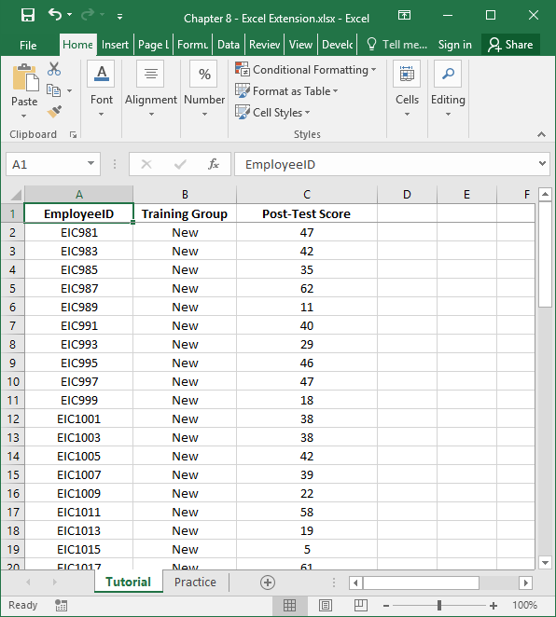
Step 1
Open the Excel workbook titled “Chapter 8--Excel Extension.xlsx”.
Click on the sheet called Tutorial. You will use the data contained in this sheet to learn how to run an independent-samples t test.
Note that the sheet includes three fields/columns/variables:
EmployeeID (unique employee identifier)
Training Group (New = new safety training program, Old = old safety training program)
Posttest Score (score on safety knowledge test after training; 0 = low safety knowledge, 70 = high safety knowledge)
Note that 30 employees were randomly assigned to complete the new training program and 30 employees were randomly assigned to complete the old training program. Everyone completed the same safety knowledge test after completing the training program they were assigned to.

Slide 4
Step 2
If you haven’t already, be sure to add in the Analysis ToolPak feature in Excel, which requires the following steps.
First, click on the File tab.

Slide 5
Step 3
Select Options.

Slide 6
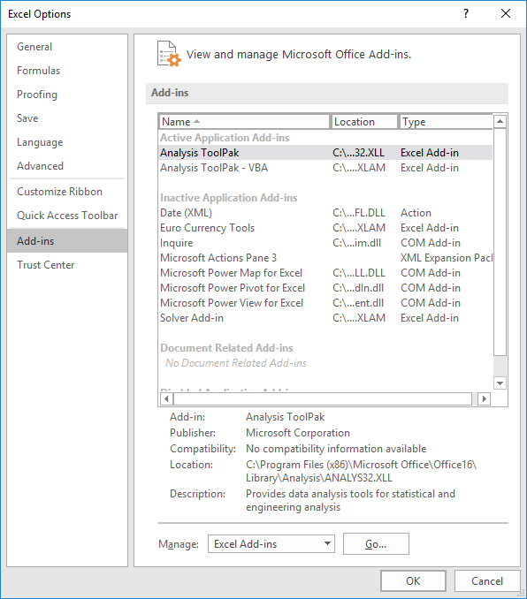
Step 4
When the Excel Options window opens, select the Add-Ins tab on the left, and then select the Analysis ToolPak in the Excel Add-Ins list, which appears next to Manage at the bottom of the window, and click Go…. A window will open, and simply check the box next to Analysis ToolPak.
If you already have the Analysis ToolPak application activated, it will appear in the Active Application Add-ins list, as shown in the image.
Click OK.

Slide 7
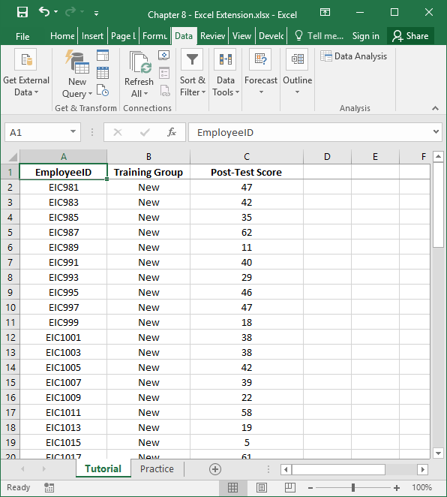
Step 5
Click on the Data tab.
Click on the Data Analysis button.

Slide 8
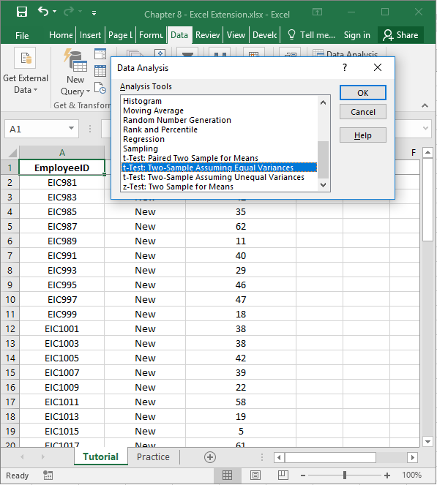
Step 6
When the Data Analysis window opens, under Analysis Tools:, select t-Test: Two-Sample Assuming Equal Variances, which is what Excel calls an independent-samples t test.
Click on OK.

Slide 9
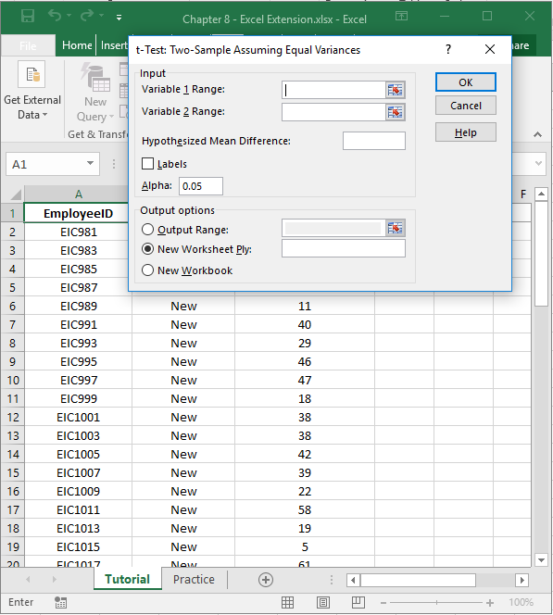
Step 7
When the t-Test: Two-Sample Assuming Equal Variances window opens, click on the upward arrow in the field adjacent to Variable 1 Range:.

Slide 10
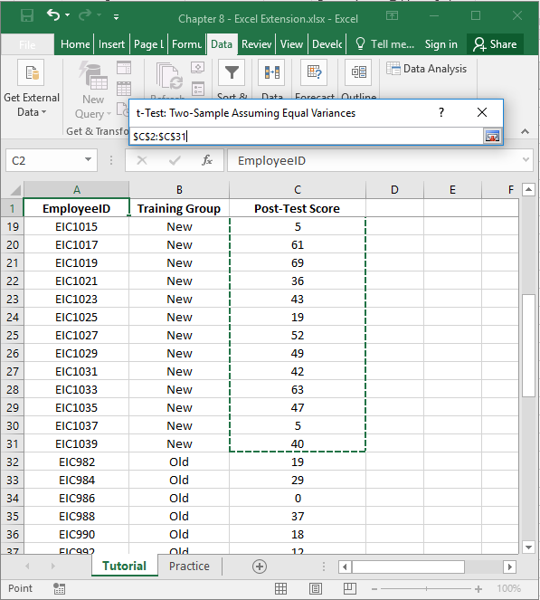
Step 8
Select the cells containing Post-Test Score numeric values that correspond to the employees (rows) with “New” in the Training Group column. By doing this, you are selecting the posttest data for those individuals who were randomly assigned to the new safety training program.
Note that the window titled t-Test: Two-Sample Assuming Equal Variances contains the array/range of cells you selected.
When you’re done, click on the downward arrow in the t-Test: Two-Sample Assuming Equal Variances window.

Slide 11
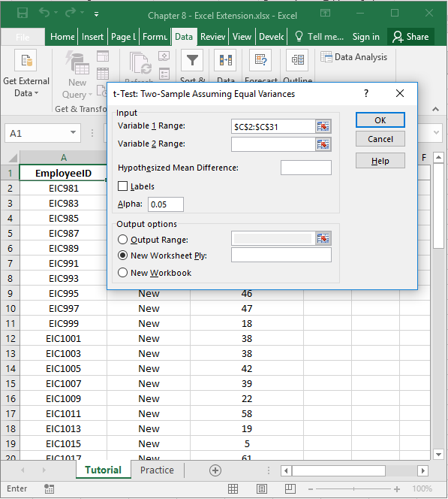
Step 9
When the t-Test: Two-Sample Assuming Equal Variances window opens, click on the upward arrow in the field adjacent to Variable 2 Range:.

Slide 12
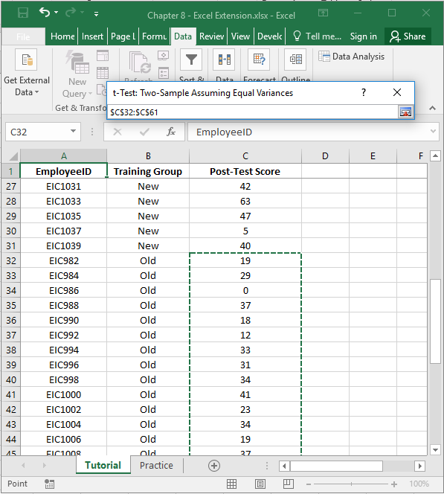
Step 10
Select the cells containing numeric values that correspond to the employees (rows) with “Old” in the Training Group column. By doing this, you are selecting the posttest data for those individuals who were randomly assigned to the old training program.
Note that the window titled t-Test: Two-Sample Assuming Equal Variances contains the array/range of cells you selected.
When you’re done, click on the downward arrow in the t-Test: Two-Sample Assuming Equal Variances window.

Slide 13
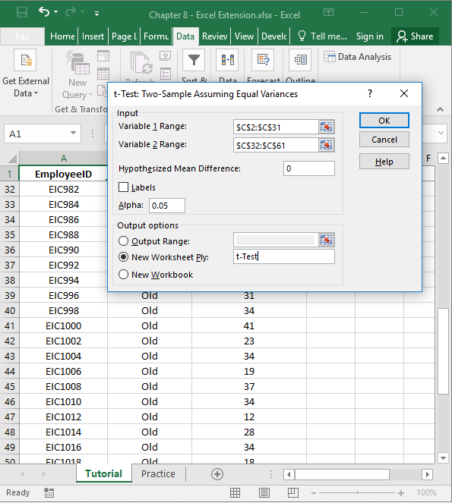
Step 11
4
In the t-Test: Two-Sample Assuming Equal Variances window, enter 0 (zero) in the field adjacent to Hypothesized Mean Difference:, which indicates that we will test whether the difference in posttest scores for those who participated in the new safety training program compared to those who participated in the old safety training program is statistically significantly different from zero.
Click the bubble next to New Worksheet Ply.
If you would like, next to New Worksheet Ply:, type in what you would like to name the new sheet. Here, “t-Test” is entered in the field.
Click OK.
1
2
3

Slide 14
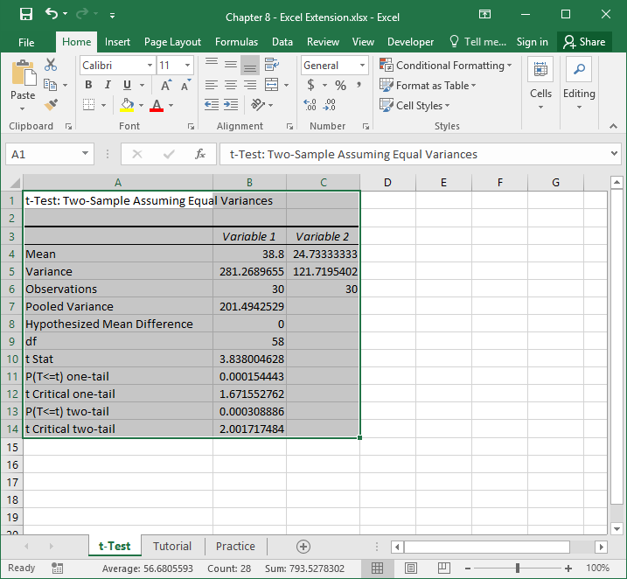
Step 12
A new sheet should appear in your workbook that is named t-Test (or whatever you named the new sheet in the previous step). This sheet contains your independent-samples t test output.
Note that the number of digits after the decimal point varies. Let’s make the number of digits after the decimal point consistent.
Select all of the cells in the output.
Click on the Home tab.
Click the small box with the arrow in the Number section.

Slide 15
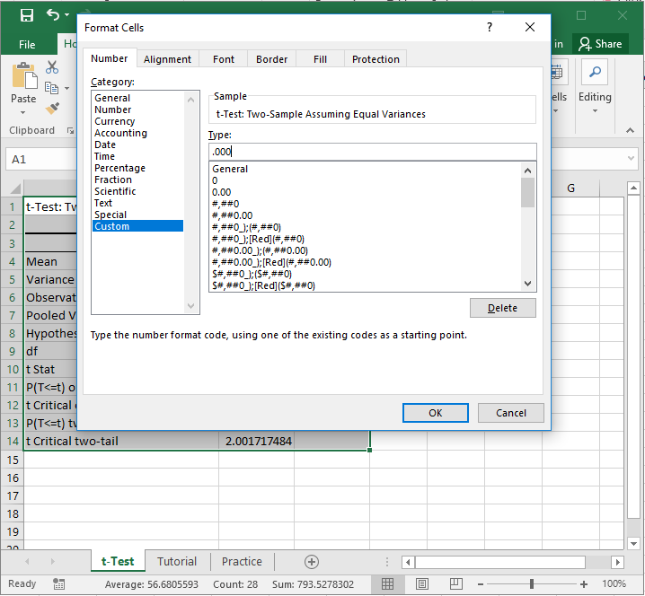
Step 13
In the Number tab of the Format Cells window, click Custom from the Category: list.
In the field under Type:, enter the following format .000 to designate that you do not want a zero before the decimal point and only want three zeroes after the decimal point.
Click OK.

Slide 16
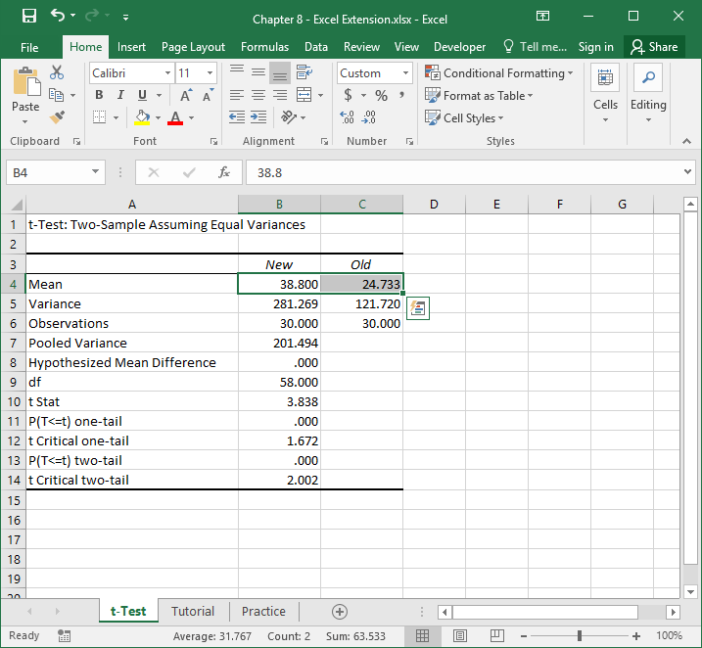
Step 14
The default names of the two columns containing the means and other information are “Variable 1” and “Variable 2”, which are not very informative.
Let’s replace those default names with “New” and “Old”, respectively.
Note that the mean (average) of safety knowledge posttest scores for those who participated in the new safety training program is 38.800 and 24.733 for those who participated in the old safety training program. Thus, our “eyeball” test tells us that descriptively the mean for those who participated in the new program is higher than those who participated in the old program. The next question is this: Is this a statistically significant difference in means?

Slide 17
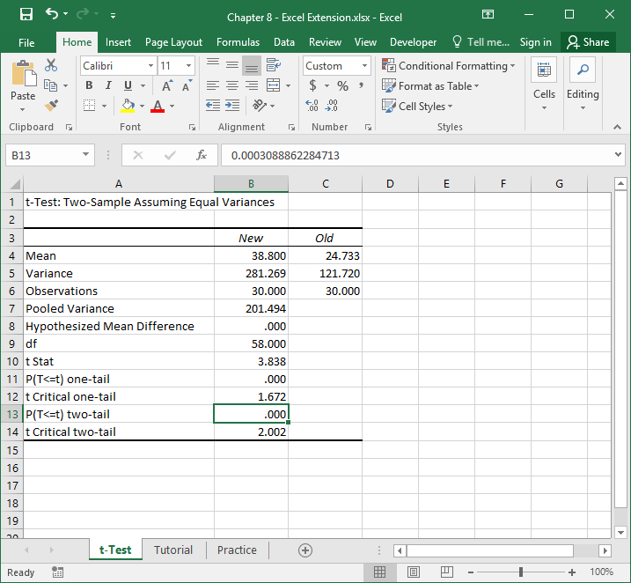
Step 15
Adjacent to P(T<=t) two-tail is the value .000, which is our p value (that corresponds to the t-statistic [t Stat] and degrees of freedom [df] that appear earlier in the table). Because the p value is less than the conventional two-tailed cutoff (α level) of .05, we can treat the aforementioned difference in means as statistically significant. If the p value were greater than .05, then it would be nonsignificant.
Thus, we can conclude that the new safety training program is associated with significantly higher posttraining safety knowledge, as measured by a knowledge test.

Slide 18
Questions
You just learned how to evaluate a training program using an independent-samples t test. Now, imagine that your organization would like to evaluate its onboarding program. To do so, new employees are randomly assigned to either receive the onboarding training program or to not receive any onboarding training program. A posttest-only, with control group design in use, and the posttest outcomes include self-report measures of Turnover Intentions, Role Clarity, and Feelings of Acceptance, which are administered 6 months after all new employees joined the organization. Higher scores on each of those measures indicate higher levels of the concept. Using data found in the “Practice” sheet of the Excel workbook, do and respond to the following:
Run three independent-samples t tests in which you compare the average levels of turnover intentions, role clarity, and feelings of acceptance for those who participated in the onboarding program (Onboarding) and those who did not (NoOnboarding). What did you find?
Based on these analyses, what is your overall impression of the organization’s new onboarding program?

