Slide 1
Chapter 7 Excel Extension: Now You Try!
Assessing the Criterion-Related Validity of Selection Procedures

Slide 2
Background
In this Excel Extension tutorial, you will learn how to assess the criterion-related validity of selection procedures using correlation and regression analyses.
For the purposes of this exercise, imagine that your HR team is revamping the selection procedures for the Sales Associate job. Your team has conducted a concurrent validation study in which Sales Associate job incumbents complete the following selection procedures: proactivity assessment, emotional intelligence inventory, and situational judgment test (SJT). With regard to the criterion (outcome) of interest, the job incumbents were also assessed in terms of their customer service job performance.

Slide 3
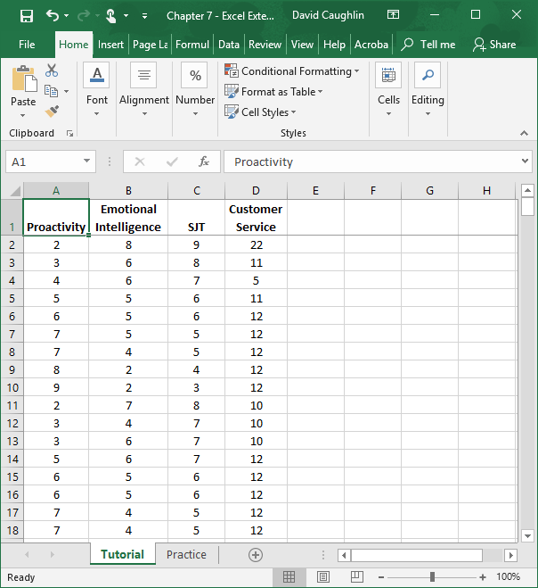
Step 1
Open the Excel workbook titled “Chapter 7--Excel Extension.xlsx”.
Click on the sheet called Tutorial. You will use the data contained in this sheet to learn how to create a correlation matrix and a multiple linear regression model in Excel.
Note that the sheet includes four fields/columns/variables:
Proactivity (productivity assessment; 1 = low proactivity, 15 = high proactivity)
Emotional Intelligence (emotional intelligence inventory; 1 = low emotional intelligence, 10 = high emotional intelligence)
SJT (situational judgment test; 1 = low SJT, 10 = high SJT)
Customer Service (customer service job performance; 1 = low performance, 30 = high performance)
Note that there are 300 employees in this sample.

Slide 4
Step 2
If you haven’t already, be sure to add in the Analysis ToolPak feature in Excel, which requires the following steps.
First, click on the File tab.

Slide 5
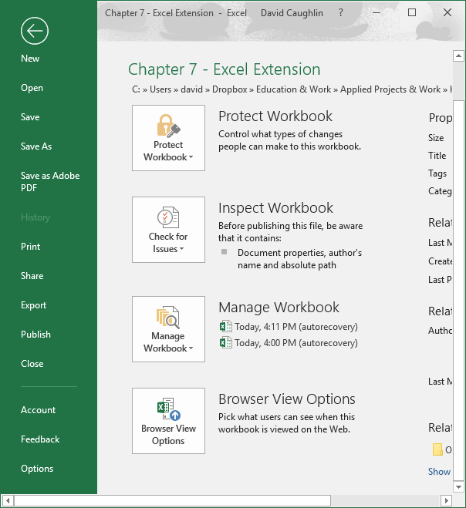
Step 3
Select Options.

Slide 6
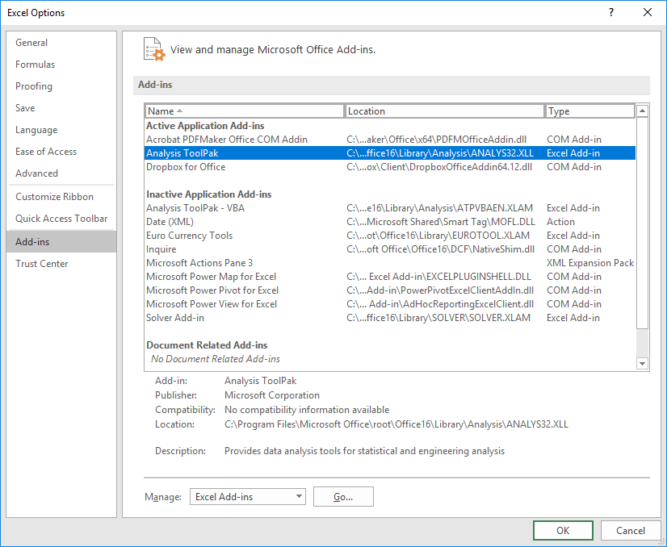
Step 4
When the Excel Options window opens, select the Add-Ins tab on the left, and then select the Analysis ToolPak in the Excel Add-Ins list, which appears next to Manage at the bottom of the window, and click Go…. A window will open, and simply check the box next to Analysis ToolPak.
If you already have the Analysis ToolPak application activated, it will appear in the Active Application Add-ins list, as shown in the image.
Click OK.

Slide 7
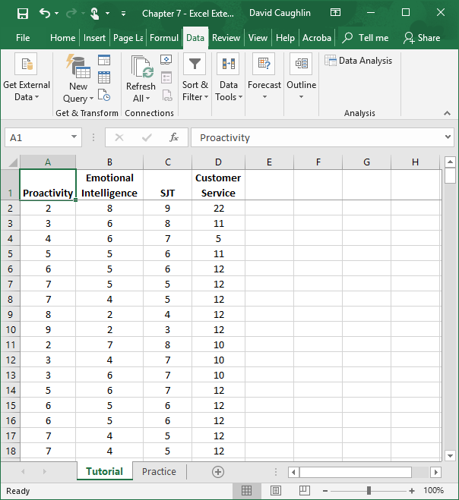
Step 5
Click on the Data tab.
Click on the Data Analysis button.

Slide 8
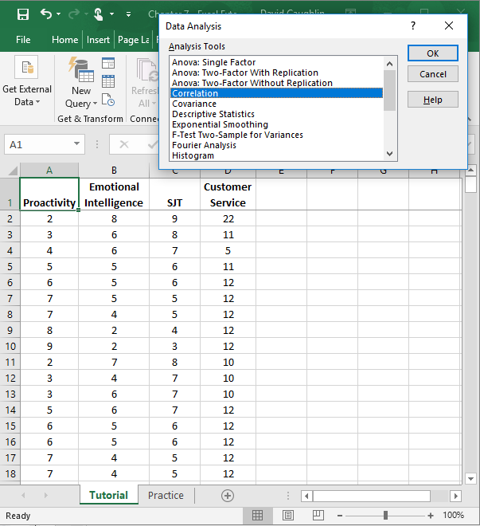
Step 6
As a first step in the criterion-related validation process, let’s create a correlation matrix that contains the intercorrelations between the three selection procedure scores and the customer service job performance scores.
To do so, in the Data Analysis window, select Correlation.
Click OK.

Slide 9
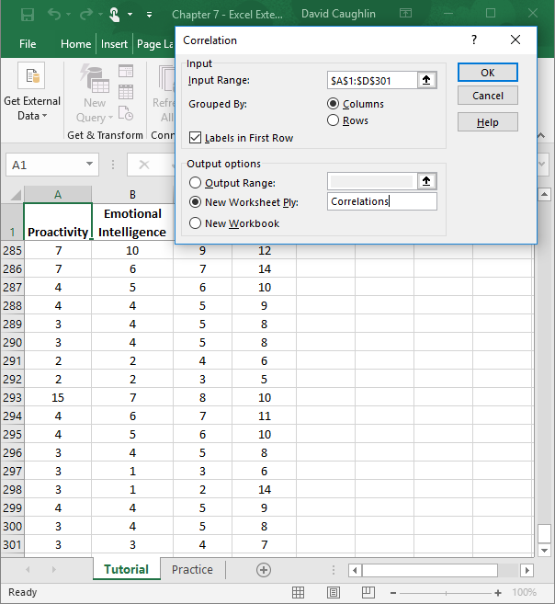
Step 7
1
5
2
When the Correlation window opens, in the field next to Input Range: enter the range of cells that contains all four variables and associated values, including the variable labels.
Check the box next to Labels in First Row.
Click the bubble next to New Worksheet Ply.
If you would like, next to New Worksheet Ply:, type in what you would like to name the new sheet. Here, “Correlations” is entered in the field.
Click OK.
3
4

Slide 10
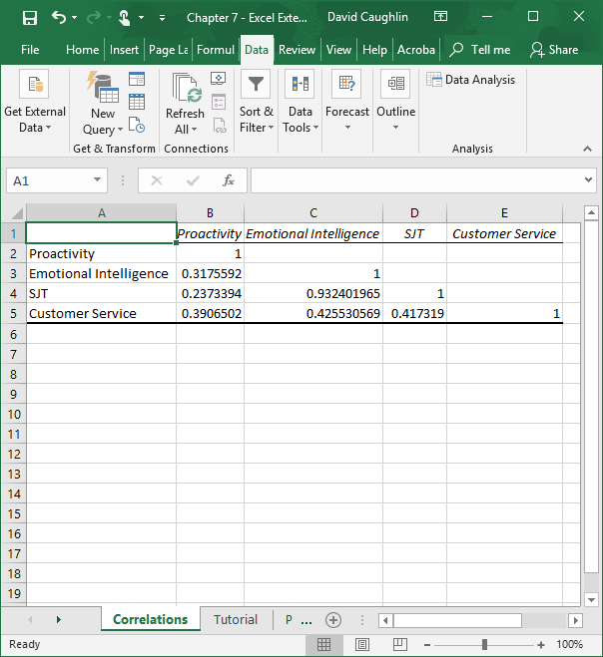
Step 8
The sheet that we named “Correlations” should open automatically, and this sheet contains the correlation matrix we requested.
The following correlation coefficients in the matrix represent the validity coefficients, which all happen to be statistically significant:
Proactivity--Customer Service (.391)
Emotional Intelligence--Customer Service (.426)
SJT--Customer Service (.417)
Note that the validity coefficients are all of about the same magnitude. We can describe the magnitude of a correlation (validity) coefficient as follows:
<.10 (negligible)
.10–.29 (small)
.30–.49 (medium)
.50–1.00 (large)
These three validity coefficients can be considered medium in magnitude.

Slide 11
Step 9
Now, take note of the correlations between the selection procedure variables. They are as follows:
Proactivity--Emotional Intelligence (.318)
Proactivity--SJT (.237)
SJT--Emotional Intelligence (.932)
The correlations between proactivity and emotional intelligence and between proactivity and SJT are small-to-medium in magnitude, which indicates that there is not much redundancy (shared variance) between them. The correlation between SJT and Emotional Intelligence, however, is concerning, as the correlation is nearly 1.00, which would indicate 100% redundancy (100% shared variance). As a rule of thumb, variables that share a correlation of .85 or higher can be considered nearly indistinguishable. This very high correlation indicates that we should pick the least resource-intensive and costly selection procedure of the two. For the time being, let’s assume the SJT procedure is considerably less costly and results in virtually no disparate (adverse) impact. Thus, the next step is to determine how to weight proactivity and SJT using regression.

Slide 12
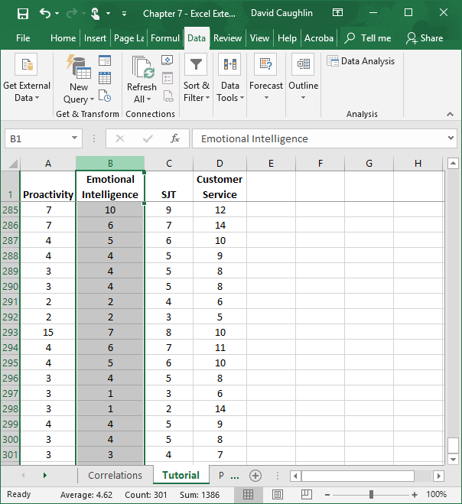
Step 10
Now we’re ready to run a multiple linear regression analysis to determine the respective regression weights for the proactivity and SJT in relation to customer service when included in the same model.
Excel can be a bit fussy when it comes to how the variables are ordered when running a regression analysis. Specifically, the predictor variables need to be in adjacent columns. As such, let’s move the emotional intelligence column to the leftmost column, as we won’t need it for the time being.
First, select the column containing Emotional Intelligence, and cut the cells by holding CTRL+X (or Command+X on a Mac).

Slide 13
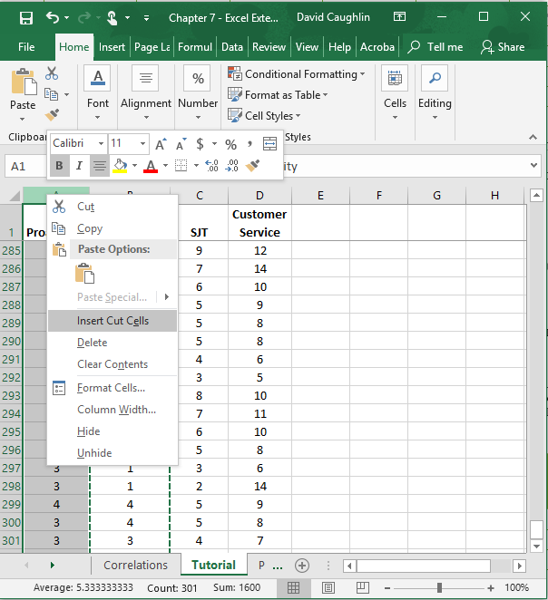
Step 11
Second right click on the header of the leftmost column (A).
Third, select Insert Cut Cells.

Slide 14
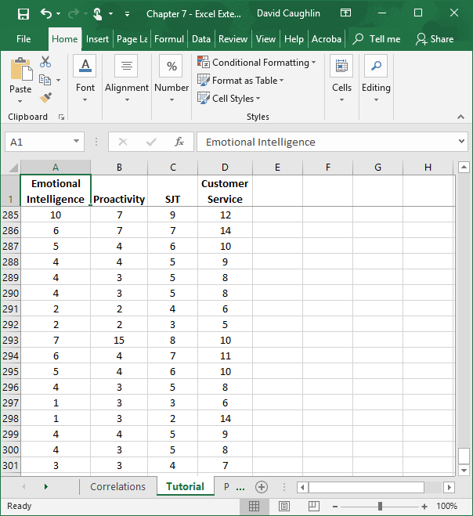
Step 12
Now the variables are in an order that will be amenable to multiple linear regression analysis in Excel.

Slide 15
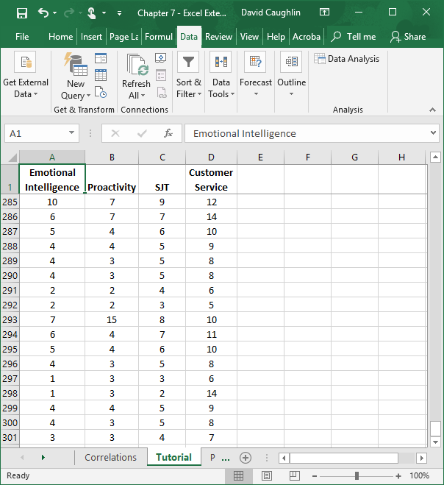
Step 13
Click on the Data tab.
Click on the Data Analysis button.

Slide 16
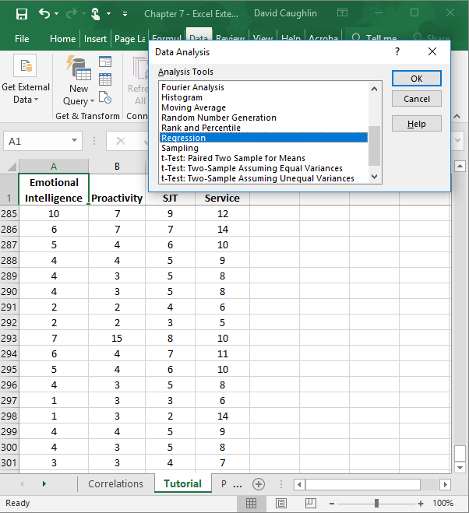
Step 14
To specify our multiple linear regression model, in the Data Analysis window, select Regression.
Click OK.

Slide 17
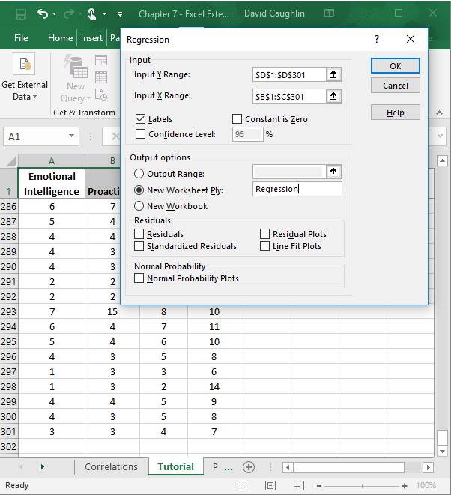
Step 15
5
1
When the Regression window opens, in the field next to Input Y Range: enter the range of cells that contains our criterion variable (Customer Service) and associated values, including the variable labels. Next, in the field next to Input X Range: enter the range of cells that contains our predictor variables (Proactivity and SJT) and associated values, including the variable labels.
Check the box next to Labels.
Click the bubble next to New Worksheet Ply.
If you would like, next to New Worksheet Ply:, type in what you would like to name the new sheet. Here, “Regression” is entered in the field.
Click OK.
2
3
4

Slide 18
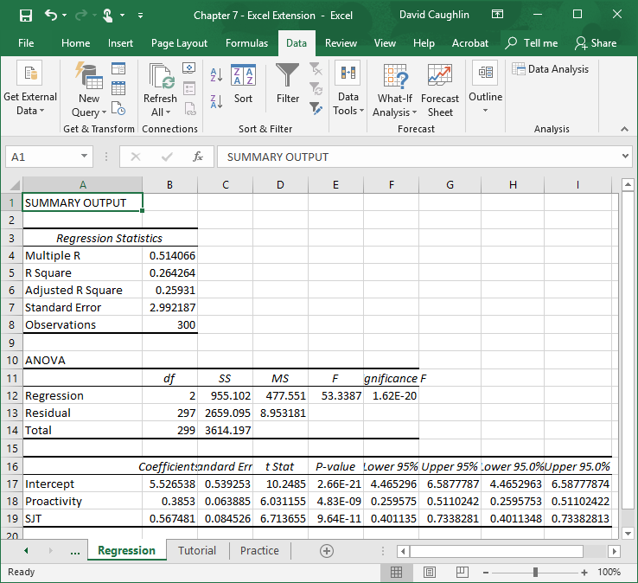
Step 16
A new sheet should appear in your workbook that Regression (or whatever you named the new sheet in the previous step). This sheet contains your multiple linear regression model output.
Note that the number of digits after the decimal point varies and that some of the values in the output are in scientific notation (e.g., 2.66E–21).

Slide 19
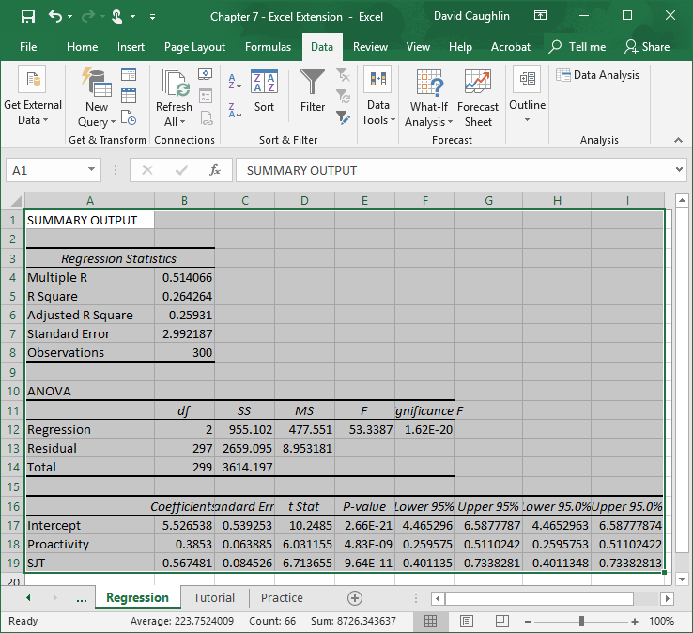
Step 17
To make your output easier to read, consider formatting the values to have two or three digits after the decimal.
To do so, first, select all of the cells in the output.

Slide 20
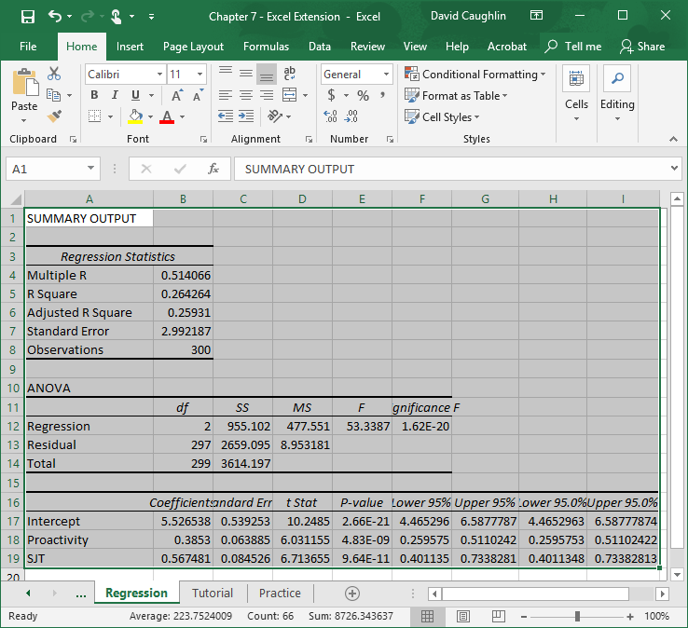
Step 18
Second, click on the Home tab, and click the small box with the arrow in the Number section.

Slide 21
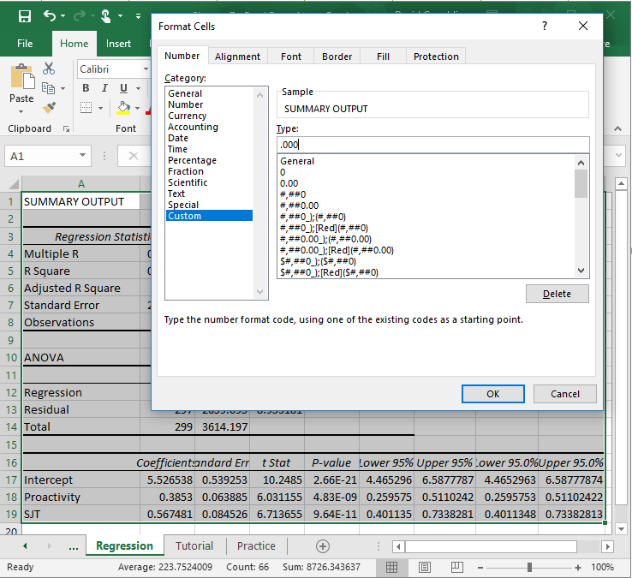
Step 19
Third, in the Number tab of the Format Cells window, click Custom from the Category: list.
In the field under Type:, enter the following format .000 to designate that you do not want a zero before the decimal point and only want three zeroes after the decimal point.
Click OK.

Slide 22
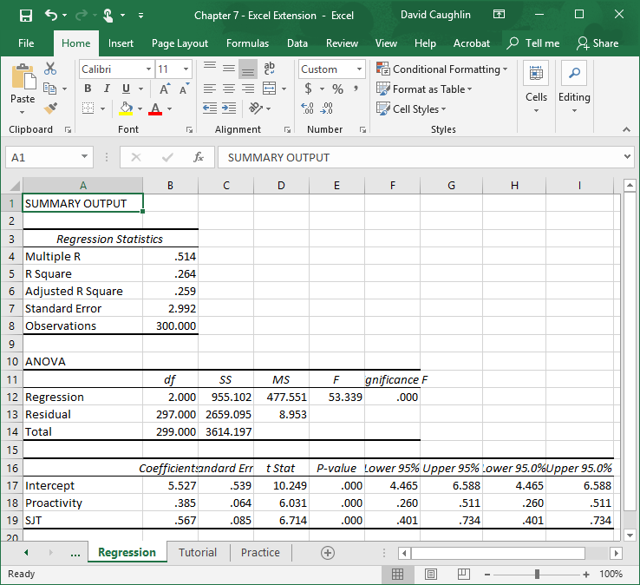
Step 20
Now the output is a bit easier to read.
In the Regression Statistics table, note that the R Square value is .264, which means that collectively the predictor variables in the model (Proactivity and SJT) explain 26.4% (.264 × 100) of the variance in the criterion (Customer Service). This may not seem like a large amount of variance explained, but this is actually quite good for a criterion-related validity study.

Slide 23
Step 21
In the table at the very bottom, you will find your regression model estimates. The first column contains the names of the predictor variables and the intercept. The second column contains the regression weights (coefficients). The fifth column contains the p values associated with the regression weights, which we use to determine whether they are statistically significant (i.e., significantly different from zero).
As you can see, the regression weights for Proactivity and SJT (in relation to Customer Service) have p values that are less than the conventional cutoff (α level) of .05, which means we can treat these as statistically significant.
Using the regression weights, we can write the following regression equation:
Y = 5.527 + .385(Proactivity score) + .567(SJT score)

Slide 24
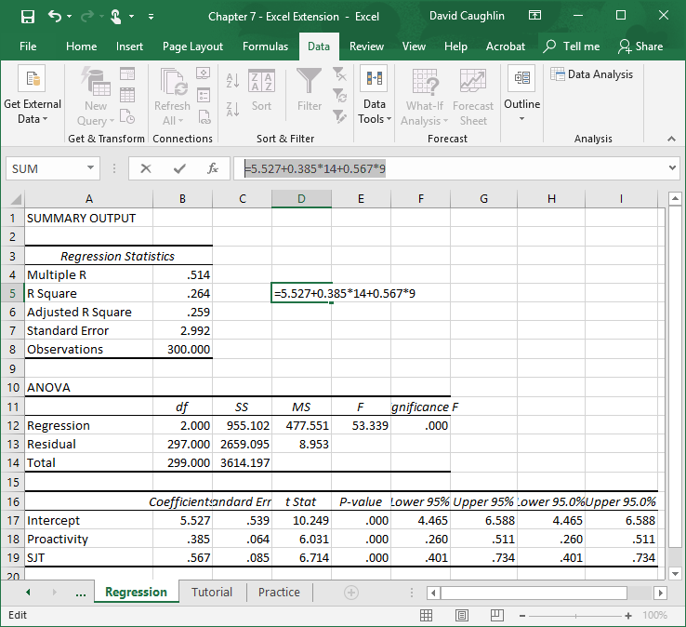
Step 22
Let’s practice plugging hypothetical values into the regression equation.
For example, imagine that an applicant scores a 14 on the proactivity assessment and a 9 on the SJT.
In an empty cell, enter an = sign, followed by the regression equation with those two scores. It should look something like:
=5.527+0.385*14+0.567*9
Click ENTER.

Slide 25
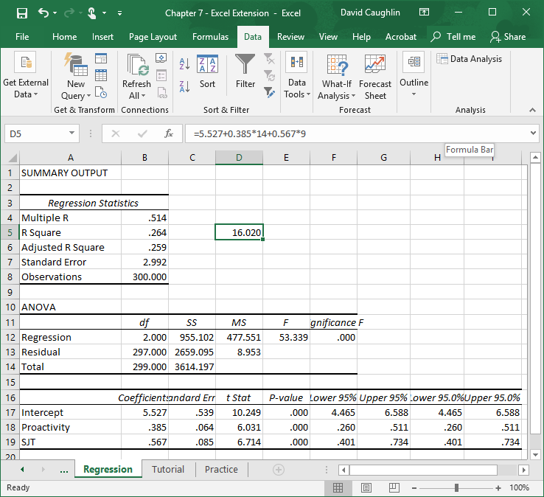
Step 23
For an applicant who scores a 14 on the proactivity assessment and a 9 on the SJT, we can predict that their future customer service job performance will be 16.020.
If you would like to continue practicing, consider running a multiple linear regression model with Proactivity and Emotional Intelligence as the predictor variables and Customer Service as the criterion variable.

Slide 26
Questions
You just learned how to create a correlation matrix and to run a regression analysis in Excel. Now, it’s time to apply your new skills to a new data set, which appears in the sheet called “Practice” in the Excel workbook. This time, your team is assessing the criterion-related validities for a scored structured interview (StructuredInterview) and work sample assessment (WorkSample) in relation to overall job performance (JobPerformance) for a Software Developer job. You have already established that both selection procedures are significantly associated with job performance by themselves (as evidenced by correlation analyses), and now it’s time assess whether there is any redundancy between the two selection procedure variables (i.e., very large correlation), if both are still significantly associated with job performance when specified in the same regression model, and what the collective criterion-related validity of the selection procedures are in terms of the R-squared value. Respond to the following questions.
Is there any concerning amount of redundancy between scores on the structured interview and scores on the work sample? How do you know?
Are both selection procedure variables still significantly associated with job performance when specified in the same multiple linear regression model? How do you know?
What is the R-square value for the model? What does this value indicate?
Do you recommend that the organization use both selection procedures in the future? Why or why not?

