Slide 1
Chapter 5 Excel Extension: Now You Try!
Evaluating Task-KSA(O) Analysis Data

Slide 2
Background
In this Excel Extension tutorial, you will learn how to evaluate task-KSA(O) analysis data by calculating the mean and standard deviation of task criticality ratings.
For the purposes of this exercise, imagine that eight subject matter experts (SMEs) rated 11 tasks on a 1 ̶ 5 criticality rating scale, where 1 indicates very low criticality and 5 indicates very high criticality. As the job analyst, your job is to calculate the mean and standard deviation of SME ratings for each task. If you recall, the mean is a measure of central tendency, and the standard deviation is represents how dispersed our spread out values are around the mean. In this context, a higher mean value indicates higher collective criticality ratings by SMEs and a higher standard deviation indicates greater disagreement in SME ratings.

Slide 3
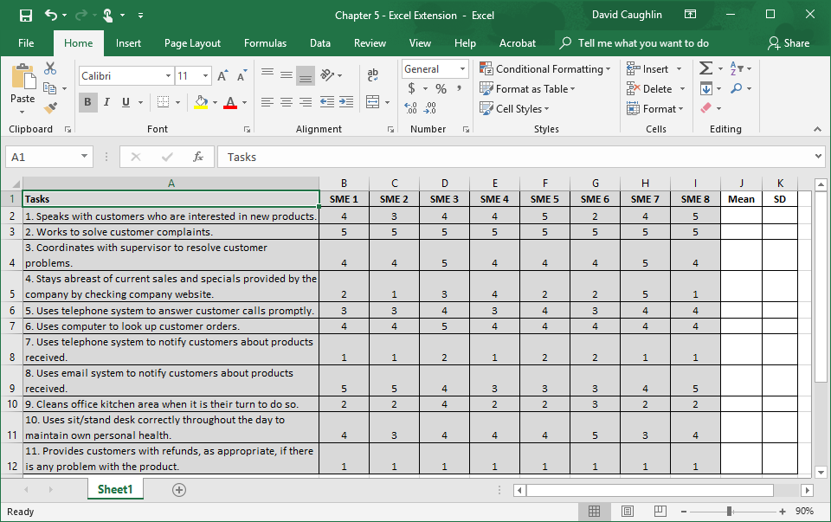
Step 1
Open the Excel workbook titled “Chapter 5 - Excel Extension.xlsx”.
Note that the tasks are listed in the first column, and the criticality ratings made by each SME fall in the following eight columns. Finally, there are two columns labeled Mean and SD (standard deviation) where we will calculate the mean and SD of SME ratings for each task.

Slide 4
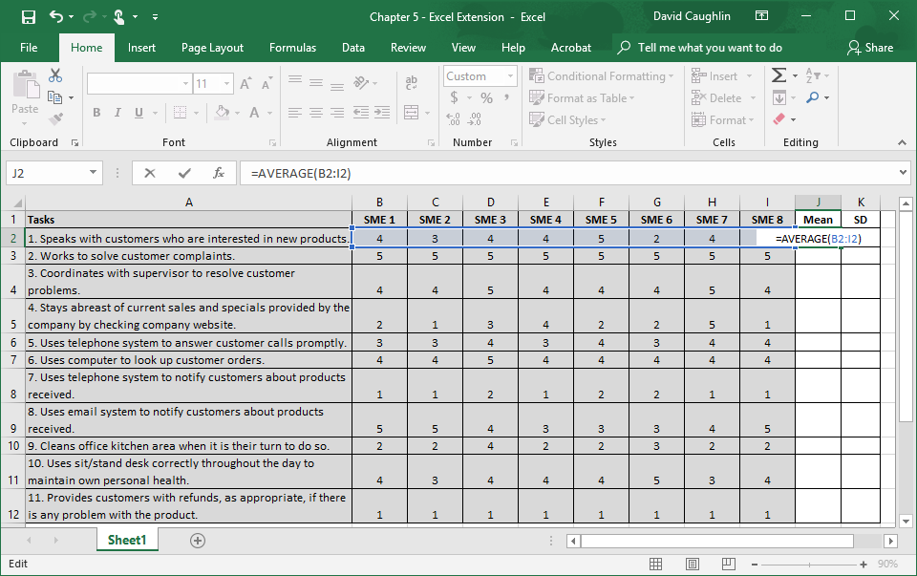
Step 2
Let’s begin by calculating the mean of the criticality ratings for the first task.
In the empty cell under the column labeled Mean that corresponds to the row with the first task (J2), type the Excel function for computing the mean, which is AVERAGE.
Type =AVERAGE( in the empty cell, followed by the array/range of cells that contains the eight SME criticality ratings (B2:I2).
Type an ending parenthesis, and click ENTER.

Slide 5
Step 3
Now let’s calculate the SD of the criticality ratings for the first task.
In the empty cell under the column labeled SD that corresponds to the row with the first task (K2), type the Excel function for computing the SD, which is STDEV.S.
Type =STDEV.S( in the empty cell, followed by the array/range of cells that contains the eight SME criticality ratings (B2:I2).
Type an ending parenthesis, and click ENTER.

Slide 6
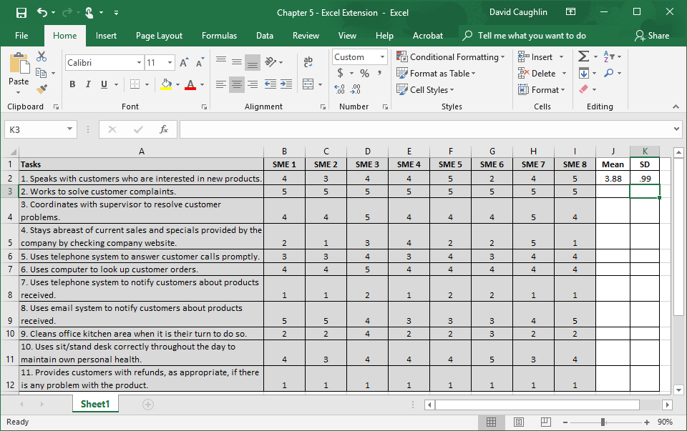
Step 4
Note that the Mean is 3.88, and the SD is .99.
By themselves the mean and the SD do not mean much; however, when you compute the means and SDs for the remaining tasks, you will be able to evaluate which tasks are perceived as most critical by SMEs as well as the extent to which SME ratings are in agreement (similar) for specific tasks.

Slide 7
Questions
You just learned how to calculate a mean and standard deviation (SD) using Microsoft Excel. Now, your job is to calculate the means and SDs for the remaining tasks in the data table. After doing so, respond to the following questions.
Which task had the highest mean? Which task had the lowest mean?
Which task had the highest SD? Which task had the lowest SD? What do these SDs indicate?
Based on the means and SDs, which three tasks would you definitely retain? Which three tasks would you definitely remove? Why?

Slide 8
Chapter 5 Excel Extension: Now You Try!
Evaluating Task-KSA(O) Analysis Data

