Slide 1
Chapter 4 Excel Extension: Now You Try!
Using the Chi-Square Test to Assess Disparate Impact

Slide 2
Background
In this Excel Extension tutorial, you will learn how to apply the χ² test of independence to assess disparate impact using Microsoft Excel.
For the purposes of this exercise, imagine that you have already queried the frequencies/counts of men and women who passed or failed a knowledge test as well as the frequencies/counts of men and women who passed or failed a physical ability test used for selection. As such, with the observed data in hand, now you’re ready to apply the χ² test of independence to assess whether there is prima facie evidence of disparate impact, which is sometimes referred to as adverse impact.

Slide 3
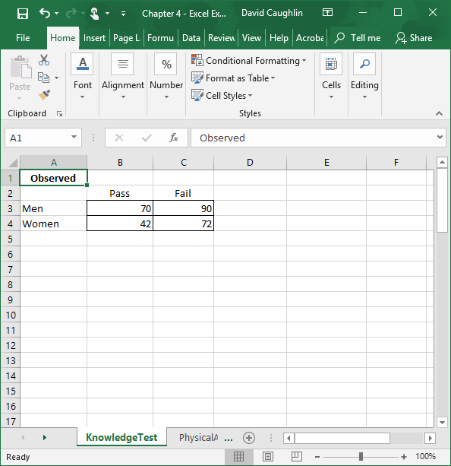
Step 1
Open the Excel workbook titled “Chapter 4--Excel Extension.xlsx”.
Click on the sheet labeled KnowledgeTest.
Note that there is a 2 × 2 table with the observed pass/fail frequency/count data for men and women.

Slide 4
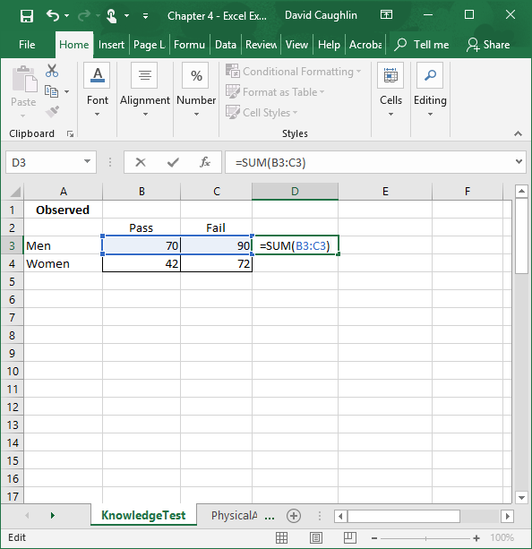
Step 2
Let’s begin by calculating the row and column marginals, which simply means that we will calculate the following sums:
# of men
# of women
# of individuals who passed
# of individuals who failed
To do so, we will use the SUM function. Start by clicking on cell D3 so that we can calculate the row marginal that reflects the number of men in our sample.
In the cell, enter =SUM( followed by array of cells that contain the number of men who passed and who failed, which in this case is B3:C3.
Type the ending parenthesis, and click ENTER.

Slide 5
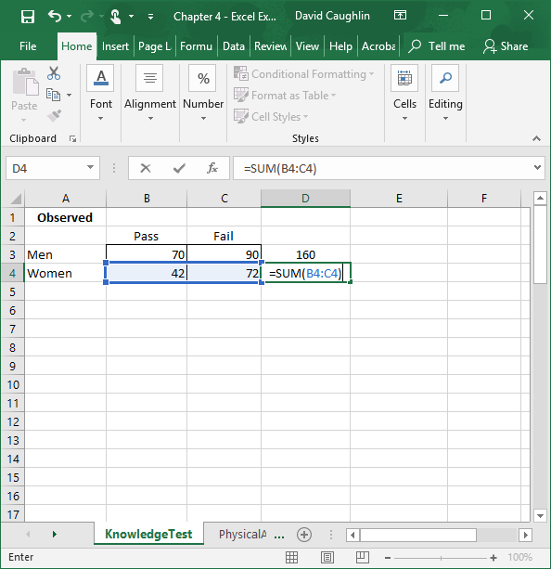
Step 3
Repeat Step 2 to calculate the row marginal for women.

Slide 6
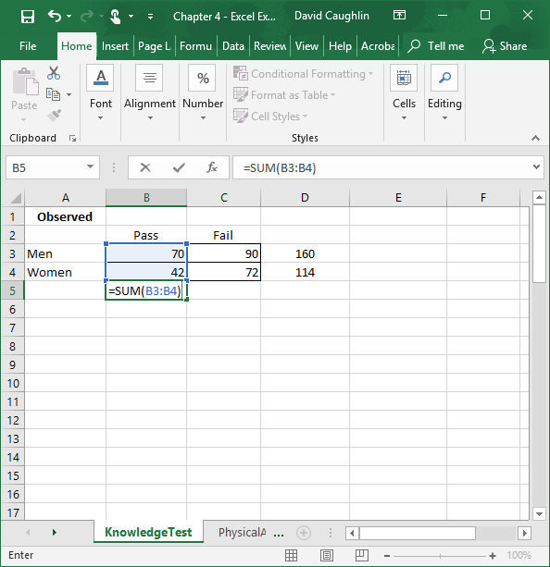
Step 4
Using the SUM function once more, click on cell B5 so that we can calculate the column marginal that reflects the number of individuals who passed the knowledge test in our sample.
In the cell, enter =SUM( followed by array of cells that contain the number of individuals who passed, which in this case is B3:B4.
Type the ending parenthesis, and click ENTER.

Slide 7
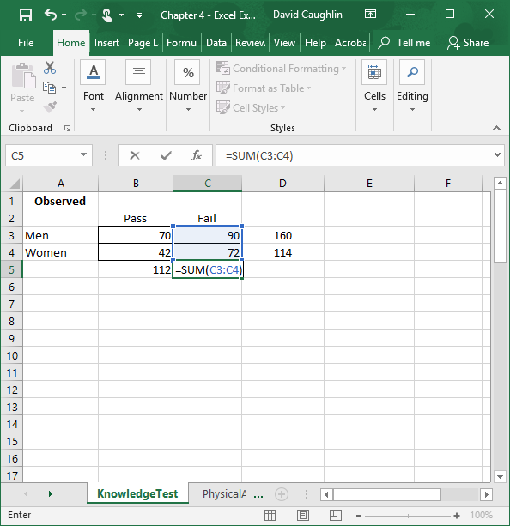
Step 5
Repeat Step 4 to calculate the column marginal for the individuals who failed.

Slide 8
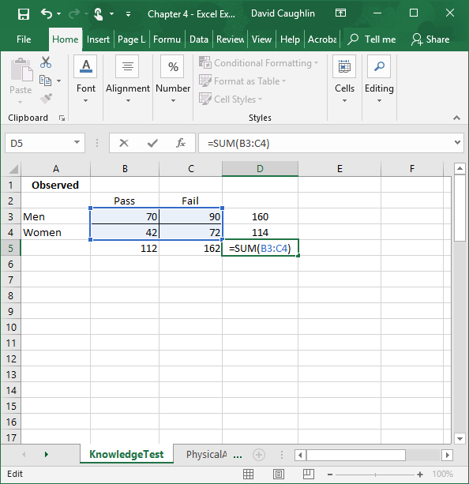
Step 6
To determine how many people are in the sample, use the SUM function and enter the array of cells that contains all of the men and women who passed or failed. In this case, the array of cells is B3:C4.
Let’s enter that function in cell D5.

Slide 9
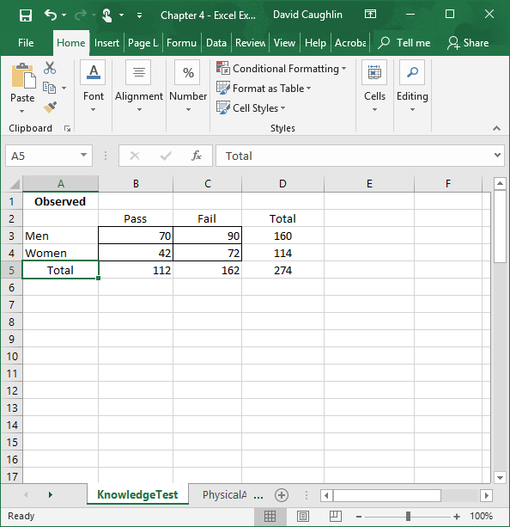
Step 7
Now let’s label the row and column marginals by typing “Total” in cells D2 and A5, respectively.
The observed table is now complete.

Slide 10
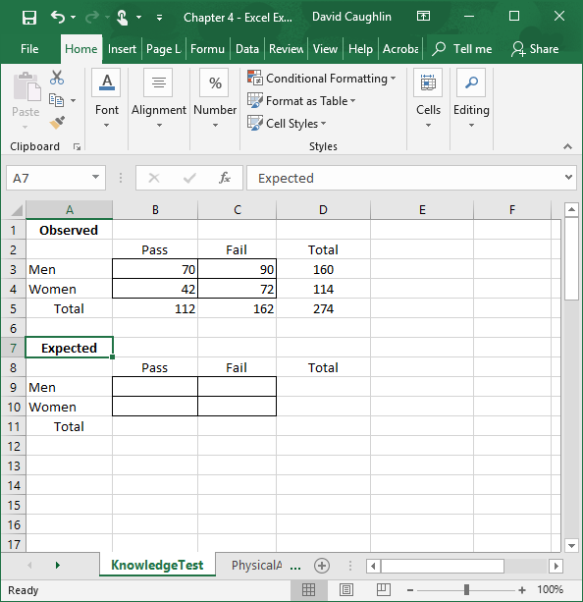
Step 8
Create a blank table titled Expected that we can use to calculate the frequencies/counts we would expect if the variables for gender (men, women) and outcome (pass, fail) were independent of one another--or in other words, unrelated.

Slide 11
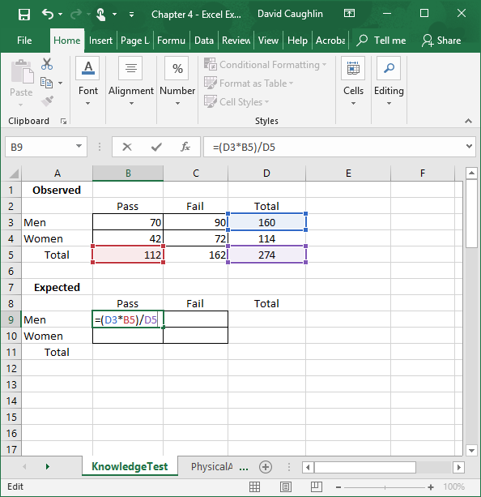
Step 9
To calculate the expected frequency/count for men who passed the knowledge test, multiply the row and column marginals that align with the cell for men who passed, and divide the product by the overall sample size.
In this example, we enter the = sign cell B9, followed by the aforementioned formula, which in this case is (D3*B5)/D5.
Note that we are referencing cells from the observed data table.
The resulting value of 65.401 (rounded) is the number of men we would expect to pass if the gender and outcome variables were not associated with one another.

Slide 12
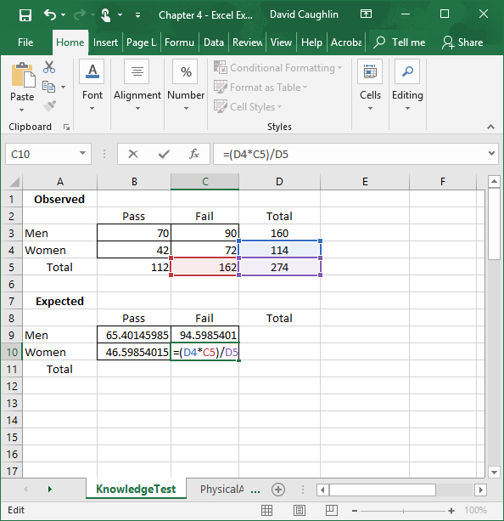
Step 10
Repeat Step 9 to calculate the expected frequencies/counts for the remaining three cells in the 2 × 2 table.

Slide 13
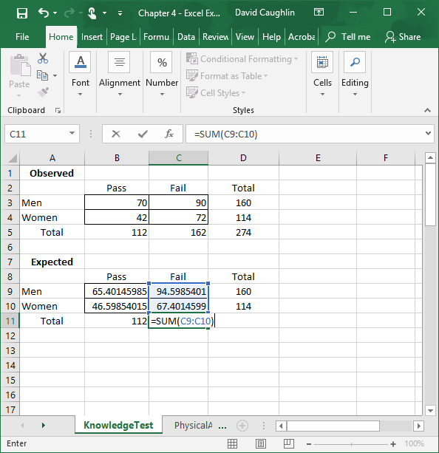
Step 11
Just as we did with the observed table, let’s calculate the row and column marginals using the SUM function.
Note that the marginal values are the same for the expected table as they are for the observed table.

Slide 14
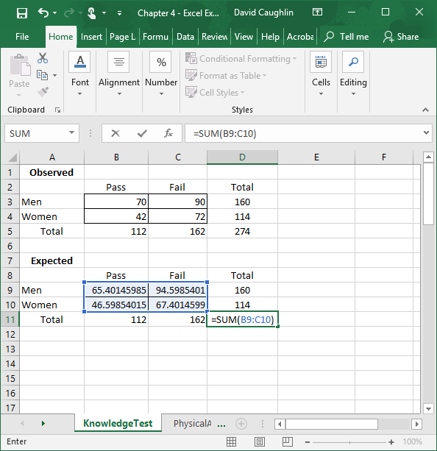
Step 12
Just as we did with the observed table, let’s calculate the overall sample size using the SUM function, which in this example includes the array of cells B9:C10.

Slide 15
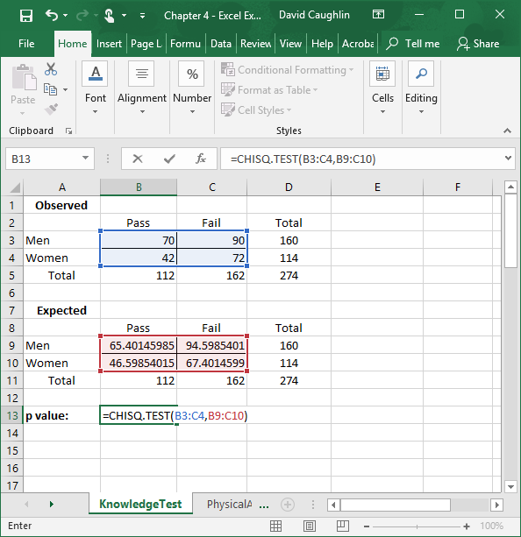
Step 13
With our observed and expected data tables complete, we are now ready to assess whether the observed data are significantly different than data we would expect if the gender and outcome variables were not associated with one another. In other words, we are determining whether we should reject the hypothesis that the observed and expected data are the same.
To do so, we will calculate a p value associated with a χ² test of independence. There are different ways we can do this in Excel, but perhaps the simplest is to use the CHISQ.TEST function. As the first argument in the function’s parentheses, we enter the array/range of cells that contain the raw data of men and women who passed or failed in the observed data table, which in this example is B3:C4. After that argument, enter a comma. Finally, enter the array/range of cells that contain the raw data of men and women who passed or failed in the expected data table, which in this example is B9:C10.
Type the ending parenthesis, and click ENTER.

Slide 16
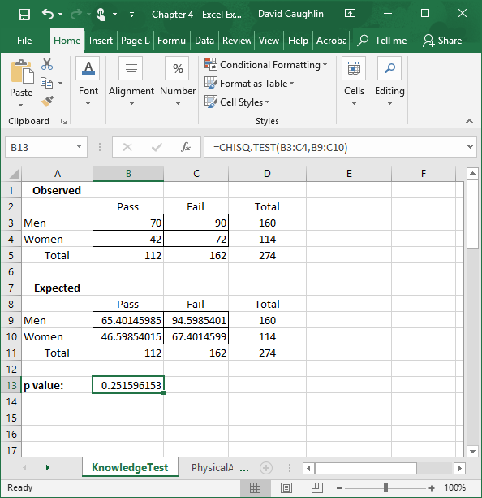
Step 14
The resulting p value is .25, which falls above the conventional cutoff value (which, if you’re wondering, is referred to as the α level) of .05. Thus, we fail to reject the hypothesis that the observed and expected data are the same, which means that we conclude that there is no evidence that the gender and knowledge test outcome variables are significantly associated with one another. In other words, we conclude that there is no evidence of a gender effect on knowledge test outcome (and ultimately selection decisions).
If the p value were less than .05, we would have concluded that the association between the two variables is statistically significant. After that, we would have to look at the observed data table to determine which gender (men or women) has a disproportionately higher selection rate based on the test outcome. That is, we would compare the proportion of men who passed relative to the proportion of women who passed. We would only make such comparisons when we find a significantly significant effect, though.

Slide 17
Questions
You just learned how to apply the χ² test of independence to assess whether there is evidence of disparate (adverse) impact for a selection knowledge test. At the bottom of the Excel workbook, you will see a sheet titled PhysicalAbility, which contains the observed data for a physical ability test used for selection. You will be comparing the pass and fail rates for Black and White candidates.
For the physical ability test, is there evidence of disparate impact according to your χ² test analysis?
If so, for which job candidates: Black candidates or White candidates?

