Slide 1
Chapter 3 Excel Extension: Now You Try!
Cleaning Your Data

Slide 2
Background
In this Excel Extension tutorial, you will learn how to clean your data using Microsoft Excel.
For the purposes of this exercise, imagine that you are an HR information system (HRIS) administrator with access to the HR relational database management system. You have queried the following fields from the Employee Data table: Employee ID, Last Name, First Name, Job Level, Facility, Hire Date, Start Date, and Onboarding Completed.
In this exercise, you will practice using filters, data validation, and PivotTables to clean the data.

Slide 3
Background
Here are the definitions for the data fields in the Employee Data table:
Employee ID (unique identifier for employee)
Last Name (last name of employee)
First Name (first name of employee)
Job Level (level at which an employee’s current job is classified; can range from 1 [lowest] to 5 [highest])
Facility (location of facility where employee currently works)
Hire Date (hire date of employee)
Start Date (first day of work for employee)
Onboarding Completed (completion of new-employee onboarding training module; Yes = module completed, No = module not completed)

Slide 4
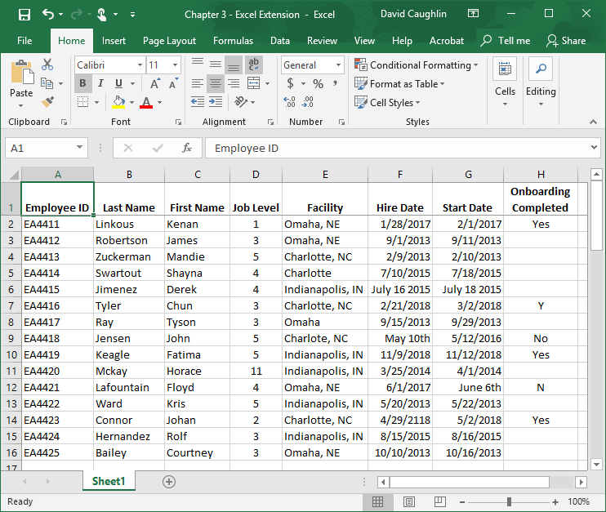
Step 1
Open the Excel workbook titled “Chapter 3--Excel Extension.xlsx”.
Review the data fields in the table, and refer to the field definitions in the Background Section of this tutorial.
Note that each row below the column names represents a unique employee, where the total number of employees is 15.

Slide 5
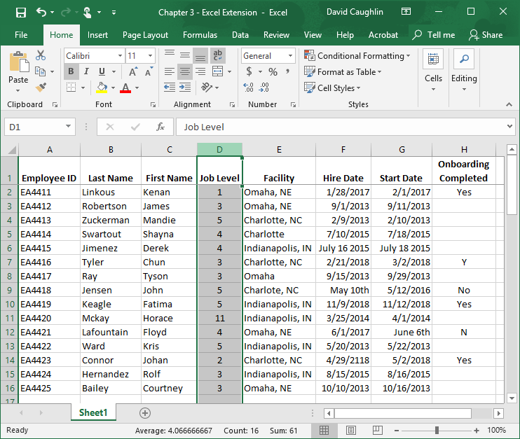
Step 2
Let’s begin by using the filter feature of Excel to determine whether the data within a field needs to be cleaned.
Select the Job Level field by clicking on the box containing the letter above that column, which in this case happens to be D.
Alternatively, you could select all of the columns to apply filters to all fields in the table.

Slide 6
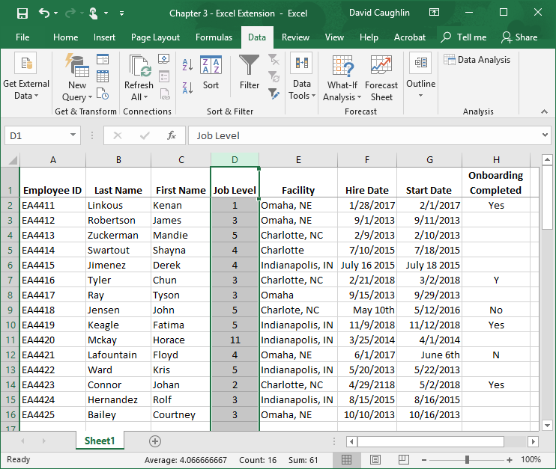
Step 3
Click on the Data tab.
Click on the Filter button.

Slide 7
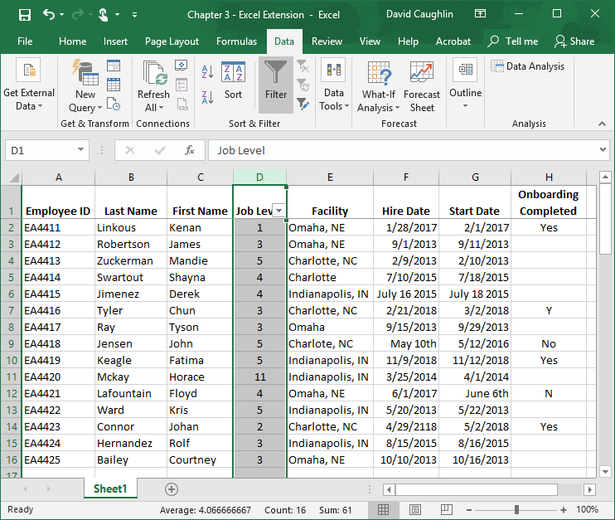
Step 4
You should now see box with a triangle in the lower left corner of the column name you selected, which in this case is Job Level.

Slide 8
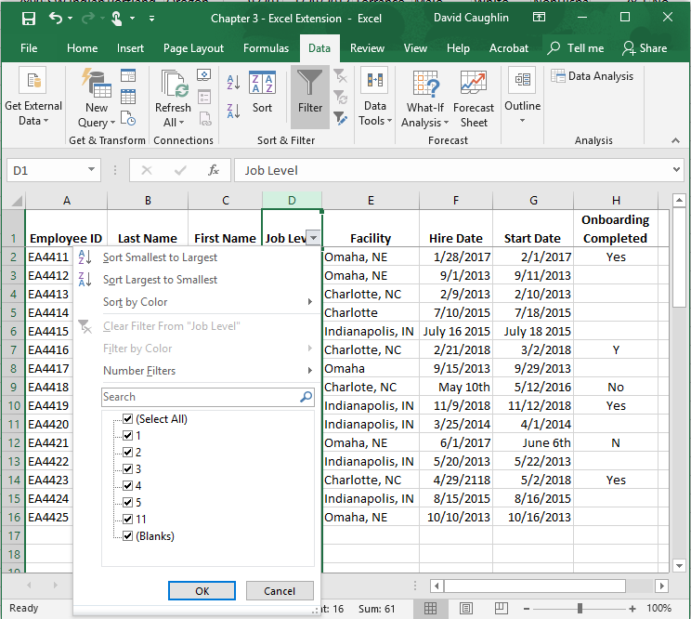
Step 5
Click on the box with a triangle in the lower left corner of the column name you selected.
Note that a window appears with options to sort the data by different attributes as well as to filter the data by different attributes.
If you recall from the definitions of the data fields at the beginning of this tutorial, there are only five possible job levels, which range from 1 to 5. Note that 11 appears as one of the job levels, which is “out of bounds.” Perhaps the person who entered the job level accidentally hit 11 instead of 1 or misunderstood the job levels.
Let’s select only the 11 value by unselecting all other boxes next to the other values.

Slide 9
Step 6
Let’s select only the 11 value by unselecting all other boxes next to the other values. This will filter out everyone who does not have a job level value of 11. The most efficient way to do this is to click on the box next to (Select All), followed by clicking on the box next to 11.
Click OK.

Slide 10
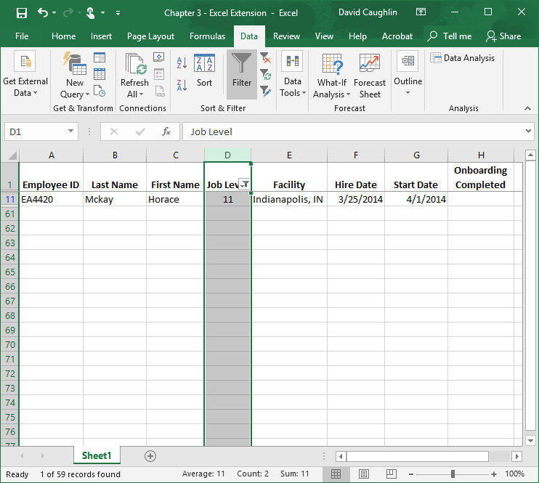
Step 7
Note that only the employee with a job level of 11 is displayed (i.e., Horace Mckay). All other employees are hidden view.
Rather than assume that the data entry person inadvertently typed a 11 instead of a 1 for the Job Level field for Horace Mckay, we should contact Horace directly (or Horace’s supervisor), or find some other source of documentation that we could use to verify correct Horace’s actual job level. At that point, we would be read to clean the Job Level value for Horace by entering the correct value.
To undo the filter you applied, click on the box in the lower left corner of the Job Level field name cell.

Slide 11
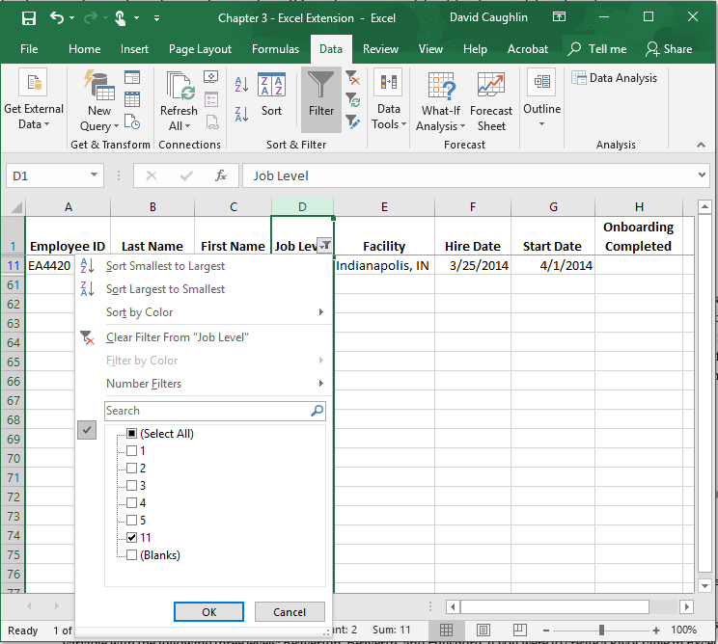
Step 8
To undo the filter you applied, click on the box next to (Select All).

Slide 12
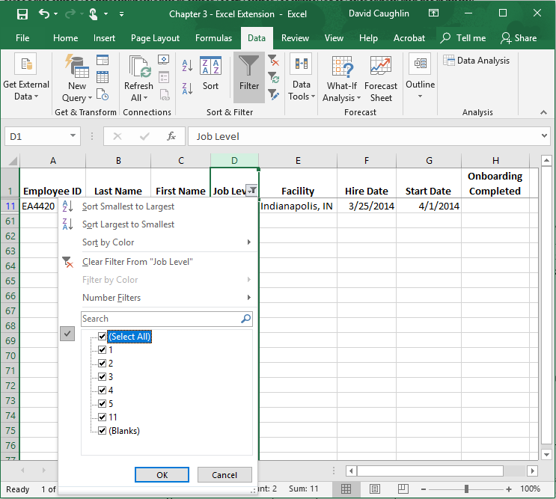
Step 9
Click OK.

Slide 13
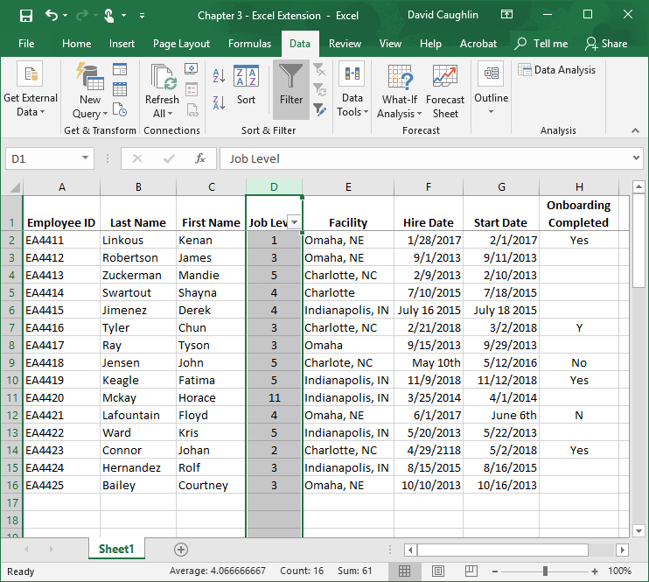
Step 10
Now all of the employees (cases) are back in view.

Slide 14
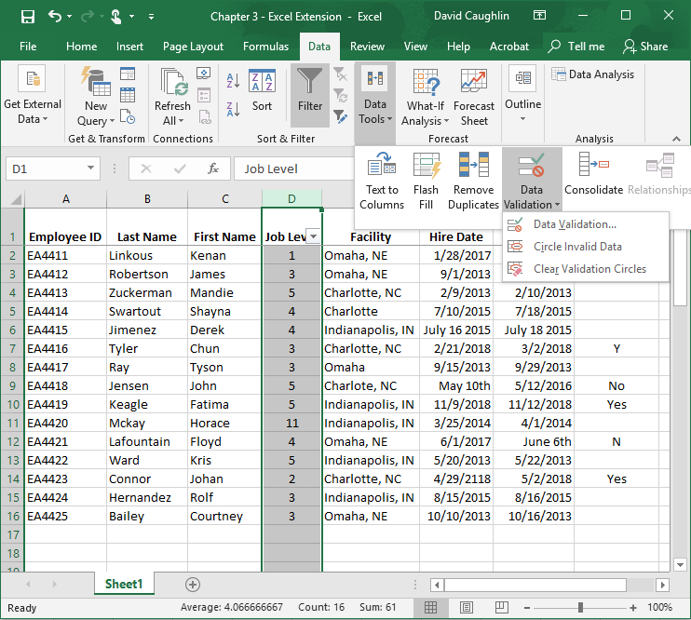
Step 11
1
2
To set what the acceptable values/levels of a particular field are (and to ultimately flag “out of bounds” or invalid values/levels), we can also use the Data Validation tools.
While in the Data tab, click on the Data Tools button.
Click on the Data Validation button.
Select Data Validation….
3
4

Slide 15
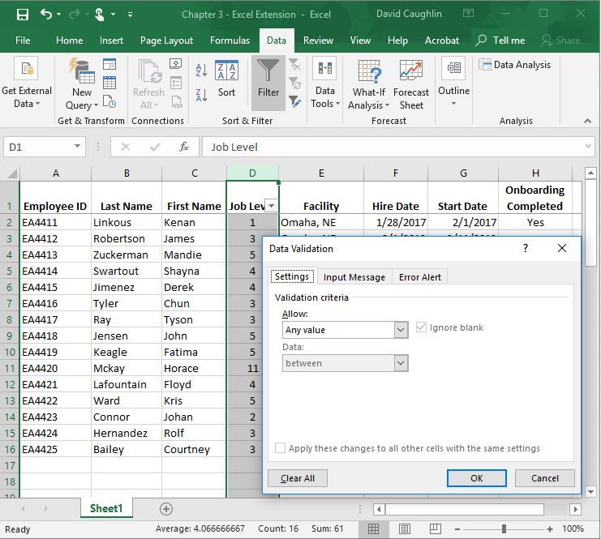
Step 12
When the Data Validation window appears, click on the arrow next to the Any value dropdown menu (which is beneath Allow:)

Slide 16
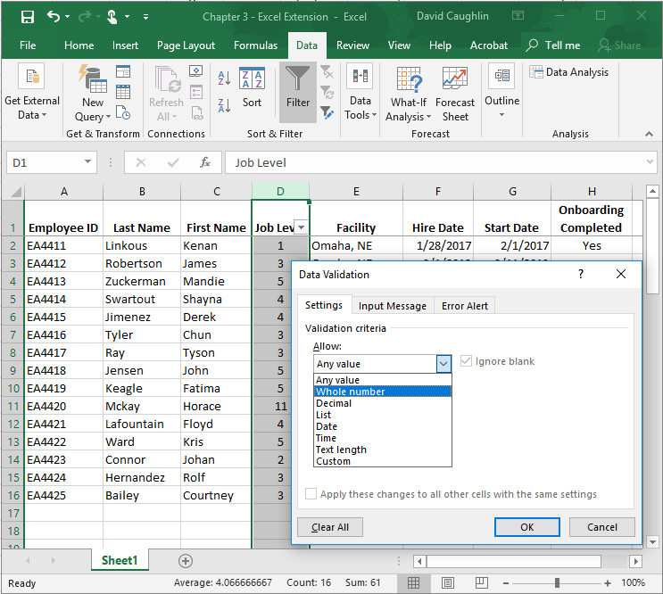
Step 13
Because the values of this field (Job Level) are numeric and whole numbers, select Whole number.
Note that there are other value types and data characteristics that you can use to validate a field, such as Date, Time, and Text length formats.

Slide 17
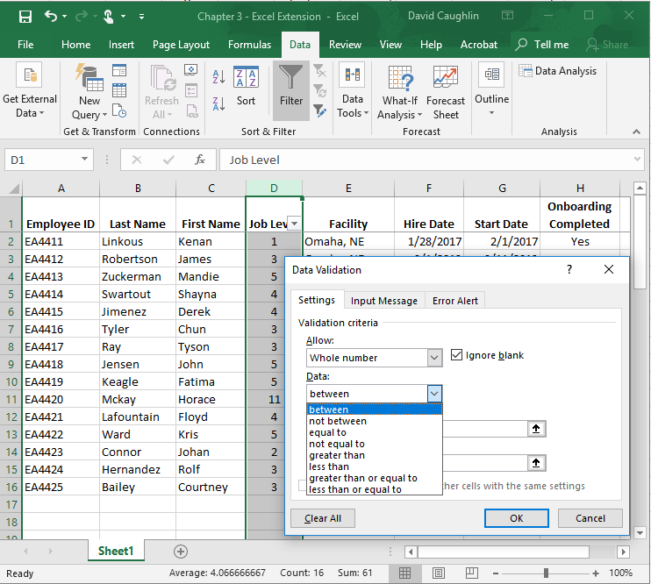
Step 14
If not already selected, click on the dropdown menu below Data: and select between.

Slide 18
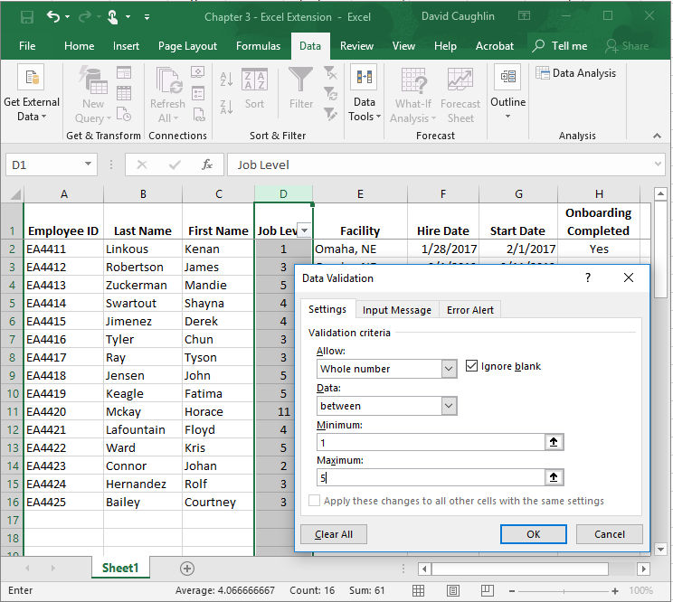
Step 15
Because we know that the Job Level field should have a minimum value of 1 and a maximum value of 5, we enter these values in the fields beneath Minimum: and Maximum:.
Click OK.

Slide 19
Step 16
1
2
To flag “out of bounds” or invalid values based on the range of values we deemed as acceptable in the previous steps, we can use the Data Validation tools once more.
While in the Data tab, click on the Data Tools button.
Click on the Data Validation button.
Select Circle Invalid Data.
3
4

Slide 20
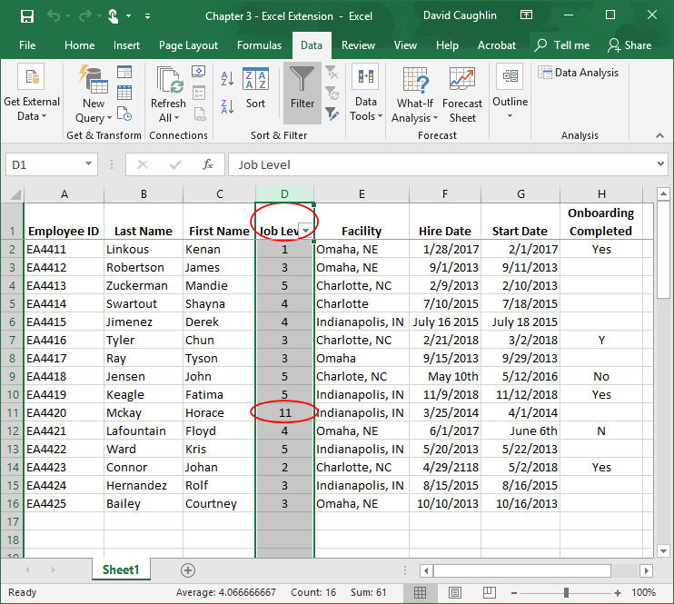
Step 17
Note that red circles appear around cells in the field that contain invalid values. We can ignore the circle around the name of the field. Again, we see that the value of 11 is invalid, and as mentioned before, we will need to take steps to determine what the appropriate job level is for Horace Mckay.

Slide 21
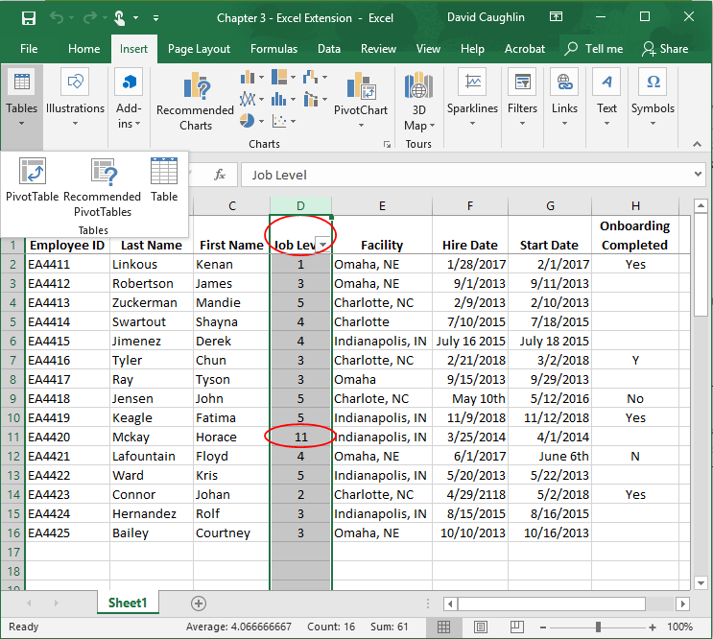
Step 18
1
2
Finally, we can also use PivotTables to identify potential “out of bounds” or invalid values, as well as to look at the frequencies of different values.
Be sure that the data field for Job Level is still highlighted. If not, click on the letter (D) above it to reselect the field.
Click on the Insert tab.
Click on the Tables button.
Select PivotTable.
3

Slide 22
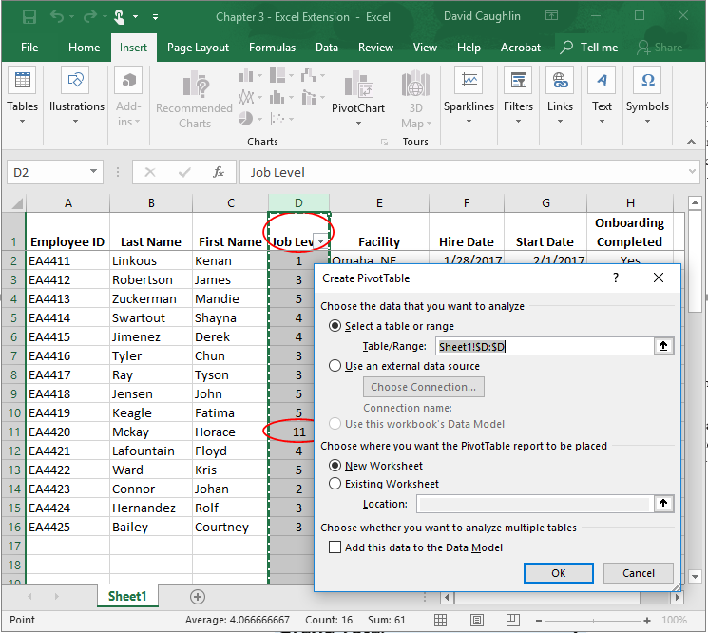
Step 19
A new window appears called Create PivotTable. Note that Select a table or range is already selected, and the field next to Table/Range: already shows the field corresponding to Job Level that we previously highlighted.
There are different options for choosing where the PivotTable will appear under Choose where you want to the PivotTable report to be placed. For simplicity, let’s go with the default, which is New Worksheet.
Click OK.

Slide 23
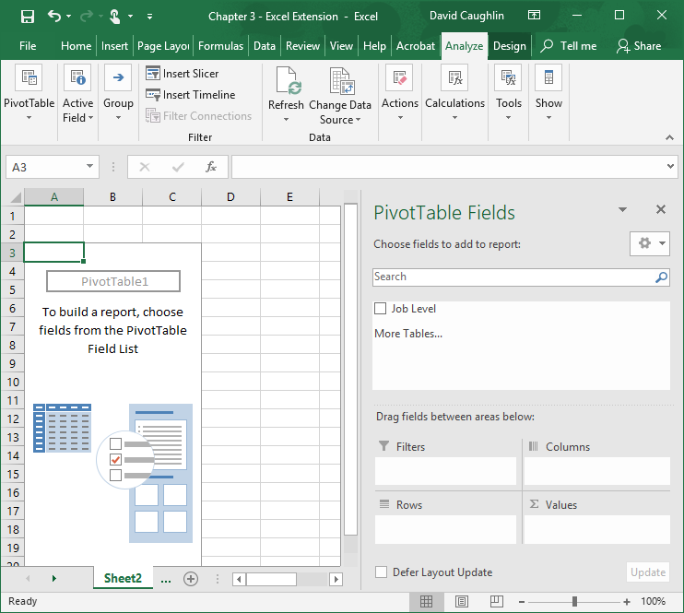
Step 20
A blank PivotTable appears in a new sheet.

Slide 24
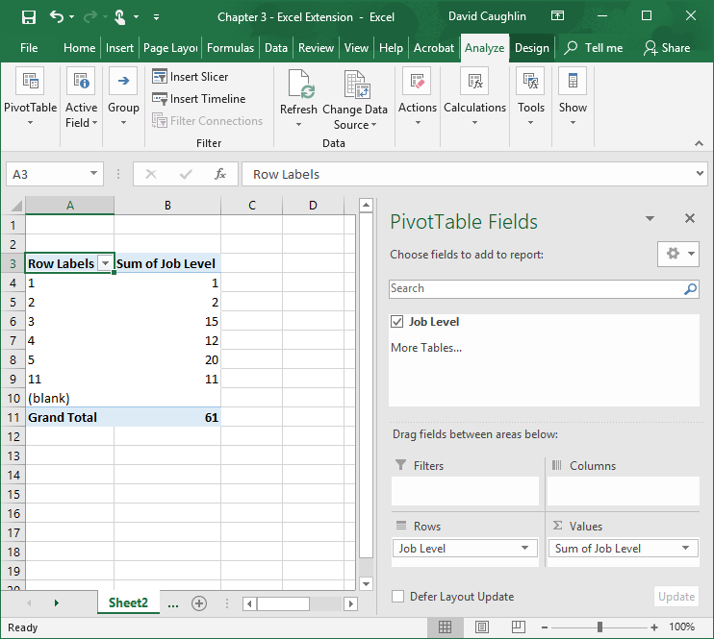
Step 21
Click the box next to the Job Level label.
Click on the Job Level label you just activated, and drag it to the box titled Rows.
1
2

Slide 25
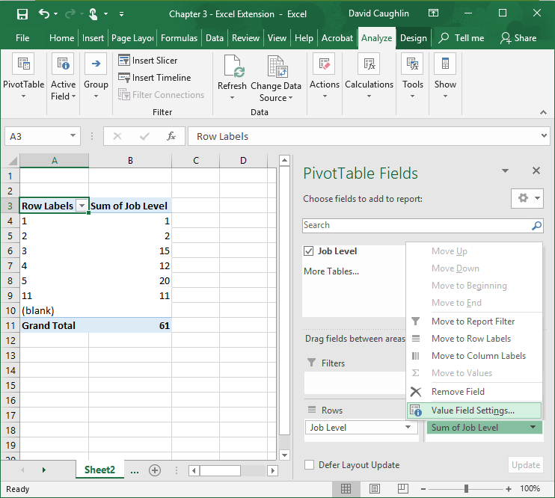
Step 22
The PivotTable here defaults to summing the values within the Job Level field. We want to change that function to a count or frequency. To do so, click on the arrow next to Sum of Job Level.
Select Value Field Settings….
2
1

Slide 26
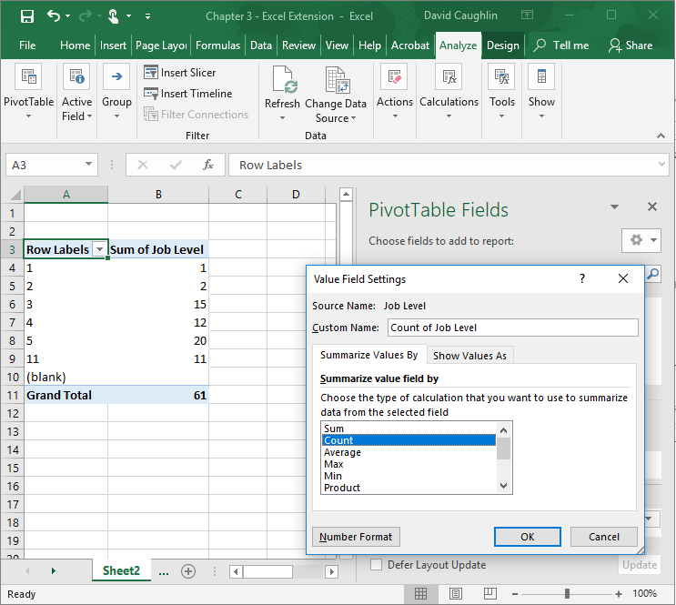
Step 23
Click on the dropdown menu below Choose the type of calculation that you want to use to summarize data from the selected field.
Select Count.
Click OK.
1
2

Slide 27
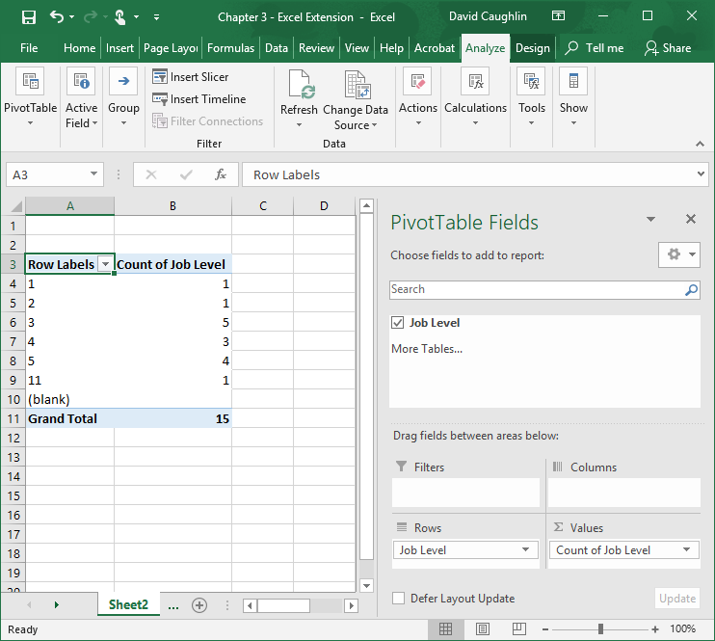
Step 24
An updated PivotTable appears that contains the different values for the Job Level field (under the Row Labels column) and the number of cases (employees) with each Job Level value (under the Count of Job Level column).
Note that the value 11 appears as Job Level value, which we know to be invalid. Further, note that one person has this value. Thus, we know that we would need to correct this value for one individual. All other Job Level values are within the range of acceptable values, which for this field is 1 through 5.

Slide 28
Questions
You just learned three different approaches to identifying potentially problematic/invalid data: (a) filtering, (b) data validation, and (c) PivotTable. Now you are ready to apply these approaches to the following fields in the table: Facility, Hire Date, Start Date, and Onboarding Completed. Be sure to revisit the definitions of the data fields that appear at the beginning of this tutorial in the Background section.
Using the PivotTable approach and one other approach of your choosing (filtering or data validation), identify any data integrity issues for the Facility, Hire Date, Start Date, and Onboarding Completion fields.
Describe any data integrity issues you identified in each field, and make recommendations regarding what information you might use (within the data table itself or potentially in the organization at large) to correct data integrity issues, which ultimately cleans the data.

