Slide 1
Chapter 2 Excel Extension: Now You Try!
Describing Your Data

Slide 2
Background
In this Excel Extension tutorial, you will learn how to describe your data using Microsoft Excel.
For the purposes of this exercise, imagine that the sex, race/ethnicity, age, and engagement data for each employee were collected using an annual employee survey, and each employee’s unique ID was used to merge their survey data with their annual base pay.

Slide 3
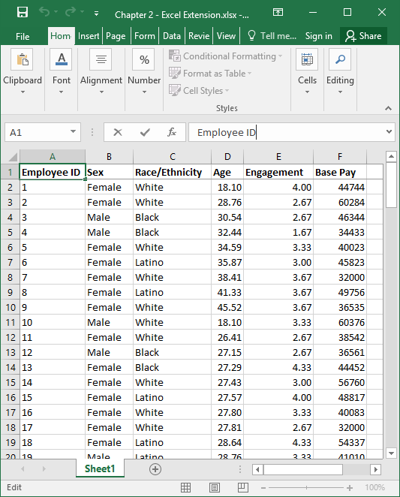
Step 1
Open the raw data sheet titled “Chapter 2--Data Exercise.xlsx”.
Note that the sheet includes six columns, where each column represents unique field/variable:
Employee ID (unique employee identifier)
Sex (Male, Female)
Race/Ethnicity (Asian, Black, Latino, White)
Age (years)
Engagement (1 = low, 5 = high)
Base Pay (U.S. dollars)
Note that each row below the column names represents a unique employee, where the total number of employees is 111.

Slide 4
Step 2
Let’s practice classifying a variable as either categorical or continuous. If you recall, a categorical variable consists of multiple levels (categories), but these levels do not have a particular order or inherent numeric values. A continuous variable consists of a continuum of numerically ordered values.
What type of variable is Sex? Note that the Sex variable, as defined in this data set as Male or Female, does not contain any inherent numeric values, and the levels (Male, Female) do not have any inherent order. We can count how many employees self-reported their sex as male or female, but we cannot say that male is more than female or female is more than male. Given this information, the Sex variable is best described as categorical.

Slide 5
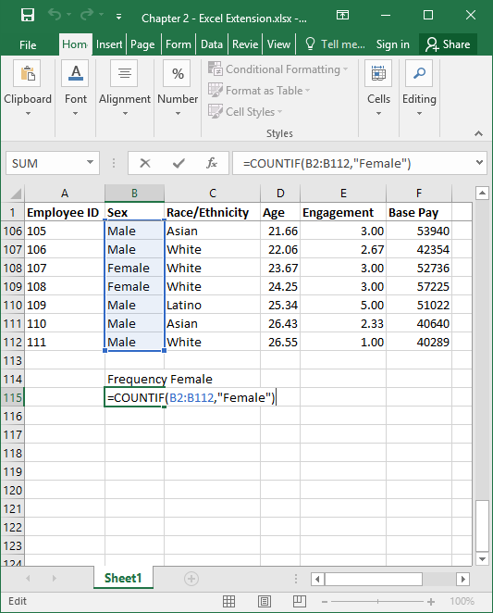
Step 3
What is the most appropriate summary statistic for describing the Sex variable? As we determined in Step 2, the Sex variable is best described as categorical. Accordingly, we can count how many employees self-reported their sex as male or female, which are often referred to as frequencies.
Scroll down below the data to find empty cells, and create a label for the frequency you plan to compute. For instance, type “Frequency Female” in a blank cell below the data in the Sex column.
In a blank cell below the “Frequency Female” label, type the equal symbol (=) followed by the COUNTIF function, followed by a beginning parenthesis.
Type the range of cell values that corresponds to the array of numeric values that fall below the Job Satisfaction variable name, which in this case is B2:B112.
Type a comma (,), and then, in quotation marks, type the exact name of one level (category) of the categorical Sex variable. Finally, type an ending parenthesis, and click ENTER.

Slide 6
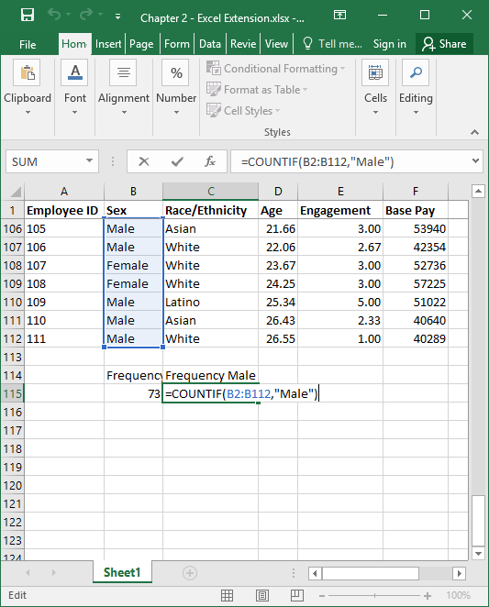
Step 4
Repeat Step 4 for the other level(s) of the categorical variable, as shown in the image.

Slide 7
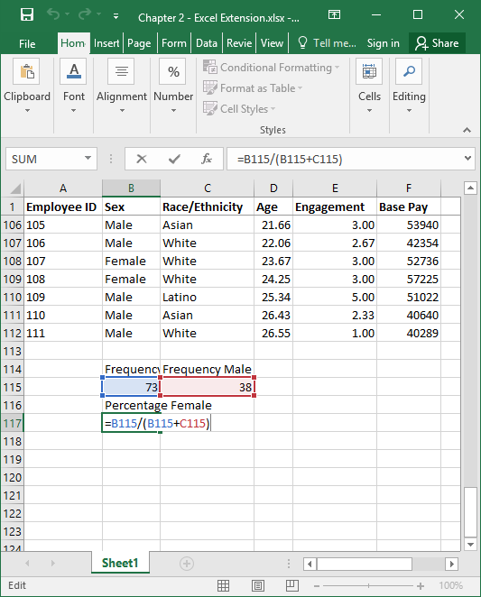
Step 5
To compute the percentage of Males and the percentage of Females in this sample for the categorical Sex variable, we can create a simple formula.
Similar to before, create a label for the percentage you plan to compute. For instance, type “Percentage Female” in a blank cell.
In a blank cell below the “Percentage Female” label, type the equal symbol (=) followed by a formula that divides the frequency of Females in the sample by the total number of individuals of both Sexes (Male, Female). To do so, reference the cells that contain the appropriate values. For example, as shown in the image, the formula is =B115/(B115+C115).

Slide 8
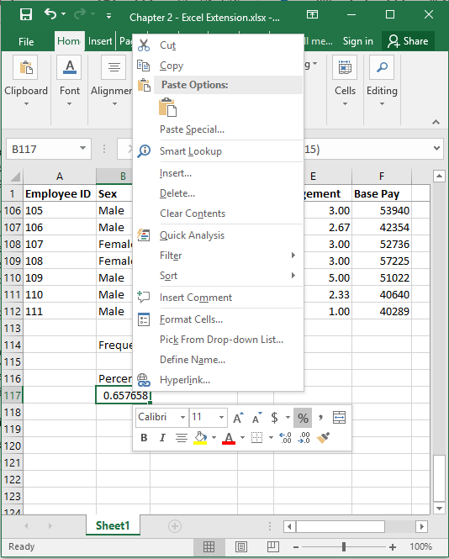
Step 6
Note that the resulting value is a proportion--not a percentage. To convert the proportion to a percentage, right click on the cell containing the proportion if you are using Windows, or hold CTRL and click on the cell if you are using a Mac.
Two menus will pop up, you can either click Format Cells… in the first menu or click on the % symbol in the second menu. Here, we will click on the % symbol in the second menu.

Slide 9
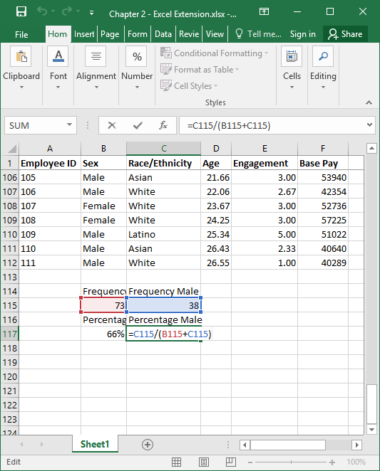
Step 7
Repeat Steps 5 and 6 for the other level(s) of the categorical variable, as shown in the image.

Slide 10
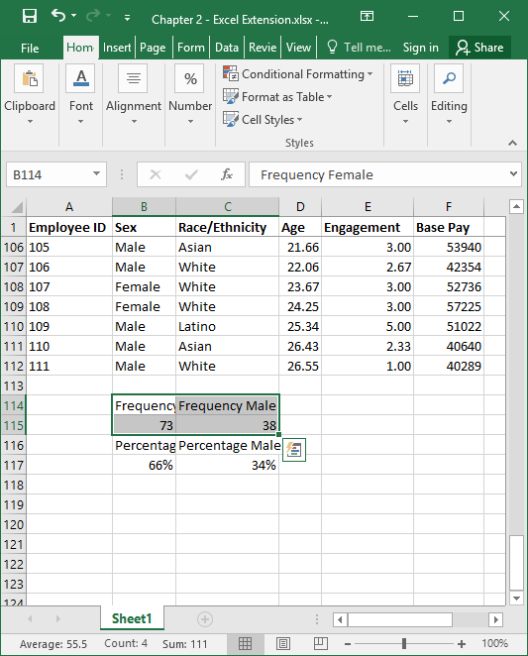
Step 8
Now we can create a data visualization to describe the frequencies.
To do so, highlight the cells with the labels and values for the frequencies.

Slide 11
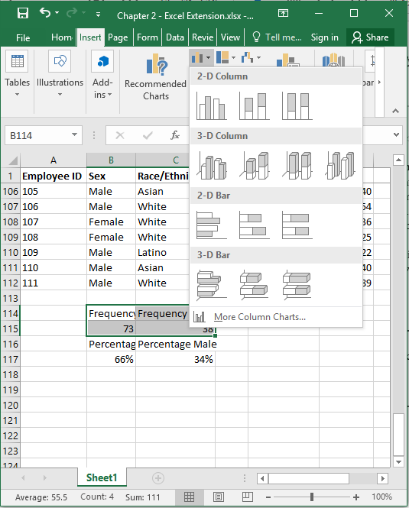
Step 9
1
2
Click the Insert tab.
Click the bar chart icon.
Select the simple 2-D column chart.
3

Slide 12
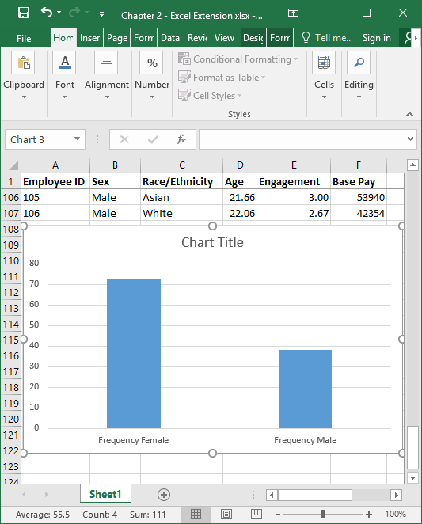
Step 10
A bar chart with the frequencies will appear.
You can use the Design and Format tabs to add/remove titles and change the formatting of the bar chart.

Slide 13
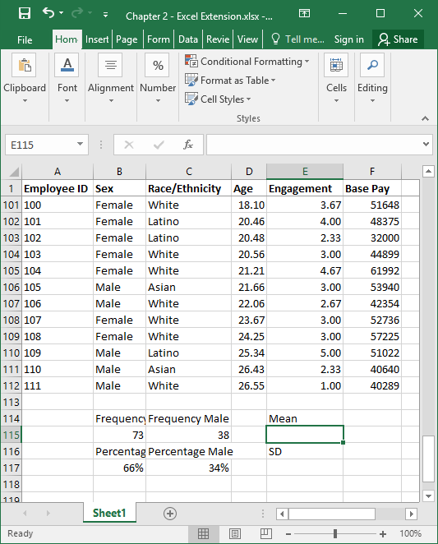
Step 11
What are the most appropriate summary statistics for describing the Age variable? In this data set, Age is numeric (years), and thus it is a continuous variable. Given this, we can calculate the mean and standard deviation (SD) for Age as summary statistics.
Somewhere below the data values, add labels for the Mean and SD.

Slide 14
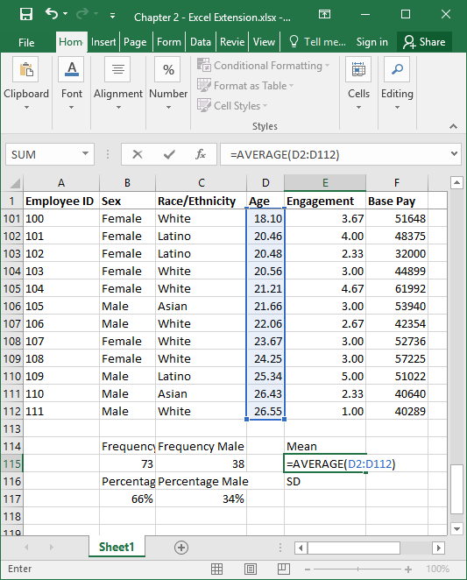
Step 12
In the empty cell under or adjacent to the label Mean, type the Excel function for computing the mean, which is AVERAGE.
Type =AVERAGE( in the empty cell, followed by the array/range of cells that contains the Age numeric values (D2:D112).
Type an ending parenthesis and click ENTER.

Slide 15
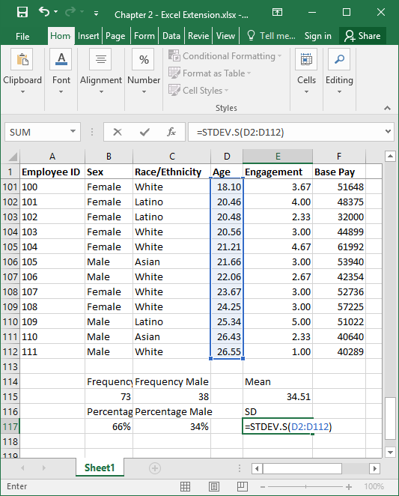
Step 13
In the empty cell under or adjacent to the label SD, type the Excel function for computing the SD, which is STDEV.S.
Type =STDEV.S( in the empty cell, followed by the array/range of cells that contains the Age numeric values (D2:D112).
Type an ending parenthesis and click ENTER.

Slide 16
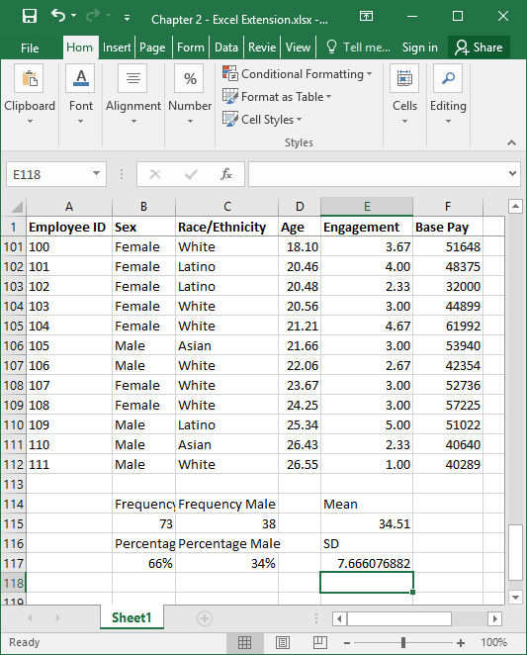
Step 14
The mean age for this sample of employees is 34.51 years with an SD of 7.67 years. This means that approximately 95% of the sample has an age that is within the range of 7.67 years above and below the mean of 34.51 years.

Slide 17
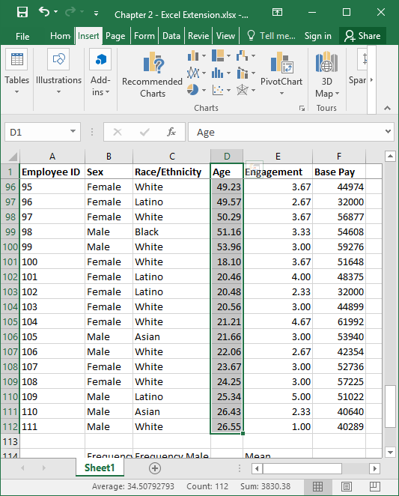
Step 15
To visualize the nature of the Age variable distribution, we can create a histogram, which is appropriate for continuous variables.
As a first step, select the array/range of cells that correspond to Age, including the variable label.

Slide 18
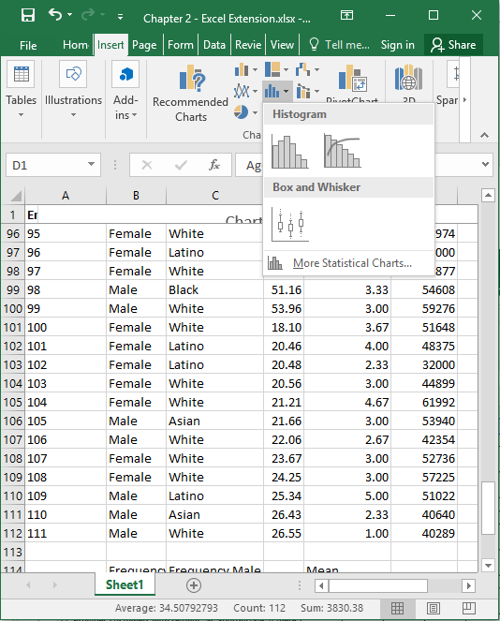
Step 16
Next, click on the Insert tab, and then click the Histogram button.
Click the basic histogram button.

Slide 19
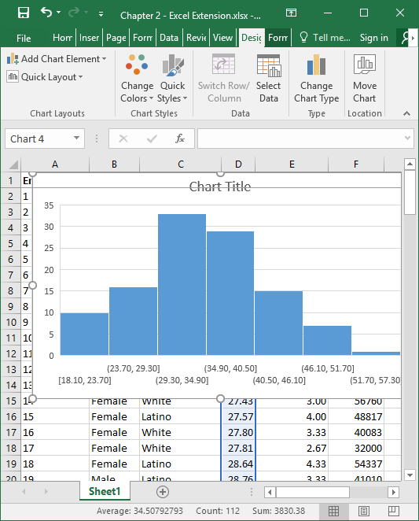
Step 17
The histogram should appear. As you can see, the data are relatively normally distributed, which means that the mean is a good estimate of central tendency for this sample.
You can use the Design and Format tabs to add/remove titles and change the formatting of the histogram.

Slide 20
Questions
Now that you have learned how to describe categorical and continuous variables in Excel, please do the following:
Determine whether the Race/Ethnicity variable is categorical or continuous. How do you know? Calculate the appropriate summary statistic(s) and create an appropriate data visualization to describe the variable.
Determine whether the Engagement variable is categorical or continuous. How do you know? Calculate the appropriate summary statistic(s) and create an appropriate data visualization to describe the variable.
Determine whether the Base Pay variable is categorical or continuous. How do you know? Calculate the appropriate summary statistic(s) and create an appropriate data visualization to describe the variable.

