Slide 1
Chapter 1 Excel Extension: Now You Try!
Computing Correlations

Slide 2
Background
In this Excel Extension tutorial, you will learn how to compute a (Pearson product-moment) correlation between two continuous variables using Microsoft Excel.
For the purposes of this exercise, imagine that the engagement and job satisfaction data for each employee were collected using an annual employee survey, and each employee’s unique ID was used to merge their survey data with their average annual customer satisfaction ratings, their supervisor-rated performance evaluation score, and the amount of annual sales revenue they generated.
For the purposes of this introductory exercise, we will ignore statistical significance, and instead practice interpreting the sign (positive or negative) and magnitude (size) of each correlation.

Slide 3
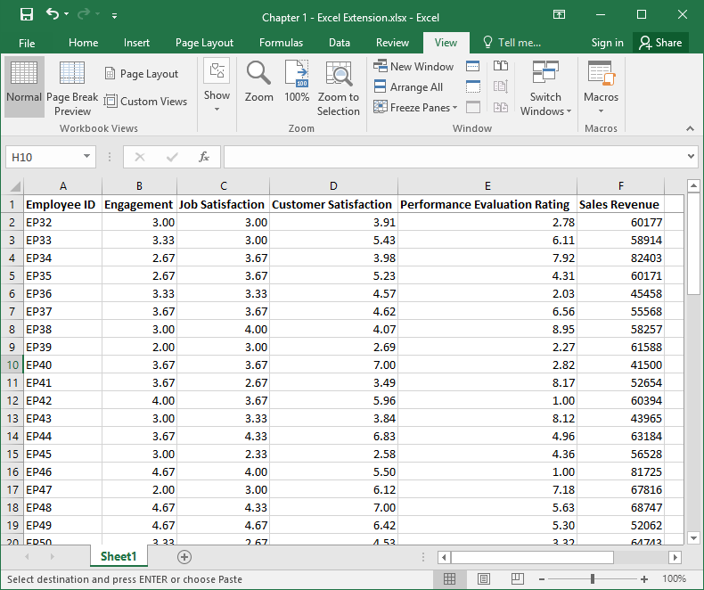
Step 1
Open the Excel workbook titled “Chapter 1--Excel Extension.xlsx”.
Note that the sheet includes six columns, where each column represents unique field/variable:
Unique employee ID (Employee ID)
Engagement (1 = low, 5 = high)
Job Satisfaction (1 = low, 5 = high)
Customer Satisfaction (1 = low, 7 = high)
Performance Evaluation Rating (1 = low, 10 = high)
Sales Revenue (U.S. dollars)
Note that each row below the column names represents a unique employee, where the total number of employees is 59.

Slide 4
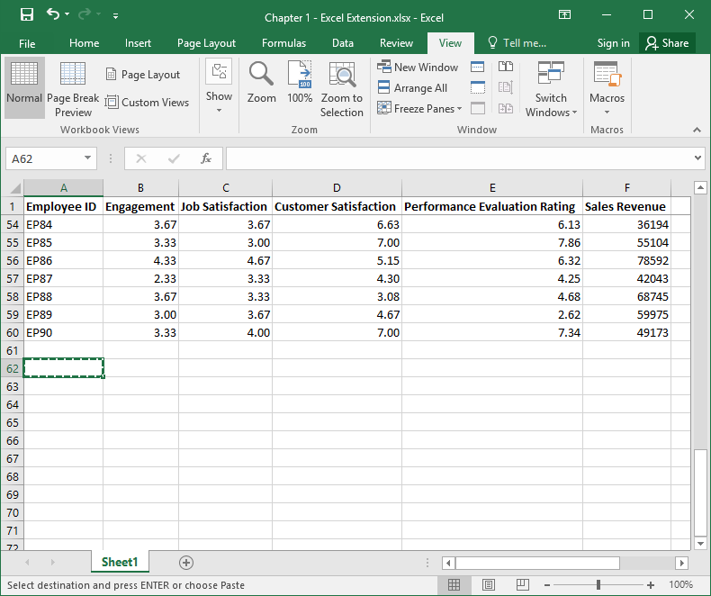
Step 2
To practice, let’s compute the correlation between Job Satisfaction and Performance Evaluation Rating.
Scroll down below the data to find empty cells.

Slide 5
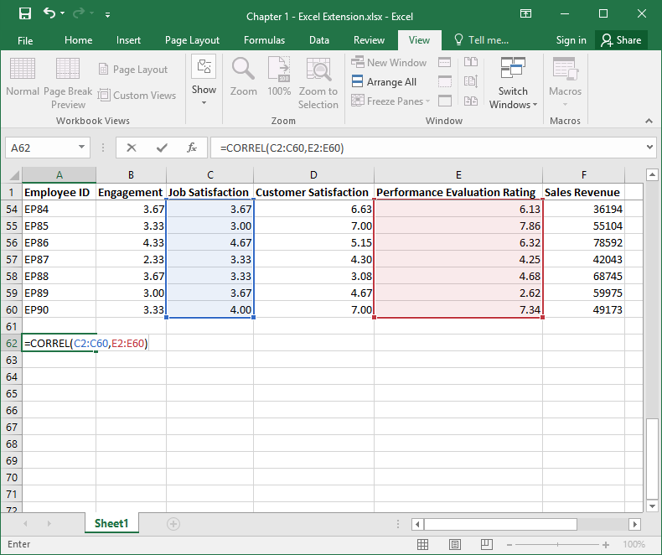
Step 3
In a blank cell, enter the equal symbol (=) followed by the CORREL function, followed by a beginning parenthesis.
Enter the range of cell values that corresponds to the array of numeric values that fall below the Job Satisfaction variable name, which in this case is C2:C60. Note that you can enter the cell range manually by entering the first cell in the array (C2), followed by a colon (:), and followed by the last cell in the array (C60); alternatively, you can select the array of cells by clicking and dragging your mouse.
Enter a comma (,).
Enter the range of cell values that corresponds to the array of numeric values that fall below the Performance Evaluation Rating variable name, which in this case is E2:E60. Enter an ending parenthesis, and click ENTER.

Slide 6
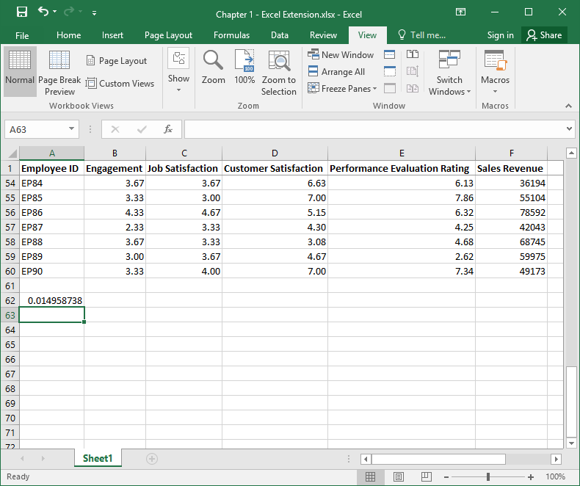
Step 4
Remember, correlation coefficients can range from –1.00 to 1.00, where –1.00 indicates a perfect negative (inverse) linear association, 1.00 indicates a perfect positive linear association, and .00 indicates no association.
Note that the correlation coefficient is approximately .015 (after rounding).
Regarding the sign, the correlation coefficient is positive, which indicates a positive, linear association.
With that said, the magnitude of the correlation coefficient is virtually zero. For our purposes, we describe the magnitude of a correlation coefficient as follows:
<.10 (negligible)
.10–.29 (small)
.30–.49 (medium)
.50–1.00 (large)

Slide 7
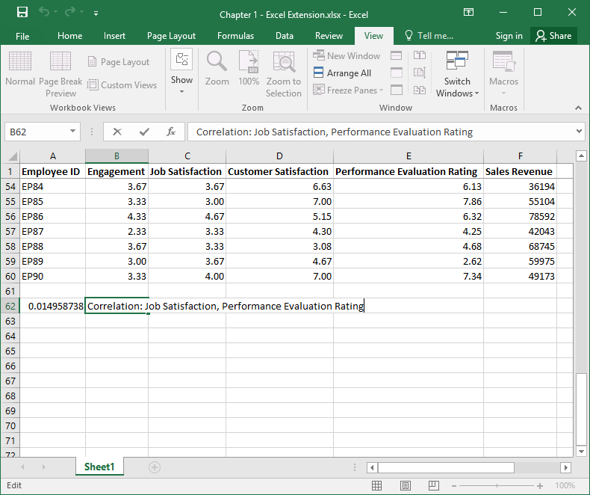
Step 5
It is generally a good practice to label each correlation coefficient so that you can remember what association it refers to.
In a cell adjacent to the cell in which the correlation coefficient appears, type information about the correlation, and click ENTER.

Slide 8
Questions
Now that you have learned how to compute a correlation using the CORREL function in Excel, please practice running additional correlations using the same data and answer the following questions. Be sure to interpret the sign and magnitude.
What is the correlation between Employee Engagement and Sales Revenue?
Consider the sign and the magnitude of the correlation. How would you describe the nature of the relation between Engagement and Sales Revenue to a manager who does not know what a correlation coefficient means?
What is the correlation between Job Satisfaction and Customer Satisfaction?
Consider the sign and the magnitude of the correlation. How would you describe the nature of the relation between Job Satisfaction and Customer Satisfaction?

