Slide 1
Chapter 15 Excel Extension: Now You Try!
Managing Expatriates Using Data

Slide 2
Background
In this Excel Extension tutorial, you will learn how to apply a simple linear regression analysis, an independent-samples t test, and a one-way analysis of variance (ANOVA) to determine some of potential correlates or drivers of expatriate assignment satisfaction.
For the purposes of this exercise, imagine that you work for a company called Ettinger Manufacturing that has 30 expatriates working in three countries. You want to know what factors/variables are associated with higher satisfaction with expatriate assignments.

Slide 3
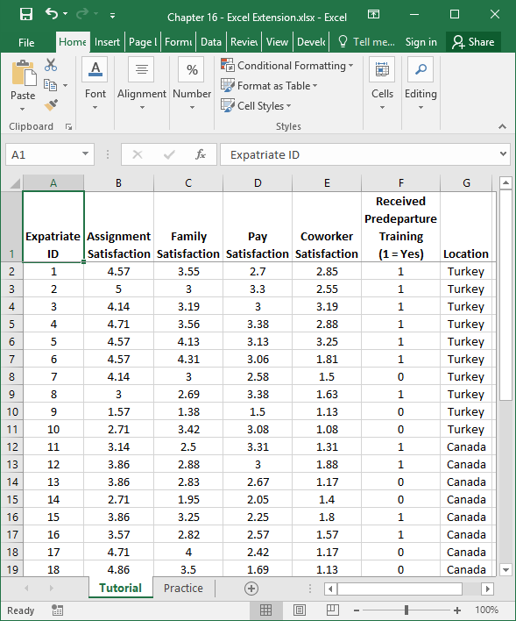
Step 1
Open the Excel workbook titled “Chapter 15--Excel Extension.xlsx”.
Click on the sheet called Tutorial. You will use the data contained in this sheet to learn how to run regression analyses, an independent-samples t test, and a one-way analysis of variance (ANOVA).
Note that the sheet includes three fields/columns/variables:
Expatriate ID (unique employee identifier)
Assignment Satisfaction (1 = low, 5 = high)
Family Satisfaction (1 = low, 5 = high)
Pay Satisfaction (1 = low, 5 = high)
Coworker Satisfaction (1 = low, 5 = high)
Received Predeparture Training (1 = Yes, 0 = No)
Location (Canada, Spain, Turkey)
Note that data for 30 expatriates who work for Ettinger Manufacturing are included in this data set.

Slide 4
Step 2
If you haven’t already, be sure to add in the Analysis ToolPak feature in Excel, which requires the following steps.
First, click on the File tab.

Slide 5
Step 3
Select Options.

Slide 6
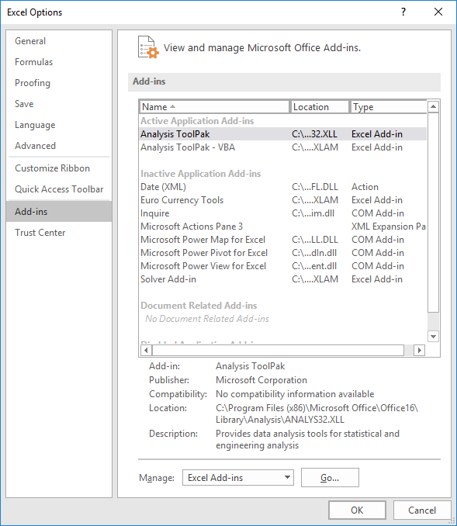
Step 4
When the Excel Options window opens, select the Add-Ins tab on the left, and then select the Analysis ToolPak in the Excel Add-Ins list, which appears next to Manage at the bottom of the window, and click Go…. A window will open, and simply check the box next to Analysis ToolPak.
If you already have the Analysis ToolPak application activated, it will appear in the Active Application Add-ins list, as shown in the image.
Click OK.

Slide 7
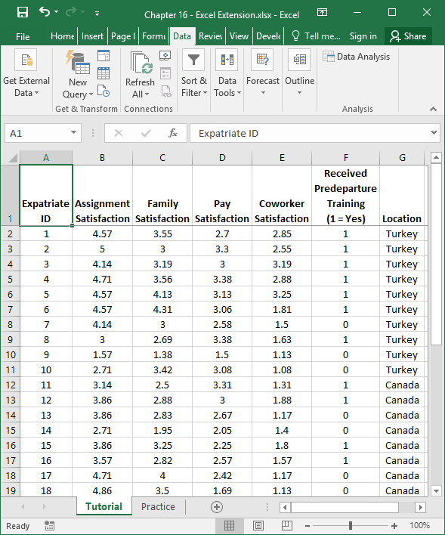
Step 5
Click on the Data tab.
Click on the Data Analysis button.

Slide 8
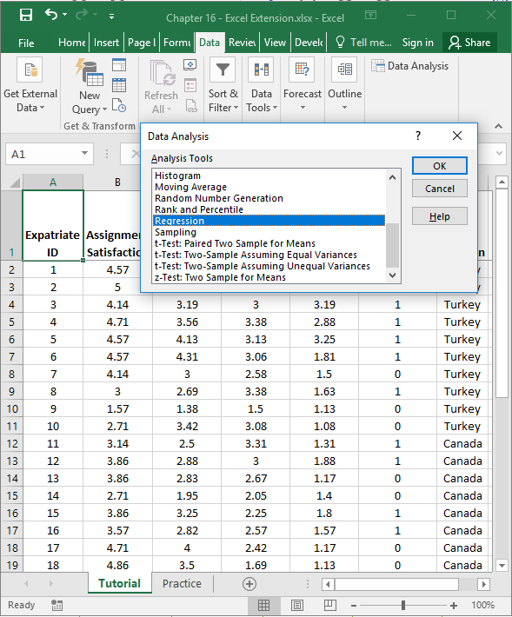
Step 6
Let’s being by posting the question: Are family satisfaction, pay satisfaction, and coworker satisfaction significant predictors of expatriate assignment satisfaction?
As an example, we will start with family satisfaction and see if it significantly predicts assignment satisfaction. We can use simple linear regression analysis to test this research question.
When the Data Analysis window opens, under Analysis Tools:, select Regression.
Click on OK.

Slide 9
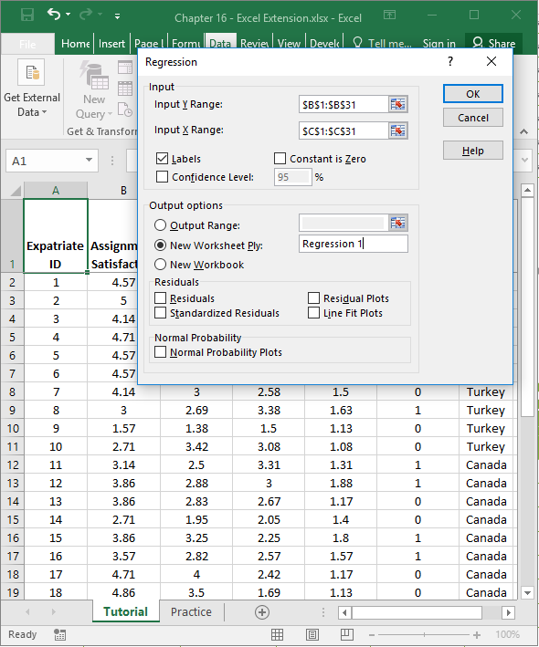
Step 7
1
2
6
3
When the Regression window opens, in the field next to Input Y Range: enter the range of cells that contains our outcome variable (Assignment Satisfaction) and associated values, including the variable labels. Next, in the field next to Input X Range:, enter the range of cells that contains one of the continuous predictor variables (Family Satisfaction) and associated values, including the variable labels.
Check the box next to Labels.
Click the bubble next to New Worksheet Ply.
If you would like, next to New Worksheet Ply:, type in what you would like to name the new sheet. Here, “Regression 1” is entered in the field because additional regression models can be estimated using these data.
Click OK.
5
4

Slide 10
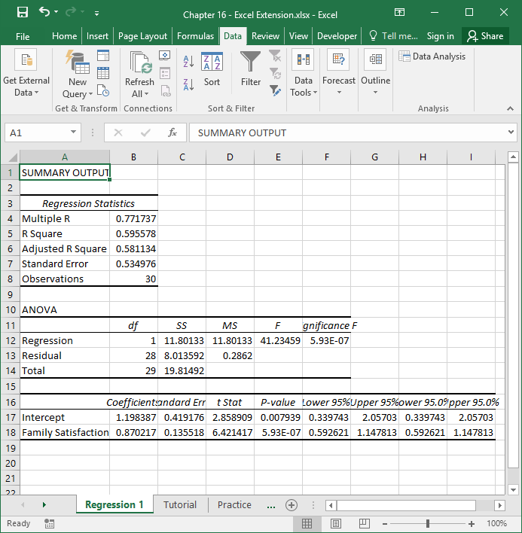
Step 8
A new sheet should appear in your workbook that is named Regression 1 (or whatever you named the new sheet in the previous step). This sheet contains your simple linear regression model output.
Note that the number of digits after the decimal point varies and that some of the values in the output are in scientific notation (e.g., 5.93E–07).

Slide 11
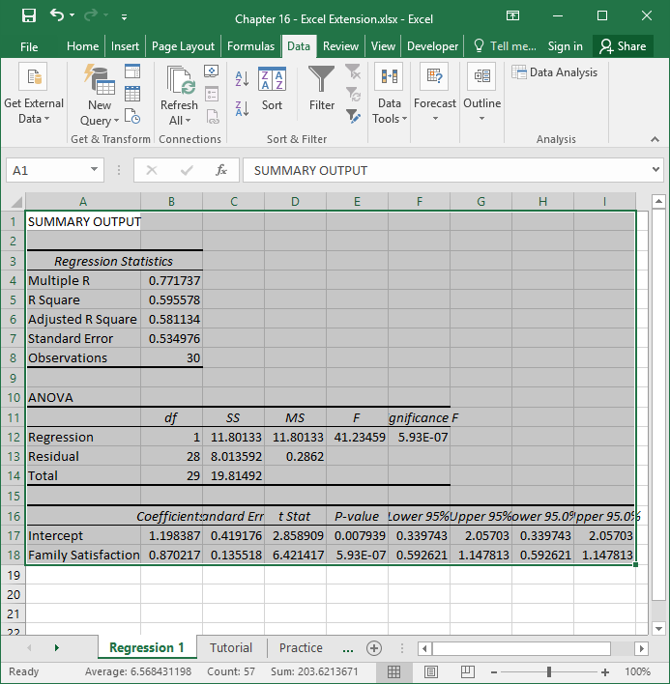
Step 9
To make your output easier to read, consider formatting the values to have two or three digits after the decimal.
To do so, first, select all of the cells in the output.

Slide 12
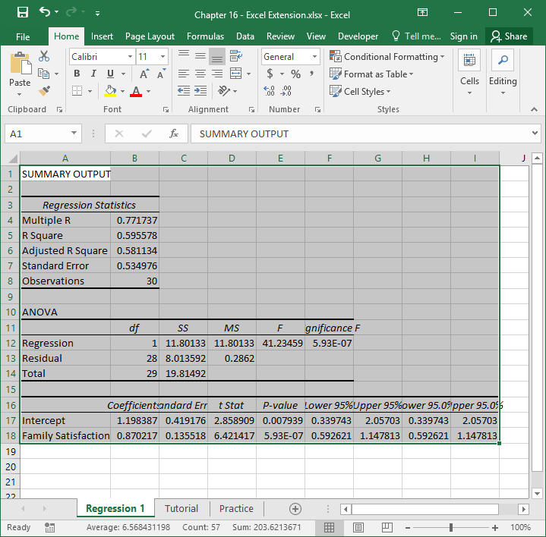
Step 10
Second, click on the Home tab, and click the small box with the arrow in the Number section.

Slide 13
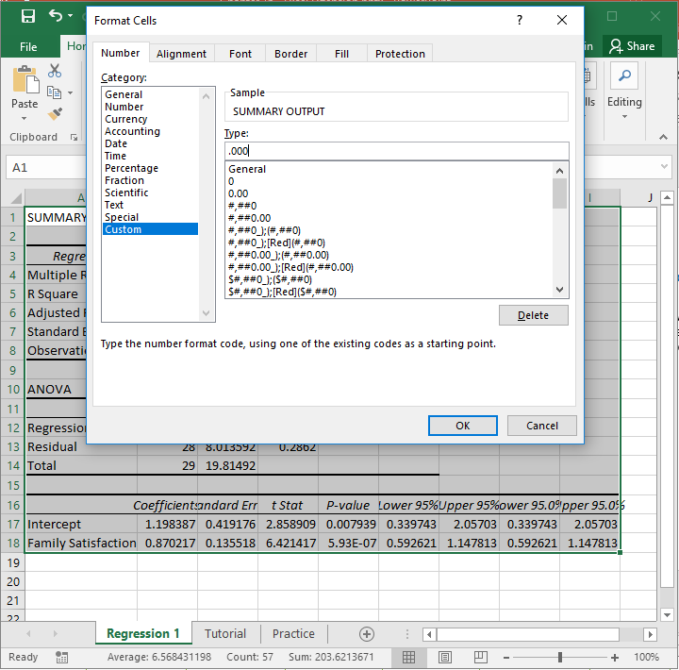
Step 11
Third, in the Number tab of the Format Cells window, click Custom from the Category: list.
In the field under Type:, enter the following format .000 to designate that you do not want a zero before the decimal point and only want three zeroes after the decimal point.
Click OK.

Slide 14
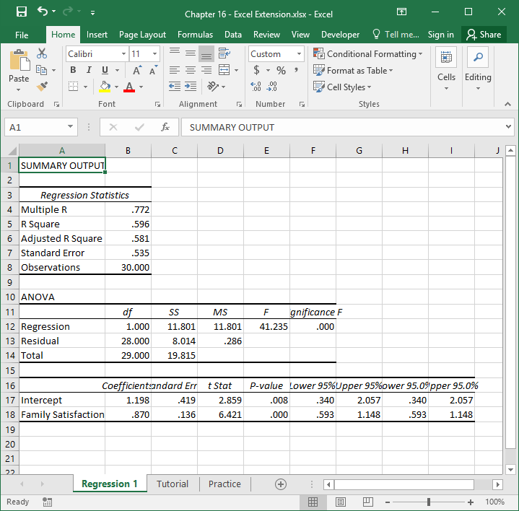
Step 12
Now the output is a bit easier to read.
In the Regression Statistics table, note that the R Square value is .596, which means that the predictor variable in the model (Family Satisfaction) explains 59.6% (.596 × 100) of the variance in the outcome variable (Assignment Satisfaction).

Slide 15
Step 13
In the table at the bottom, you will find your regression model estimates. The first column contains the names of the predictor variable and the intercept. The second column contains the regression weights (coefficients). The fifth column contains the p values associated with the regression weights, which we use to determine whether they are statistically significant (i.e., significantly different from zero).
As you can see, the regression weight for Family Satisfaction (in relation to Assignment Satisfaction) is positive and has a p value that is less than the conventional two-tailed cutoff (α level) of .05, which means we can treat this regression weight as statistically significant. If the p value were greater than .05, then it would be nonsignificant.
Continue practicing simple linear regression analysis by testing whether Pay Satisfaction and Coworker Satisfaction predict Assignment Satisfaction.

Slide 16
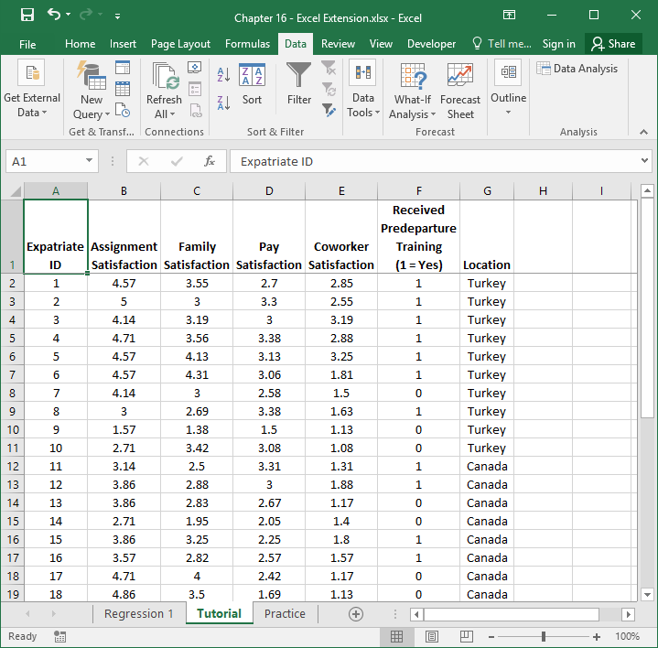
Step 14
Now let’s answer the following question: Do expatriates who received predeparture training have higher assignment satisfaction?
Because Assignment Satisfaction is a continuous variable and Received Predeparture Training is a categorical variable with only two levels (Yes, No), we can use an independent-samples t test to determine whether the mean level of expatriate assignment satisfaction for those who received predeparture training is significantly different than for those who did not receive the training.
Click back to the sheet labeled Tutorial, and click on the Data tab.

Slide 17
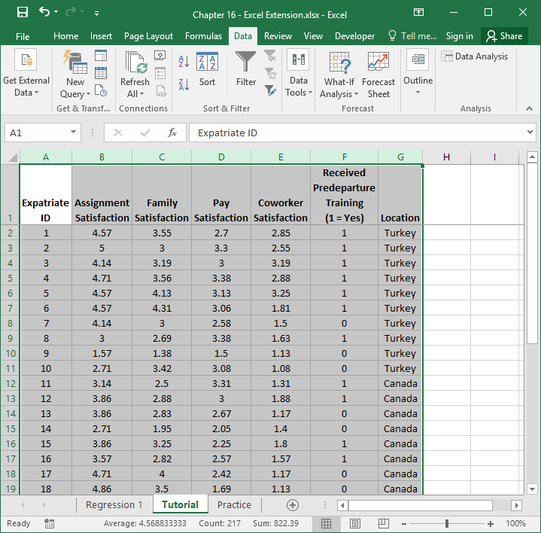
Step 15
To make things easier for ourselves, let’s select all of the cells with data (including variable/column labels), and then click the Sort button in the Data tab.

Slide 18
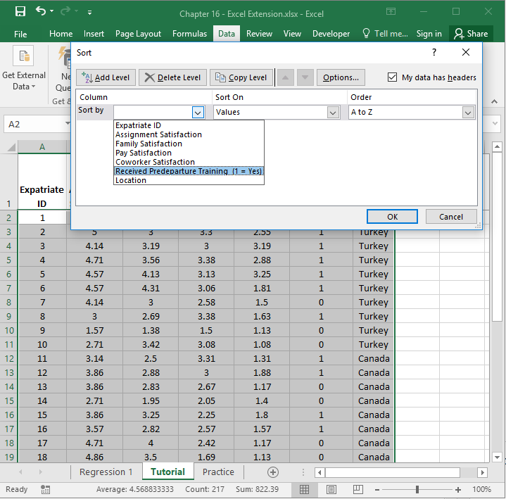
Step 16
In the Sort window, click on the name of the Received Predeparture Training categorical variable in the Sort by dropdown menu.

Slide 19
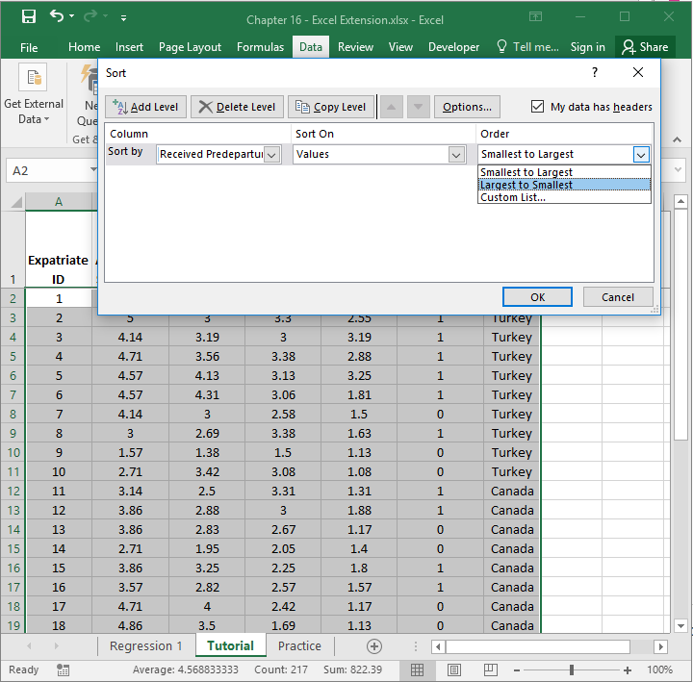
Step 17
In the Order dropdown menu, select Largest to Smallest, so that the individuals who received the predeparture training will appear first (1), followed by those who did not receive the training (0).
Click OK.

Slide 20
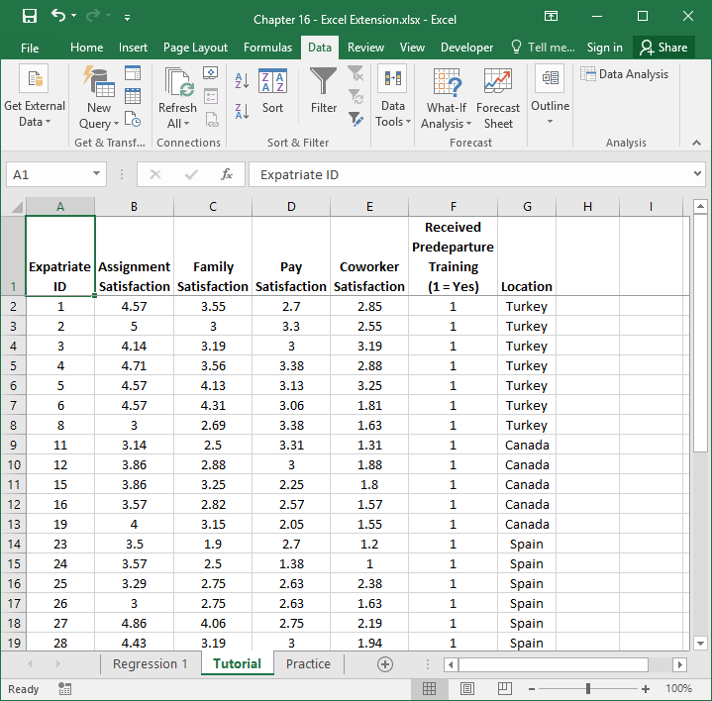
Step 18
Now that the data are sorted by the Received Predeparture Training categorical variable, in the Data tab, select Data Analysis.

Slide 21
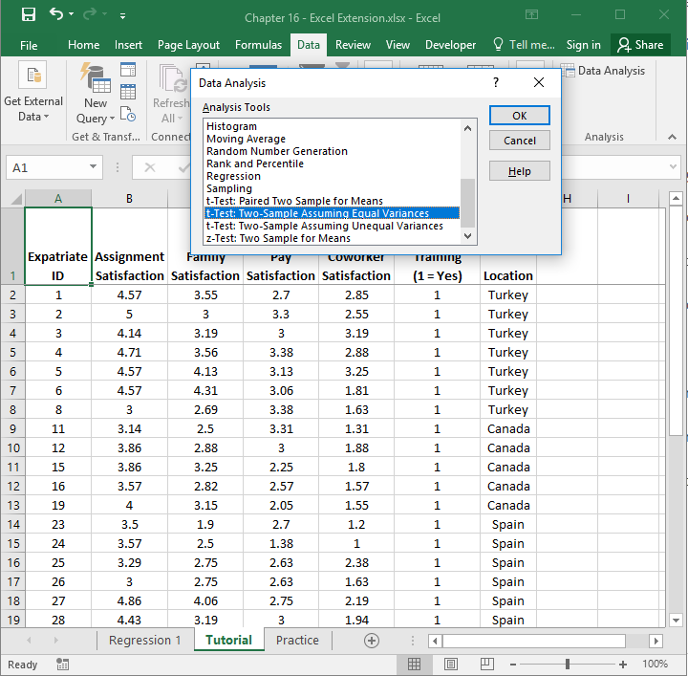
Step 19
When the Data Analysis window opens, under Analysis Tools:, select t-Test: Two-Sample Assuming Equal Variances, which is what Excel calls an independent-samples t test.
Click on OK.

Slide 22
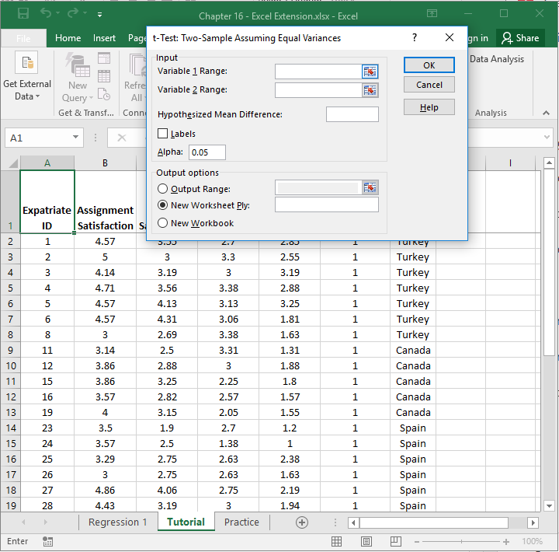
Step 20
When the t-Test: Two-Sample Assuming Equal Variances window opens, click on the upward arrow in the field adjacent to Variable 1 Range:.

Slide 23
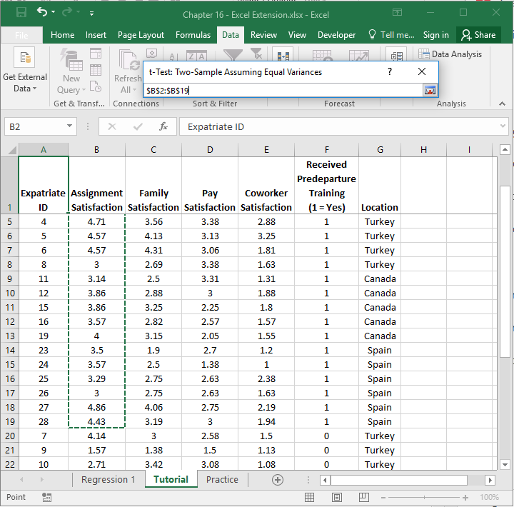
Step 21
Select the Assignment Satisfaction cells containing numeric values that correspond to the employees (rows) with 1 in the Received Predeparture Training column. By doing this, you are selecting the Assignment Satisfaction data for those individuals who received predeparture training.
Note that the window titled t-Test: Two-Sample Assuming Equal Variances contains the array/range of cells you selected.
When you’re done, click on the downward arrow in the t-Test: Two-Sample Assuming Equal Variances window.

Slide 24
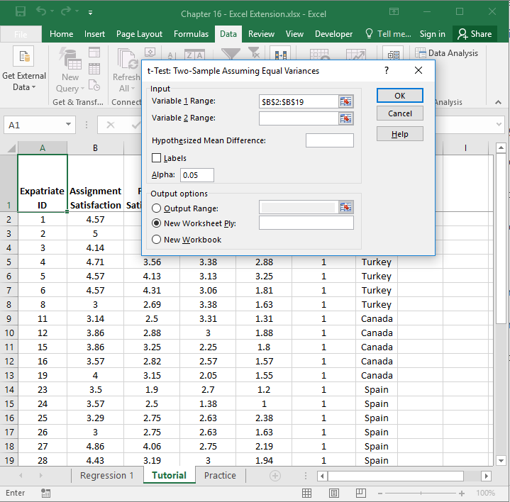
Step 22
When the t-Test: Two-Sample Assuming Equal Variances window opens, click on the upward arrow in the field adjacent to Variable 2 Range:.

Slide 25
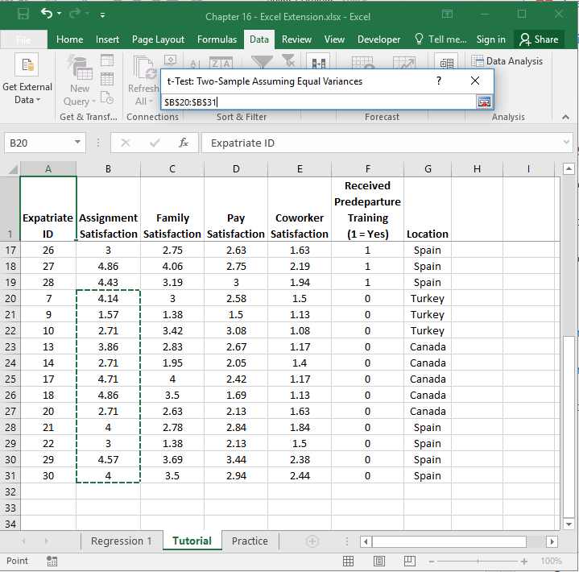
Step 23
Select the cells containing numeric values for Assignment Satisfaction that correspond to the employees (rows) with 0 in the Received Predeparture Training column. By doing this, you are selecting the Assignment Satisfaction data for those individuals who did not receive predeparture training.
Note that the window titled t-Test: Two-Sample Assuming Equal Variances contains the array/range of cells you selected.
When you’re done, click on the downward arrow in the t-Test: Two-Sample Assuming Equal Variances window.

Slide 26
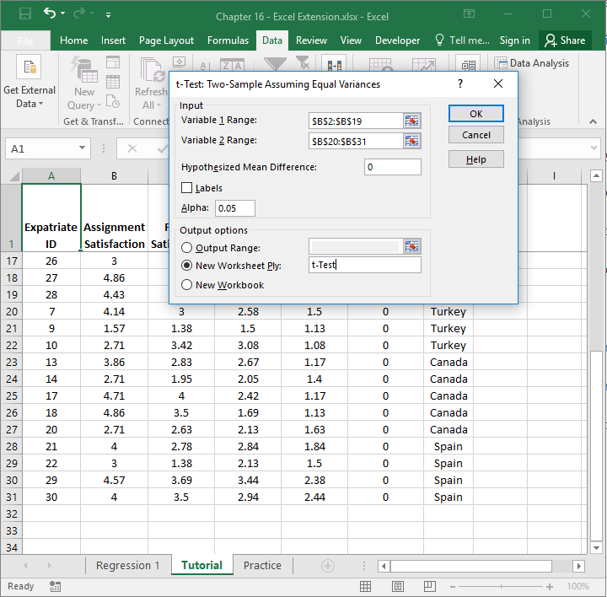
Step 24
4
1
In the t-Test: Two-Sample Assuming Equal Variances window, enter 0 (zero) in the field adjacent to Hypothesized Mean Difference:, which indicates that we will test whether the difference in assignment satisfaction for those who received predeparture training compared to those who did not is statistically significantly different from zero.
Click the bubble next to New Worksheet Ply.
If you would like, next to New Worksheet Ply:, type in what you would like to name the new sheet. Here, “t-Test” is entered in the field.
Click OK.
2
3

Slide 27
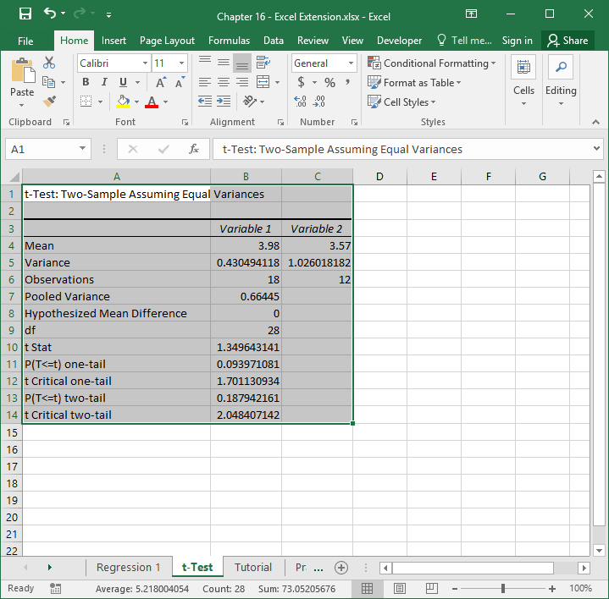
Step 25
A new sheet should appear in your workbook that is named t-Test (or whatever you named the new sheet in the previous step). This sheet contains your independent-samples t test output.
Note that the number of digits after the decimal point varies. Let’s make the number of digits after the decimal point consistent.
Select all of the cells in the output.
Click on the Home tab.
Click the small box with the arrow in the Number section.

Slide 28
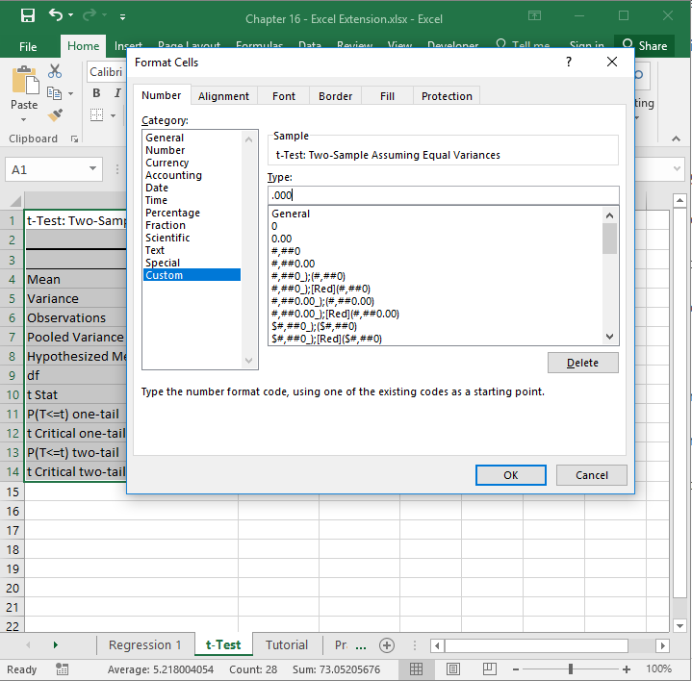
Step 26
In the Number tab of the Format Cells window, click Custom from the Category: list.
In the field under Type:, enter the following format .000 to designate that you do not want a zero before the decimal point and only want three zeroes after the decimal point.
Click OK.

Slide 29
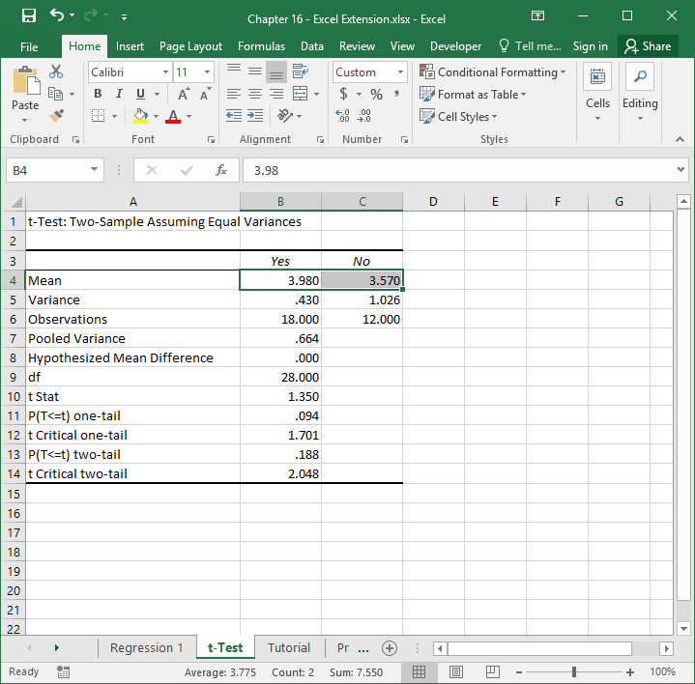
Step 27
The default names of the two columns containing the means and other information are “Variable 1” and “Variable 2”, which are not very informative.
Let’s replace those default names with “Yes” and “No,” respectively, to indicate who received the predeparture training (Yes) and who did not (No).
Note that the mean (average) of assignment satisfaction for those who received predeparture training is 3.980 and 3.570 for those who did not. Thus, our “eyeball” test tells us that descriptively the mean for those who received training is higher than those who did not. The next question is this: Is this a statistically significant difference in means?

Slide 30
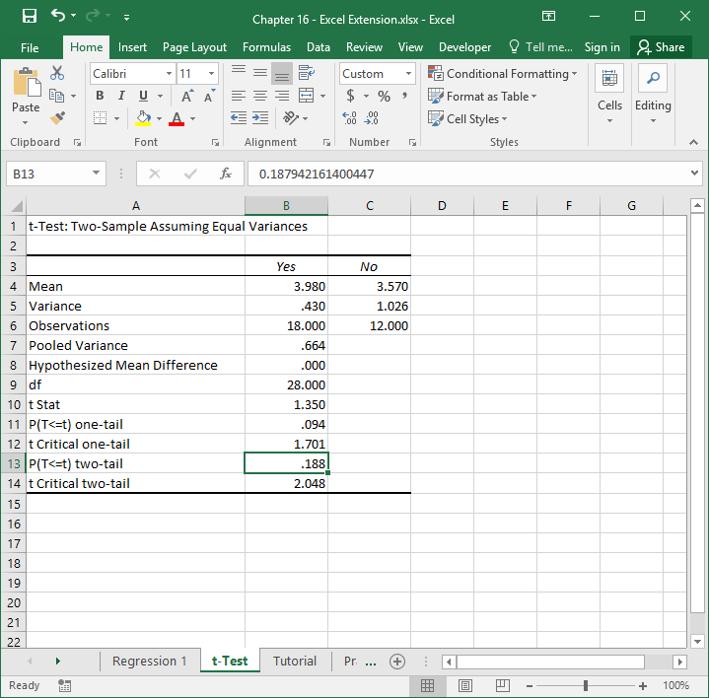
Step 28
Adjacent to P(T<=t) two-tail is the value .188, which is our p value (that corresponds to the t statistic [t Stat] and degrees of freedom [df] that appear earlier in the table). Because the p value is equal to or greater than the conventional two-tailed cutoff (α level) of .05, we can treat the aforementioned difference in means as not statistically significant. If the p value were less than .05, then it would be statistically significant.
Thus, we did not find statistically significant differences in assignment satisfaction between expatriates who received predeparture training and those who did not.

Slide 31
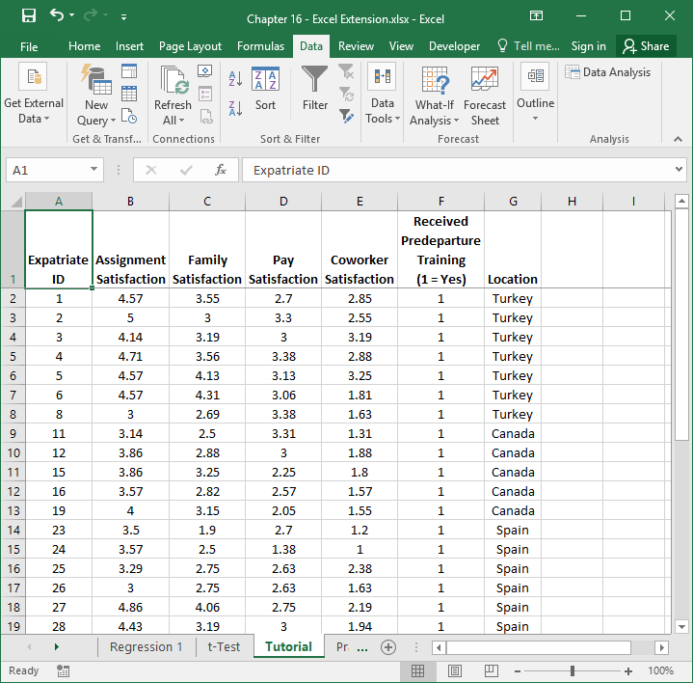
Step 29
Now let’s answer the following question: Does the location (Canada, Spain, Turkey) to which expatriates are assigned affect their level of assignment satisfaction?
Because Assignment Satisfaction is a continuous variable and Location is a categorical variable with three levels (Canada, Spain, Turkey), we use an one-way analysis of variance (ANOVA) to determine whether the mean level of expatriate assignment satisfaction differs across assignment locations. An independent-samples t test is only appropriate for comparing two means.
Click back to the sheet labeled Tutorial, and click on the Data tab.

Slide 32
Step 30
To make things easier for ourselves, let’s select all of the cells with data (including variable/column labels), and then click the Sort button in the Data tab.

Slide 33
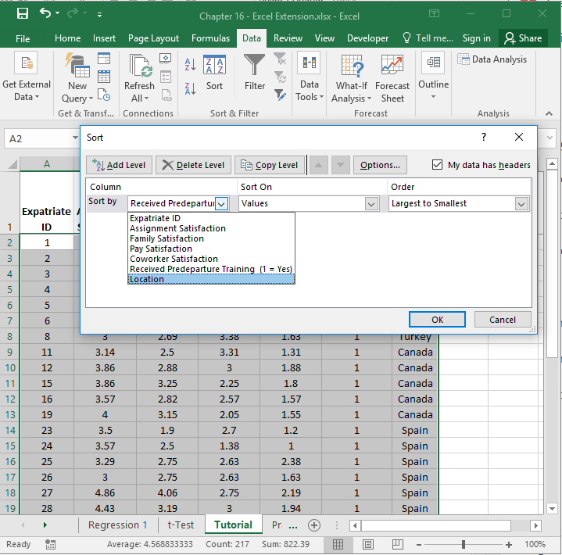
Step 31
In the Sort window, click on the name of the Location categorical variable in the Sort by dropdown menu.

Slide 34
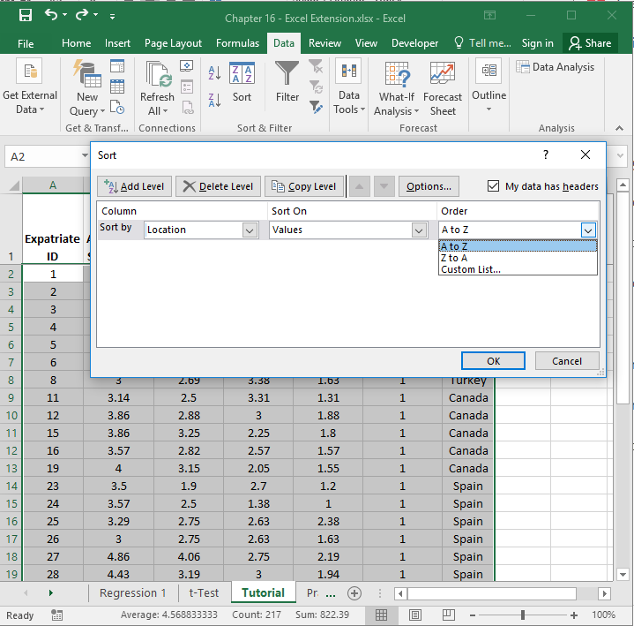
Step 32
In the Order dropdown menu, select A to Z, so that the individuals will be ordered by Canada, Spain, and Turkey.
Click OK.

Slide 35
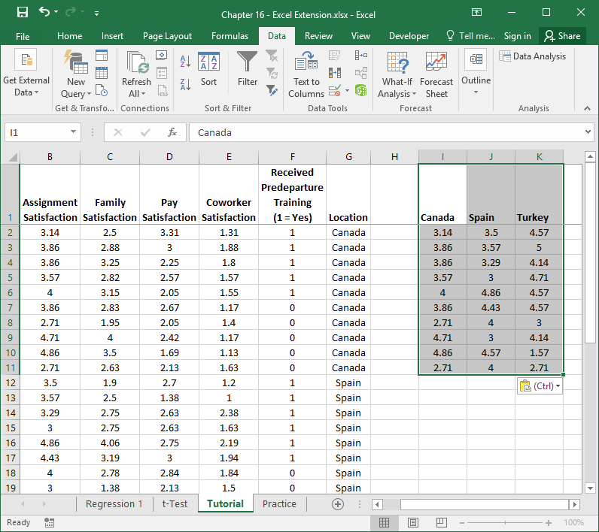
Step 33
Before running a one-way analysis of variance (ANOVA), we need to restructure the data for the Location and Assignment Satisfaction variables. As shown in the image, somewhere in the sheet, create three columns that correspond to one of the three locations (Canada, Spain, Turkey). Copy the Assignment Satisfaction scores that correspond to expatriates who were assigned to Canada, and paste below the Canada label that you typed. Then repeat this process for Spain and Turkey.

Slide 36
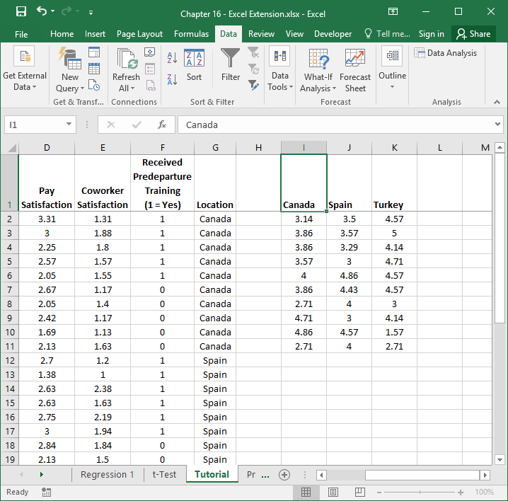
Step 34
After restructuring the Assignment Satisfaction values by the their respective Location category, in the Data tab, select Data Analysis.

Slide 37
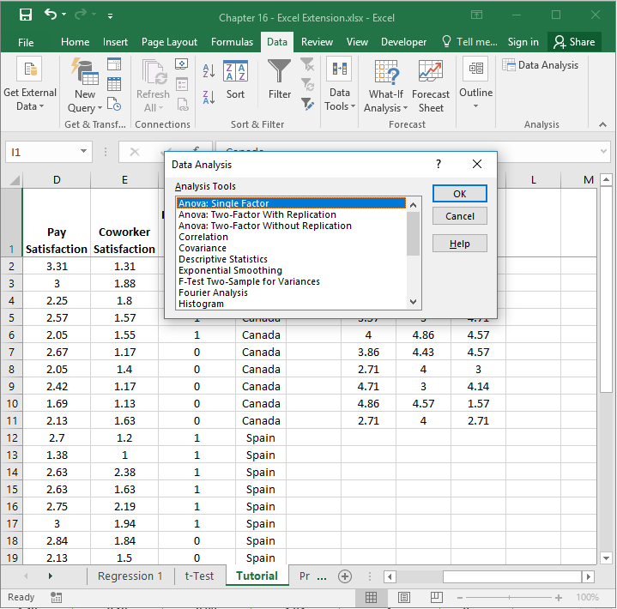
Step 35
When the Data Analysis window opens, under Analysis Tools:, select Anova: Single Factor, which is what Excel calls a one-way analysis of variance (ANOVA).
Click on OK.

Slide 38
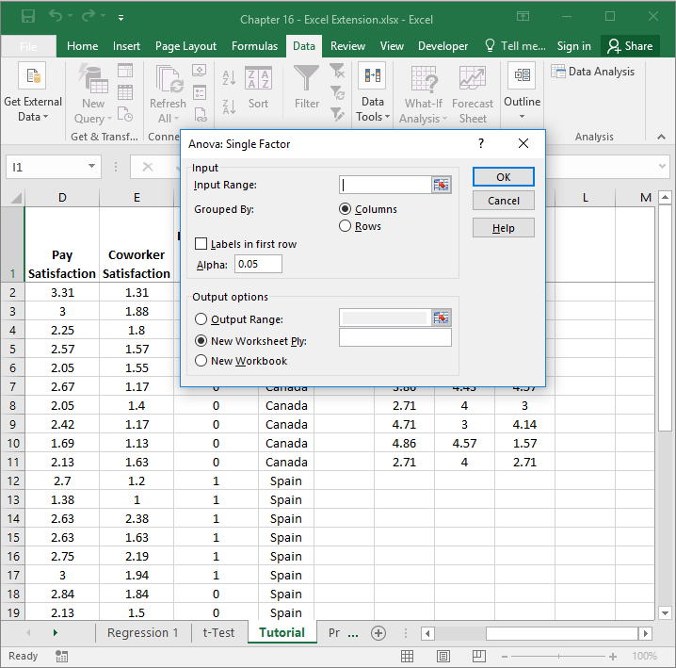
Step 36
When the Anova: Single Factor window opens, click on the upward arrow in the field adjacent to Input Range:.

Slide 39
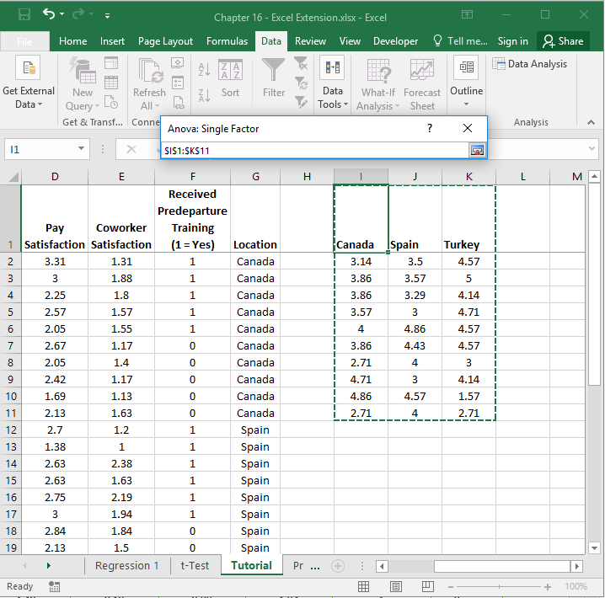
Step 37
Select all of the cells in the data you just restructured, as shown in the image (including the category labels of Canada, Spain, and Turkey).
Note that the window titled Anova: Single Factor contains the array/range of cells you selected.
When you’re done, click on the downward arrow in the Anova: Single Factor window.

Slide 40
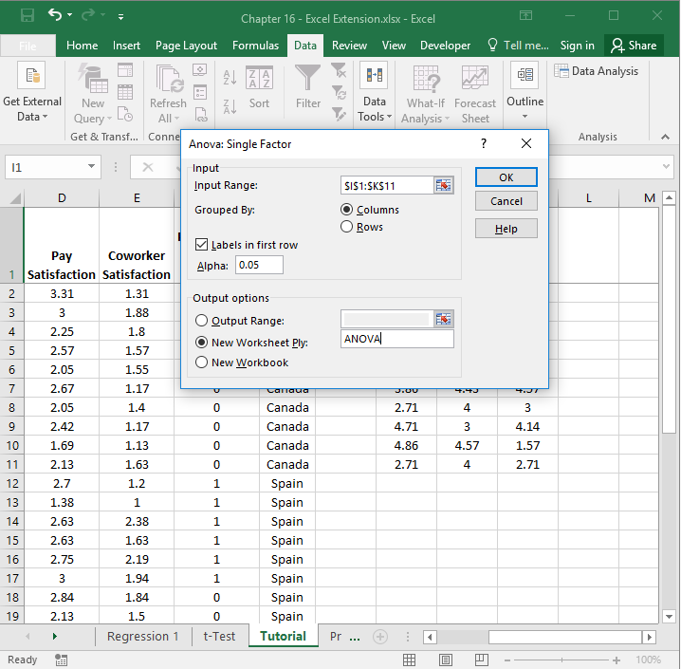
Step 38
5
In the Anova: Single Factor window, click the bubble next to Columns, as the data you restructured are organized by columns.
Check the box next to Labels in the first row.
Click the bubble next to New Worksheet Ply.
If you would like, next to New Worksheet Ply:, type in what you would like to name the new sheet. Here, “ANOVA” is entered in the field.
Click OK.
1
2
3
4

Slide 41
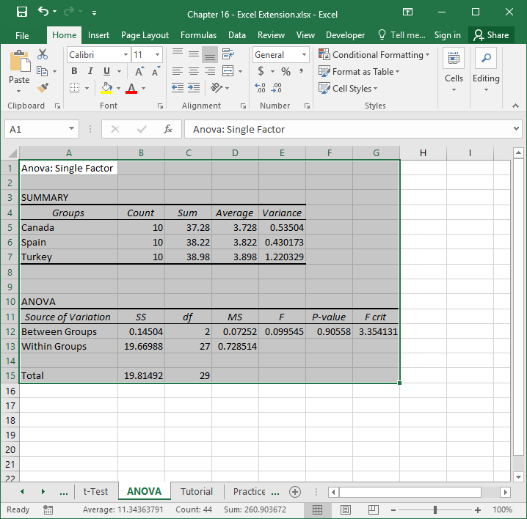
Step 39
A new sheet should appear in your workbook that is named ANOVA (or whatever you named the new sheet in the previous step). This sheet contains your one-way ANOVA output.
Note that the number of digits after the decimal point varies. Let’s make the number of digits after the decimal point consistent.
Select all of the cells in the output.
Click on the Home tab.
Click the small box with the arrow in the Number section.

Slide 42
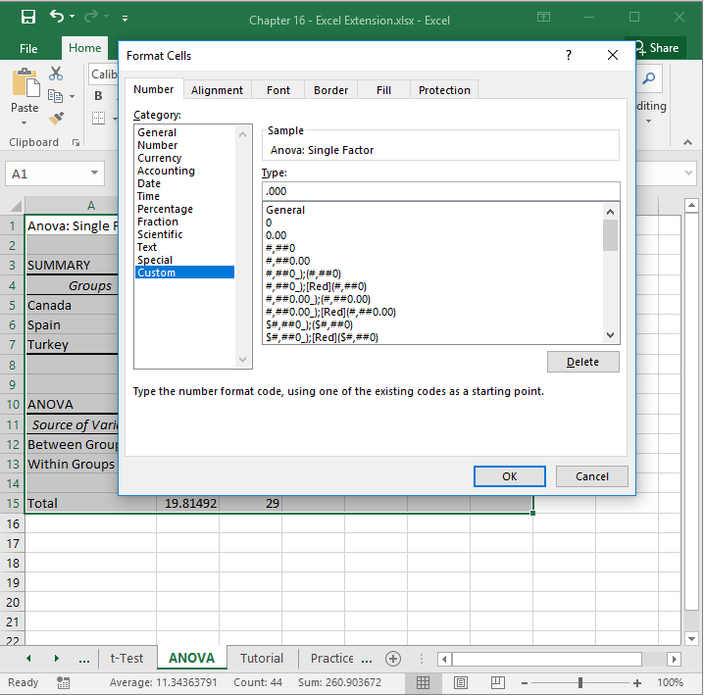
Step 40
In the Number tab of the Format Cells window, click Custom from the Category: list.
In the field under Type:, enter the following format .000 to designate that you do not want a zero before the decimal point and only want three zeroes after the decimal point.
Click OK.

Slide 43
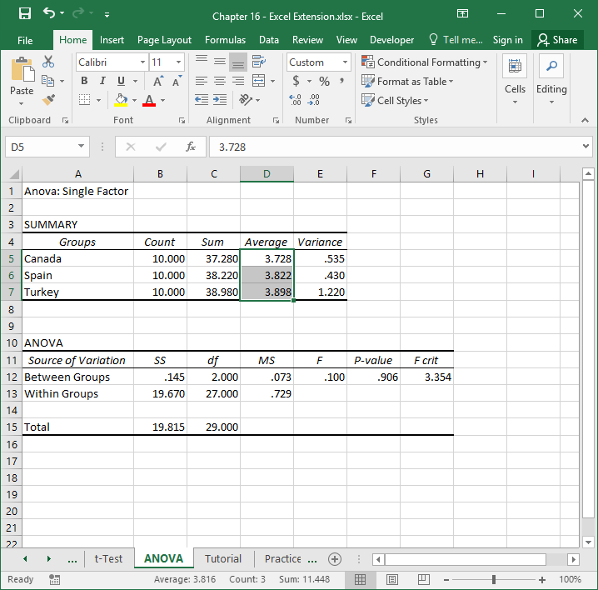
Step 41
Note that the mean (average) of assignment satisfaction for Canada, Spain, and Turkey is 3.728, 3.822, and 3.898, respectively. Now the question becomes this: Do differences between these three means exist?

Slide 44
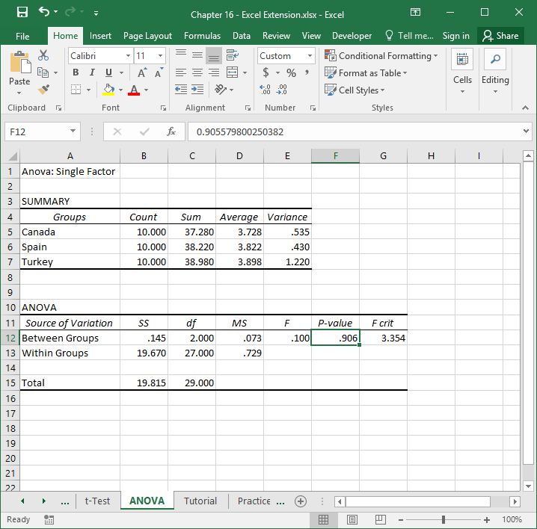
Step 42
Under the P-value column, we see the value .906, which is our p value (that corresponds to the F statistic [F] and degrees of freedom [df] that appear earlier in the table). Because the p value is equal to or greater than the conventional two-tailed cutoff (α level) of .05, we can treat the aforementioned difference in means as not statistically significant. If the p value were less than .05, then we would assume significant differences between the means, and then we could run independent-samples t tests to compare each pair of means (e.g., Turkey vs. Canada, Turkey vs. Spain, Spain vs. Canada).
With the present data, however, we did not find statistically significant differences in assignment satisfaction across the three locations.

Slide 45
Questions
You just learned how to identify which factors/variables are associated with expatriate assignment satisfaction by using a simple linear regression analysis, an independent-samples t test, and a one-way analysis of variance (ANOVA). Now, imagine that you work for multinational technology firm with multiple locations around the world. Using data found in the “Practice” sheet of the Excel workbook, do and respond to the following:
Run the same analyses that you ran in the tutorial on this new data set. What factors/variables are associated with satisfaction with expatriate assignment in this multinational technology firm?
Based on your findings, what do you recommend that the firm do to improve expatriate assignment satisfaction? Why?

