Slide 1
Chapter 15 Excel Extension: Now You Try!
Investigating Employee Stress

Slide 2
Background
In this Excel Extension tutorial, you will learn how to apply simple linear regression analysis to the implications of employee stress.
For the purposes of this exercise, imagine that you have been tasked with determining the potential implications of employee stress. Specifically, you are to investigate whether the stressor called interpersonal conflict is associated with the strain called turnover intentions. To gather the data, you administer a voluntary employee survey that asks respondents to indicate their exposure to interpersonal conflict at work and their turnover intentions.

Slide 3
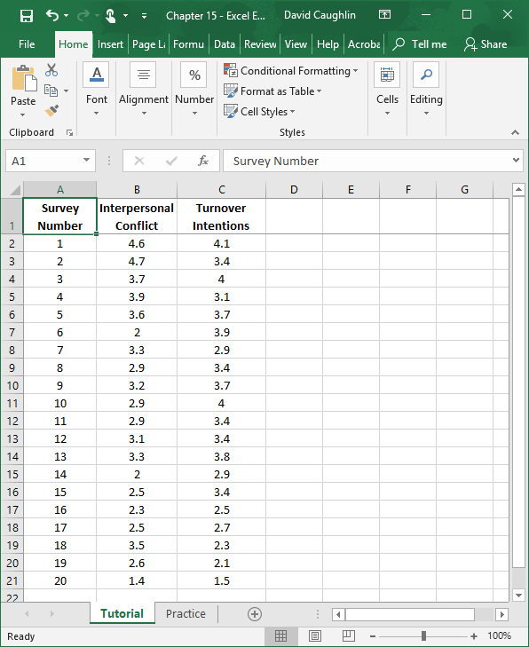
Step 1
Open the Excel workbook titled “Chapter 15 - Excel Extension.xlsx”.
Click on the sheet called Tutorial. You will use the data contained in this sheet to learn how to run a simple linear regression analysis.
Note that the sheet includes three fields/columns/variables:
Survey Number (unique survey identifier)
Interpersonal Conflict (1 = low conflict, 5 = high conflict)
Turnover Intentions (1 = low intentions to quit, 5 = high intentions to quit)
Note that there are 20 survey respondents in this sample.

Slide 4
Step 2
If you haven’t already, be sure to add in the Analysis ToolPak feature in Excel, which requires the following steps.
First, click on the File tab.

Slide 5
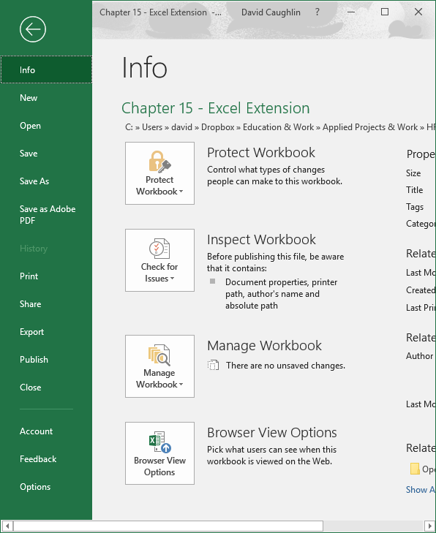
Step 3
Select Options.

Slide 6
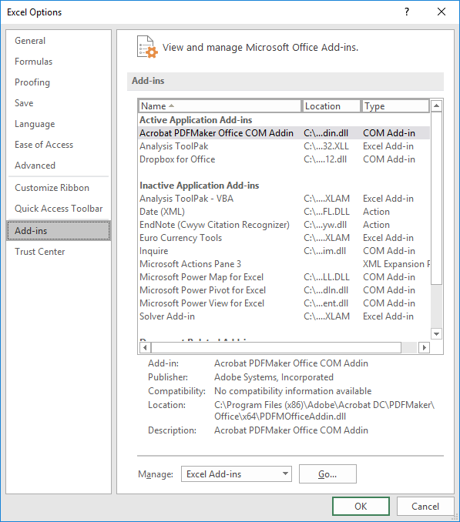
Step 4
When the Excel Options window opens, select the Add-Ins tab on the left, and then select the Analysis ToolPak in the Excel Add-Ins list, which appears next Manage at the bottom of the window, and click Go…. A window will open, and simply check the box next to Analysis ToolPak.
If you already have the Analysis ToolPak application activated, it will appear in the Active Application Add-ins list, as shown in the image.
Click OK.

Slide 7
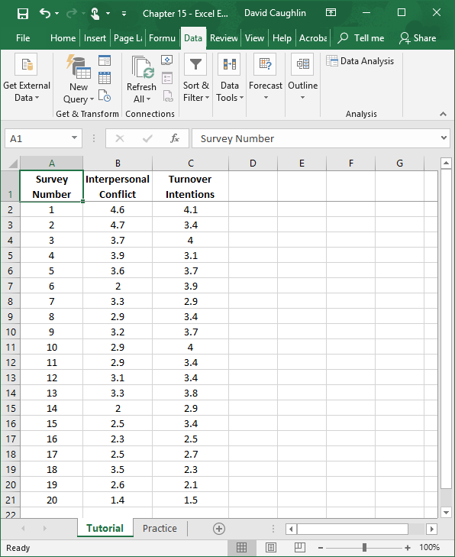
Step 5
Click on the Data tab.
Click on the Data Analysis button.

Slide 8
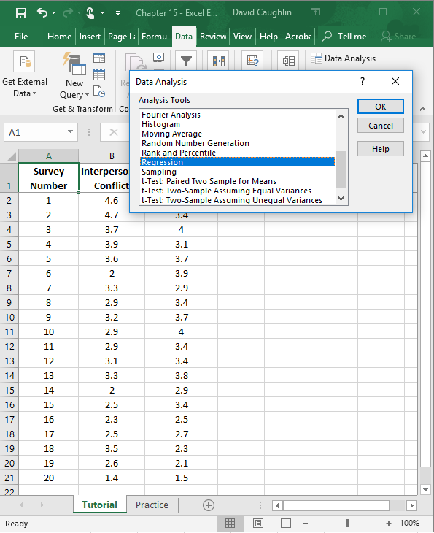
Step 6
Let’s begin by specifying a simple linear regression model in which we regress Turnover Intentions on Interpersonal Conflict.
To specify our simple linear regression model, in the Data Analysis window, select Regression.
Click OK.

Slide 9
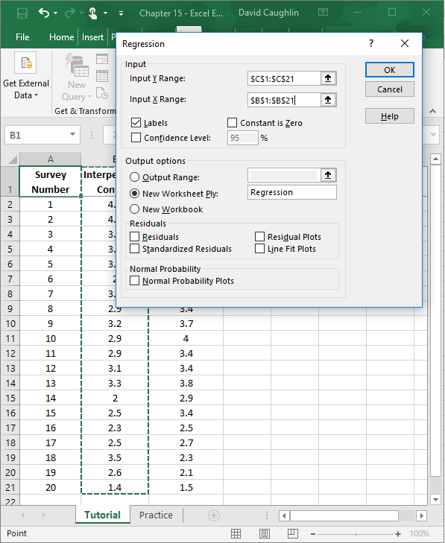
1
Step 7
6
2
3
When the Regression window opens, in the field next to Input Y Range: enter the range of cells that contains our outcome variable (Turnover Intentions) and associated values, including the variable labels. Next, in the field next to Input X Range: enter the range of cells that contains our predictor variable (Interpersonal Conflict) and associated values, including the variable labels.
Check the box next to Labels.
Click the bubble next to New Worksheet Ply.
If you would like, next to New Worksheet Ply:, type in what you would like to name the new sheet. Here, “Regression” is entered in the field.
Click OK.
5
4

Slide 10
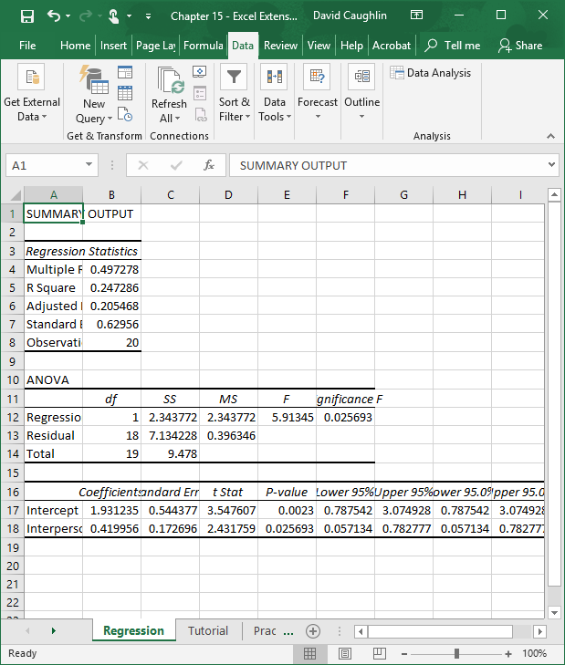
Step 8
A new sheet should appear in your workbook that is named Regression (or whatever you named the new sheet in the previous step). This sheet contains your simple linear regression model output.
Note that the number of digits after the decimal point varies.

Slide 11
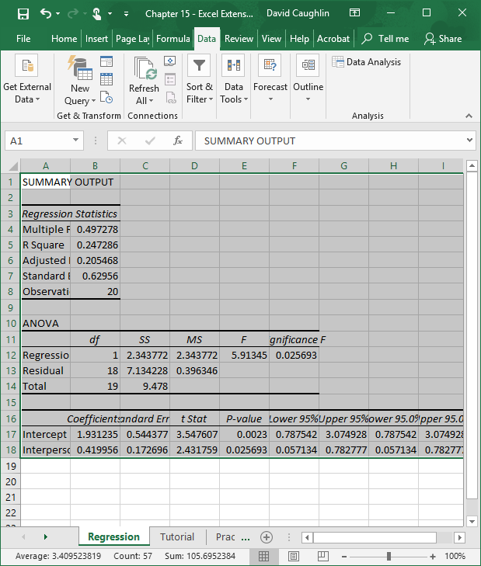
Step 9
To make your output easier to read, consider formatting the values to have two or three digits after the decimal.
To do so, first, select all of the cells in the output.

Slide 12
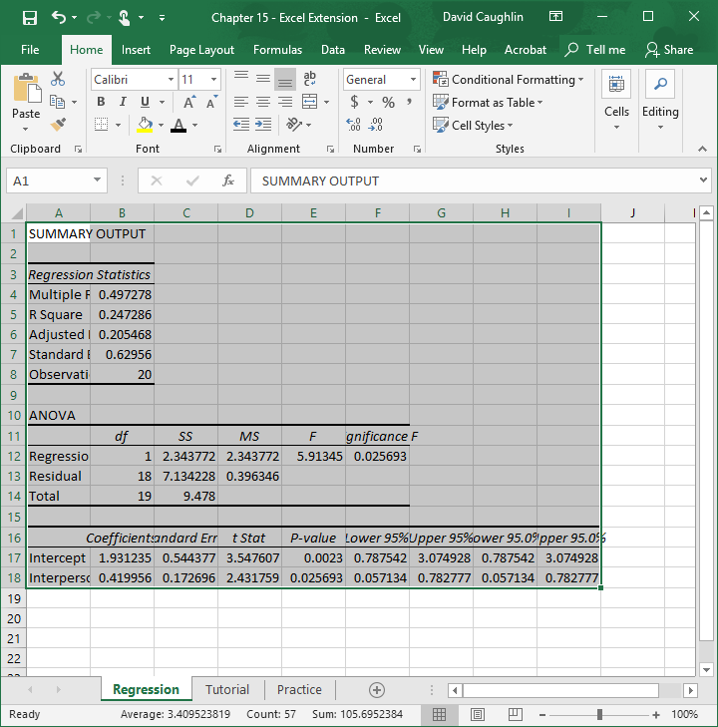
Step 10
Second, click on the Home tab, and click the small box with the arrow in the Number section.

Slide 13
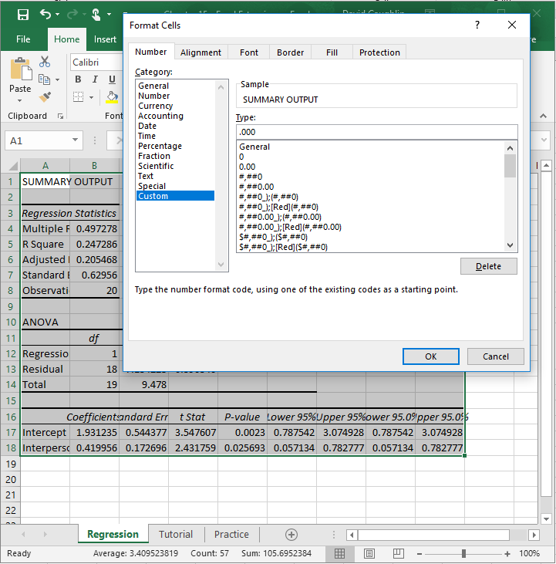
Step 11
Third, in the Number tab of the Format Cells window, click Custom from the Category: list.
In the field under Type:, enter the following format .000 to designate that you do not want a zero before the decimal point and only want three zeroes after the decimal point.
Click OK.

Slide 14
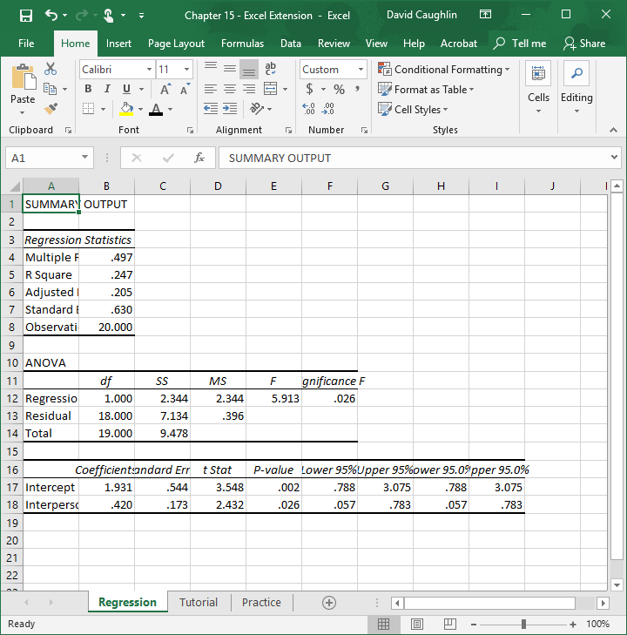
Step 12
Now the output is a bit easier to read.
In the Regression Statistics table, note that the R Square value is .247, which means that the predictor variable in the model (Interpersonal Conflict) explains 24.7% (.247 x 100) of the variance in the outcome variable (Turnover Intentions).

Slide 15
Step 13
In the table at the very bottom, you will find your regression model estimates. The first column contains the names of the predictor variable and the intercept. The second column contains the regression weights (coefficients). The fifth column contains the p values associated with the regression weights, which we use to determine whether they are statistically significant (i.e., significantly different from zero).
As you can see, the regression weight for Interpersonal Conflict (in relation to Turnover Intentions) is positive and has a p value that is less than the conventional two-tailed, cutoff (alpha level) of .05, which means we can treat this regression weight as statistically significant. If the p value were greater than .05, then it would be nonsignificant.
Using the regression weights, we can write the following regression equation:
Y = 1.931 + .420(Interpersonal Conflict)

Slide 16
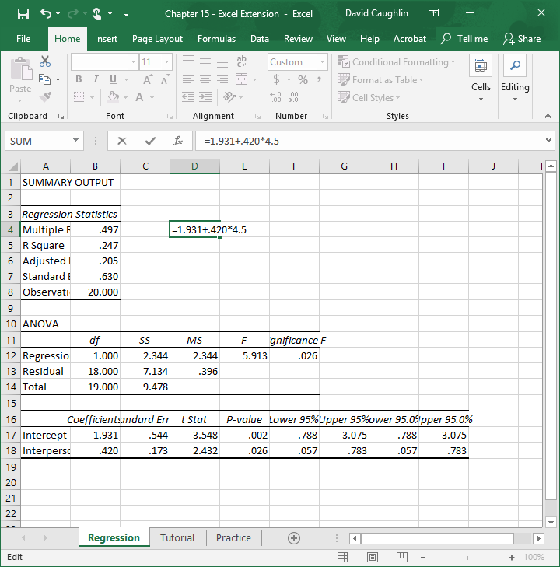
Step 14
Let’s practice plugging hypothetical values into the regression equation.
For example, imagine that an employee has a score of 4.5 on the interpersonal conflict variable.
In an empty cell, enter an = sign, followed by the regression equation with the aforementioned score of 4.5. It should look something like:
=1.931+.420*4.5
Click ENTER.

Slide 17
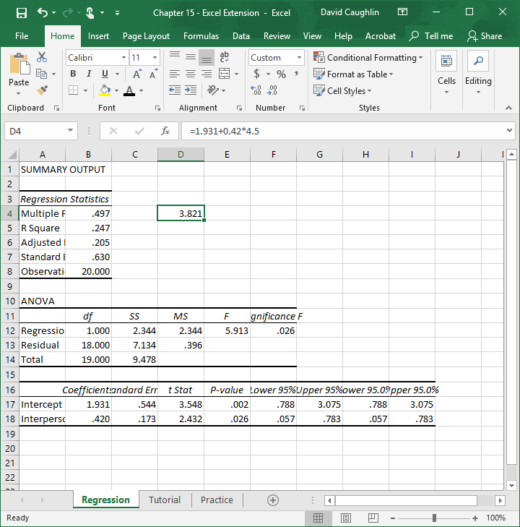
Step 15
For an employee who scores a 4.5 on interpersonal conflict, we predict that their turnover intention score will be 3.821, which indicates some inclination to quit.

Slide 18
Questions
You just learned how to investigate the implications of employee stress using simple linear regression analysis. Now, imagine that you work for a different organization that has administered a similar survey to employees, except the new survey has two stressor (interpersonal conflict, role ambiguity) and two strain (turnover intentions, burnout) variables, as opposed to just one stressor and one strain variable. Using data found in the “Practice” sheet of the Excel workbook, do and respond to the following:
Run a simple linear regression analysis with interpersonal conflict as the predictor and turnover intentions as the outcome. What did you find?
Run a simple linear regression analysis with role ambiguity as the predictor and turnover intentions as the outcome. What did you find?
Run a simple linear regression analysis with interpersonal conflict as the predictor and burnout as the outcome. What did you find?
Run a simple linear regression analysis with role ambiguity as the predictor and burnout as the outcome. What did you find?
How would you explain and communicate these findings to someone in the organization who does not know anything about data analytics?

Slide 19
Chapter 15 Excel Extension: Now You Try!
Investigating Employee Stress

