Slide 1
Chapter 14 Excel Extension: Now You Try!
Using Opinion Survey Data to Gauge Employee Satisfaction

Slide 2
Background
In this Excel Extension tutorial, you will learn how to create heat map based on the magnitude of numeric values and you will practice learning how to interpret and communicate the results of data analyses.
For the purposes of this exercise, imagine that your organization gathered opinion survey data from 38 current and former employees from 2010 to 2018. To match employees’ survey responses across years, each employee was assigned a random identification number that they reported on each year’s survey. Each year, the survey included a five-item measure of job satisfaction. For example, one item was “My tasks, duties, and responsibilities.” For each item, employees responded using a 1 (completely dissatisfied) to 7 (completely satisfied) rating scale. In this exercise, you will evaluate employees’ overall job satisfaction over time, which has already been calculated based on their responses to the five job satisfaction items on each year’s survey.

Slide 3
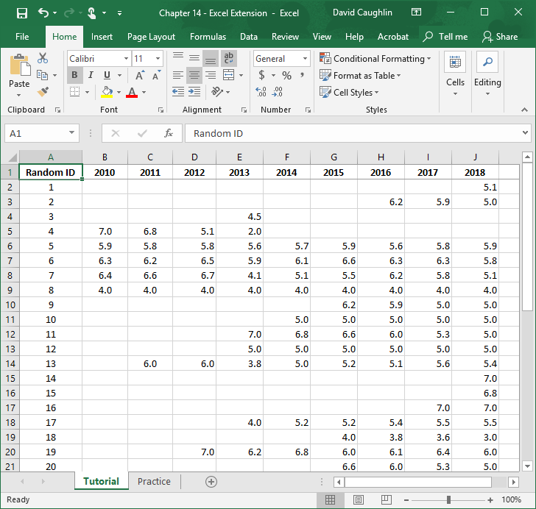
Step 1
Open the Excel workbook titled “Chapter 14 - Excel Extension.xlsx”. Click on the sheet called Tutorial. You will use the data contained in this sheet to learn how to run a simple linear regression analysis and an independent-samples t-test.
Note that the sheet includes 10 fields/columns/variables:
Random ID (random employee identifier used to match each employee’s responses across years)
2010 – 2018 (annual overall job satisfaction score; 1 = completely dissatisfied, 7 = completely satisfied)
Note that there are 38 survey respondents in this sample, although one of the respondents (Random ID 36) never responded to the job satisfaction survey items, and thus does not have any values in this dataset.

Slide 4
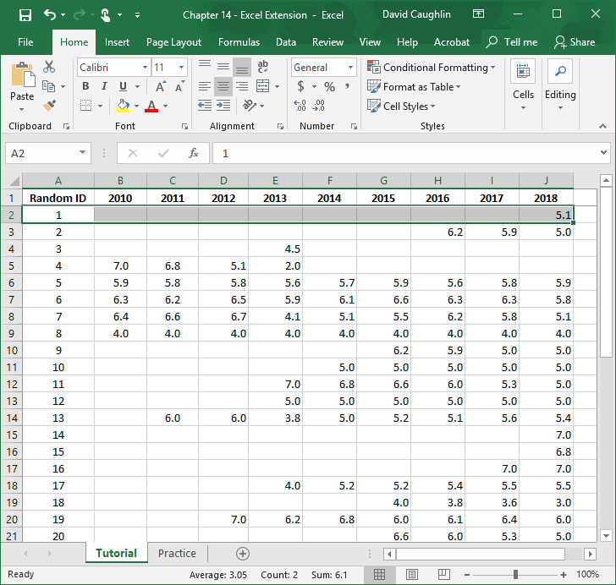
Step 2
Note that there is a quite a bit of missing data across the years. Some of these missing data can be explained by the fact that employees started and ended their tenure in this small organization at different times. For example, it appears that the employee associated with Random ID 1 may have just joined the organization in 2018, as that is the only year in which they completed the annual opinion survey. That said, it could be that the employee joined the organization before 2018 but did not complete the annual opinion survey in prior years. This highlights the tricky nature of missing data.

Slide 5
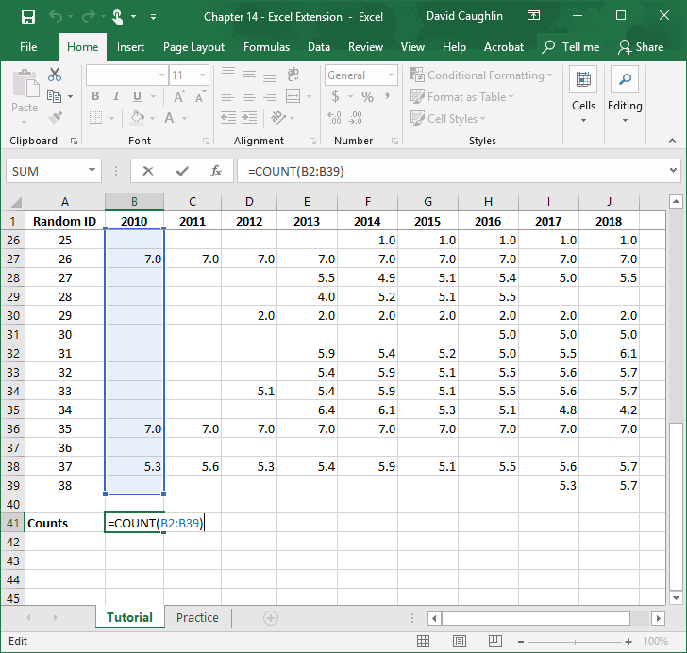
Step 3
Let’s use the COUNT function in Excel to determine how many people completed job satisfaction items of the opinion survey each year.
First, type “Counts” in column A somewhere below the last row of survey data.
Second, type the = symbol followed by COUNT(.
Third, type the array/range of numeric values that correspond to the 2010 survey data. In this case, the array/range is B2:B39.
Fourth, type the ending parenthesis, and hit ENTER.

Slide 6
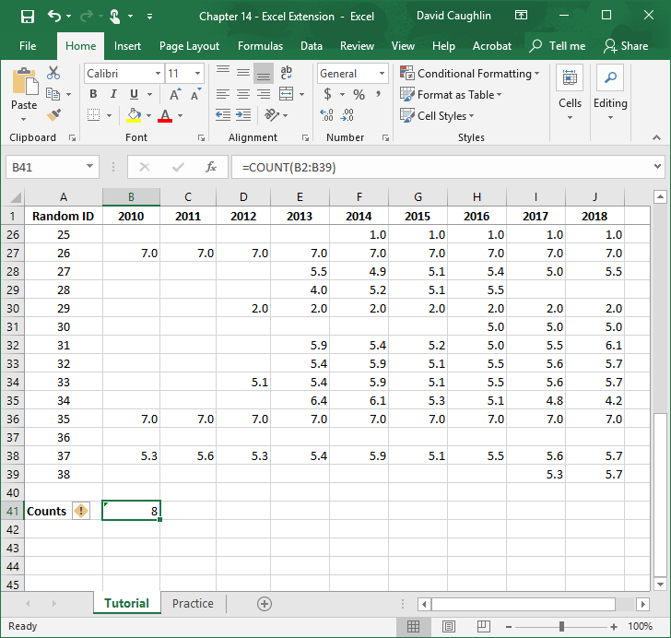
Step 4
When applied to the 2010 survey responses, the COUNT function indicates that eight respondents completed the survey and job satisfaction items.
Select the cell (B41) containing the count value, and click on the green box in the lower left corner of the selected cell, hold, and drag all the way through the column with 2018 survey responses (J).

Slide 7
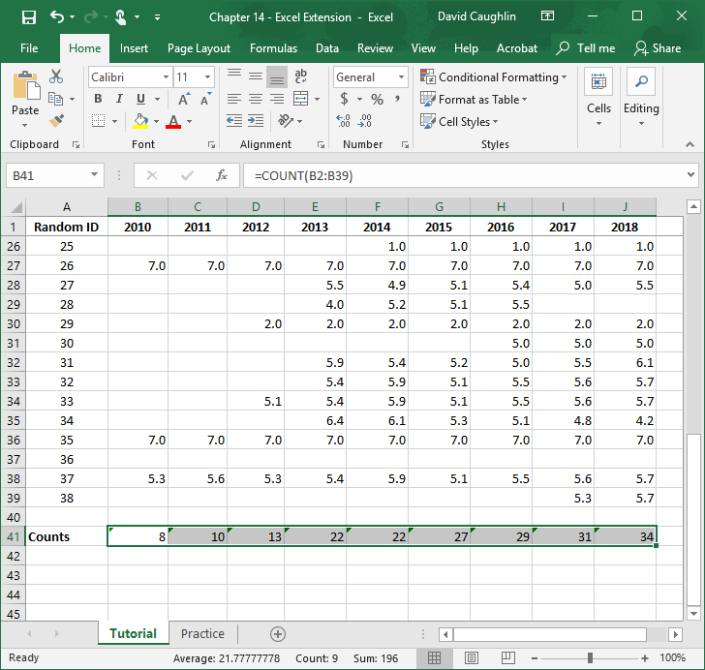
Step 5
Note that the number of employees who completed the survey increased from year to year, except for from 2013 to 2014 when the number of respondents remained the same (i.e., 22).

Slide 8
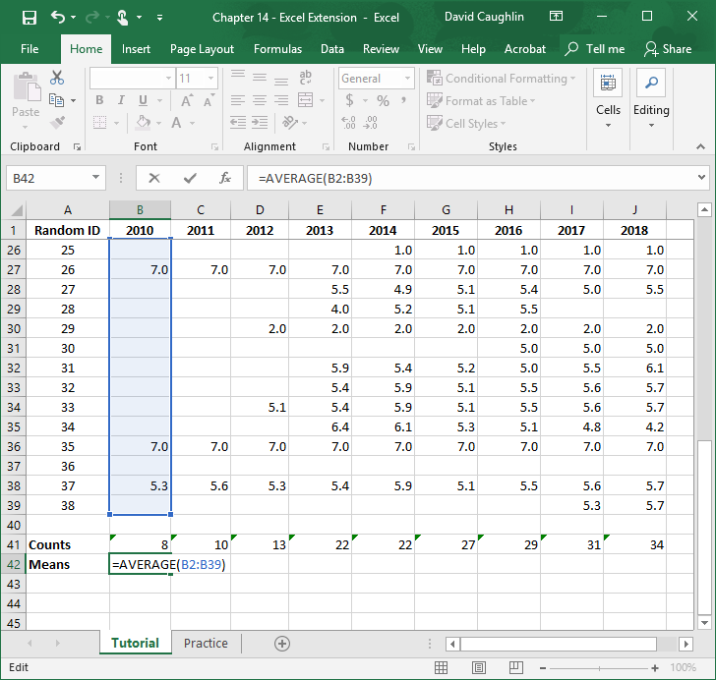
Step 6
Let’s use the AVERAGE function in Excel to calculate the mean level of overall job satisfaction for employees each year.
First, type “Means” in column A below the “Counts” label we previously typed.
Second, type the = symbol followed by AVERAGE(.
Third, type the array/range of numeric values that correspond to the 2010 survey data. In this case, the array/range is B2:B39.
Fourth, type the ending parenthesis, and hit ENTER.

Slide 9
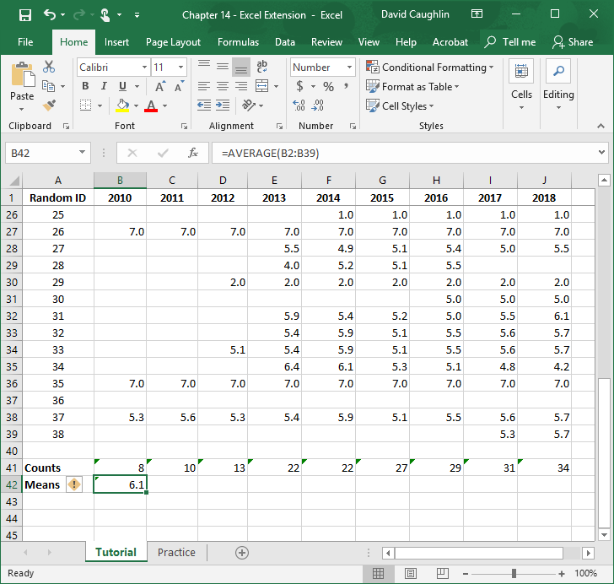
Step 7
When applied to the 2010 survey responses, the AVERAGE function indicates that the mean level of overall job satisfaction across the eight survey respondents for that year was 6.2, which would indicate a relatively high level of collective job satisfaction.
Select the cell (B42) containing the mean value, and click on the green box in the lower left corner of the selected cell, hold, and drag all the way through the column with 2018 survey responses (J).

Slide 10
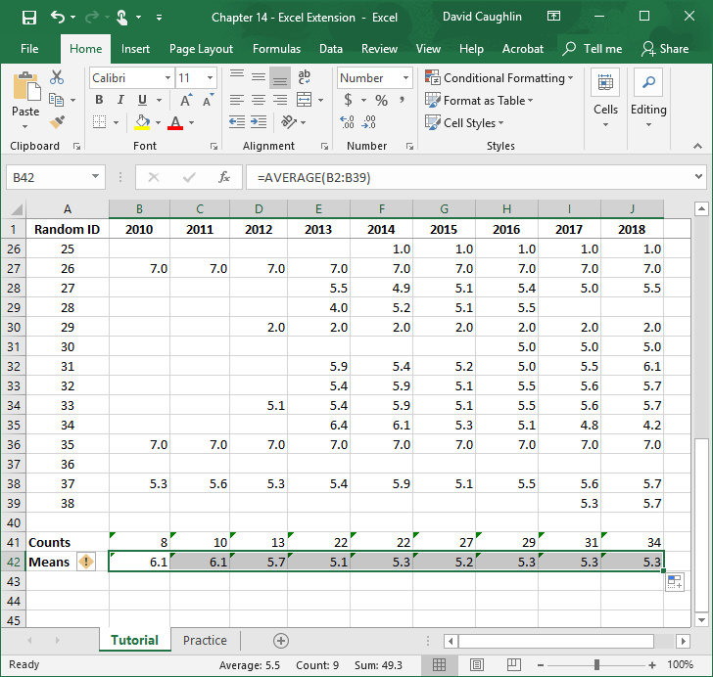
Step 8
Note that the mean level of overall job satisfaction declined from 2011 to 2013, increased slightly between 2013 and 2014, and then it most stabilized from 2014 to 2018.

Slide 11
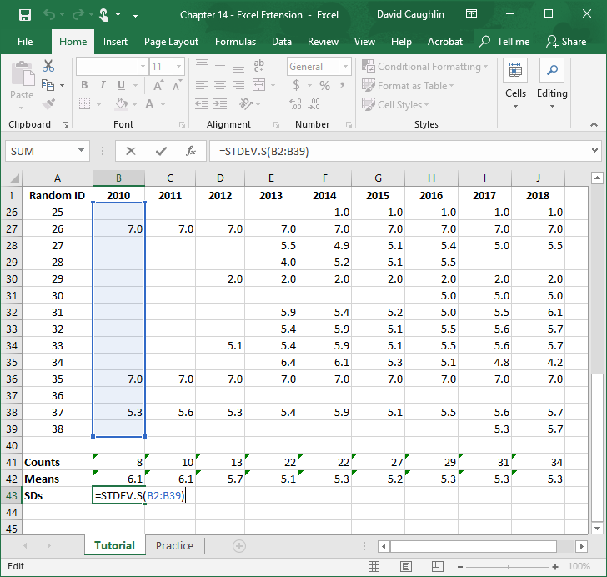
Step 9
Let’s use the STDEV.S function in Excel to calculate the standard deviation (SD) of overall job satisfaction scores for employees each year.
First, type “SDs” in column A below the “Means” label we previously typed.
Second, type the = symbol followed by STDEV.S(.
Third, type the array/range of numeric values that correspond to the 2010 survey data. In this case, the array/range is B2:B39.
Fourth, type the ending parenthesis, and hit ENTER.

Slide 12
Step 10
When applied to the 2010 survey responses, the STDEV.S function indicates that the dispersion/spread of overall job satisfaction scores across the eight survey respondents for that year was approximately 1.045.
Select the cell (B43) containing the SD value, and click on the green box in the lower left corner of the selected cell, hold, and drag all the way through the column with 2018 survey responses (J).

Slide 13
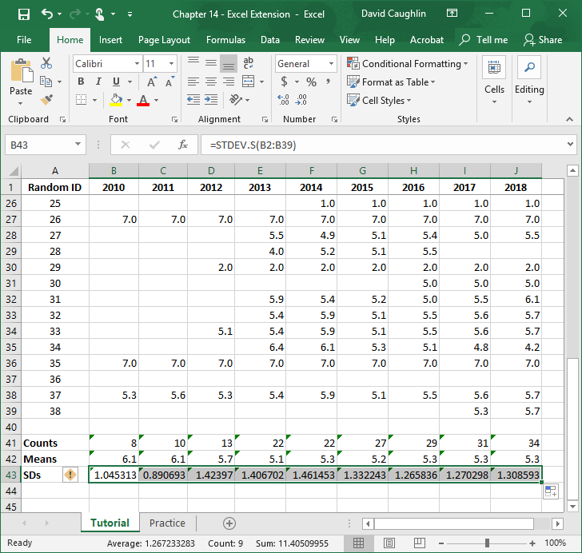
Step 11
Note that the SD of overall job satisfaction scores declined from 2011, which indicates less variation in overall job satisfaction, meaning employees were more closely clustered around the mean of 6.1 compared to 2010. In subsequent years, the SDs increased quite a bit, indicating that there was more variation in overall job satisfaction across employees who responded to the survey.

Slide 14
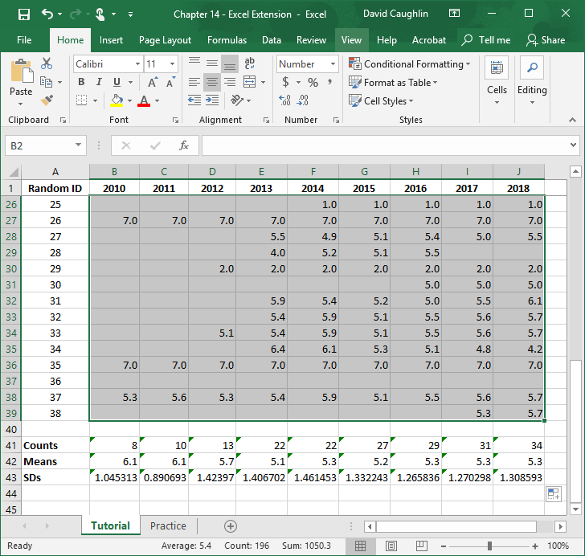
Step 12
To aid our interpretation of the raw data and our interpretation of the descriptive (summary) statistics (e.g., counts, means, SDs), we can create a heat map.
Let’s begin by creating a heat map of the raw survey response data.
Select the numeric values for all years.

Slide 15
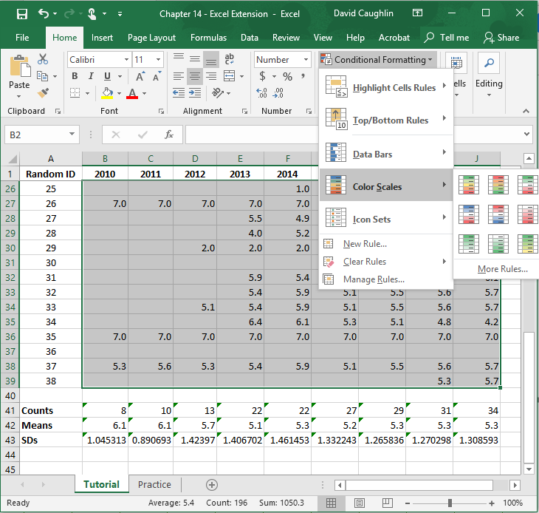
Step 13
Click on the Home tab.
Click on Conditional Formatting.
Click on Color Scales.
Select one of the color scale options. Let’s pick the first option which ranges from red (small values) to green (large values).

Slide 16
Step 14
Here, you can visually inspect trends or patterns over time for specific employees. For instance, note that the employee with Random ID 4 started with an overall job satisfaction score of 7.0 in 2010 and essentially maintained that level in 2011 (6.8), but then the employee’s job satisfaction declined through 2013, which appears to be the last year the employee participated in the survey and possibly the last year that they were employed by the organization.

Slide 17
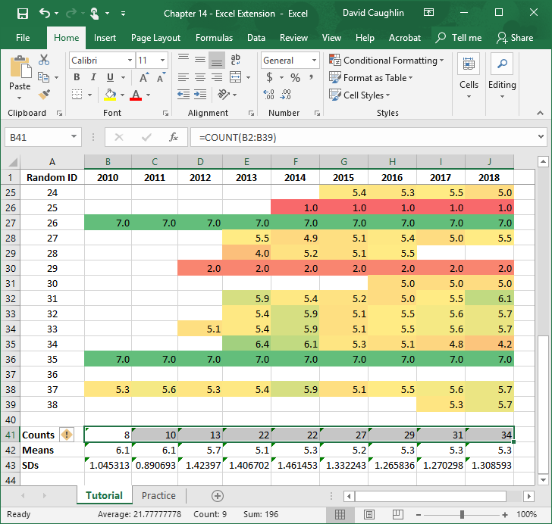
Step 15
Now, let’s create a heat map of counts descriptive statistics across the years.
Select the numeric values for the Counts row.

Slide 18
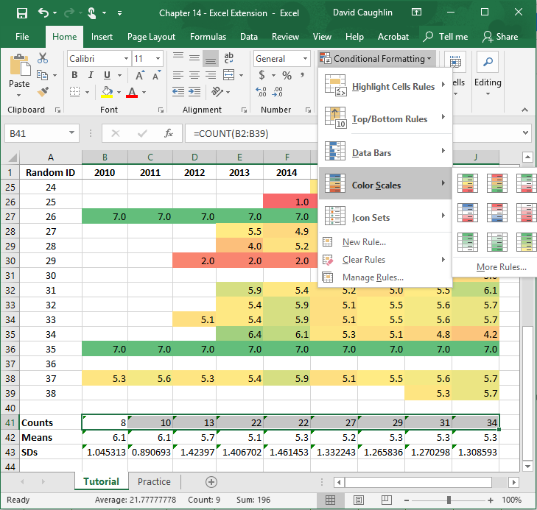
Step 16
Click on the Home tab.
Click on Conditional Formatting.
Click on Color Scales.
Select one of the color scale options. Let’s pick the first option which ranges from red (small values) to green (large values).

Slide 19
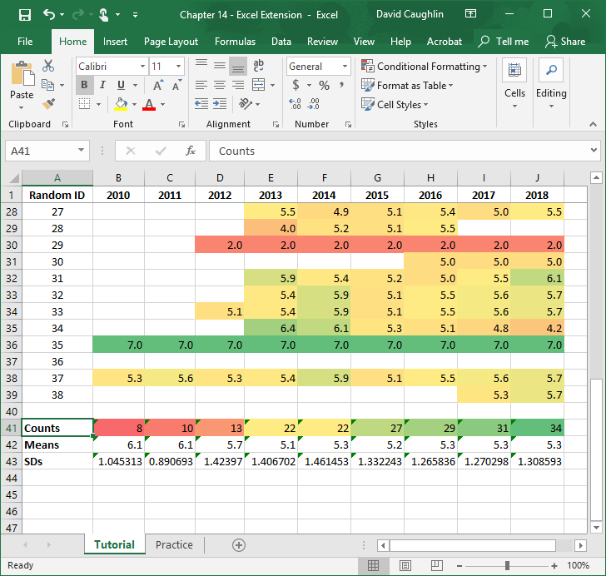
Step 17
Here, the transition from red to yellow to green over the years indicates that the number of employees responding to the survey each year increased, in general.

Slide 20
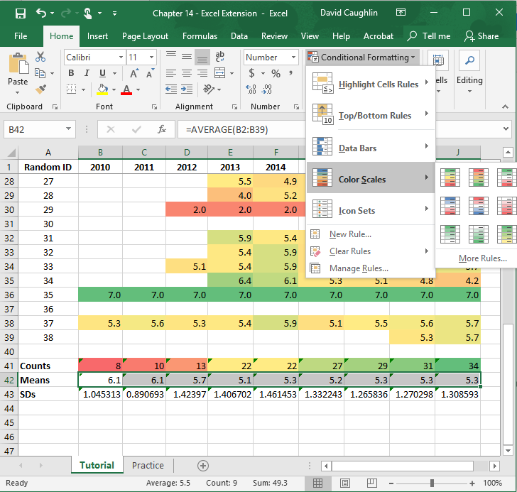
Step 18
Now, let’s create a heat map of means descriptive statistics across the years.
Select the numeric values for the Means row.
Click on the Home tab.
Click on Conditional Formatting.
Click on Color Scales.
Select one of the color scale options. Let’s pick the first option which ranges from red (small values) to green (large values).

Slide 21
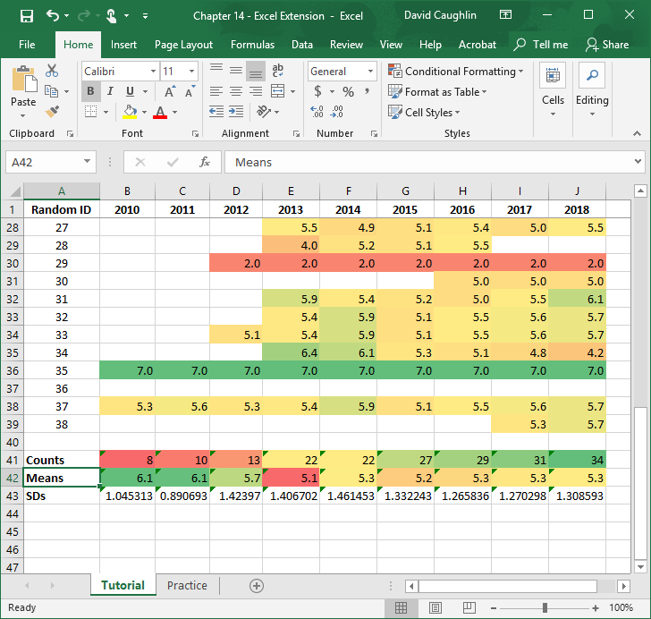
Step 19
Here, the transition from green to red and then yellow over the years indicates that the average level overall job satisfaction was highest in 2010 and 2011 and then declined and plateaued.

Slide 22
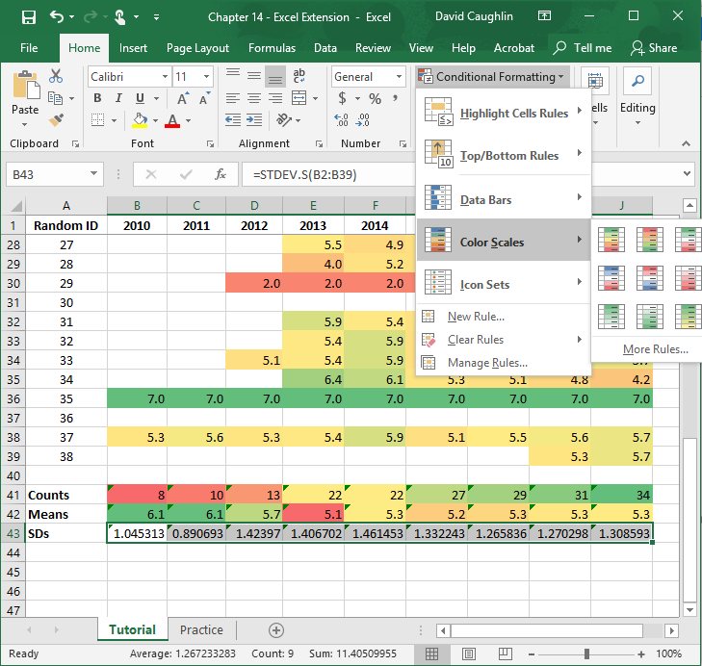
Step 20
Now, let’s create a heat map of SDs descriptive statistics across the years.
Select the numeric values for the SDs row.
Click on the Home tab.
Click on Conditional Formatting.
Click on Color Scales.
Select one of the color scale options. Let’s pick the first option which ranges from red (small values) to green (large values).

Slide 23
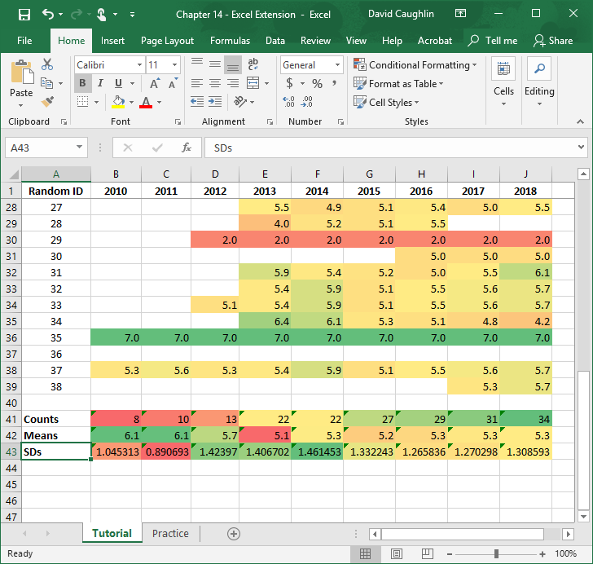
Step 21
Here, the transition from orange/red to green and then to yellow over the years indicates that the variation in employee overall job satisfaction was initially relatively low and then increased only to plateau in a relative midrange.

Slide 24
Questions
You just learned how to use opinion survey data to gauge employee job satisfaction over consecutive years. Now, imagine that you work for a different, larger organization that has administered a similar survey to employees over a 5-year period: 2014 ̶ 2018. Using data found in the “Practice” sheet of the Excel workbook, do and respond to the following:
Visually inspect the data. Do you think these data are truly anonymous? Is there any way that one might determine who certain data belong to? If so, how?
Calculate counts, means, and standard deviations for all survey administration years.
Create heatmaps of the raw data, counts, means, and standard deviations. Do you notice any trends/patterns? If so, what?

Slide 25
Chapter 14 Excel Extension: Now You Try!
Using Opinion Survey Data to Gauge Employee Satisfaction

