Slide 1
Chapter 12 Excel Extension: Now You Try!
Evaluating Employees’ Satisfaction With Benefits

Slide 2
Background
In this Excel Extension tutorial, you will learn how to apply simple linear regression analysis and independent-samples t test to evaluate employees’ satisfaction with the organization’s benefits offerings.
For the purposes of this exercise, imagine that you have been tasked with determining the potential implications of employees benefits satisfaction in terms of turnover intentions as well whether attending a benefits information session is associated with higher benefits satisfaction. To gather the data, you administer a voluntary employee survey that asks respondents to indicate their overall benefits satisfaction, turnover intentions, and whether they attended a benefits information session in the past year.

Slide 3
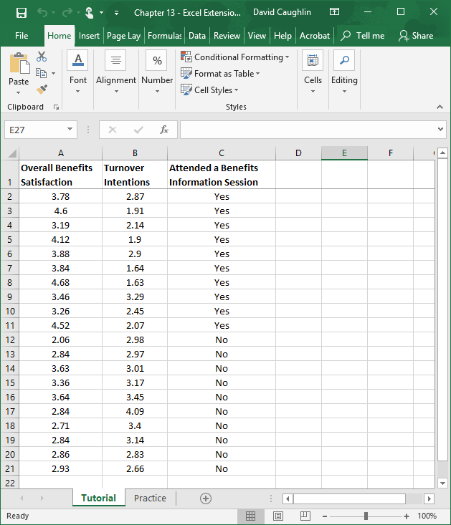
Step 1
Open the Excel workbook titled “Chapter 13--Excel Extension.xlsx”.
Click on the sheet called Tutorial. You will use the data contained in this sheet to learn how to run a simple linear regression analysis and an independent-samples t test.
Note that the sheet includes three fields/columns/variables:
Overall Benefits Satisfaction (1 = low satisfaction, 5 = high satisfaction)
Turnover Intentions (1 = low intentions to quit, 5 = high intentions to quit)
Attended a Benefits Information Session (Yes = attended session, No = did not attend session)
Note that there are 20 survey respondents in this sample.

Slide 4
Step 2
If you haven’t already, be sure to add in the Analysis ToolPak feature in Excel, which requires the following steps.
First, click on the File tab.

Slide 5
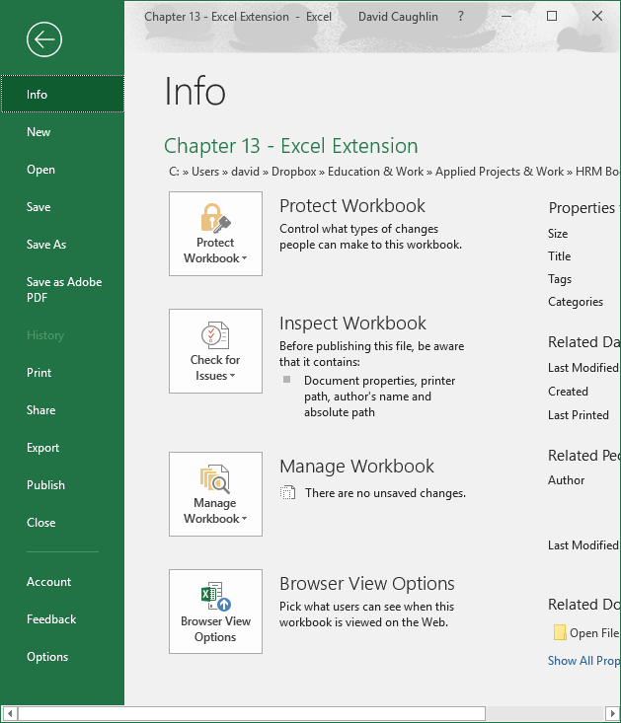
Step 3
Select Options.

Slide 6
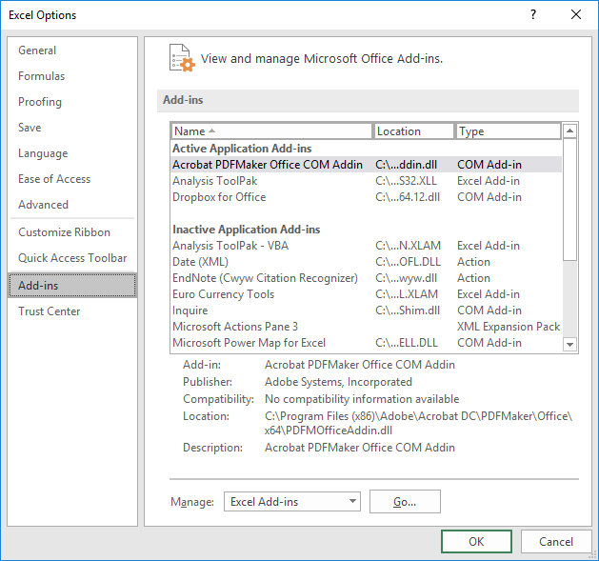
Step 4
When the Excel Options window opens, select the Add-Ins tab on the left, and then select the Analysis ToolPak in the Excel Add-Ins list, which appears next to Manage at the bottom of the window, and click Go…. A window will open, and simply check the box next to Analysis ToolPak.
If you already have the Analysis ToolPak application activated, it will appear in the Active Application Add-ins list, as shown in the image.
Click OK.

Slide 7
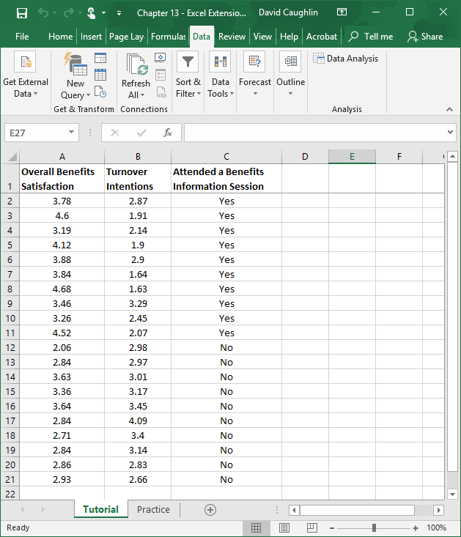
Step 5
Click on the Data tab.
Click on the Data Analysis button.

Slide 8
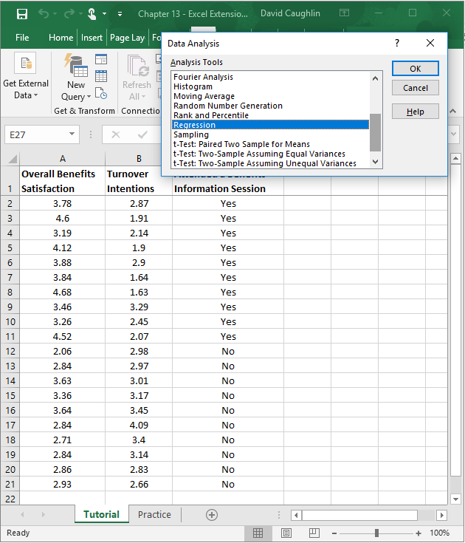
Step 6
Let’s begin by specifying a simple linear regression model in which we regress Turnover Intentions on Overall Benefits Satisfaction.
To specify our simple linear regression model, in the Data Analysis window, select Regression.
Click OK.

Slide 9
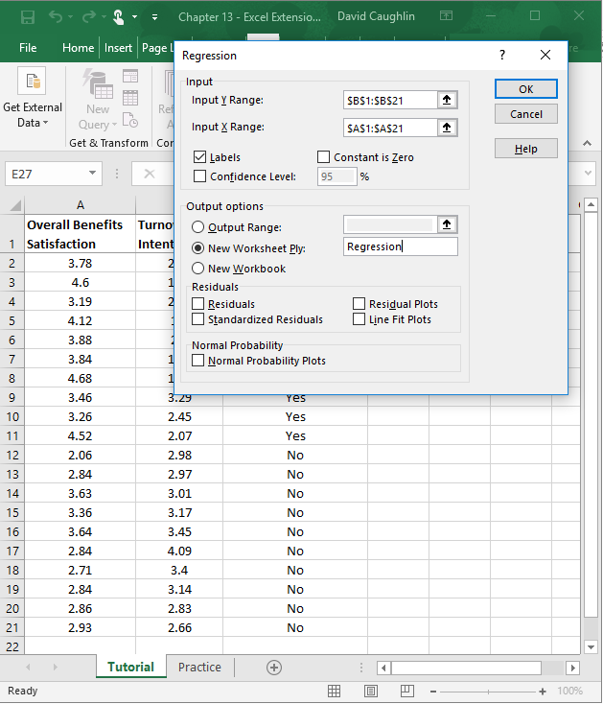
1
Step 7
6
2
3
When the Regression window opens, in the field next to Input Y Range: enter the range of cells that contains our outcome variable (Turnover Intentions) and associated values, including the variable labels. Next, in the field next to Input X Range: enter the range of cells that contains our predictor variable (Overall Benefits Satisfaction) and associated values, including the variable labels.
Check the box next to Labels.
Click the bubble next to New Worksheet Ply.
If you would like, next to New Worksheet Ply:, type in what you would like to name the new sheet. Here, “Regression” is entered in the field.
Click OK.
5
4

Slide 10
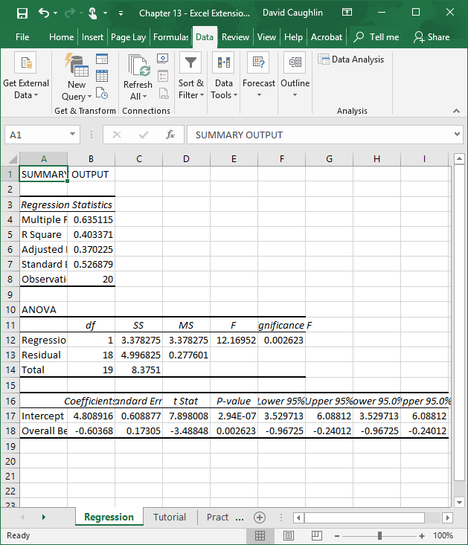
Step 8
A new sheet should appear in your workbook that is named Regression (or whatever you named the new sheet in the previous step). This sheet contains your simple linear regression model output.
Note that the number of digits after the decimal point varies and that some of the values in the output are in scientific notation (e.g., 2.94E–07).

Slide 11
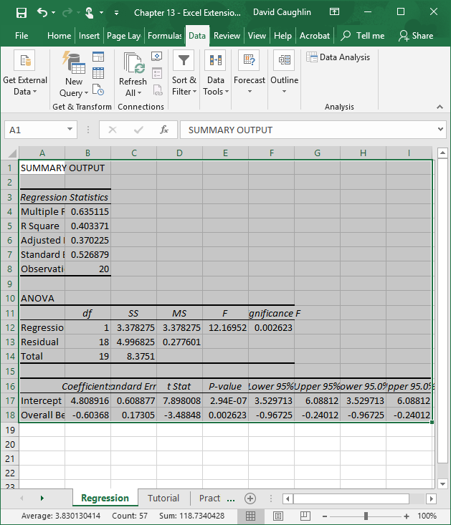
Step 9
To make your output easier to read, consider formatting the values to have two or three digits after the decimal.
To do so, first, select all of the cells in the output.

Slide 12
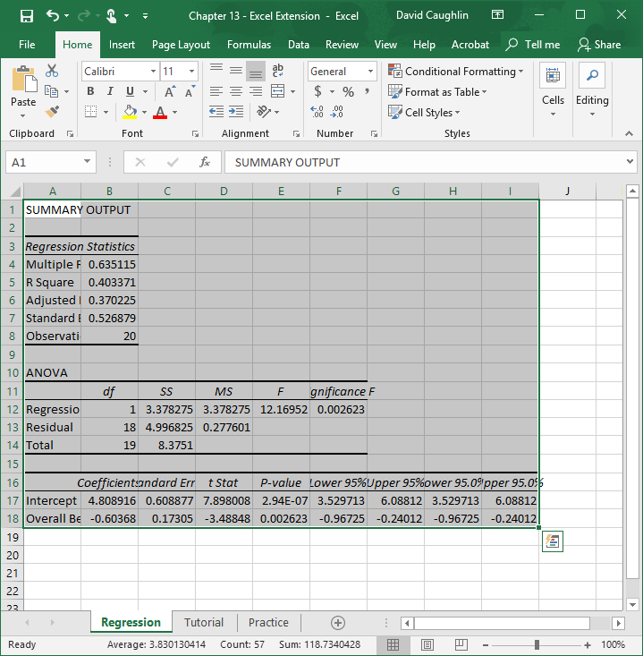
Step 10
Second, click on the Home tab, and click the small box with the arrow in the Number section.

Slide 13
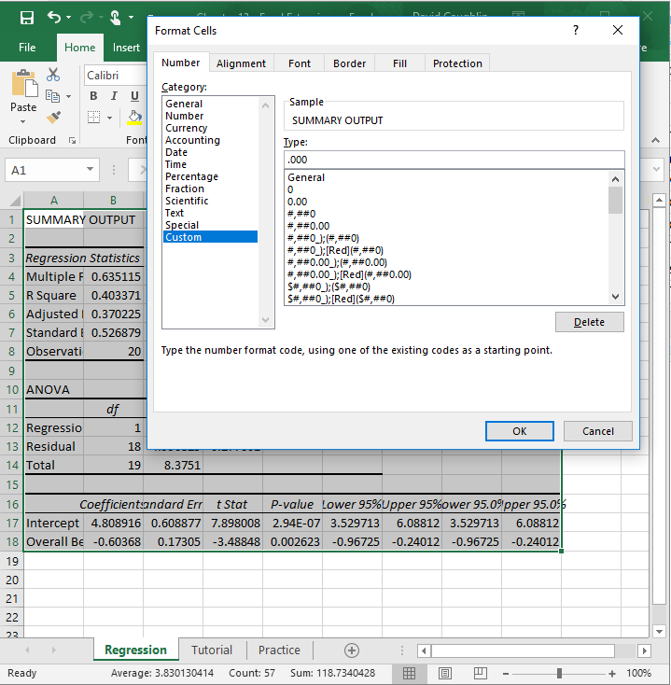
Step 11
Third, in the Number tab of the Format Cells window, click Custom from the Category: list.
In the field under Type:, enter the following format .000 to designate that you do not want a zero before the decimal point and only want three zeroes after the decimal point.
Click OK.

Slide 14
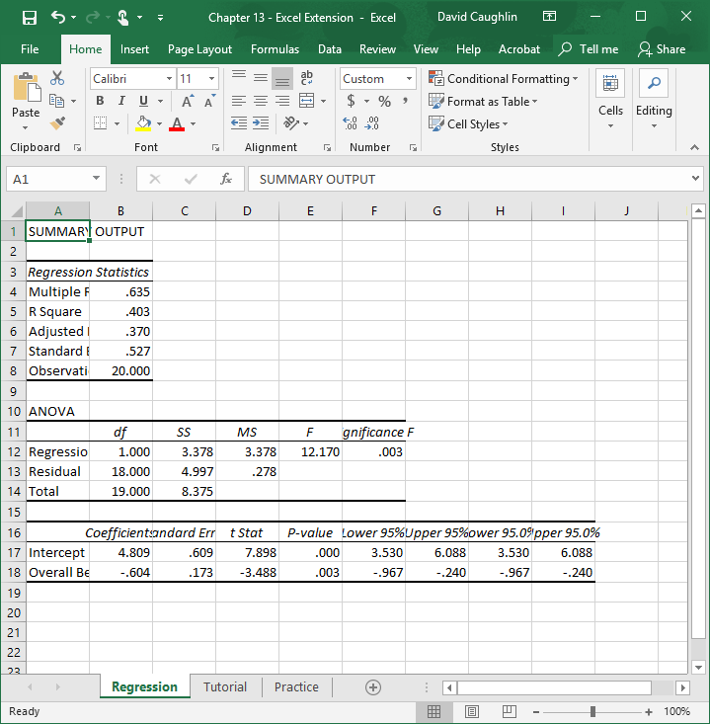
Step 12
Now the output is a bit easier to read.
In the Regression Statistics table, note that the R Square value is .403, which means that the predictor variable in the model (Overall Benefits Satisfaction) explains 40.3% (.403 × 100) of the variance in the outcome variable (Turnover Intentions).

Slide 15
Step 13
In the table at the very bottom, you will find your regression model estimates. The first column contains the names of the predictor variable and the intercept. The second column contains the regression weights (coefficients). The fifth column contains the p values associated with the regression weights, which we use to determine whether they are statistically significant (i.e., significantly different from zero).
As you can see, the regression weight for Overall Benefits Satisfaction (in relation to Turnover Intentions) is negative and has a p value that is less than the conventional two-tailed cutoff (α level) of .05, which means we can treat this regression weight as statistically significant. If the p value were greater than .05, then it would be nonsignificant.
Using the regression weights, we can write the following regression equation:
Y = 4.809 + -.604(Overall Benefits Satisfaction)

Slide 16
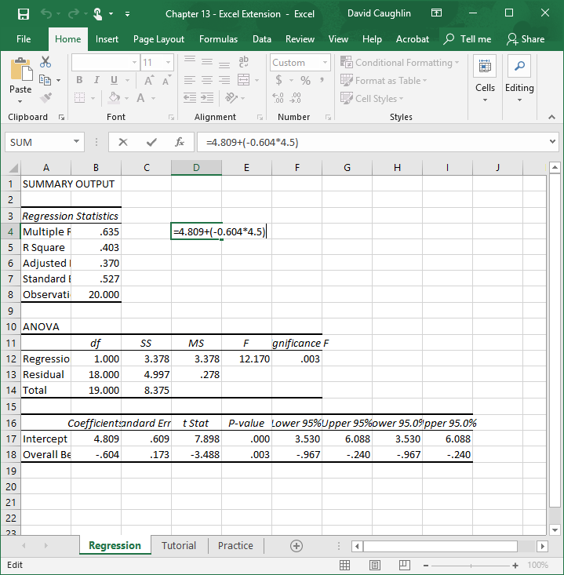
Step 14
Let’s practice plugging hypothetical values into the regression equation.
For example, imagine that an employee has a score of 4.5 on the overall benefits satisfaction assessment.
In an empty cell, enter an = sign, followed by the regression equation with the aforementioned score of 4.5. It should look something like:
=4.809+(–0.604*4.5)
Click ENTER.

Slide 17
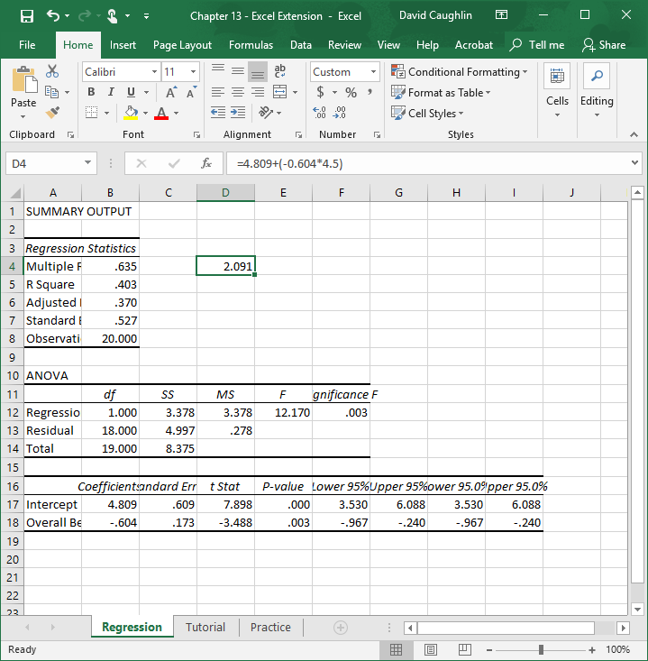
Step 15
For an employee who scores a 4.5 on overall benefits satisfaction, we can predict that their turnover intention score will be 2.09, which indicates relatively low intentions to quit.

Slide 18
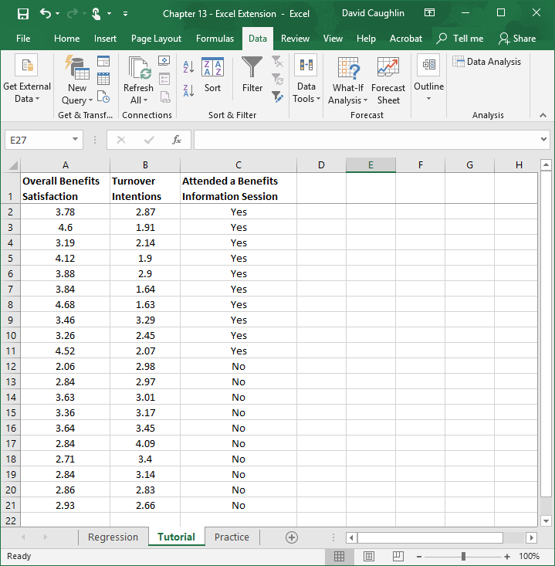
Step 16
Now let’s evaluate whether those employees who attended a benefits information session have higher overall benefits satisfaction.
Unlike the Overall Benefits Satisfaction and Turnover Intentions variables (which were both continuous variables), the Overall Benefits Satisfaction and Attended a Benefits Information Session variables are continuous and categorical, respectively. Given this, we could use a regression analysis to evaluate whether the Attending a Benefits Information Session is associated with Overall Benefits Satisfaction, but given that we have (roughly) the same number of people who attended a session as those who did not, we can run an independent-samples t test instead.
Click back to the sheet labeled Tutorial, and click on the Data tab.
Click on Data Analysis.

Slide 19
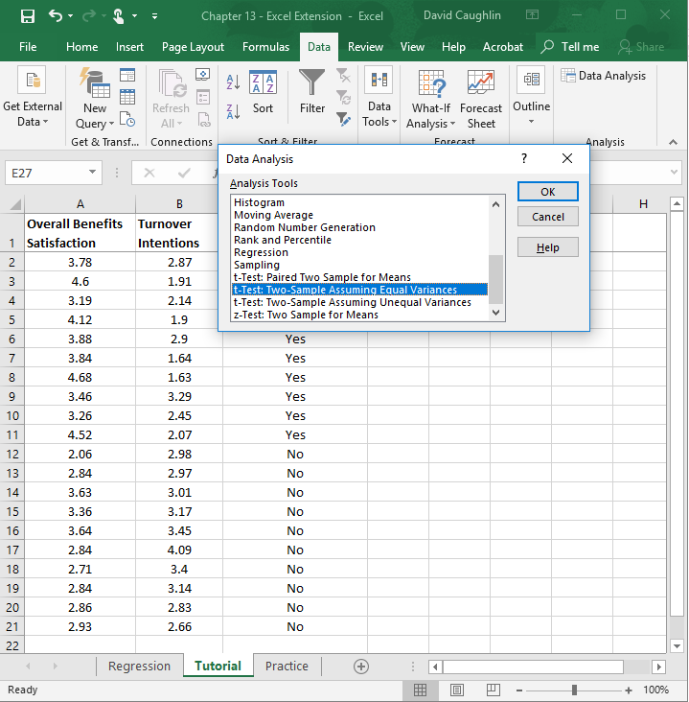
Step 17
When the Data Analysis window opens, under Analysis Tools:, select t-Test: Two-Sample Assuming Equal Variances, which is what Excel calls an independent-samples t test.
Click on OK.

Slide 20
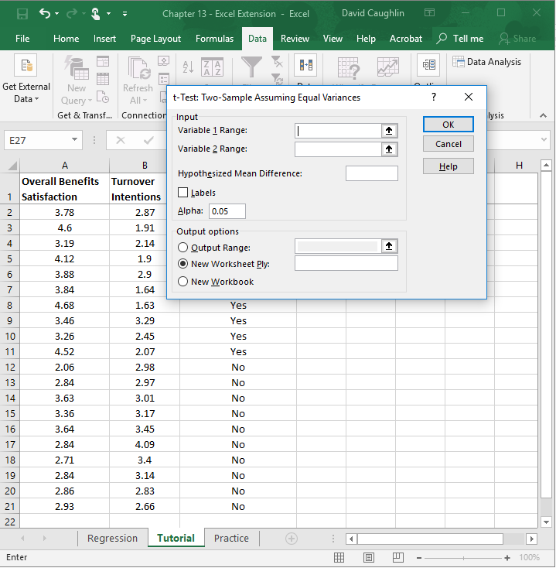
Step 18
When the t-Test: Two-Sample Assuming Equal Variances window opens, click on the upward arrow in the field adjacent to Variable 1 Range:.

Slide 21
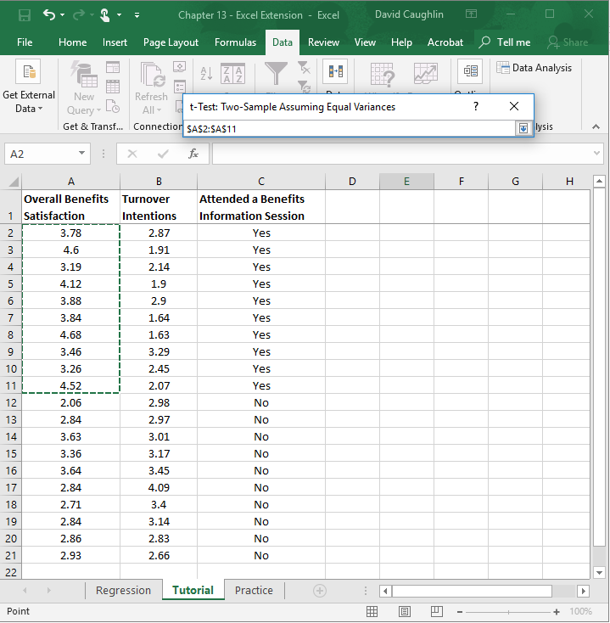
Step 19
Select the overall benefits satisfaction cells containing numeric values that correspond to the employees (rows) with “Yes” in the Attended a Benefits Information Session column. By doing this, you are selecting the overall benefits satisfaction data for those individuals who attended an information session.
Note that the window titled t-Test: Two-Sample Assuming Equal Variances contains the array/range of cells you selected.
When you’re done, click on the downward arrow in the t-Test: Two-Sample Assuming Equal Variances window.

Slide 22
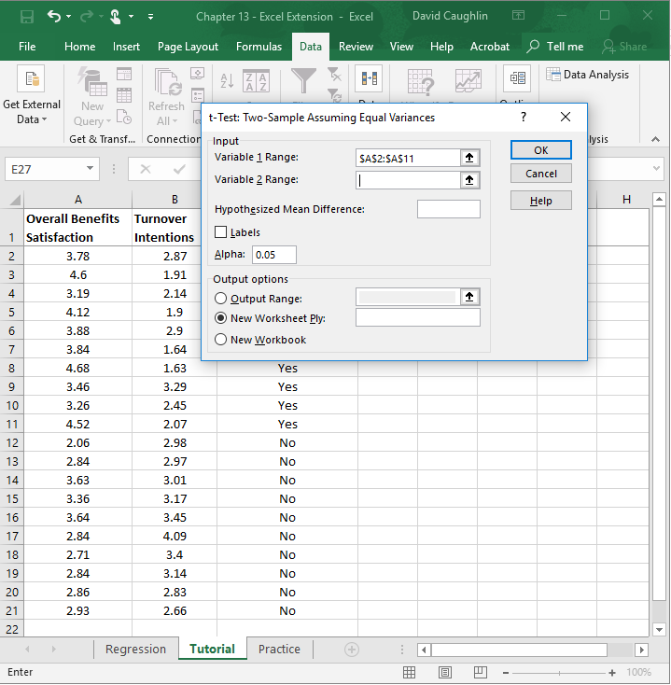
Step 20
When the t-Test: Two-Sample Assuming Equal Variances window opens, click on the upward arrow in the field adjacent to Variable 2 Range:.

Slide 23
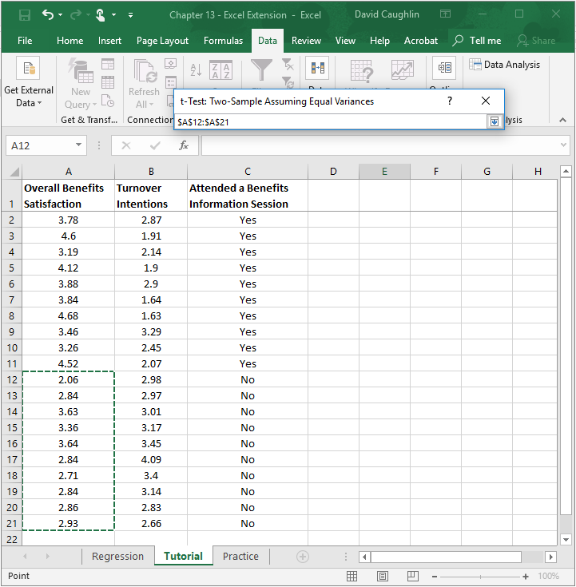
Step 21
Select the cells containing numeric values that correspond to the employees (rows) with “No” in the Attended a Benefits Information Session column. By doing this, you are selecting the overall benefits satisfaction data for those individuals who did not attend an information session.
Note that the window titled t-Test: Two-Sample Assuming Equal Variances contains the array/range of cells you selected.
When you’re done, click on the downward arrow in the t-Test: Two-Sample Assuming Equal Variances window.

Slide 24
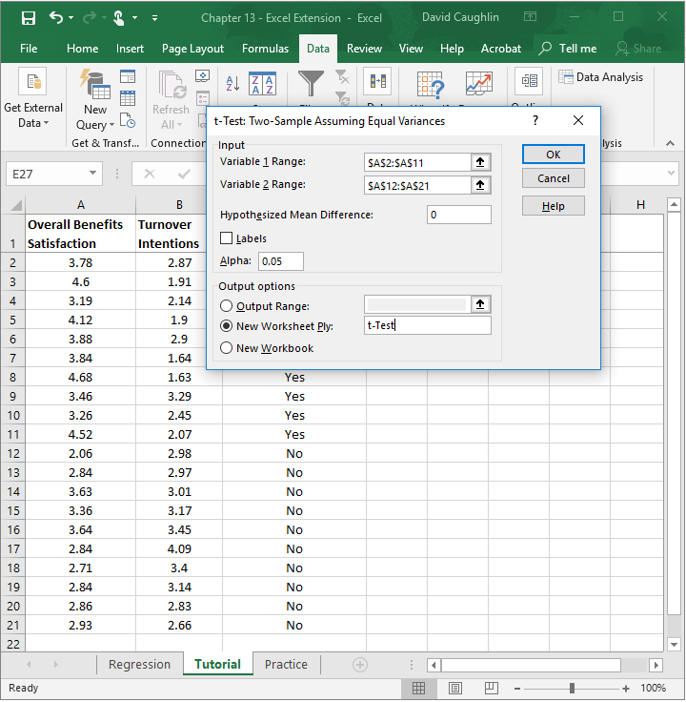
Step 22
4
1
In the t-Test: Two-Sample Assuming Equal Variances window, enter 0 (zero) in the field adjacent to Hypothesized Mean Difference:, which indicates that we will test whether the difference in overall benefits satisfaction for those who attended a benefits information session compared to those who did not is statistically significantly different from zero.
Click the bubble next to New Worksheet Ply.
If you would like, next to New Worksheet Ply:, type in what you would like to name the new sheet. Here, “t-Test” is entered in the field.
Click OK.
2
3

Slide 25
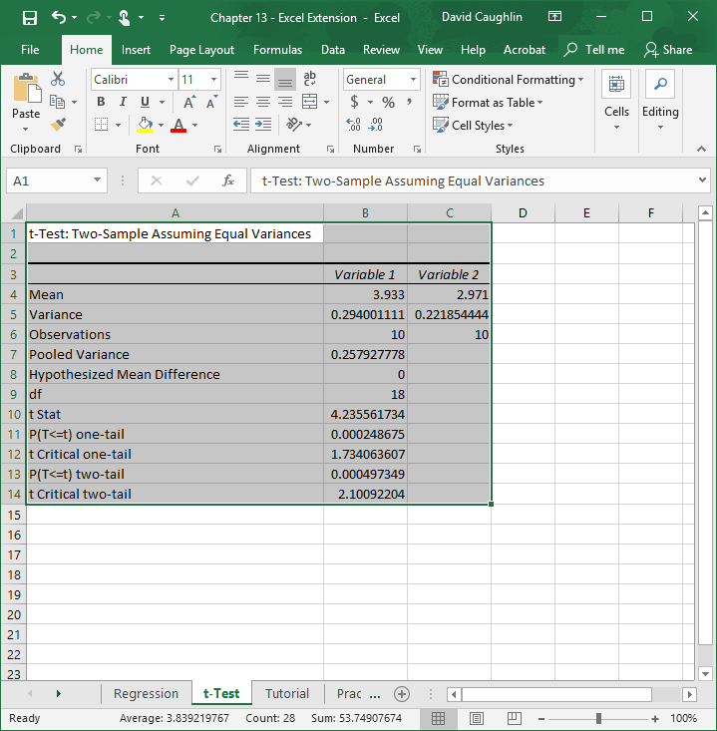
Step 23
A new sheet should appear in your workbook that is named t-Test (or whatever you named the new sheet in the previous step). This sheet contains your independent-samples t test output.
Note that the number of digits after the decimal point varies. Let’s make the number of digits after the decimal point consistent.
Select all of the cells in the output.
Click on the Home tab.
Click the small box with the arrow in the Number section.

Slide 26
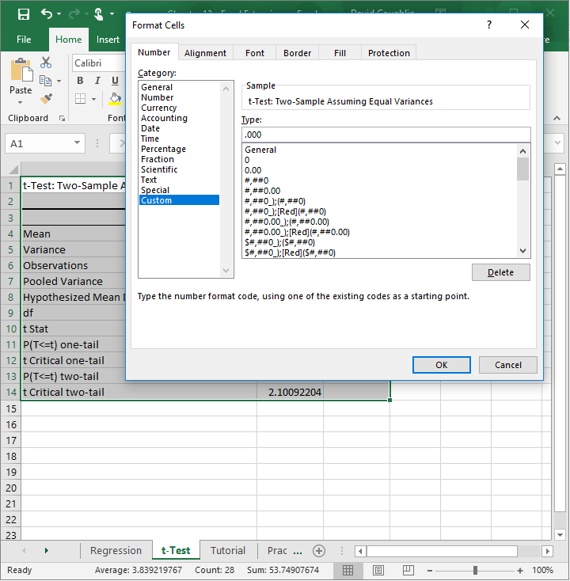
Step 24
In the Number tab of the Format Cells window, click Custom from the Category: list.
In the field under Type:, enter the following format .000 to designate that you do not want a zero before the decimal point and only want three zeroes after the decimal point.
Click OK.

Slide 27
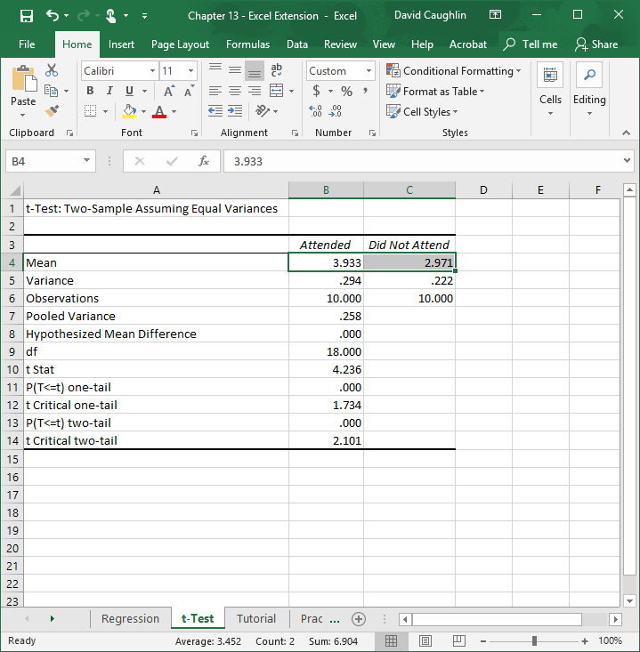
Step 25
The default names of the two columns containing the means and other information are “Variable 1” and “Variable 2”, which are not very informative.
Let’s replace those default names with “Attended” and “Did Not Attend”, respectively.
Note that the mean (average) of overall benefits satisfaction for those who attended a benefits information session is 3.933 and 2.971 for those who did not attend one. Thus, our “eyeball” test tells us that descriptively the mean for those who attended a session is higher than those who did not attend a session. The next question is this: Is this a statistically significant difference in means?

Slide 28
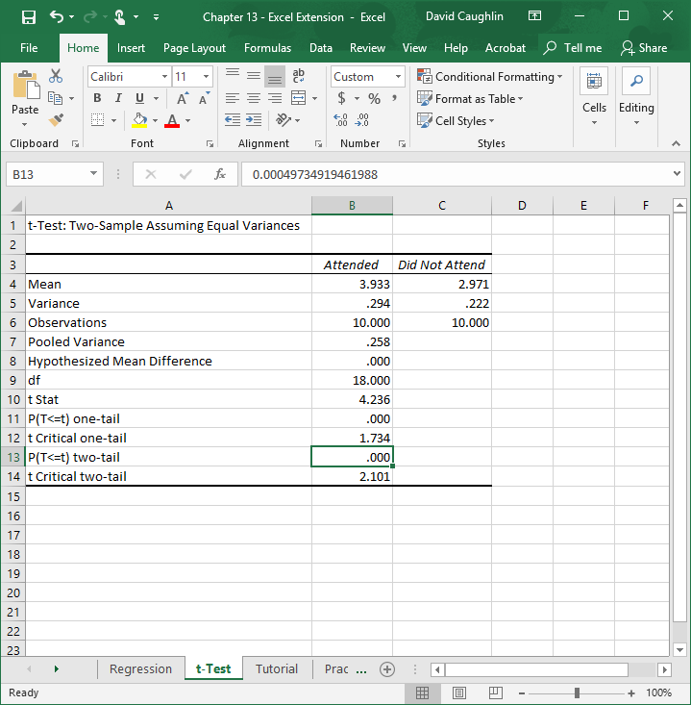
Step 26
Adjacent to P(T<=t) two-tail is the value .000, which is our p value (that corresponds to the t statistic [t Stat] and degrees of freedom [df] that appear earlier in the table). Because the p value is less than the conventional two-tailed cutoff (α level) of .05, we can treat the aforementioned difference in means as statistically significant. If the p value were greater than .05, then it would be nonsignificant.
Thus, we can conclude that employees who attended a benefits information session tended to report significantly higher overall satisfaction with the benefits offerings.

Slide 29
Questions
You just learned how to evaluate employee perceptions of benefits offerings using simple linear regression and independent-samples t test. Now, imagine that you work for a different organization that has administered a similar survey to employees. Using data found in the “Practice” sheet of the Excel workbook, do and respond to the following:
Run a simple linear regression analysis in which you specify overall benefits satisfaction as the predictor variable and turnover intentions as the outcome variable. What did you find?
Run an independent-samples t test in which you compare the means of overall benefits satisfaction for those employees who attended a benefits information session with those who did not. What did you find?
Based on these analyses, what is your overall impression of the organization’s current benefits offerings and employees’ perceptions of them?

