Slide 1
Chapter 12 Excel Extension: Now You Try!
Evaluating Compensation Systems

Slide 2
Background
In this Excel Extension tutorial, you will learn how to calculate simple but important metrics that can be used to evaluated different components of compensation and reward systems. These metrics include Total Compensation Expense Factor, Pay-for-Performance Expense Factor, Total Compensation Revenue Factor, and Pay-for-Performance Revenue.
For the purposes of this exercise, imagine that you have concerns about how much your organization has been spending on total compensation (compensation and benefits) and pay-for-performance programs, specifically, for nonproduction employees. Fortunately, your firm has data for the past 3 years that you can use to evaluate your organization’s reward systems for nonproduction employees relative to total operating expenses and total revenue.

Slide 3
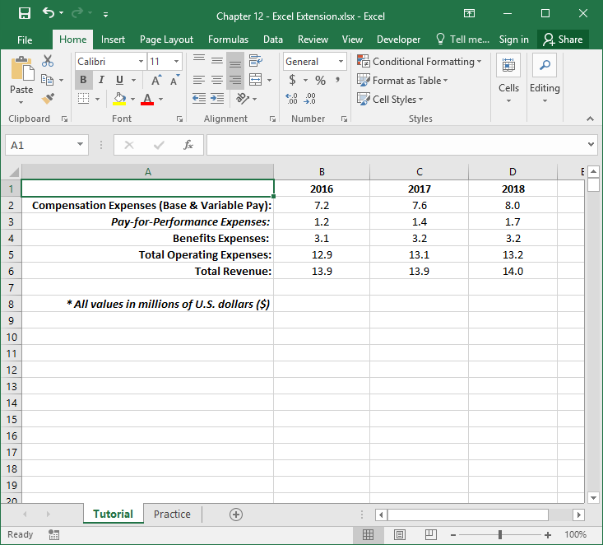
Step 1
Open the Excel workbook titled “Chapter 12 - Excel Extension.xlsx”.
You will use the data contained in the Tutorial sheet to learn how to calculate the following metrics:
Total Compensation Expense Factor
Pay-for-Performance Expense Factor
Total Compensation Revenue Factor
Pay-for-Performance Revenue Factor
Note that there are data available for the fiscal years 2016, 2017, and 2018.

Slide 4
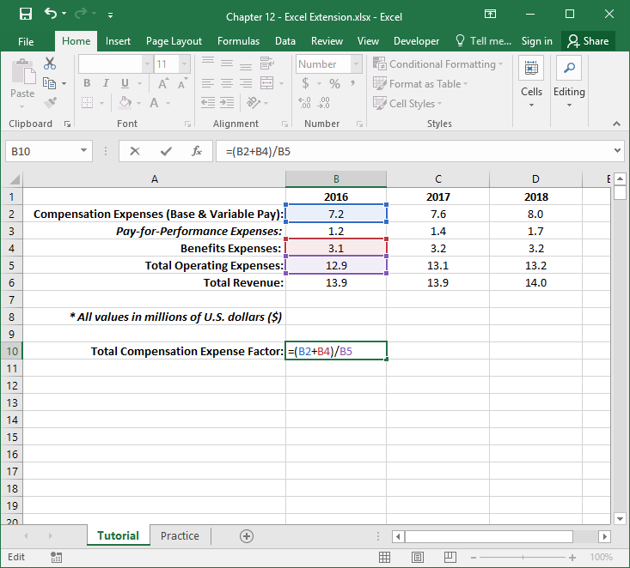
Step 2
Let’s begin by calculating the Total Compensation Expense Factor for 2016.
The Total Compensation Expense Factor is computed by dividing compensation and benefits expenses by total operating expenses. Total operating expenses include those business expenditures that are necessary but not directly related to the production of goods or services.
In cell A10, type in “Total Compensation Expense Factor:”.
In cell B10, type in the formula for the metric by referencing the cells associated with 2016 Compensation Expenses, Benefits Expenses, and Total Operating Expenses. Your formula should be: =(B2+B4)/B5.

Slide 5
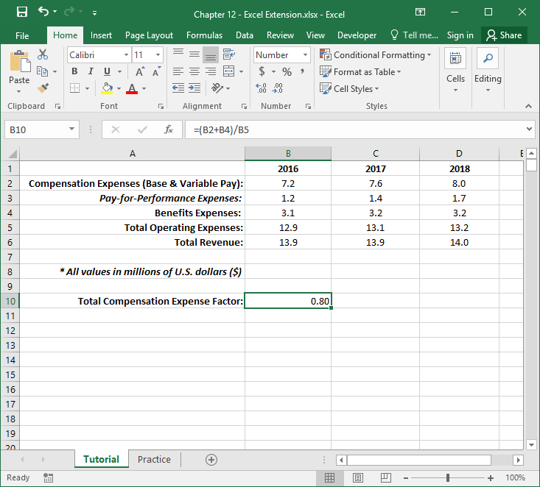
Step 3
The Total Compensation Expense Factor is .80. Because the total operating expenses include payroll costs such as compensation and benefits expenses for nonproduction staff, you can think of this metric as the proportion of total operating expenses that compensation and benefits expenses account for. In this case, compensation and benefits for nonproduction employees account for approximately 80% of total operating expenses.
Select the cell that includes the total compensation expense factor value, and click on the square in the bottom right corner of the green box, hold, and drag to the column D. This will drag the formula and apply it to years 2017 and 2018.

Slide 6
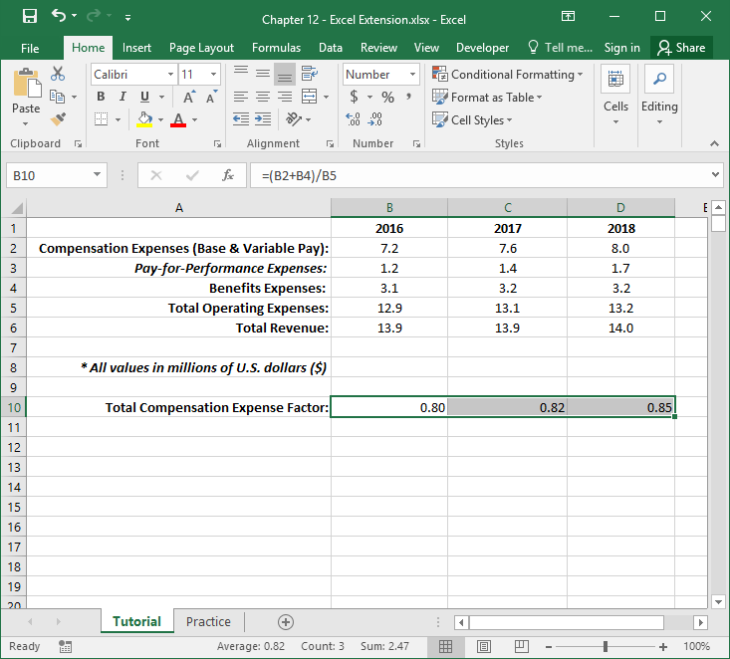
Step 4
You can see that over the past three years (.80, .82, .85) the compensation and benefits expenses for nonproduction employees have been increasing relative to the total operating expenses, which suggests that payroll for nonproduction staff is becoming a larger part of operating expenses.

Slide 7
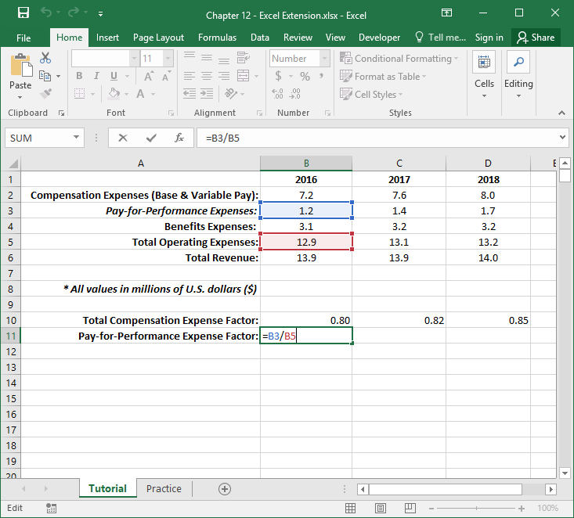
Step 5
We can drill down to pay-for-performance programs specifically for nonproduction employees to understand how much they contribute to total operating expenses.
To do so, we can calculate the Pay-for-Performance Expense Factor, which is computed by dividing pay-for-performance expenses by total operating expenses.
In cell A11, type in “Pay-for-Performance Expense Factor:”.
In cell B11, type in the formula for the metric by referencing the cells associated with 2016 Pay-for-Performance Expenses and Total Operating Expenses. Your formula should be: =B3/B5.

Slide 8
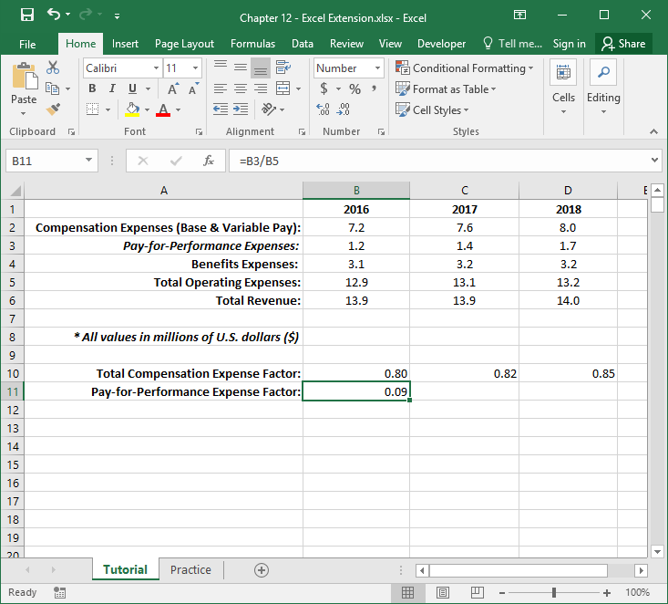
Step 6
The Pay-for-Performance Expense Factor is .09. Because the total operating expenses include payroll costs such as pay-for-performance expenses for nonproduction staff, you can think of this metric as the proportion of total operating expenses that pay-for-performance expenses account for. In this case, pay-for-performance programs for nonproduction employees account for approximately 9% of total operating expenses.
Select the cell that includes the pay-for-performance expense factor value, and click on the square in the bottom right corner of the green box, hold, and drag to the column D. This will drag the formula and apply it to years 2017 and 2018.

Slide 9
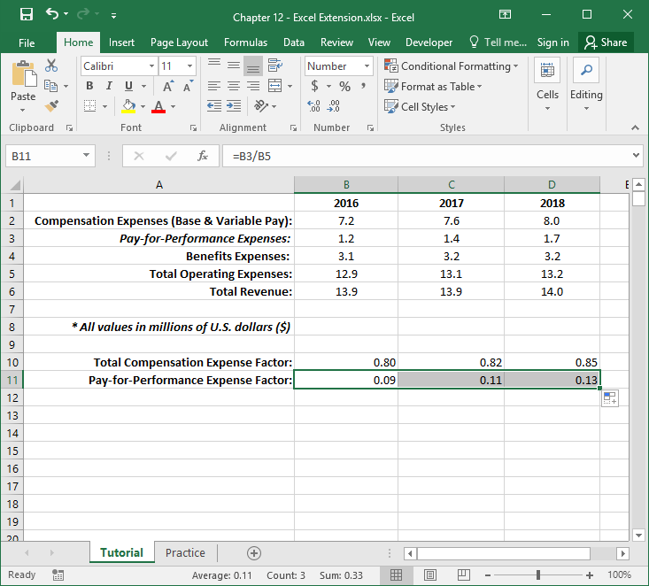
Step 7
You can see that over the past three years (.09, .11, .13) the pay-for-performance expenses for nonproduction employees have been increasing relative to the total operating expenses, which suggests that payroll specifically tied to pay-for-performance programs for nonproduction staff is becoming a larger part of operating expenses.

Slide 10
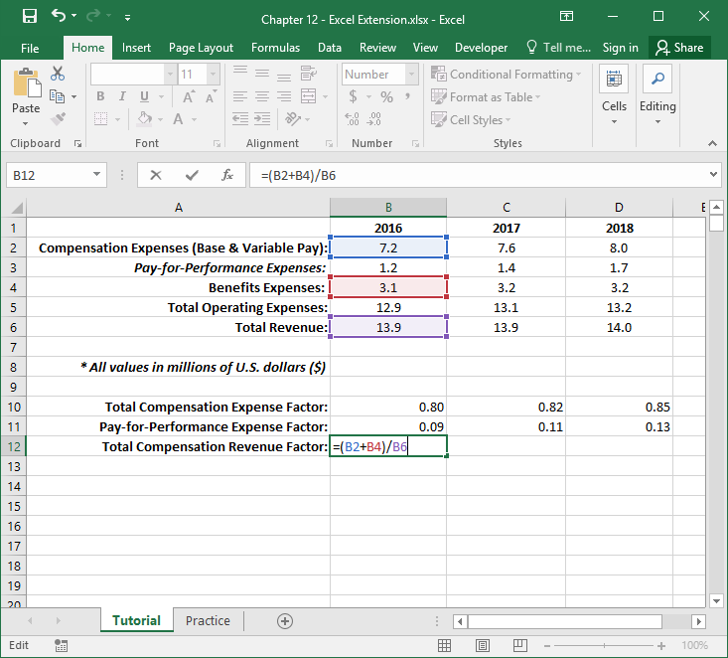
Step 8
The Total Compensation Revenue Factor is computed by dividing compensation and benefits expenses by total revenue.
In cell A12, type in “Total Compensation Revenue Factor:”.
In cell B12, type in the formula for the metric by referencing the cells associated with 2016 Compensation Expenses, Benefits Expenses, and Total Revenue. Your formula should be: =(B2+B4)/B6.

Slide 11
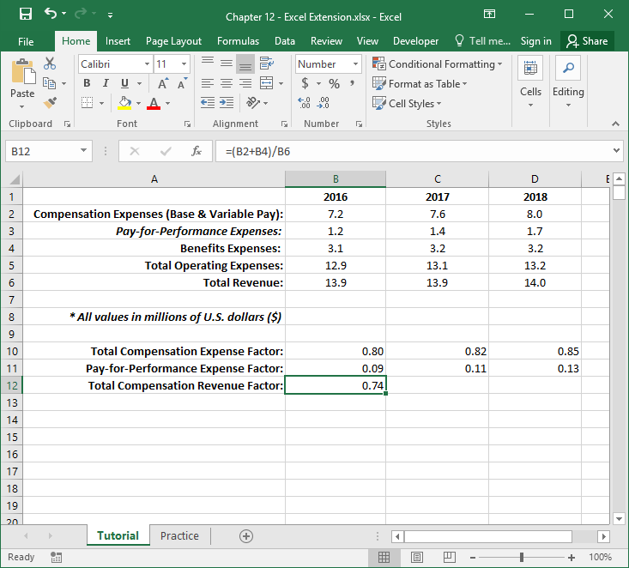
Step 9
The Total Compensation Revenue Factor is .74. You can think of this metric as the amount of total compensation expenses (compensation and benefits) for nonproduction employees relative to the total amount of revenue generated by the organization. Most organizations would prefer a smaller value for this metric as opposed to a higher one, as compensation expenses eat into profit.
Select the cell that includes the total compensation revenue factor value, and click on the square in the bottom right corner of the green box, hold, and drag to the column D. This will drag the formula and apply it to years 2017 and 2018.

Slide 12
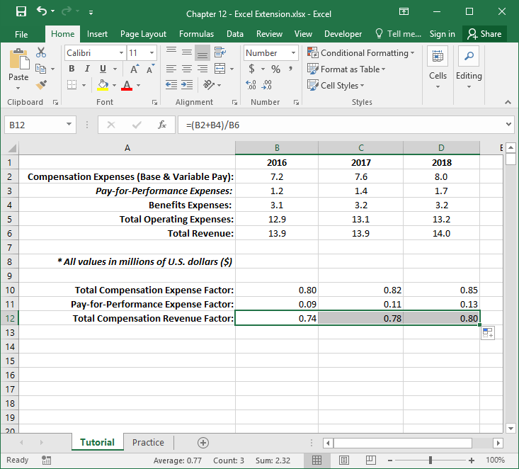
Step 10
You can see that over the past three years (.74, .78, .80) the total compensation expenses for nonproduction employees have been increasing relative to the total revenue, which suggests that payroll may be adversely affecting profits.

Slide 13
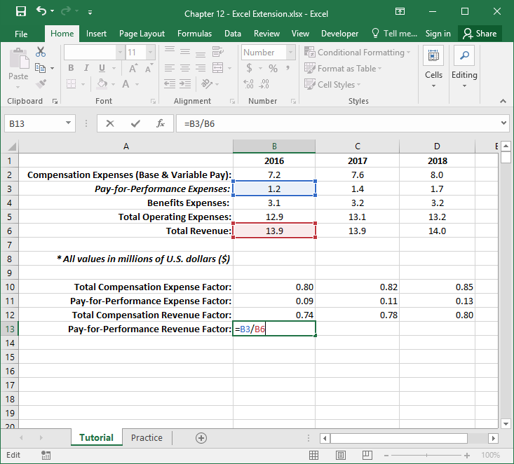
Step 11
The Pay-for-Performance Revenue Factor is computed by dividing pay-for-performance expenses by total revenue.
In cell A13, type in “Pay-for-Performance Revenue Factor:”.
In cell B13, type in the formula for the metric by referencing the cells associated with 2016 Pay-for-Performance Expenses and Total Revenue. Your formula should be: =B3/B6.

Slide 14
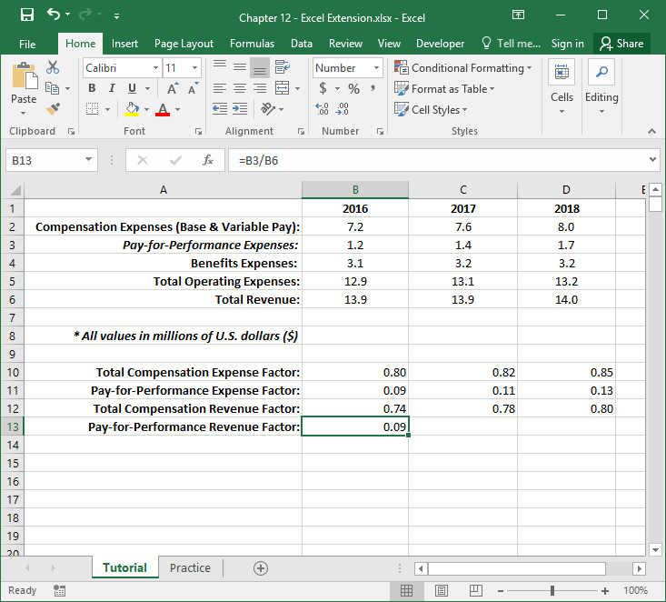
Step 12
The Pay-for-Performance Revenue Factor is .09. You can think of this metric as the amount of pay-for-performance expenses associated with nonproduction employees relative to the total amount of revenue generated by the organization. Most organizations would prefer a smaller value for this metric as opposed to a higher one, as such expenses cut into profit.
Select the cell that includes the pay-for-performance revenue factor value, and click on the square in the bottom right corner of the green box, hold, and drag to the column D. This will drag the formula and apply it to years 2017 and 2018.

Slide 15
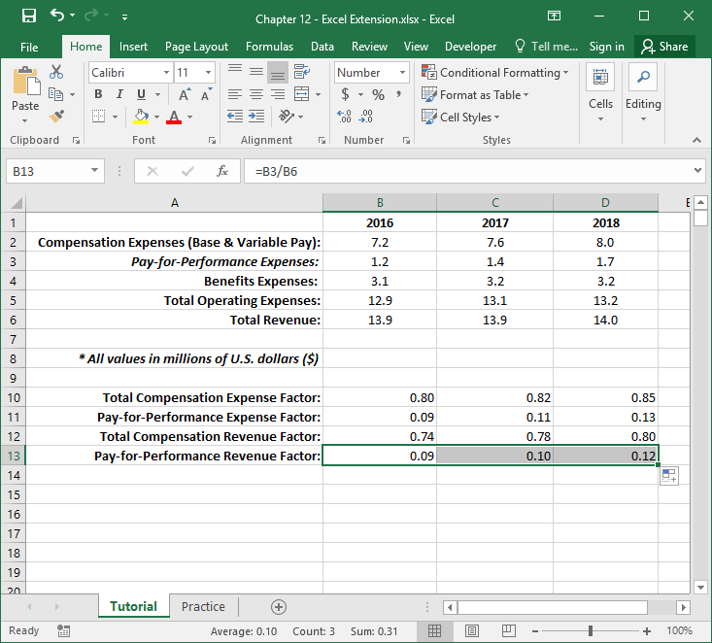
Step 13
You can see that over the past 3 years (.09, .10, .12) the pay-for-performance expenses for nonproduction employees have been increasing relative to the total revenue, which suggests that this specific component of payroll may be adversely affecting profits.

Slide 16
Questions
You just learned how to evaluate pay compression systems by the following metrics: Total Compensation Expense Factor, Pay-for-Performance Expense Factor, Total Compensation Revenue Factor, and Pay-for-Performance Revenue. In the “Practice” sheet of the Excel workbook, you will find a new set of compensation, operating, and revenue data for a different company. Again, you will focus on compensation expenses associated with nonproduction employees. Do and respond to the following:
First, compute the total compensation expense factors and total compensation revenue factors across 3 years.
Second, compute the pay-for-performance expense factors and pay-for-performance revenue factors across the same 3 years.
What trends did you notice? What implications do they have?

Slide 17
Chapter 12 Excel Extension: Now You Try!
Evaluating Compensation Systems

