Slide 1
Chapter 10 Excel Extension: Now You Try!
Evaluating Turnover

Slide 2
Background
In this Excel Extension tutorial, you will learn how to calculate annual turnover rate.
For the purposes of this exercise, imagine that organizational leaders have become increasingly concerned with turnover in the organization. To understand the extent of the turnover issue, you will calculate the annual turnover rate, which is an important HR metric.

Slide 3
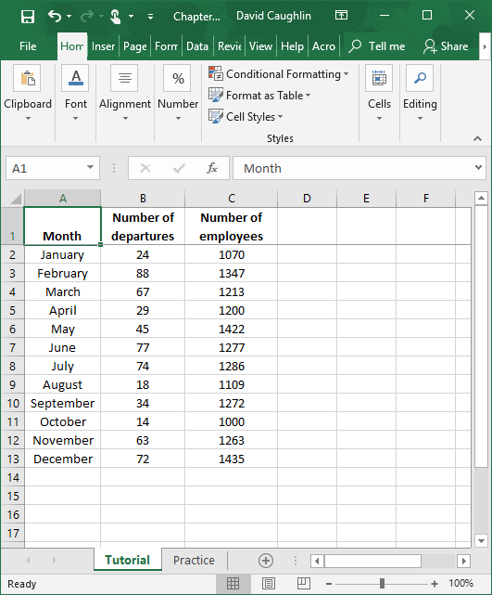
Step 1
Open the Excel workbook titled “Chapter 10--Excel Extension.xlsx”.
You will use the data contained in the Tutorial sheet to learn how to calculate an annual turnover rate.
Note that these data represent the entire organization.

Slide 4
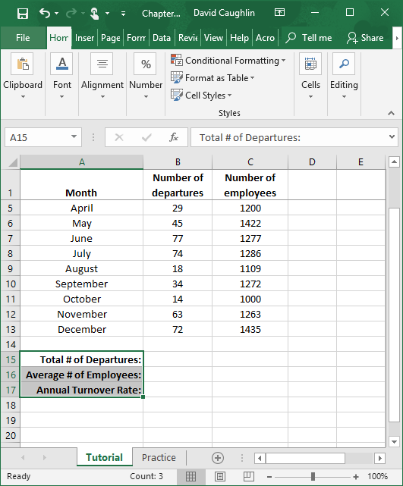
Step 2
Annual turnover rate is calculated by dividing the total number of departures during the year by the average number of employees during the year, and then multiplying that quotient by 100.
Let’s begin by creating labels for “Total # of Departures”, “Average # of Employees”, and “Annual Turnover Rate” in cells A15:A17.

Slide 5
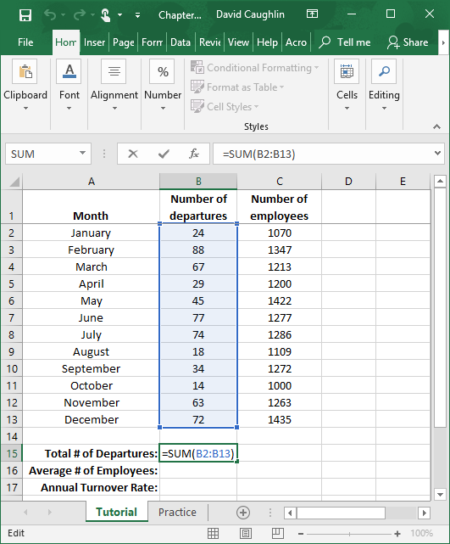
Step 3
To calculate the total number of departures for the year, use the SUM function in Excel.
First, type the = sign, followed by SUM( and the array/range of cells that contains the raw data for the number of departures across months (B2:B13).
Second, type the ending parenthesis, and click ENTER.

Slide 6
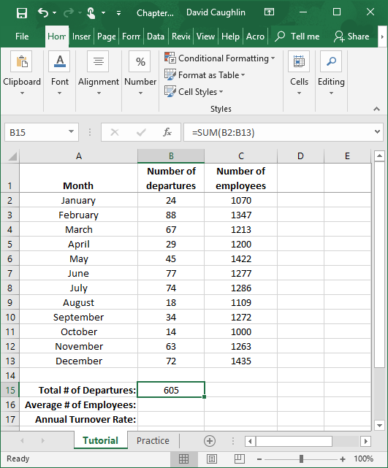
Step 4
The total number of departures for the year is 605.

Slide 7
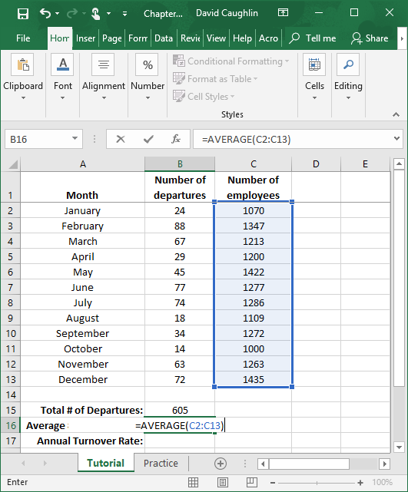
Step 5
To calculate the average (mean) number of employees for the year, use the AVERAGE function in Excel.
First, type the = sign, followed by AVERAGE( and the array/range of cells that contains the raw data for the number of employees across months (C2:C13).
Second, type the ending parenthesis, and click ENTER.

Slide 8
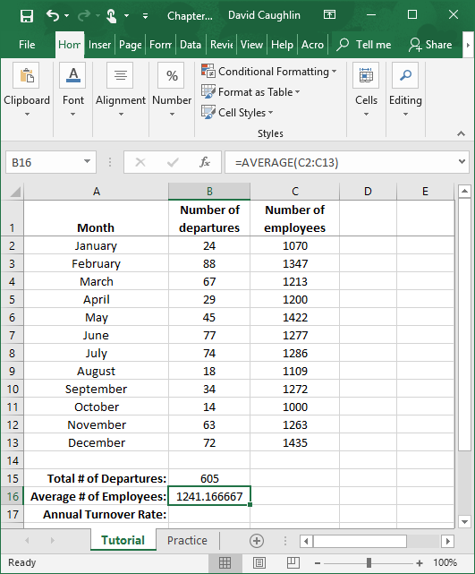
Step 6
The average number of employees for the year is approximately 1,241.17.

Slide 9
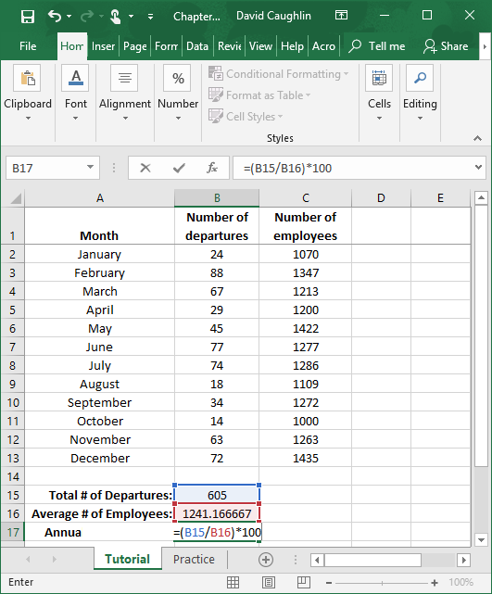
Step 7
To calculate annual turnover rate, divide the total number of departures during the year by the average number of employees during the year, and then multiply that quotient by 100.
Type the = sign.
In parentheses, enter the cell that contains the total number of departures (B15) and divide by the cell that contains the average number of employees.
Multiply the quotient by 100 to yield a percentage.

Slide 10
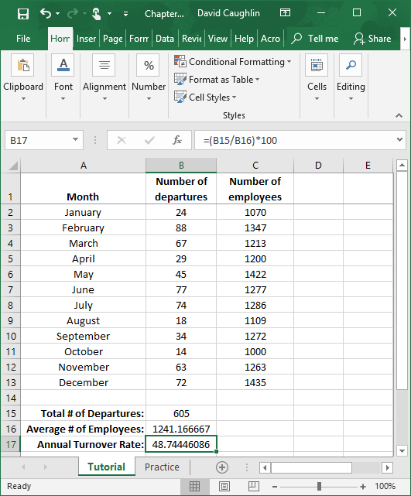
Step 8
The annual turnover rate is 48.7%.

Slide 11
Questions
You just learned how to calculate the annual turnover rate for an entire organization. In the “Practice” sheet of the Excel workbook, you will find a new data set. As before, you will have access to the number of departures and number of employees for each month of the year; however, in this data set, you will have access to such data for multiple units in the organization. Do and respond to the following:
First, compute the annual turnover rates for all units. Which unit has the highest annual turnover rate? Which has the lowest?
Second, calculate the annual turnover rate for the entire organization. What is the advantage of calculating annual turnover rates for specific units as well as the organization as a whole? Did you notice anything surprising or particularly informative?

