Slide 2
Chapter 1: Introduction to Managing Global Operations and Supply Chains

Slide 3
Learning Objectives
Explain how globalization has influenced the management of supply chains and their operations.
Describe the role of operations management within a company and in society.
Trace the path of a raw material from the start of the supply chain to the final consumer.
Explain why it is important to have an integrated view of operations from a larger supply-chain framework.
Describe the evolution of operations and supply chain management from the industrial revolution to the present.
Identify some of the current and emerging trends in operations and supply chain management.

Slide 4
Operations Profile – Intel Uses Quality Control to Achieve World Domination
Intel, Inc. is the world’s largest manufacturer of microprocessor chips.
The development and manufacture of computer chips is a fantastic and complex global voyage.
Quality control practices ensure that Intel’s chips are very nearly identical and of the highest possible quality.
What sets Intel apart from other manufacturers is its devotion to this process, even copying what may seem to be random elements in its manufacturing centers.

Slide 5
1.1 The Effect of Globalization on Supply Chains and Operations Management
Currently, about two thirds of the businesses operate in global markets.
Globalization enables companies and customers to sell and buy products and services internationally.
Advancements in IT and the elimination of trade barriers are the main reasons for this phenomenon.
Globalization means that a business can sell in a foreign country, manufacture products in a foreign land, buy materials from an overseas supplier, operate as franchises, or partner with a foreign company.

Slide 6
Offshoring
Offshoring refers to sourcing from overseas or getting work done in a foreign country.
China has now become the preeminent source of low-cost offshore manufacturing.
The benefits of offshoring include being able to tap a larger pool of skilled people, get work done faster, and lower a company’s labor costs.
Risks of offshoring include transfer of jobs to other countries, geopolitical risk, language differences, and poor communication.

Slide 7
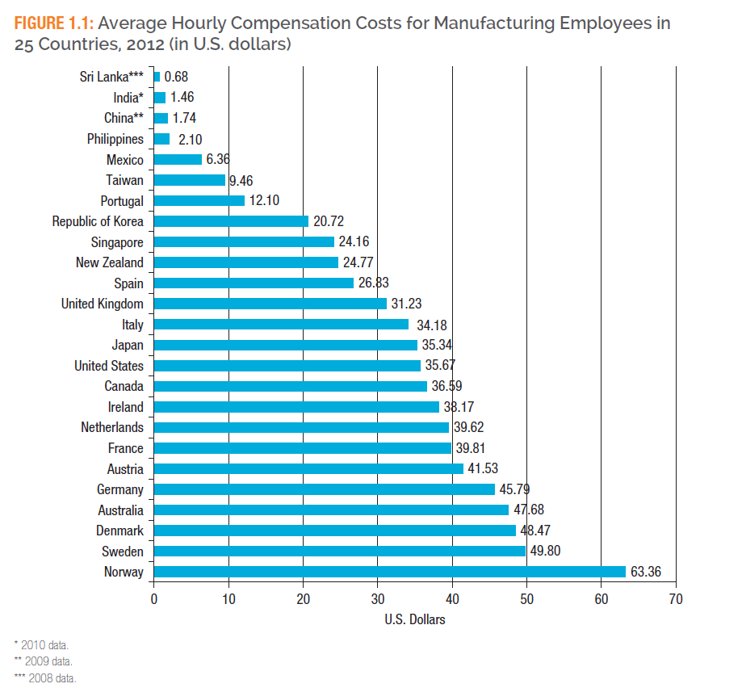
Offshoring
SOURCE: Adapted from the U.S. Bureau of Labor Statistics, International Comparisons of Hourly Compensation in Manufacturing, August 9, 2013.
Notes:
Figure 1.1 compares the average hourly compensation costs in U.S. dollars for manufacturing employees in 25 countries. The hourly amount includes the payments made directly to workers, as well as employers’ expenditures on benefits and social insurance.
Bureau of Labor Statistics, Charting International Labor Comparisons, 2010 edition, page 24.

Slide 8
Outsourcing
Outsourcing refers to contracting with a third party or an external company to manufacture a good or deliver a service.
The external company may or may not be a foreign company.
India has now become the hotspot for outsourcing.
Because of the continuing offshoring and outsourcing, manufacturing in United States has declined from nearly 30% of the gross domestic product (GDP) after World War II to just 10% by 2008.

Slide 9
Consider This 1.1: Is American Manufacturing Dead?
A study* found that American manufacturers have a better chance of surviving the onslaught of offshoring and outsourcing if they adhere to the following principles:
Build technologies that cannot be duplicated.
Bundle value-added services along with manufactured products.
Manufacture high-quality, high-price goods in-house, and outsource low-profit and labor-intensive work.
*Jacoby, D., (2008), “Can western manufacturers beat the competition?” APICS Magazine, May/June, pp. 40-44.

Slide 10
Globalization, Supply Chains, and Operations Management
A supply chain is a sequence of interconnected organizations that help develop, produce, distribute, and sell a product to the final consumer.
A supply chain is often called a value chain.
Global supply chains are a global networks of organizations involved in these activities.
Operations management (OM) is the process of managing the system of designing, producing, and delivering goods or services that add value throughout the supply chain and benefit the final consumer.

Slide 11
Consider This 1.2: Why You Should Consider a Career in Operations and Supply Chain Management
Managing operations and supply chains has become the focus of every senior executive and is at the top of the corporate agenda.
Graduates with specialization in service operations will be hired to work in diverse areas.
There are many career opportunities in a variety of organizations for people with these credentials.
In addition to securing a degree in OM or SCM, you can enhance your education by joining professional organizations e.g. APICS, ISM, ASQ, etc. that offer certifications.

Slide 12
1.2 What Does Operations Management Entail?
Each organization in a supply chain has internal operations that it has to manage effectively.
Managing operations within each company in a supply chain requires planning, organizing, and executing both long-term and short-term tasks.
Effectively managing operations requires cross-functional cooperation not only within your own company but also with other businesses, or partners, in the supply chain.

Slide 13
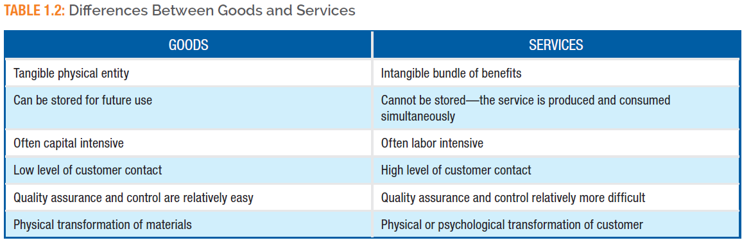
Goods and Services
A good is a tangible physical entity such as a car, camera, or a television set.
Services are intangible in the sense that they are a set of benefits that may or may not be accompanied by a tangible good.

Slide 14
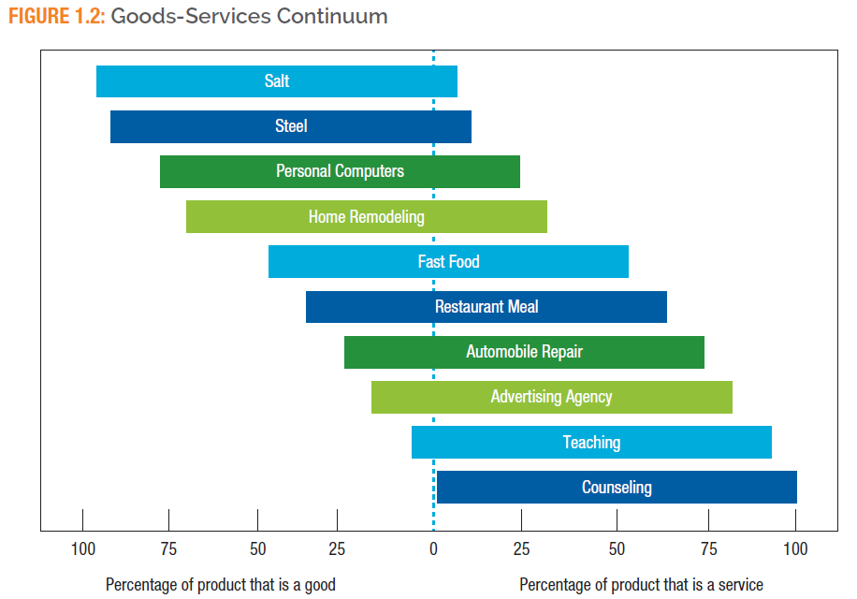
Goods and Services Continuum
The operation functions of most businesses provide a mix of both goods and services.
SOURCE: Adapted from Economypedia.com. Retrieved June 16, 2015, from http://www.economypedia.com/wiki/index.php?title=Goods_and_services

Slide 15
Consider This 1.3: Service Operations and India
India is the world’s leading service provider.
India has a large pool of highly skilled workers at less than half the cost of developed countries.
Many Indian companies are global leaders in software development and business processes.
Many multinational companies such as Microsoft have established operations in India in order to take advantage of India’s low-cost services.

Slide 16
Operations as a Transformation System
OM is a system that transforms inputs into outputs to create value.
The transformation process can be:
Physical: manufacturing operations
Locational: transportation and warehouse operations
Transactional: banking and retail operations
Physiological: health care
Psychological: entertainment

Slide 17
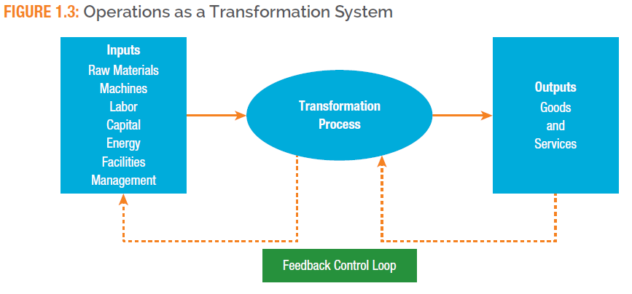
Operations as a Transformation System
In any OM system, outputs should meet standards for that system.
If the output does not meet the standards, then changes need to be made to the transformation process, the inputs, or both.

Slide 18
Typical Functions’ Interface With Operations
Finance provides funding that allows a firm’s operations group to produce products.
Marketing gathers market intelligence and can provide the operations group with meaningful ideas.
IT provides the operations group with technical information support.
HR provides the recruitment, hiring, and training of operations personnel.
R&D develops product and service ideas for the operations group to pursue.

Slide 19
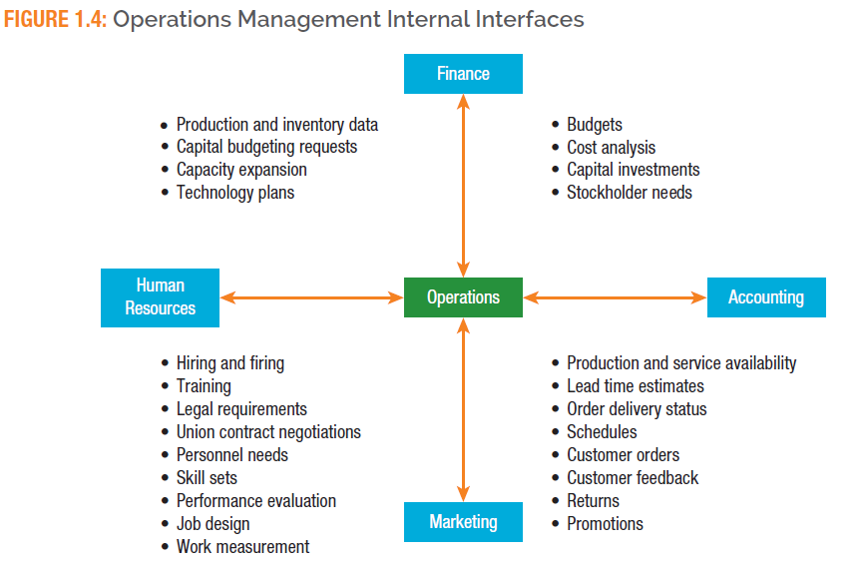
Operations Management Internal Interfaces
SOURCE: Adapted from Russell, R.S., and Taylor III, B.W., (2011) Operations Management: Creating Value along the Supply Chain, 7th Ed., John Wiley and Sons, Hoboken, NJ, page 4.
Notes:
Figure 1.4 shows the internal interfaces between operations and the four primary functional areas of finance, accounting, marketing, and human resources.

Slide 20
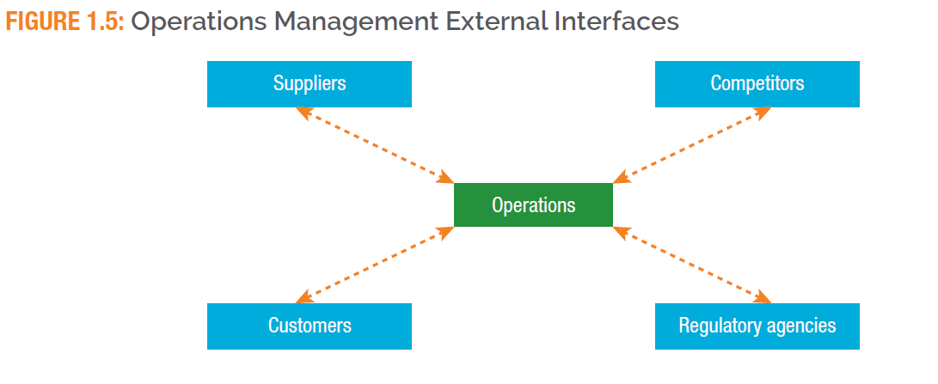
Operations Management External Interfaces

Slide 21
1.3 What Does Supply Chain Management Entail?
A company has to decide which functions to outsource and which functions to perform in-house.
Companies that choose to locate their manufacturing facilities overseas face logistical problems.
These companies must also examine these issues from the perspective of the global supply chain.
The recent financial turmoil and economic turbulence have made the job of managing supply chains even more complex.

Slide 22
Operations Profile: Zara – Bringing Speed to Fashion Through Supply Chain Management
It takes Zara three weeks to spot, design, manufacture, and ship one of the 300,000 different pieces of clothing it sells to stores each year.
The promotion attracts shoppers who know that if they hesitate, the style will be gone.
The secret to Zara’s success is a well-developed supply chain that includes the firm’s own retail stores, distribution centers, a design and manufacturing center, and textile-milling factories.

Slide 23
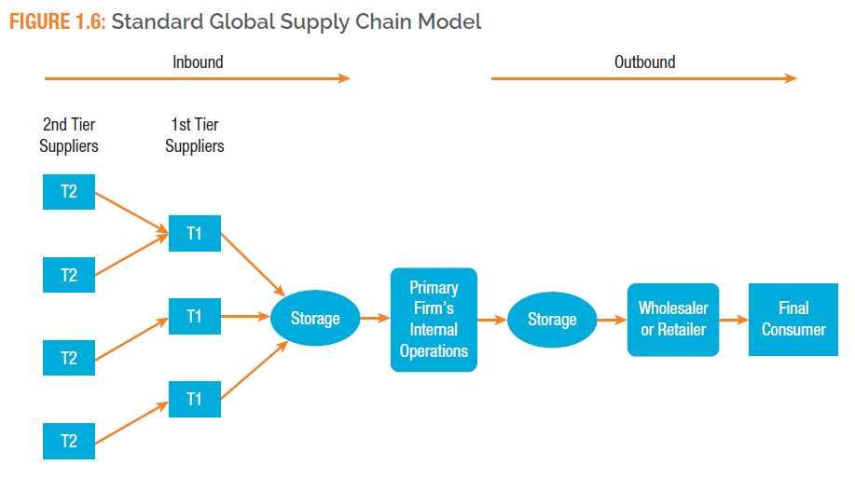
Standard Global Supply Chain Model
Notes:
Figure 1.6 illustrates a typical global supply chain for a manufacturing company.
Each organization’s supply chain has inbound and outbound elements.
The inbound portion can consist of local or foreign suppliers of product ideas, designs, basic raw materials and components, transportation links, and warehouses. It ends with the internal operations of the company.
The outbound portion begins when the organization delivers its output to its immediate customers in the supply chain. This portion of the supply chain might include globally dispersed wholesalers, retailers, distribution centers, and transportation companies, the consumer, and companies that facilitate the return of products or their disposal.
Many online businesses often contract with other companies to handle the return of products purchased online by their customers.

Slide 24
Supply Chain Structures and Partners
First-Tier Suppliers
Second-Tier Suppliers
Inbound Storage
Outbound Storage
Wholesalers and Retailers
Final Consumers

Slide 25
The 2014 Release of the Apple IPhone 6
GT was Apple’s sole supplier of the super-hard sapphire smartphone screen.
Apple was so set on this technology that it formed a JV with GT to build a $1 billion manufacturing plant.
GT, in August, 2014, sought bankruptcy protection.
Apple’s response to this disaster was to use the standard glass screen for the iPhone release.
Apple continues to investigate the possibility of sapphire glass for future model releases but it has learned a hard lesson about using a sole-source supplier for such a critical product.

Slide 26
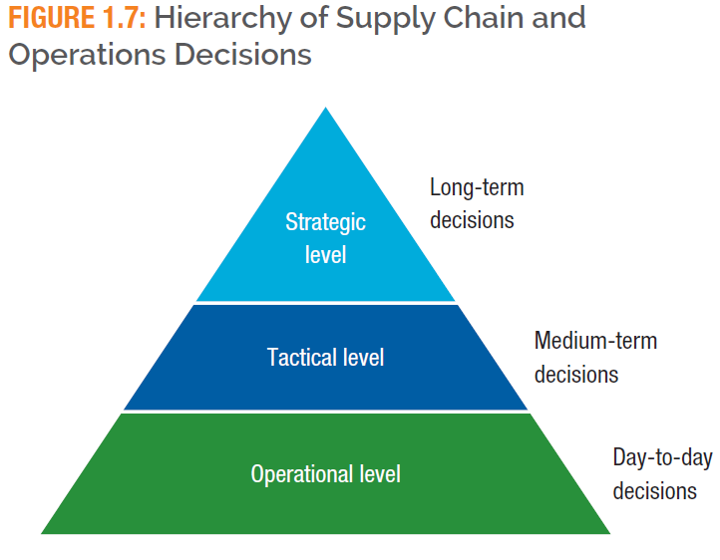
Decisions in Operations and Supply Chain Management
SOURCE: Enterprise Integration Laboratory (EIL). (n.d.). Supply chain management. Toronto, Ontario, Canada: University of Toronto. Retrieved from http://www.eil.utoronto.ca/profiles/rune/node5.html
Notes:
These types of decisions fall into a hierarchy, as shown in Figure 1.7. The decisions at a higher level in the pyramid will set the constraints for lower-level decisions. Strategic decision have a long-term impact on the firm, whereas tactical decisions are made for the medium term and operational decisions are short-term, day-to-day decisions.

Slide 27
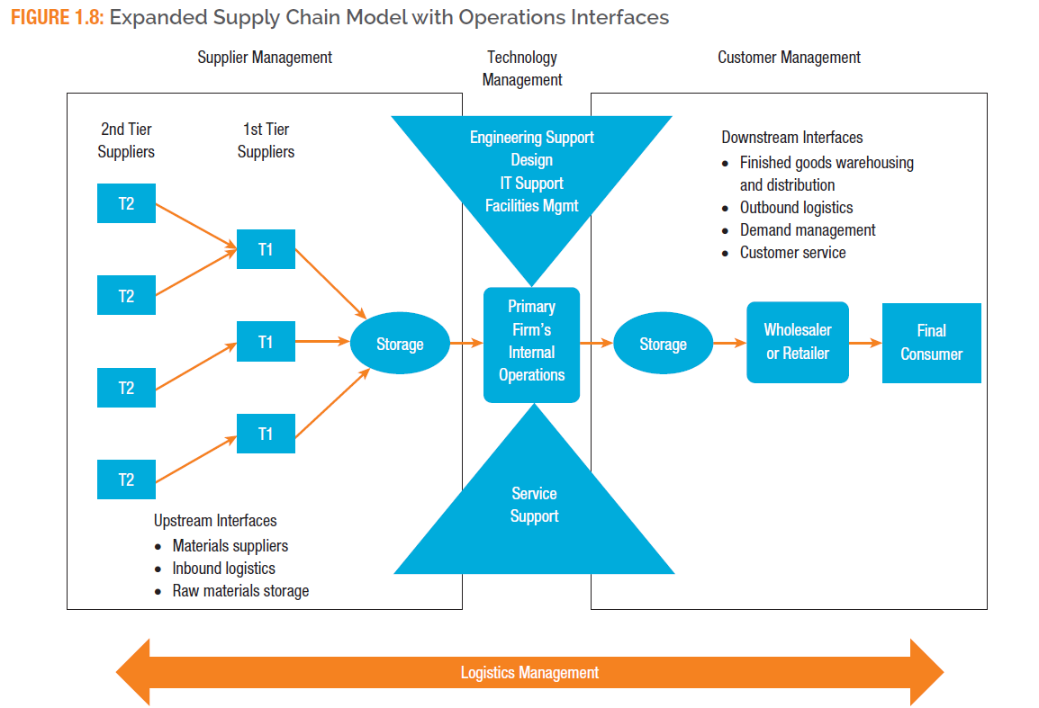
Expanded Supply Chain Model With Operations Interfaces

Slide 28
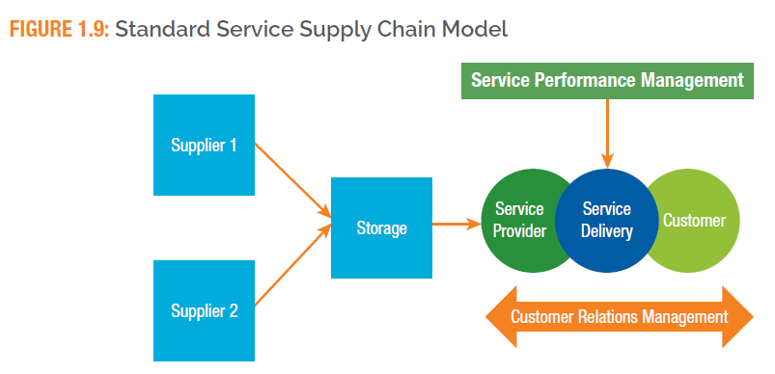
Standard Service Supply Chain Model
SOURCE: Baltacioglu, T., Ada, E., Kaplan, M., Yurt, O., & Kaplan C. (2007). A new framework for service supply chains. Services Industry Journal, 27.

Slide 29
1.5 The Evolution of Operations and Supply Chain Management
The concept of production is as old as humanity itself.
Production during those early days was performed by skilled artisans who produced customized goods for individual customers.
Large-scale production of consumer goods began during the Industrial Revolution.
During the twentieth century most operations innovations occurred.

Slide 30
Evolution of OM and SCM Between 1970–1990s
TQM focuses on continuously improving the quality of a company’s products and processes.
Six Sigma centers around improving quality through reducing the number of defects.
Lean manufacturing is built on the idea of eliminating non-value added (waste) activities.
Agile manufacturing is the ability of an organization to respond quickly to market changes.
BPR is the radical redesign of a firm’s existing workflows and resources to reduce operational costs and better meet the needs of customers.

Slide 31
Corporate Social Responsibility
Corporate Social Responsibility (CSR) is the process of incorporating the interests of the public into a company’s core business.
One of the principles of CSR is that companies should make decisions with an eye toward what is good for the triple bottom line.
Triple bottom line consists of people, the planet (environmental impact), and profits.

Slide 32
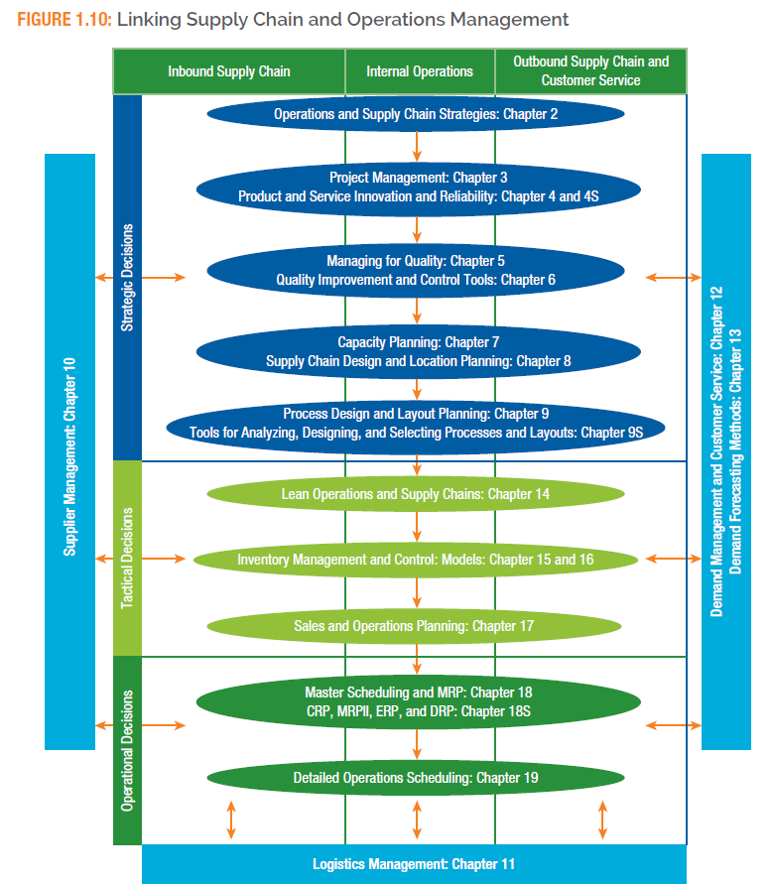
Road Map: How This Text is Organized

