Slide 1
Chapter One: Public Policy and Politics

Slide 2
Broad Course Goals
To help you:
Understand public policy and how governments make policy decisions
Think about implications of policy choices
Develop critical thinking skills to consider alternative courses of action

Slide 3
Policy Issues We Will Study This Term
Economics
Health care
Welfare and Social Security
K-12 education and higher education
Environment and energy
Foreign policy and homeland security

Slide 4
Introduction
What is public policy? What is involved?
What is the goal of public policy?
Why does government take action?
What factors affect policymaking?
How can we improve the policies made by government?

Slide 5
Regulation of Amusement Parks
Video (http://youtu.be/1vlL5FPq_3o):
News story; federal government does not oversee theme park rides (1:38) incident at Universal Studios
Notes:
Video: News story; federal government does not oversee theme park rides (1:38) incident at Universal Studios
http://youtu.be/1vlL5FPq_3o news feature; not graphic.

Slide 6
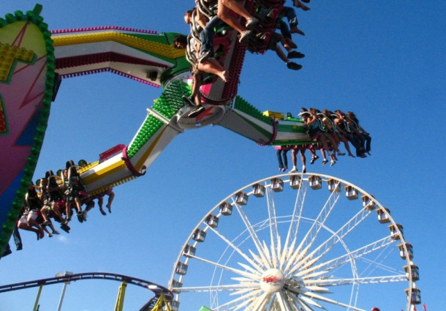
Discussion
Should government regulate amusement park rides?
  Arguments for
  Arguments against
If so, which level of government should do it?
Notes:
Picture licensed by Bing Creative Commons

Slide 7
What is a Policy?
(of any kind)
Do you know of any policies in place where you work?
A purposive course of action that an individual or group consistently follows in dealing with a problem
It can be in the public or private sector.
Notes:
Do you know of any policies in place where you work?
A purposive course of action that an individual or group consistently follows in dealing with a problem
It can be in the public or private sector.

Slide 8
What is Public Policy?
Government action that responds to public problems
It is what government does (at all levels)
Public problems – not being solved by free market or individuals themselves (Social Security – retirement savings)
To solve a problem or reach a goal, do we need new “courses of action” (laws, regulations, programs)
Notes:
Public problems – not being solved by free market or individuals themselves (Social Security – retirement savings)
To solve a problem or reach a goal, do we need new “courses of action” (laws, regulations, programs)?

Slide 9
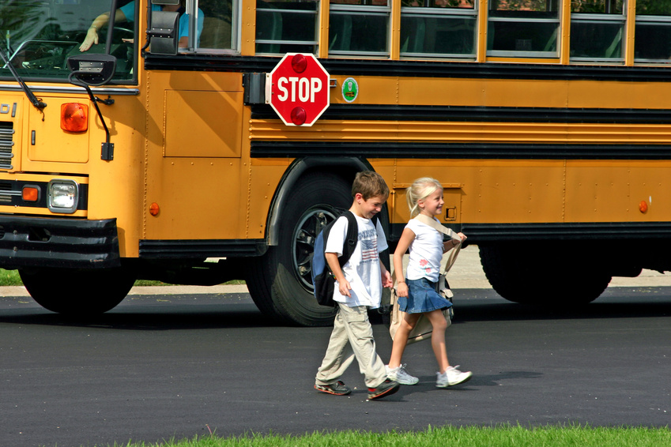
Why Have Policies?
To promote and protect the public good
Notes:
Photo from Clip Art

Slide 10
Why Study Public Policy?
Improve citizens’ ability to participate and make choices
    More knowledge of policy issues and process
Improve citizens’ ability to influence policy decisions
    More informed arguments and analyses

Slide 11

How Might Government Act?
Some Policy “Tools” Include
  Give tax breaks
  Subsidize
  Regulate
  Educate
  Offer direct services
  Set up market incentives
Notes:
Photo from Clip Art

Slide 12
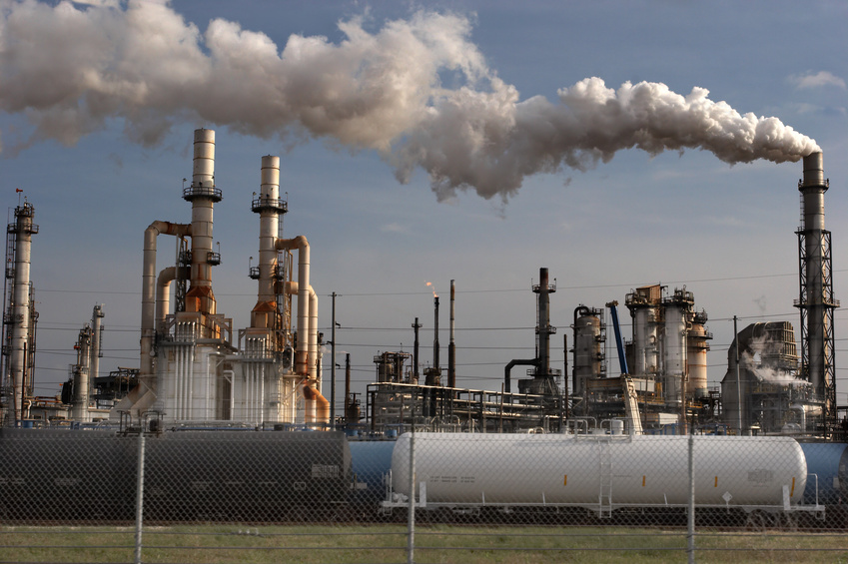
What a Great Time to Study Public Policy…
Should your community, state, or U.S. government regulate greenhouse gases?
Does someone in your family own a small business?
Do you have health insurance?
Climate Debate (http://www.youtube.com/watch?v=1zFruNyiUHQ)
Notes:
Video clip: http://www.youtube.com/watch?v=1zFruNyiUHQ Meet the Press debate on Climate Change with Bill Nye the science guy, and Congresswoman Marsha Blackburn. Should the U.S. develop policy? (Time: 13:42)
Photo from Clip Art

Slide 13
How Are Problems in Society Addressed?
Private action:
Individuals and corporations act individually
There is little coordination or thought about public well being
People have liberty to pursue their own interests
Government action:
Governments can set policies that require people and organizations to act collectively
The focus is on public well being
People must comply with the law

Slide 14
What Situational Factors Affect Policymaking?
“Context” or surrounding circumstances

Slide 15
Contexts of Public Policy
Social context
  Societal changes (e.g., population changes)
Economic context
  State of the economy (e.g., surplus vs. deficit)
Political context
  Political/ideological issues (who is in power?)
Governing context
  Structure of government (e.g., separation of powers)
Cultural context
  Values, beliefs (e.g., red state vs. blue state)

Slide 16
Social and Demographic Changes
Video: (https://www.youtube.com/watch?v=31wEk1nHTo4)
Polarization Around Social Identity Is Shaping the Future of Politics
Notes:
Video (https://www.youtube.com/watch?v=31wEk1nHTo4)

Slide 17
Why Does Government Take Action?
When the public decides that private action IS NOT enough
  The problem has become too severe or widespread

Slide 18
Many Reasons. . .
Political reasons
Moral or ethical reasons
Economic reasons – Market failures
  The “free market” does not solve a problem

Slide 19
Should the U.S. Become More Involved in Climate Change Policy?
Video: (http://www.youtube.com/watch?v=1zFruNyiUHQ)
Meet the Press debate on Climate Change with Bill Nye the science guy and Congresswoman Marsha Blackburn. Should the US develop policy? (Time: 13:42)
Notes:
Video: http://www.youtube.com/watch?v=1zFruNyiUHQ Meet the Press debate on Climate Change with Bill Nye the science guy and Congresswoman Marsha Blackburn. Should the US develop policy? (Time: 13:42)

Slide 20
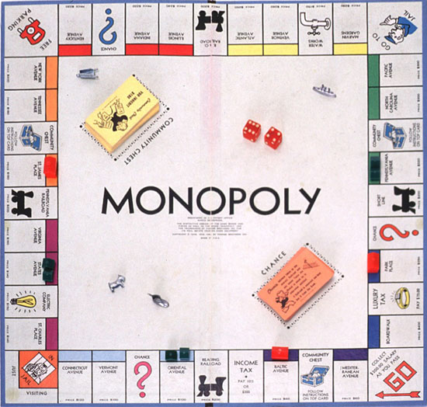
Market Failures: Four Types
Monopolies: one entity has too much control over the market.
Externalities: effects external to a transaction.
    Negative: third party harmed by a transaction (e.g. pollution)
    Positive: third party benefits from a transaction (e.g. education)
Notes:
Monopoly game licensed by Bing Creative Commons
Externality – transaction between two parties affects a third party
Negative externality – someone else is harmed because of other person’s actions
home foreclosures – property values
water pollution – farmers – runoff
air pollution – burning coal
Positive externality – education for children or higher education. All taxpayers benefit. Our region benefits when you finish college – why?
fix up neighborhood – all benefit

Slide 21
What Constitutes a Monopoly?
Video: (https://www.youtube.com/watch?v=LCpIm4YolQI)
“Is Google a Monopoly?” (June 8, 2012) Wall Street Journal Opinion. Good debate starter – what makes a monopoly? (Time: 3:07)
Notes:
Video: https://www.youtube.com/watch?v=LCpIm4YolQI “Is Google a Monopoly?” (June 8, 2012) Wall Street Journal Opinion. Good debate starter – what makes a monopoly? (Time: 3:07)

Slide 22
Marketing Failures (cont’d)
Information Failures
  Incomplete information
  Consumers are unable to make some decisions on their own due to complexities
  Not a problem for certain items
  Can be a problem for complex items that are difficult to understand e.g. purchasing health insurance, privatizing Social Security
Notes:
Information failures – in a perfect market consumers have the information they need. Medicare Part D. Privatize Social Security – can everyone be a smart investor?

Slide 23
Marketing Failures (cont’d)
4. Protection of Public or Collective Good
  Free market transactions might harm things we all use or enjoy
  e.g. wetlands, clean air, beautiful places
  Government protects the jointly consumed or collective resources e.g. national security, natural resources
Notes:
Example – national security – safety is a collective good
Example – state smoking bans – the air, or not being exposed to tobacco, is a collective good

Slide 24
  Private Goods and Public Goods
    No Joint Consumption Joint Consumption
Exclusion is 1 2
Feasible Pure Private Goods Toll goods
Examples: DVD players, automobiles, Examples: Cable TV Services,
houses electrical utilities
Exclusion is 3 4
Not Feasible Common pool resources Pure public goods
Examples: air, water, grazing land, Examples: national defense,
oceans, fisheries, wildlife public parks
Notes:
INSERT TABLE 1.1
No joint consumption = individuals use it and can use it up
Joint consumption = shared, not sold to an individual
Exclusion feasible – not everyone uses it
Exclusion not feasible – affects the entire public
1. The government protects things that the free market wouldn’t protect
Does not protect pure private goods, which are not subject to market failure
2. Toll goods, government subsidizes to keep these goods affordable so that all people can access the service (electricity, roads)
3. Common pool – shared resources; everyone uses these goods. If left alone, individuals might use the goods up or destroy them, so government protects
4. Pure public goods – national defense; there is no market incentive at all for this type of thing; it wouldn’t happen if not for the government.

Slide 25
How Can We Improve the Policies That Our Governments Make?
Study the problems
Develop careful policies

Slide 26
Policy Analysis
A systematic method for studying
  Problems – nature and scope
  Proposals, policy alternatives – possible actions
  Policy outcomes – effects of policies
Dissect problems and possible solutions
Good policy analysis equals better policy
Policy analysis is a career field!
Notes:
Policy analysis – “deconstructing something to its basic elements and looking at those elements”
Study the causes and consequences of policy decisions

Slide 27
Why Should You Study Public Policy?
Improve your ability to take a position and participate
Influence policy decisions
      If you know how policies get made, you can influence that process!
      If you stay informed on issues and speak up, you may influence the outcome for the better!

Slide 28
Evaluate Our Policies
Evaluative criteria help policymakers ask:
Did the policy alleviate the problem?
Was the policy fair and equitable?
Did the policy impinge too much on our freedoms?
Will the policy be feasible to implement?

Slide 29
Wrap-Up
What is public policy? What is involved?
What is the goal of public policy?
Why does government take action?
What factors affect policymaking?
How can we improve the policies made by government?

