Slide 1
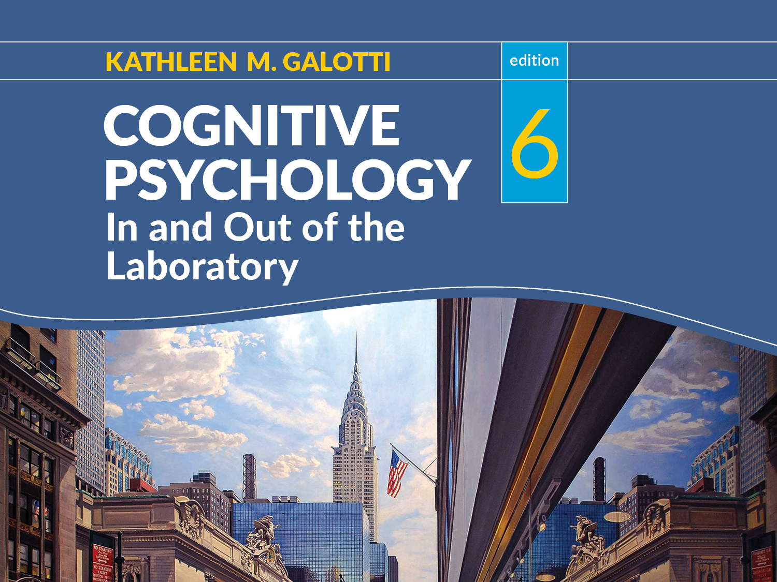

Slide 2
Chapter 1
Cognitive Psychology: History, Methods, and Paradigms

Slide 3
Setting the stage: What is cognition?
Cognition = what goes on inside our heads
When we perceive
When we pay attention
When we remember
When we think
Notes:
Learning objective: Identify examples of cognitive activity that occur in everyday life
Have students think of their own examples of cognition. Note that the act of “thinking of examples of cognition” is itself an example of cognition.

Slide 4
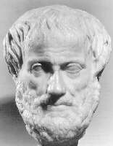
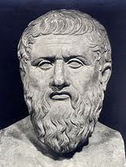

Influences on the study of cognition
Empiricism vs Nativism
Aristotle
Plato
John Locke
“Blank slate”
Descartes
Experience
Heredity and biology
Notes:
Learning objective: Describe the various schools of psychology as their history relates to cognitive psychology
Empiricism: Knowledge comes from experience
Locke: learning takes place through the association of ideas, when two experiences happen to occur at the same time
Nativism: emphasizes “native ability,” constitutional factors, biologically endowed capacities
Cognitive functions are “hard wired”
Still a controversial issue in cognitive psychology

Slide 5


Influences on the study of cognition
Structuralism (Wilhelm Wundt)
Apple
Red
Juicy
Tart
Round
Shiny
Notes:
Learning objective: Describe the various schools of psychology as their history relates to cognitive psychology
1879: Wilhelm Wundt founds first experimental psychology laboratory
Wanted to establish a science of mind, similar to chemistry, to find the “mental elements” and how they react to form new experiences—to understand the structure of mental experience
Developed technique of introspection for examining one’s conscious experiences and breaking them down into their simplest properties: mode, quality, intensity, and duration

Slide 6
Influences on the study of cognition
Functionalism (William James)
What is the purpose of the mind?
Evolution and adaptation
Habit
Study real-life situations
Notes:
Learning objective: Describe the various schools of psychology as their history relates to cognitive psychology
William James
Drew on the concepts of evolution and adaptation: How does the mind help us to adapt to our environment?
Study of habits: Establish good habits (eat fruits and veggies) and avoid bad habits (fast food)
James preferred to study behavior in the real world rather than a sterile laboratory

Slide 7
Influences on the study of cognition
Behaviorism
John B. Watson
B. F. Skinner
Notes:
Learning objective: Describe the various schools of psychology as their history relates to cognitive psychology
Behaviorists believed that references to unobservable mental states and processes were unscientific and should not be part of psychology
Watson believed that “thinking” was simply a perception of slight muscle movements in the tongue and larynx
Skinner felt that mental representations were simply internal copies of external stimuli. Because they are triggered by external stimuli and caused behaviors, there was no need to study them separately from the stimulus and the response.
Other behaviorists, such as Tolman, were more open to actually studying things that happen “in the head”—for example, cognitive maps that allow rats to find their way through mazes

Slide 8
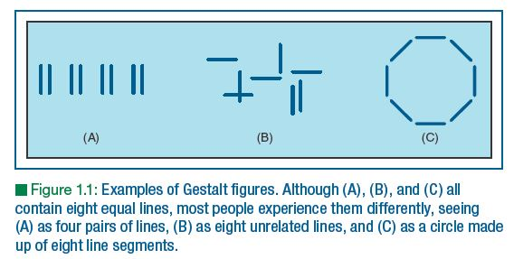
Influences on the study of cognition
Gestalt Psychology
Whole > Sum of Parts
Notes:
Learning objective: Describe the various schools of psychology as their history relates to cognitive psychology
It is the relationship among elements that determines our experience—not the individual elements themselves.
The mind imposes structure and organization on the environment, simplifying the world and making it meaningful.

Slide 9
Influences on the study of cognition
The study of individual differences
Francis Galton
Measurement of intelligence
Statistical tests
Notes:
Learning objective: Describe the various schools of psychology as their history relates to cognitive psychology
Galton was a cousin of Charles Darwin
Galton invented many statistical techniques to analyze his data on the heritability of “eminence.” Students who don’t like statistics can blame Francis Galton!

Slide 10
Influences on the study of cognition
The cognitive revolution
Roots in human factors engineering
Linguistics: Noam Chomsky
Neuroscience: Localization of function
Computers and artificial intelligence
Notes:
Learning objective: Describe the various schools of psychology as their history relates to cognitive psychology
Cognitive revolution rejected the assumptions of behaviorism and sought to study the unobservable processes of the mind
Human factors engineering: concept of a person-machine system
Viewed people as limited-capacity processors of information
Influenced by developments in linguistics, neuroscience and computer science
Chomsky showed that behaviorism cannot adequately explain language, particularly the learning of the rules of grammar
Neuroscience: discovery of cell assemblies in the brain that were specialized to very specific content (vertical lines, movement in a particular direction)
Computer metaphor became central to study of cognition. Artificial intelligence studies how to program computers to solve the same sorts of problems that humans do.

Slide 11
Research methods in cognitive psychology
Experimental method
Independent variable: manipulated
Dependent variable
Between-subjects design
Within-subjects design
Quasi-experiment
Notes:
Learning objective: Summarize the major research designs used in cognitive psychology
Experimental method
Independent variable = presumed cause, manipulated by the experimenter
Dependent variable = presumed effect; measured by the experimenter
Between subjects design: different groups of people receive different conditions
Within subjects design: each person is exposed to more than one condition
Quasi-experiment: the presumed cause that you want to investigate cannot be controlled and randomly assigned by the researcher (gender, age, ethnicity, educational background, etc.)

Slide 12
Research methods in cognitive psychology
Naturalistic observation
High ecological validity
Low experimental control
Controlled observation
Clinical interview
Notes:
Learning objective: Summarize the major research designs used in cognitive psychology
Naturalistic observation: watching people in everyday contexts
High in ecological validity, but….
Low in experimental control
Controlled observation: Researcher can control the setting or the conditions of the study
Clinical interview: Researcher intervenes through asking a series of planned, open-ended questions

Slide 13
Research methods in cognitive psychology
Additional methods
Introspection
Investigations of neural underpinnings
Notes:
Learning objective: Summarize the major research designs used in cognitive psychology
Introspection: asking people to “think aloud” while they solve a problem or make a decision
Has all of the benefits and drawbacks of observational studies, plus
Benefit: an individual may have better insight into his or her own experience than an outside observer could have
Drawback: people may also be more biased about their own cognitions
Investigations of neural underpinnings (cognitive neuroscience): to be discussed in Chapter 2

Slide 14
Paradigms of cognitive psychology
What is a paradigm?
Paradigms determine our
Assumptions
Research methods
Questions
Analogies
Notes:
Learning objective: Differentiate among the four paradigms of cognitive psychology
A paradigm is a body of knowledge structured according to what its proponents consider important and what they do not
Assumptions made by investigators
Appropriate types of research methods
Appropriate questions for the field
Appropriate analogies

Slide 15
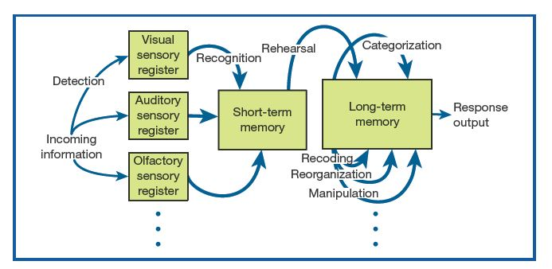

Paradigms of cognitive psychology
The information processing approach
Notes:
Learning objective: Differentiate among the four paradigms of cognitive psychology
Key elements:
Processing occurs in a series of stages
Information is stored in specific places while being processed
People’s cognitive abilities can be thought of as systems of interrelated capabilities
Metaphor of computer
Rooted in structuralism

Slide 16
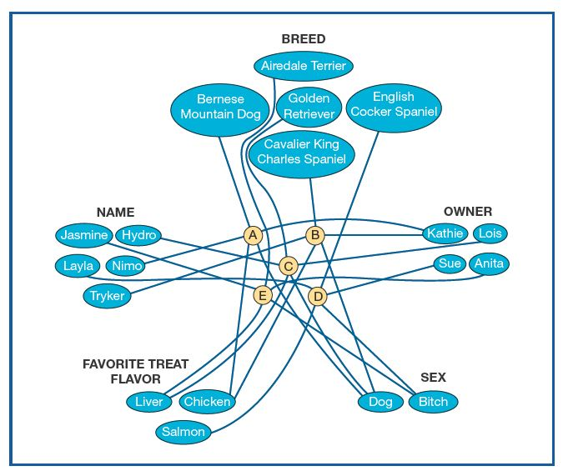

Paradigms of cognitive psychology
Connectionism
Notes:
Learning objective: Differentiate among the four paradigms of cognitive psychology
Key elements:
Processing occurs in parallel rather than in a series of stages
Each processing unit is connected to other units
Connections between two units have positive or negative weights, causing one unit to either excite or inhibit another
More like the human nervous system

Slide 17
Paradigms of cognitive psychology
Evolutionary approach
Human mind has evolved
Understand evolutionary pressures on ancestors
Notes:
Learning objective: Differentiate among the four paradigms of cognitive psychology
Evolutionary approach:
Human beings have specialized areas of competence produced by our evolutionary heritage
The environment that shapes us is not only physical, but also ecological and social
Helps us understand how modern human beings reason about cheating, for example

Slide 18
Paradigms of cognitive psychology
Ecological approach
Cognitive processes vary with context.
“Embodied cognition”
Notes:
Learning objective: Differentiate among the four paradigms of cognitive psychology
Ecological approach:
All cognitive activities are shaped by the culture and by the context in which they occur
Focus on studying cognition in everyday contexts
Overlaps more with evolutionary approach than with information-processing or connectionist
Shaped by functionalist and Gestalt approaches
Embodied cognition: body requires a mind to make it function; our cognitive processes are always linked to the fact that minds are typically encased in bodies that influence how we perceive, navigate and behave

Slide 19
Review
Role of cognition
Structuralism, functionalism, behaviorism, and Gestalt psychology
Influences outside of psychology
Research methods
Four paradigms

