Slide 2
Chapter 1
The What and the Why of Statistics

Slide 3
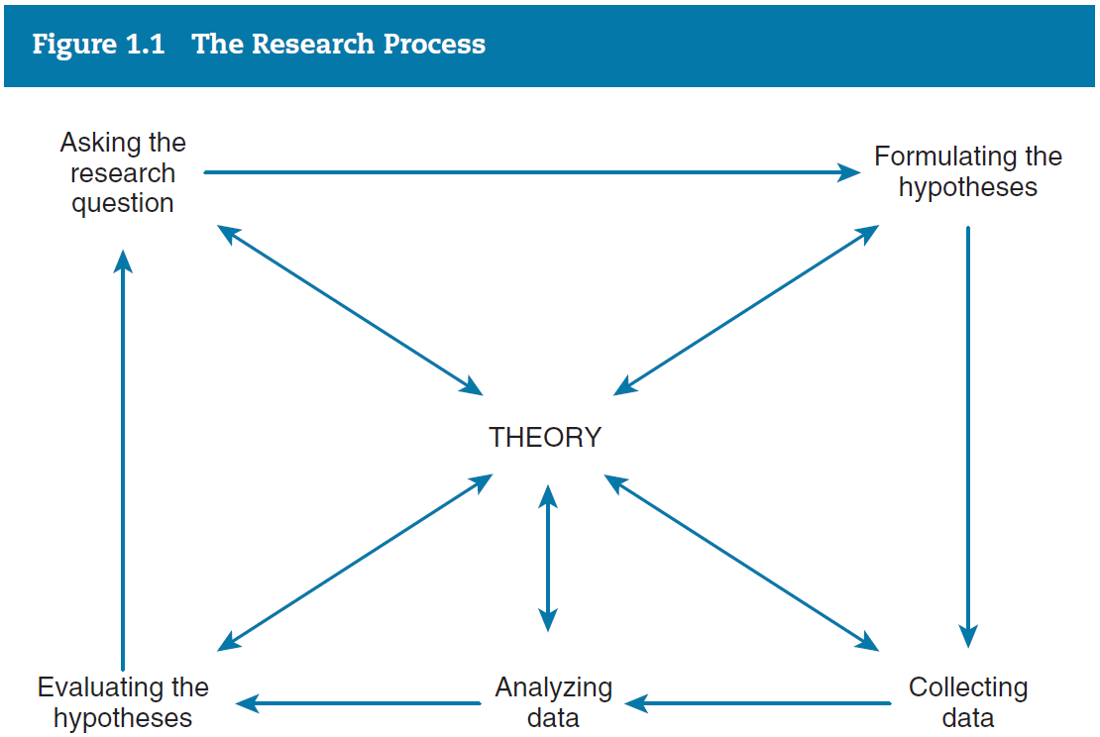
The research process

Slide 4
Asking a research question
What is empirical research?
Research based on information that can be verified by using our direct experience
Cannot rely on reasoning, speculation, moral judgment, or subjective preference
Empirical: Are women paid less than men for the same types of work?”
Not empirical: Is racial equality good for society?

Slide 5
The role of theory
A theory is a set of assumptions and propositions used by social scientists to explain, predict, and understand social phenomena.
Social scientists use theory to attempt to establish a link between what we observe (the data) and our understanding of why certain phenomena are related to each other in a particular way

Slide 6
The hypothesis
A statement predicting the relationship between two or more observable attributes
Subject to empirical verification
A statement of a relationship between characteristics that vary
Variables

Slide 7
Variable
A property of people or objects that takes on two or more values
Must include categories that are both exhaustive and mutually exclusive
Social class, age, gender, and income

Slide 8
Units of analysis
The level of social life on which social scientists focus
Individual
Family
Organization
City

Slide 9
Cause and effect
Three Criteria
The cause has to precede the effect in time
There has to be an empirical relationship between the cause and effect
This relationship cannot be explained by other factors

Slide 10
Variables
Dependent
The variable to be explained
Independent
The variable expected to account for the dependent variable

Slide 11
Variables
The dependent variable is always the property one is trying to explain
The object of the research
The independent variable usually occurs earlier in time than the dependent variable
The independent variable is often seen as influencing, directly or indirectly, the dependent variable

Slide 12
Example
Hypothesis
People who attend church regularly are more likely to oppose abortion than people who do not attend church regularly

Slide 13
Example hypothesis
Identify the variables
Independent = Church attendance
Dependent = Attitudes toward abortion

Slide 14
Example hypothesis
Identify possible control variables
Gender
Age
Religious affiliation
Political party identification

Slide 15
Example hypothesis
Are the causal arguments sound?

Slide 16
Collecting data
Researchers must decide
How to measure the variables of interest
How to select the cases for the research
What kind of data collection techniques to use

Slide 17
Levels of measurement
Nominal
Ordinal
Interval-Ratio

Slide 18
Nominal
Numbers or other symbols are assigned to a set of categories for the purpose of naming, labeling, or classifying the observations. Nominal categories cannot be rank-ordered
Political party
Religion
Race

Slide 19
Ordinal
Nominal levels that can be ranked from low to high
Social class
Upper
Middle
Working

Slide 20
Interval-ratio
All cases are expressed in the same units
Age
Income
SAT scores
Ratio variables
Natural zero point

Slide 21
Cumulative property
Variables that can be measured at the interval-ratio level of measurement can also be measured at the ordinal and nominal levels
Variables that are measured at the nominal and ordinal levels can’t be measured at higher levels

Slide 22
Cumulative property
Exception
Dichotomous variables
Because there are only two possible values for a dichotomy, we can measure it at the ordinal or the interval-ratio level
There is no way to get them out of order
More powerful variable

Slide 23
Variables
Discrete
Variables that have a minimum-sized unit of measurement which cannot be sub-divided
The number of children per family

Slide 24
Variables
Continuous
Variables that can theoretically can take on all possible numerical values in a given interval
Length

Slide 25
Analyzing data
Population
The total set of individuals, objects, groups, or events in which the researcher is interested
Sample
A relatively small subset selected from a population

Slide 26
Analyzing data
Descriptive statistics
Procedures that help us organize and describe data collected from either a sample or a population
Inferential statistics
The logic and procedures concerned with making predictions or inferences about a population from observations and analyses of a sample

Slide 27
Key terms
Data
Dependent Variable
Descriptive Statistics
Dichotomous Variable
Empirical Research
Hypothesis
Independent Variable
Inferential Statistics
Interval-ratio
Measurement
Nominal Measurement

Slide 28
Key terms
Ordinal Measurement
Population
Research Process
Sample
Statistics
Theory
Unit of Analysis
Variable

