Slide 1
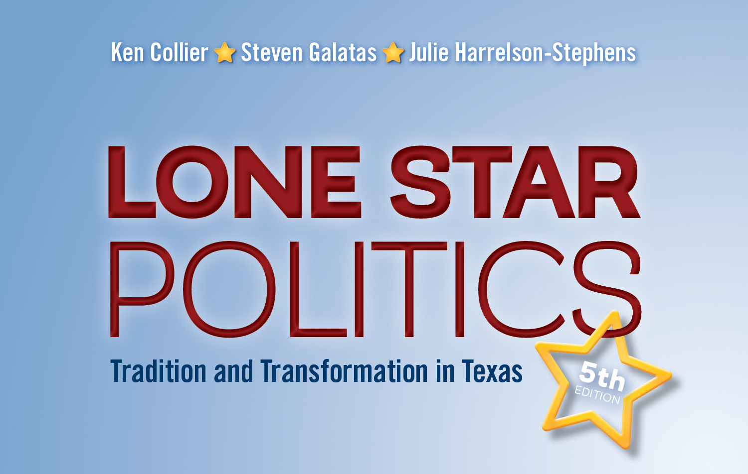
Chapter 1
Introduction: “Gone to Texas”

Slide 2
Introduction
The gap between legend and reality
  How do we manage change? Then and now
  Immigration patterns and reactions under Mexico and today
  Traditional frontier image versus substantial innovation in the global marketplace
Collier, Lone Star Politics 5e. CQ Press, 2018.

Slide 3
Texas Geography
Texas is the second largest state, ranging from urban to rural, forest to desert
Distance complicates campaigning, encouraging disorganized, dramatic politics
  “there were more eccentric, unpredictable, and flat crazy characters than you’d find in any novel”
  —Former Lt. Gov. Ben Barnes
Collier, Lone Star Politics 5e. CQ Press, 2018.

Slide 4
Texas Geography
The costs and benefits of geographic size
  The state size insulated Texas from the large, corrupt party machines of the nineteenth century
  Spaciousness encourages independence and represents opportunity
  At the same time the size of Texas stifled the development of beneficial groups to support community interests
Collier, Lone Star Politics 5e. CQ Press, 2018.

Slide 5
The Birth of Texas Traditions
Native Americans
  Caddos—East Texas, “the Romans of Texas”
  Karankawas—on the Gulf Coast
  Apaches—in the Panhandle
The French
  Sieur de La Salle & René-Robert Cavelier
Collier, Lone Star Politics 5e. CQ Press, 2018.

Slide 6
The Birth of Texas Traditions
The Spanish
  Spanish horses transformed Indian society
  Suspicion of new arrivals—American immigrants would be nothing but “crows to pick out our eyes”
  High costs associated with maintaining missions and forts
  Spanish population decline forced recruiting Anglo settlers to populate their territory
Collier, Lone Star Politics 5e. CQ Press, 2018.

Slide 7
Mexican Independence
Mexican independence from Spain
Mexico authorized Anglo settlers
  Moses Austin
  Stephen F. Austin and the role of the empresario
Illegal immigrants created problems for Mexico and the empresarios
Collier, Lone Star Politics 5e. CQ Press, 2018.

Slide 8
The Texas Revolution
Divisive issues regarding Texas’s split with Mexico included:
  Political culture
  Spanish as the official language
  Catholicism as the official religion
  Slavery
Collier, Lone Star Politics 5e. CQ Press, 2018.

Slide 9
The Texas Revolution
Divisive issues regarding Texas’s split with Mexico
  Statehood within the Mexican national government or complete independence?
  Tejanos: Remain under Mexican rule or risk living under the rule of Anglo settlers?
  Anglos: United against Mexican rule but often fought amongst themselves after independence was won.
Collier, Lone Star Politics 5e. CQ Press, 2018.

Slide 10
The Republic of Texas
Key events
  Sam Houston elected president
  The Constitution of the Republic of Texas ratified
  Population doubled
  Process of annexation by United States started
  Mirabeau Lamar, president after Houston
    Opposed annexation, increased debt, disastrous relationship with Native American tribes
  Sam Houston elected for a second time
Collier, Lone Star Politics 5e. CQ Press, 2018.

Slide 11
The Republic of Texas
Key events
  Northern U.S. states objected to admitting another slave state
  Extensive Texas land claims, north and west
  Overtures to England and France
    Assistance with prisoners in Mexico
    Create incentive for U.S. to admit Texas, to avoid foreign presence on borders
Collier, Lone Star Politics 5e. CQ Press, 2018.

Slide 12
Texas Statehood
James K. Polk, backed by Andrew Jackson, makes Texas statehood a central part of his presidential campaign in 1844
The U.S. Senate admits Texas by a narrow margin
Formal statehood: February 19, 1846
Texas’s north and west borders are redrawn
Texas does not have the legal, constitutional, right to secede from the union
Collier, Lone Star Politics 5e. CQ Press, 2018.

Slide 13
Texas Statehood
Mexican–American war
  Confirming fears of statehood opponents?
  Orchestrated by President Polk?
Treaty of Guadalupe Hidalgo
  Established Rio Grande boundary
  Intensified clash of Mexican and Anglo cultures
Collier, Lone Star Politics 5e. CQ Press, 2018.

Slide 14
Texas in the Confederacy
With the rise of the cotton economy came increased reliance on and tremendous expansion of slavery
Despite Governor Sam Houston’s objections, the legislature voted to secede from the Union February 1, 1861
The Confederate regime was a disaster for pro-Union Anglos, Germans, Tejanos, and free blacks
Collier, Lone Star Politics 5e. CQ Press, 2018.

Slide 15
Reconstruction in Texas
January 1863 versus June 19, 1865
  The Emancipation Proclamation and “Juneteenth”
1866 Constitution
  Failed to meet the demands of the newly empowered “Radical Republicans” in Congress
  The Second Reconstruction Act purged Democrats from office and voting lists in the South
  Black codes continued to limit rights of former slaves
1869 Constitution included rights for freed slaves
Collier, Lone Star Politics 5e. CQ Press, 2018.

Slide 16
The End of Reconstruction and Rise of the Redeemers
Republican Gov. E. J. Davis centralized power
Democrat “Redeemers” regained control of the legislature in 1872
The 1875 constitutional convention
  The role of the Grange
The sixth constitution of the state of Texas
  Ratified in 1876
State government encouraged immigration
The era of the Texas Cowboy
Collier, Lone Star Politics 5e. CQ Press, 2018.

Slide 17
The Era of Reform
Populist and Progressive reforms were popular, but legislative victories were limited
“Pa” Ferguson, and his impeachment
Prohibition of alcohol passed, first statewide then nationally, but proved unworkable
  Over 20% of all arrests in the state were related to prohibition
By 1929, oil replaced cotton as the largest part of Texas’s economy
  Spindletop in 1901
Collier, Lone Star Politics 5e. CQ Press, 2018.

Slide 18
The Era of Reform
Rejection of the Women’s Voting Rights amendment
  Fear of “Negro rule” and socialism
Rise of the lumber business
Development of 19,000 miles of highway by 1920
Introduction of fruit trees in South Texas and the roots of migratory labor
Collier, Lone Star Politics 5e. CQ Press, 2018.

Slide 19
The Great Depression and the New Deal in Texas
Hoover and economic depression
  Hoover first Republican for president
Farmers and oil overproduction
  Governor Sterling declares martial law
Notable state politicians
  “Pa” and “Ma” Ferguson
  “Pappy” O’Daniel
Collier, Lone Star Politics 5e. CQ Press, 2018.

Slide 20
Transitions to the Twenty-First Century
School desegregation resisted until the 70s
  Federal courts order implementation of 1954
  Brown v. Board of Education decision
In 1954 women won the right to serve on juries
  In 1972 voters approved an equal rights amendment to the state constitution and voted to ratify the ERA after earlier rejecting it
  1975 Liz Cockrell was elected in San Antonio, making her the first female mayor of a major Texas city
Collier, Lone Star Politics 5e. CQ Press, 2018.

Slide 21
Transitions to the Twenty-First Century
Presidential republicanism
William P. Clements elected governor in 1978
  First Republican governor since E.J. Davis
By 2000, Republicans win every statewide elected office in Texas
Collier, Lone Star Politics 5e. CQ Press, 2018.

Slide 22
Texas Today
Daniel Elazar’s political culture types
  Individualism
    Demonstrates a general distrust for government outside of popularly demanded actions
  Traditionalism
    Wants government’s role to be limited to preserving the existing social order
  Moralism
    Views government as a positive and necessary force but is rarely found in Texas
Collier, Lone Star Politics 5e. CQ Press, 2018.

Slide 23
Texas Today
Frontier heritage influence on criminal justice
  Castle doctrine
  Death penalty
Texas as a state and a “Colbert Nation”
Deep South, Greater Appalachia, the Midlands, and El Norte
Texas culture reflects both national polarization and a unique Texas intermixing
Collier, Lone Star Politics 5e. CQ Press, 2018.

Slide 24
A Tradition of Change
How will Texas handle projected growth?
Texas is one of four “majority-minority” states
Diversity of immigrants to Texas growing rapidly
  Almost as many immigrants coming from Asia as from Latin America
Texas is sometimes described as “the buckle of the Bible Belt”
  Catholics slightly outnumber Baptists
Agriculture now the smallest industry group in Texas
Collier, Lone Star Politics 5e. CQ Press, 2018.

Slide 25
A Tradition of Change
Continued rapid population growth
  Texas population has grown over 40% each decade since admission to the Union
  In 2015 the total population of Texas was estimated at 27,496,114
  80% of Texans live in 1,210 cities and suburbs
Collier, Lone Star Politics 5e. CQ Press, 2018.

Slide 26
A Tradition of Change
Texas economy continues to grow
  Almost $1.5 trillion gross state product in 2013
Economic success has not been shared equally. Compared to national average, Texas has:
  Lower per capita income
  Higher poverty rate
  Lower home ownership
  Among the highest income inequality
Collier, Lone Star Politics 5e. CQ Press, 2018.

Slide 27
Winners and Losers
Tensions surrounding immigration have helped shape Texas’s past and present
Tejano contributions have been de-emphasized or forgotten
Texas’s future will be shaped in large part by how it deals with its diverse population
Collier, Lone Star Politics 5e. CQ Press, 2018.

