Slide 1

Chapter Seven
PROMOTING ACCESS TO THE CURRICULUM

Slide 2
Learning Objectives
What is Universal Design for Learning?
What is the ADAPT framework?
What are effective instructional practices?

Slide 3
Learning Objectives
How can instructional-grouping practices promote effective instruction?
What guidelines should be followed for textbooks and instructional materials?
What are assistive technology devices and services for promoting access to the general education curriculum?

Slide 4
Inclusive Schools
They ensure that all students are provided the opportunity to
learn and thrive in a supportive, responsive school environment.
have access to the general education curriculum.
receive differentiated instruction.

Slide 5
Inclusive Schools
Access to the general education curriculum
Learn the knowledge and skills we expect all students to learn.
Benefit from evidence-based instruction that is designed, delivered, and evaluated for effectiveness.
Use materials, facilities, and labs that facilitate learning.

Slide 6
Inclusive Schools
Differentiating Instruction – instruction that is responsive to the diverse needs of all students.
Focuses on
curriculum
instructional adaptations
services
instructional Intensity

Slide 7
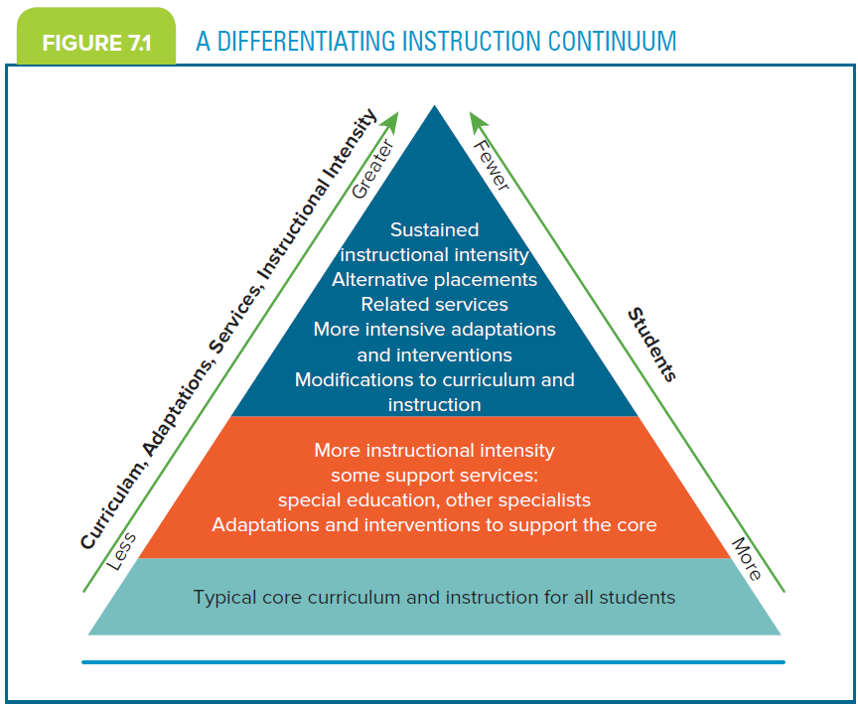
A Differentiating Instruction Continuum

Slide 8
Universal Design for Learning (UDL)
UDL is a means for differentiating instruction.
(A) Provides flexibility in the way information is presented.
Students respond or demonstrate knowledge and skills.
Students are engaged.
Notes:
Added (UDL); deleted ellipses; capped Students in last two lines

Slide 9
Universal Design for Learning (UDL)
(B) Reduces barriers in instruction,
provides appropriate accommodations,
supports and challenges, and
maintains high achievement expectations for all students.
According to the Higher Education Opportunity Act (2008)

Slide 10
Universal Design for Learning (UDL)
UDL is an outgrowth of the concept of universal design (UD). UD reflects three principles (Rose, Harbour, Johnston, Daley, & Abarbanell, 2006).
1. Multiple means of Representation
2. Multiple means of Action and Expression
3. Multiple means of Engagement

Slide 11
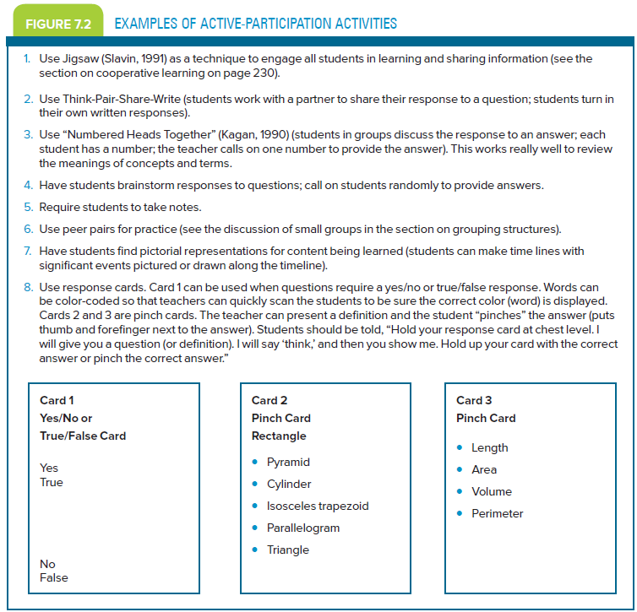
Universal Design for Learning Guidelines

Slide 12
Strategies for Differentiated Instruction for English Language Learners
Considering Diversity
Scheduling strategies
Setting strategies
Presentation strategies
Response strategies
Notes:
Capped main words in heading

Slide 13
ADAPT Framework
Way of identifying appropriate adaptations for students with special needs (Bryant & Bryant, 1998)
Adapting activities used to
‒ teach objectives.
content being taught.
procedures for delivering instruction.
materials that support instruction.
Notes:
The Adapting activities used to does not smoothly connect to the last three items listed. Can it be reworded to Adapting activities used and put the correct preposition at the beginning of esch item: to teach . . ., with content . . ., etc.?

Slide 14
ADAPT Framework
Adaptations share three characteristics:
Individualized
Relevant
Effective
Notes:
Added colon

Slide 15
ADAPT Framework
Five Steps
Ask, “What am I requiring the student to do?”
2. Determine the prerequisite skills of the task.
3. Analyze the student’s strengths and struggles.

Slide 16
ADAPT Framework
Propose and implement adaptations from among the four instructional categories—content, materials, delivery, and activity.
5. Test to determine whether the adaptations helped the student accomplish the task.

Slide 17
ADAPT Framework
Four categories of adaptations:
Activity
Content
Delivery
Materials
(Bryant & Bryant, 1998)
Notes:
Added colon

Slide 18
Effective Instructional Practices
Planning Instruction
Considering what you will teach.
Considering how you will go about teaching it.
Delivering Instruction
Adopting specific practices for conveying information.
Ensuring appropriate student responses.

Slide 19
Planning Instruction
Four areas that teachers should plan as they prepare to teach lessons
Types of knowledge and critical thinking
Types of questions
Stages of learning
Instructional components

Slide 20
Planning Instruction
Types of knowledge and critical thinking
Discrimination
Factual knowledge
Procedural knowledge
Conceptual knowledge
Meta-Cognitive knowledge
Instructional techniques
Critical thinking
(Mastropieri & Scruggs, 2014)

Slide 21
Planning Instruction
Discrimination
Ability to distinguish one item from another
Factual Knowledge
Ability to memorize, retain, and recall information (Swanson, Clooney, & O’Shaughnessy (1998)
Procedural Knowledge
Ability to learn a set of steps that must be followed to complete a task

Slide 22
Planning Instruction
Conceptual Knowledge
Knowledge about principles, models, and classifications (categories of knowledge).
Can be abstract or concrete
Meta-Cognitive Knowledge
Thinking about the strategies we use to tackle task (Pintrich, 2002)

Slide 23
Planning Instruction
Instructional Techniques
For students to learn information from content instruction, information must be presented in a meaningful way to aid memory (Schumaker & Deshler, 2006)
Clustering
Elaboration
Mnemonic Devices: keyword method, acronym, or acrostic
(Schumaker & Deshler, 2006; Mastropieri & Scruggs, 2014)

Slide 24
Planning Instruction
Critical Thinking
Reasoning to learn new concepts, ideas, or problem solutions (Mastropieri & Scruggs, 2014)
Incorporate activities that tap domains of cognitive taxonomies that foster critical thinking (Anderson & Krathwohl, 2000; Bloom, 1956).
Domains of Cognitive Taxonomies
1. Remember | 4. Analyze
2. Understand | 5. Evaluate
3. Apply | 6. Create

Slide 25
Planning Instruction
Types of questions
Convergent, lower-order questions usually have one answer.
Divergent, higher-order questions require students to make inferences, to analyze or synthesize information, and to evaluate content.

Slide 26
Planning Instruction
Stages of Learning
Acquisition
Proficiency
Maintenance
Generalization
Application

Slide 27
Planning Instruction
Acquisition Stage of Learning
The learner may not know how to perform the skill, so the aim is for the individual to learn to perform it accurately.
Proficiency Stage of Learning
The aim is for the learner to perform the skills fluently; the focus is on accuracy and speed of responding.

Slide 28
Planning Instruction
Maintenance Stage of Learning
The goal is for the mastered skills to remain at the same performance level as during the proficiency stage (retention of learning).
Generalization Stage of Learning
Mastered skills should occur across all appropriate situations (transferability).

Slide 29
Planning Instruction
Application Stage of Learning
Requires the student to use learning and extend it to new situations (apply strategies to real-life situations).

Slide 30
Planning Instruction
Instructional Components
Direct Instruction – teacher directed and focuses on the teaching of skills using explicit, systematic procedures.
Strategy Instruction – focuses on the process of learning by using cognitive strategies and meta-cognitive cues.
(Deshler et al., 1996; Swanson, 2001; Wong, 1993)

Slide 31
Planning Instruction
Instructional Components
Sequencing: breaking down the task, providing step-by-step prompts
Drill–repetition–practice: daily testing of skills, repeated practice
Segmentation: breaking down skills into parts and then synthesizing the parts into a whole

Slide 32
Planning Instruction
Instructional Components (cont)
Directed questioning and responses: asking process or content questions of students.
Control of task difficulty: sequencing tasks from easy to difficult, teaching prerequisite skills
Technology: delivering instruction via computer or presentation software

Slide 33
Planning Instruction
Instructional Components (cont)
Teacher-Modeled Problem Solving: demonstrating processes or steps to solve a problem or explaining how to do a task
Small-Group Instruction: delivering instruction to a small group
Strategy Cues: reminding students to use strategies, modeling the “think aloud” technique

Slide 34
Delivery of Instruction
Advance Organizer
Presentation of Subject Matter
Practice
Checking for Understanding (CFU)
Independent Practice
Closure
Progress Monitoring

Slide 35
Delivery of Instruction
Advance Organizer
Consists of activities to prepare students for the lesson’s content (Lenz & Deshler, 2004; Schumaker & Deshler, 2006)
Sets the purpose for lesson (objectives)
Motivates students
Activates background knowledge
The “warm-up” of lesson

Slide 36
Delivery of Instruction
Presentation of Subject Matter
Teachers present instructional content related to the instructional objective.
Facts, rules, procedures
Strategies
Concepts
Teachers should model (demonstrate) correct responses and appropriate thinking processes by using think aloud.

Slide 37
Delivery of Instruction
Practice
Guided Practice – Students practice what they have learned under teacher direction.
Massed Practice – multiple opportunities to learn Provided by
Active Participation which promotes
Engaged Time – amount of time students are actively learning

Slide 38
Delivery of Instruction
Checking for Understanding (CFU)
Periodically determining whether students are learning the content
Error Correction Procedures
Stopping the student if an error is made, modeling the correct response, and having the student repeat the correct response

Slide 39
Delivery of Instruction
Independent Practice
Activities that do not require direct teacher supervision or guidance
Can occur in the classroom or as homework
Students have demonstrated a good understanding of the skill
Distributive Practice – practice opportunities presented over time on skills that have been taught (ensures and maintains retention of skills)

Slide 40
Delivery of Instruction
Closure
Review of instructional objective and lesson’s activity, relate learning to other contexts, and discuss follow-up plans
Progress Monitoring
Evaluation of students’ understanding of the lesson and their ability to perform the skill

Slide 41
Instructional Grouping Practices to Promote Effective Instruction
Instructional Grouping Practices
Improving instructional outcomes through effective grouping
Peer Tutoring
Students assume roles of tutor and tutee.
Cooperative Learning
Students of all learning skills and backgrounds work cooperatively.

Slide 42
Instructional Grouping Practices
Whole-Group Instruction – lesson presented to entire class
Flexible Small Groups – 3 to 5 students; can include those of the same or different abilities
Same-Ability Groups – Students perform comparably on a particular skill and require extra or accelerated instruction.

Slide 43
Instructional Grouping Practices
Mixed-Ability Groups – students who are performing at various levels on skills; identified through assessment
One-to-One Teaching – instruction provided to individual students an their specific learning and behavioral needs level

Slide 44
Peer Tutoring
Pairs of students work on assigned skills, usually for extra practice.
Opportunity for students to develop academic skills
Form cooperative relationships
Gain extra instructional support for learning and behavioral problems

Slide 45
Cooperative Learning
Mixed-ability small groups focus on academic and social skills.
Students work collaboratively to achieve common academic and social goals and to be accountable to the team for their individual efforts. (Johnson, Johnson, & Holubec, 1994)

Slide 46
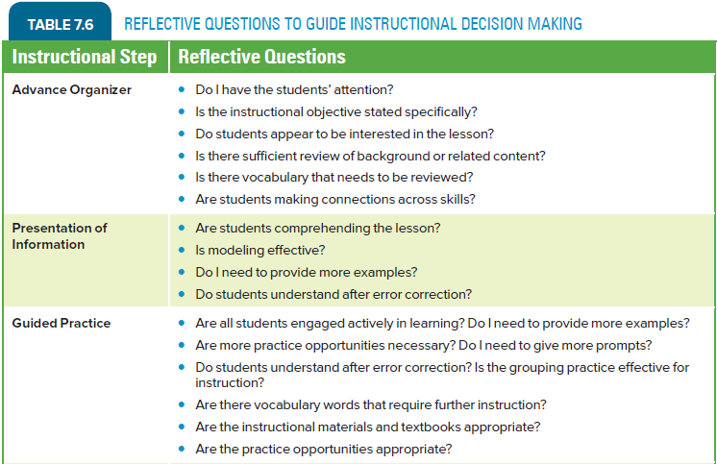
Selected Models of Cooperative Learning

Slide 47
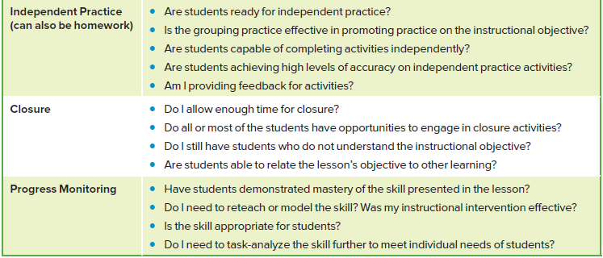
Selected Models of Cooperative Learning

Slide 48
Guidelines to Follow for Textbooks and Instructional Materials
Textbooks
Instructional Materials
Instructional Content and Methodology
Adaptations for Curricular Materials

Slide 49
Textbooks
Basals – textbooks usually adopted by school districts to serve as a primary source for subject-area content
Source of instructional content
Instructional Reading Level – the level at which 90% to 94% word recognition and 90% to 100% comprehension is met

Slide 50
Textbooks
Challenges for Struggling Readers
Textbook probably exceeds the ability.
Recognize how text content is organized to help them comprehend the material.
Usually do not include enough direct, explicit instruction

Slide 51
Instructional Materials
Selecting and using instructional materials should address
(1) the student
(2) the content and methodology

Slide 52
Instructional Materials
(1) The Students: think about their
present levels of educational performance.
individualized education program (IEP) goals.
motivation to accomplish tasks.
focus and persistence to tasks.

Slide 53
Instructional Content and Methodology
Ask yourself
Is the content age appropriate?
Does the content address state standards and core curriculum?
Does the instructional material specify a sequence of skills?

Slide 54
Instructional Content and Methodology
Is information about teaching strategies included?
Are there sufficient opportunities for practicing new skills?
Are generalization and maintenance activities included?

Slide 55
Adaptations for Curricular Materials
Instructional materials are used when concepts are first presented, during guided practice, and as part of independent practice activities.
Analyze them critically to see what difficulties students might encounter when engaging with the material.
Choose and adapt carefully to augment instruction.

Slide 56
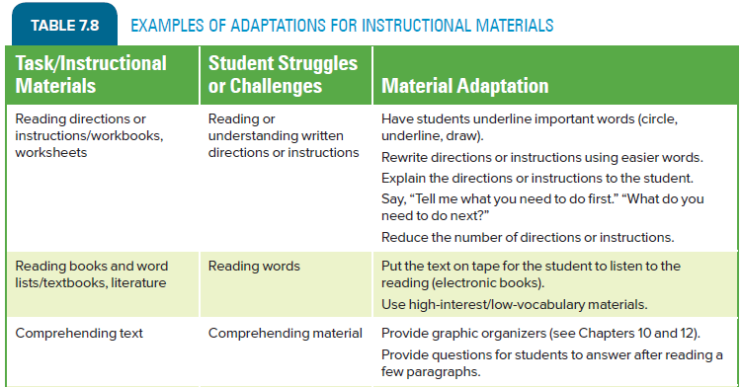
Examples of Adaptations for Instructional Materials

Slide 57
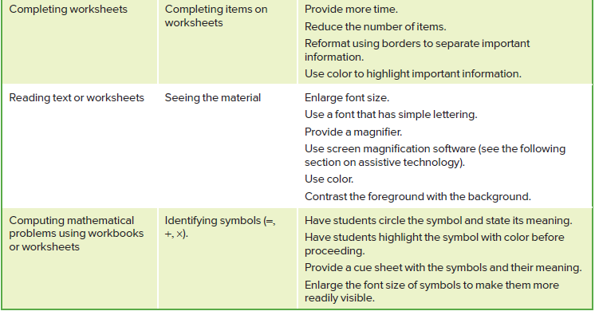
Examples of Adaptations for Instructional Materials

Slide 58
Assistive Technology (AT) Devices and Services for Promoting Access to the General Education Curriculum
AT allows students access to the curriculum in inclusive settings and environments at school.
Focuses on functional capabilities (and enhances functioning)
Promotes Independence
Permits students to demonstrate their learning of the curriculum

Slide 59
Assistive Technology (AT) Devices and Services for Promoting Access to the General Education Curriculum
Functional capability – those abilities (such as vision, hearing, communication, mobility, cognition, and motor control) that are used to help individuals compensate for struggles that are disability related

Slide 60
Assistive Technology (AT) Devices and Services for Promoting Access to the General Education Curriculum
Assistive Technology Devices
The unit itself, which can be an item, a piece of equipment, or a product system (Bryant & Bryant, 2003)
Low-tech
High-tech
Assistive Technology Services
Assistive Technology Integration

Slide 61
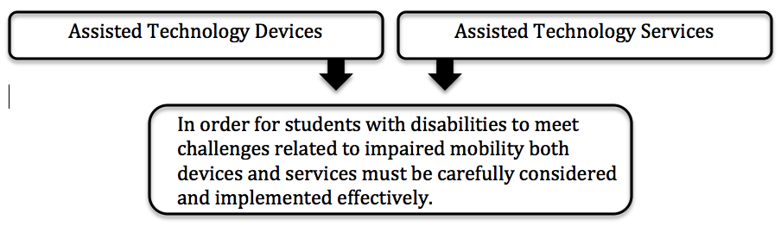

Assistive Technology Devices
Assistive Technology Service – “any service that directly assists an individual with a disability in the selection, acquisition, or use of an assistive technology device.” (defined by the Tech Act)
Notes:
In the boxes, the word Assisted should be changed to Assistive to match rest of text.

Slide 62
Assistive Technology Devices
Categories of AT devices: reflect their purpose and function
Positioning and Seating
Encourage the best posture and seating arrangement for a particular function and time period
Mobility
Act of movement

Slide 63
Assistive Technology Devices
Communication
Help people compensate for expressive language (speaking) difficulties by focusing on their capabilities to understand language and to convey their thoughts, ideas, and needs.
Augmentative and alternative communication – supplement vocalizations when speech is not understood by a particular communication partner and can provide a way for an individual actually to speak.

Slide 64
Assistive Technology Devices
Adaptive Toys and Games
Help them develop cognitive skills and to socialize with their peers
Adaptive Environments
Devices and approaches that enable a person to manipulate the environment to allow for daily living, working, schooling, playing, and so forth
Computer Use
Devices that allow for access to computer technology

Slide 65
Assistive Technology Devices
Instructional Aids
Provide access to the curriculum, instruction, and instructional materials
Instructional software can provide students with extra practice on academic and problem solving skills.
(Bryant & Bryant, 2003, Technology and Media [TAM], 2003)

Slide 66
Assistive Technology Devices
Guidelines for Software and Apps Evaluation and Selection insert:
Basic Information
Description
Instructional Design
Content
Technical Considerations
Source: Adapted from B. R. Bryant, 2015, Application Evaluation Form, Austin, TX: Psycho-Educational Services.

Slide 67
Assistive Technology Services
AT services must be provided to ensure that devices are properly identified and used.
Services:
Selection of appropriate AT devices are based on an evaluation of the individual’s needs.
Training on AT devices should be provided to the students or users of the devices.
Include family members.
Notes:
Changed Inclusion of to Include to be consistent with first two items (sentences).

Slide 68
Assistive Technology Integration
As teachers design instruction, consider
Curriculum.
Objectives.
instructional delivery.
strength and needs of students with IEPs and AT devices.
environmental requirements for AT devices.

Slide 69
Assistive Technology Integration
During Instruction teachers should monitor
how easy it is to use the device and whether further training is required.
students’ ability to keep pace with their peers in completing the tasks.
the fatigue factor: Some devices may be tiring and hinder productivity.

