Slide 1
Research Methods for the Behavioral Sciences
Gregory J. Privitera
St. Bonaventure University
Privitera, Research Methods for the Behavioral Sciences, 3rd Edition. © SAGE Publications, 2020.

Slide 2
Chapter 13: Analysis and Interpretation: Exposition of Data
SPSS Screencasts:
13.5 SPSS in Focus: Central Tendency and Variability
13.8a SPSS in Focus: Cronbach’s Alpha
13.8b SPSS in Focus: Cohen’s Kappa
Privitera, Research Methods for the Behavioral Sciences, 3rd Edition. © SAGE Publications, 2020.

Slide 3
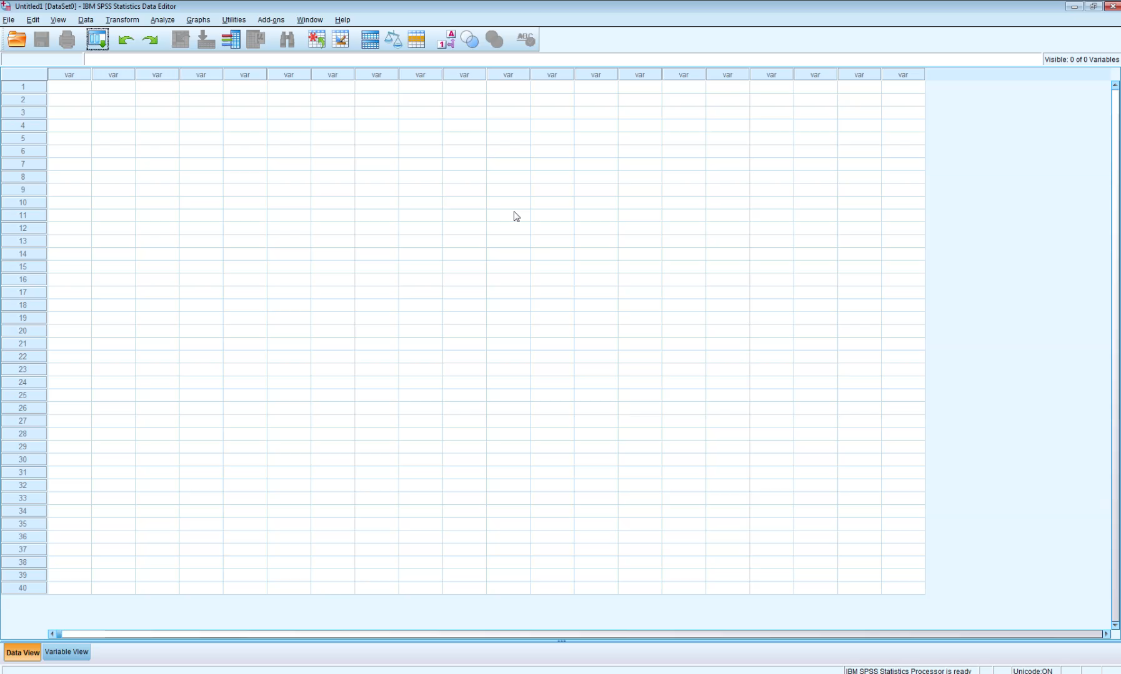
Screencast 13.5
Privitera, Research Methods for the Behavioral Sciences, 3rd Edition. © SAGE Publications, 2020.

Slide 4

Screencast 13.8a
Privitera, Research Methods for the Behavioral Sciences, 3rd Edition. © SAGE Publications, 2020.

Slide 5
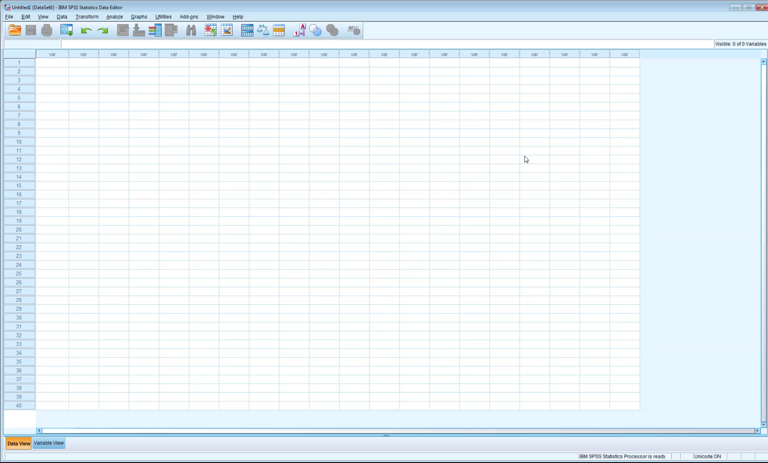
Screencast 13.8b
Privitera, Research Methods for the Behavioral Sciences, 3rd Edition. © SAGE Publications, 2020.

