Slide 1
Research Methods for the Behavioral Sciences
Gregory J. Privitera
St. Bonaventure University
Privitera, Research Methods for the Behavioral Sciences, 3rd Edition. © SAGE Publications, 2020.

Slide 2
Chapter 11: Within-Subjects Experimental Designs
SPSS Screencasts:
11.6 SPSS in Focus: Related-Samples t Test
11.8 SPSS in Focus: One-Way Within-Subjects ANOVA
Privitera, Research Methods for the Behavioral Sciences, 3rd Edition. © SAGE Publications, 2020.

Slide 3
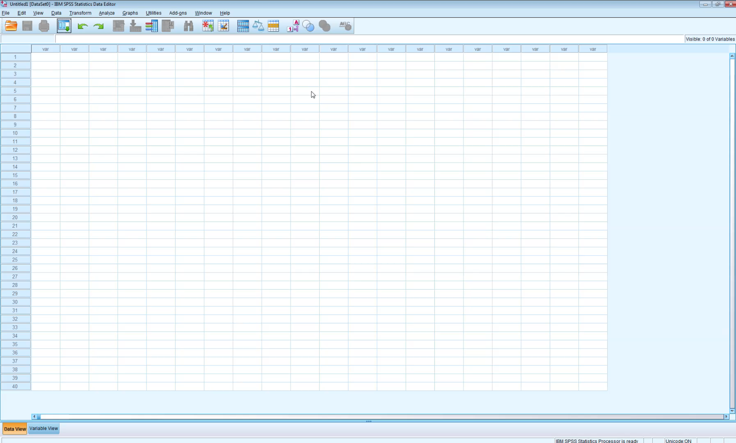
Screencast 11.6
Privitera, Research Methods for the Behavioral Sciences, 3rd Edition. © SAGE Publications, 2020.

Slide 4
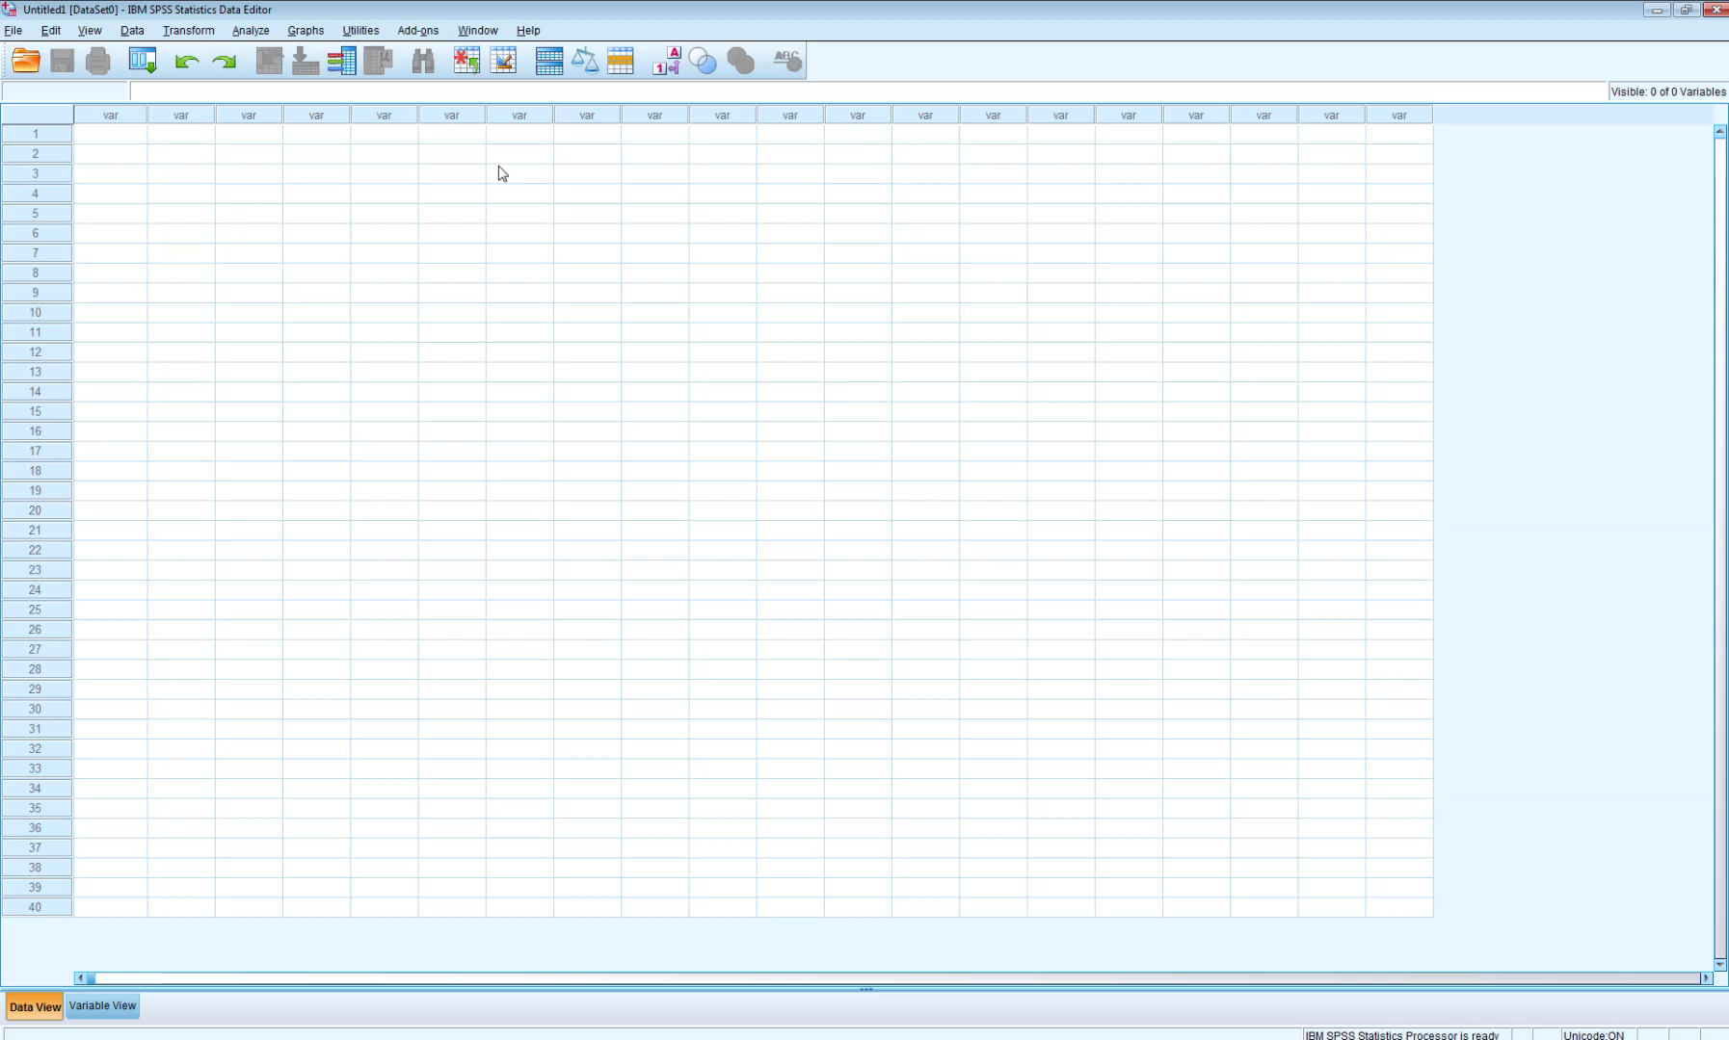
Screencast 11.8
Privitera, Research Methods for the Behavioral Sciences, 3rd Edition. © SAGE Publications, 2020.

