Slide 1
Research Methods for the Behavioral Sciences
Gregory J. Privitera
St. Bonaventure University
Privitera, Research Methods for the Behavioral Sciences, 3rd Edition. © SAGE Publications, 2020.

Slide 2
Chapter 10: Between-Subjects Experimental Designs
SPSS Screencasts:
10.7 SPSS in Focus: Two-Independent-Sample t Test
10.9 SPSS in Focus: One-Way Between-Subjects ANOVA
Privitera, Research Methods for the Behavioral Sciences, 3rd Edition. © SAGE Publications, 2020.

Slide 3
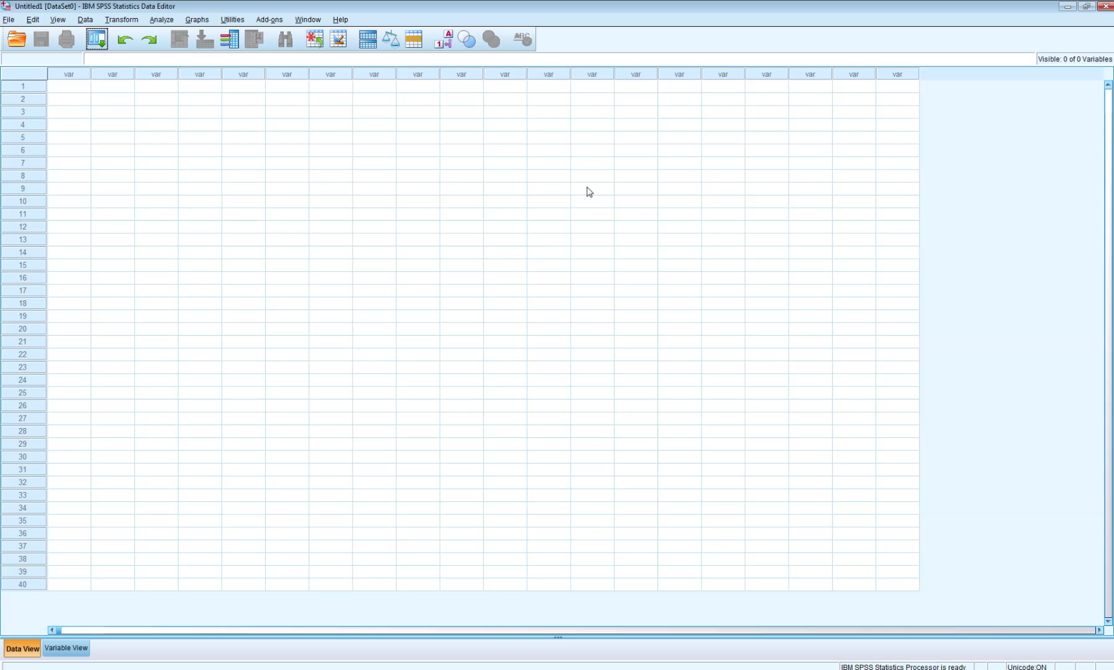
Screencast 10.7
Privitera, Research Methods for the Behavioral Sciences, 3rd Edition. © SAGE Publications, 2020.

Slide 4
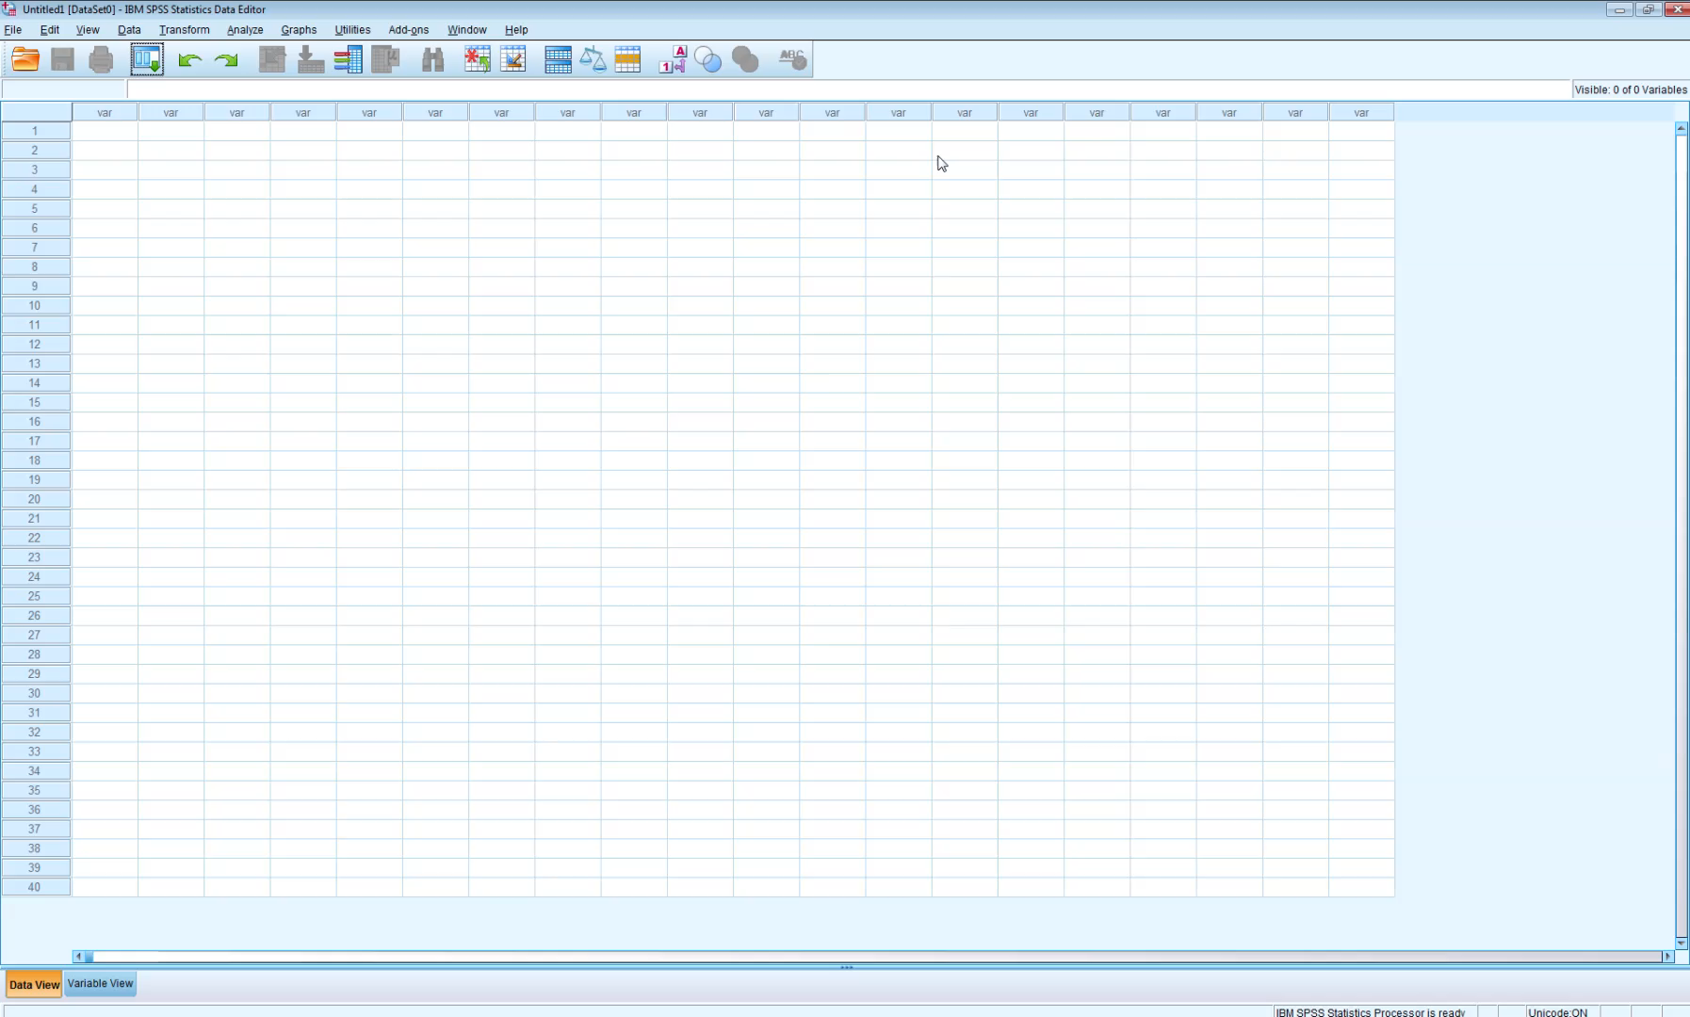
Screencast 10.9
Privitera, Research Methods for the Behavioral Sciences, 3rd Edition. © SAGE Publications, 2020.

