Slide 1
Research Methods for the Behavioral Sciences
Gregory J. Privitera
St. Bonaventure University
Privitera, Research Methods for the Behavioral Sciences, 3rd Edition. © SAGE Publications, 2020.

Slide 2
Chapter 4: Defining and Measuring Variables, Selecting Samples, and Choosing an Appropriate Research Design
SPSS Screencasts:
4.9 SPSS in Focus: Entering and Coding Data
Privitera, Research Methods for the Behavioral Sciences, 3rd Edition. © SAGE Publications, 2020.

Slide 3
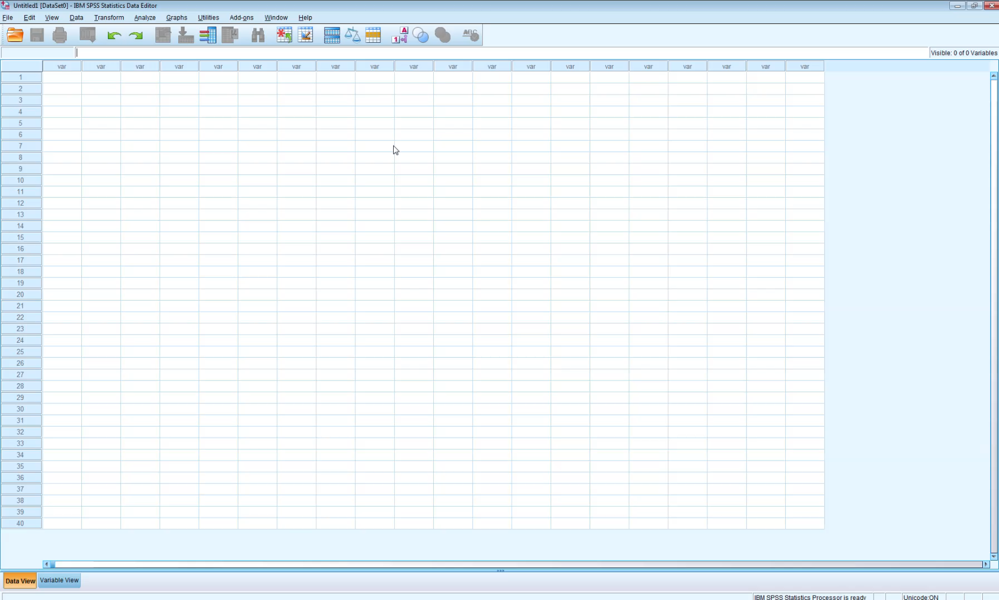
Screencast 4.9
Privitera, Research Methods for the Behavioral Sciences, 3rd Edition. © SAGE Publications, 2020.

