Slide 1
Logic Model Practice
Reverse complete the logic model:
The school counselor implemented three mentoring small groups impacting 22 students. A comparison group of 54 other students was used to analyze the impact of the mentoring intervention.
Fifth-grade students receiving the mentoring intervention increased their reading scores across fall, winter, and spring assessments by 28.27 points. The group that did not receive the intervention increased by 14.85.

Slide 2
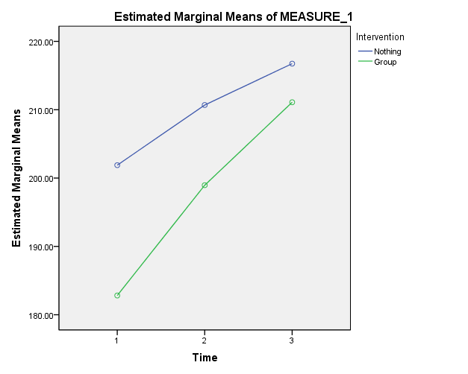

Slide 3
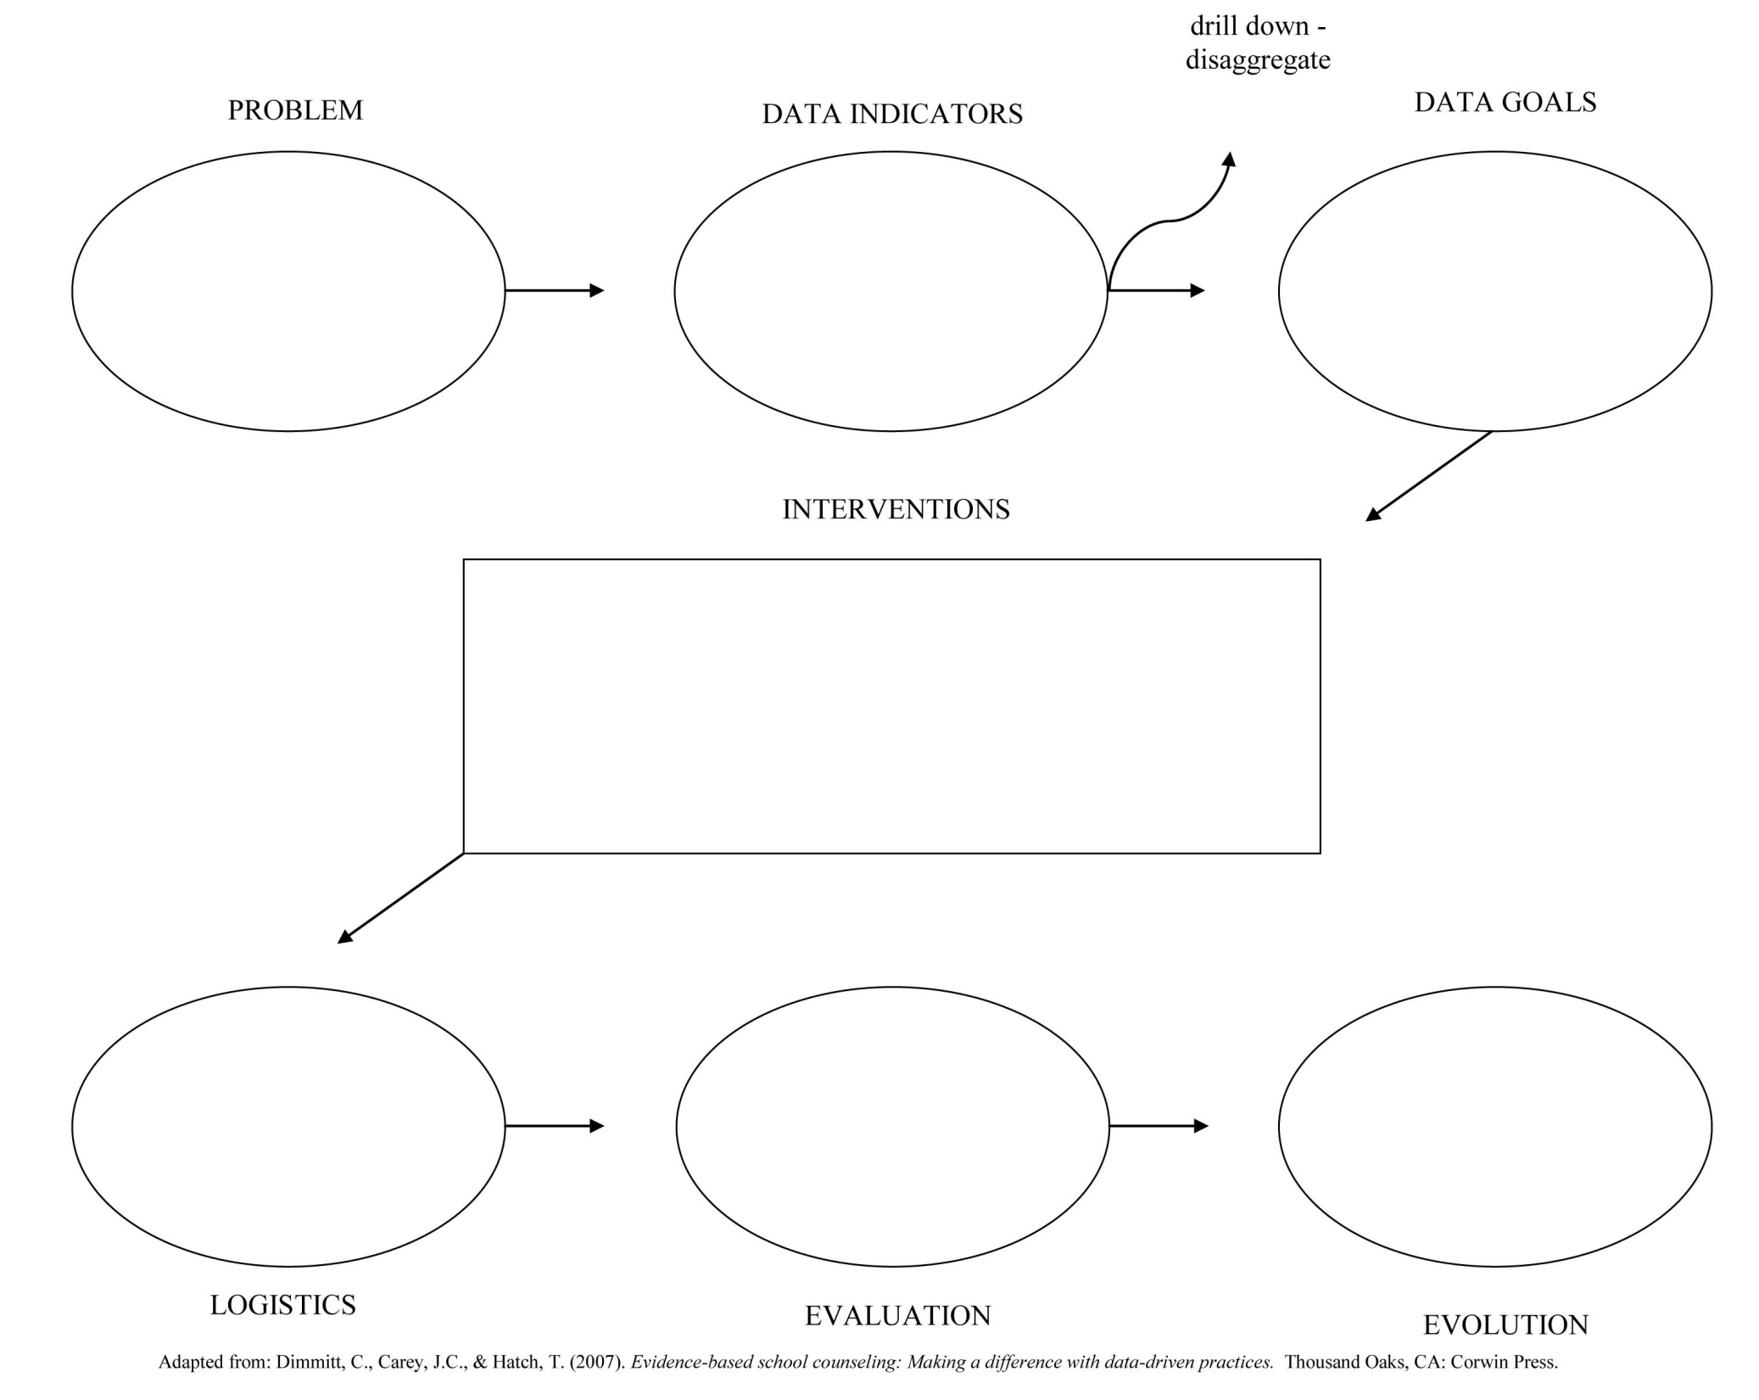
???????
Reading Scores
5-pt increase
Mentoring Groups
Small groups
MAP Scores - comparison

