Slide 1
A MIDDLE school Example
Dr. Brett Zyromski
Dr. Melissa Mariani

Slide 2
Overview
Middle school demographics
What are the issues?
What did students receive?
Why are we implementing this intervention?
Goal
Process data
Results and implications
Next steps

Slide 3
Example middle school
900 Total Students
529 Free or reduced lunch (58.7%)
744 White (82.6%)
76 Hispanic/Latino (8%)
44 African American (4.8%)
18 Asian (2%)
18 Multiracial (2%)
438 Male (48.6%)
462 Female (51.4%)

Slide 4
What are the issues?
Bullying, harassment, rumors, and gossip
Self-harm
Mood management — sadness and depression
Self-esteem

Slide 5
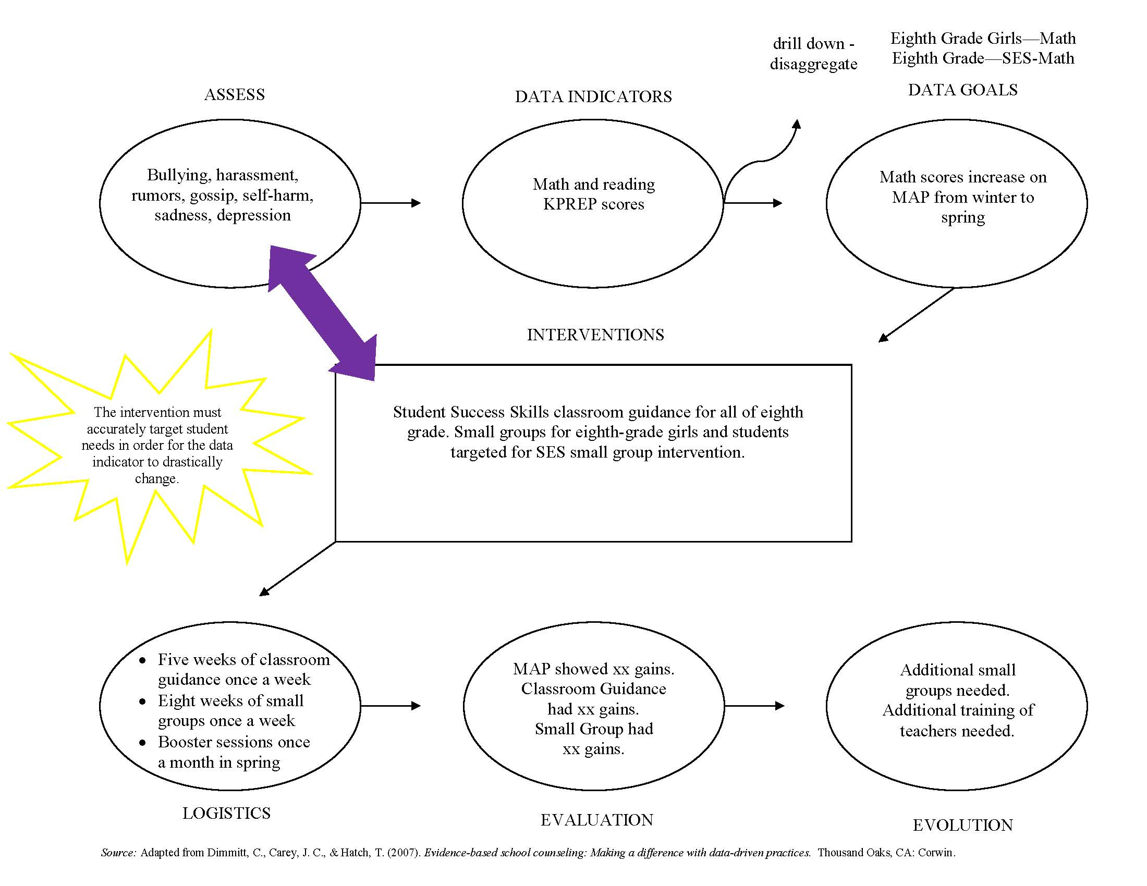

Slide 6
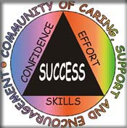
What Did Students Receive?
Students received Student Success Skills
Classroom guidance
School counselor–led lessons focused on helping students develop skills needed to improve performance
Small groups

Slide 7
Why Are We Implementing Student Success Skills?
Research
In the Brigman and Campbell (2005) study, 240 students (12 students from 20 schools) in fifth and sixth grades participated in SSS.
86% of students improved state testing scores in math by an average of 30 points.
78% of students improved state testing scores in reading by an average of 25 points.
69% of students showed improvement on the behavior ranking scale, with an average improvement of 18 points.
Implications
If a program could improve a student’s skills for school success, then this skill development would facilitate development in achievement and behavior.
Results show positive correlation between group treatment and improvement in both academic performance and behavior.
SSS will enable our middle school to reach program goals. (Increasing student MAP scores)
Making a Difference in Student Achievement and Behavior

Slide 8
Our Goal
Eighth-grade girls who scored at novice or apprentice the previous year on KPREP or who scored in the lower 25% on the fall MAP evaluation will be targeted for Tier 2 Student Success Skills small groups and, as a result, will increase their MAP scores on the spring math MAP evaluation by 10% more than peers not receiving the SSS small groups.

Slide 9
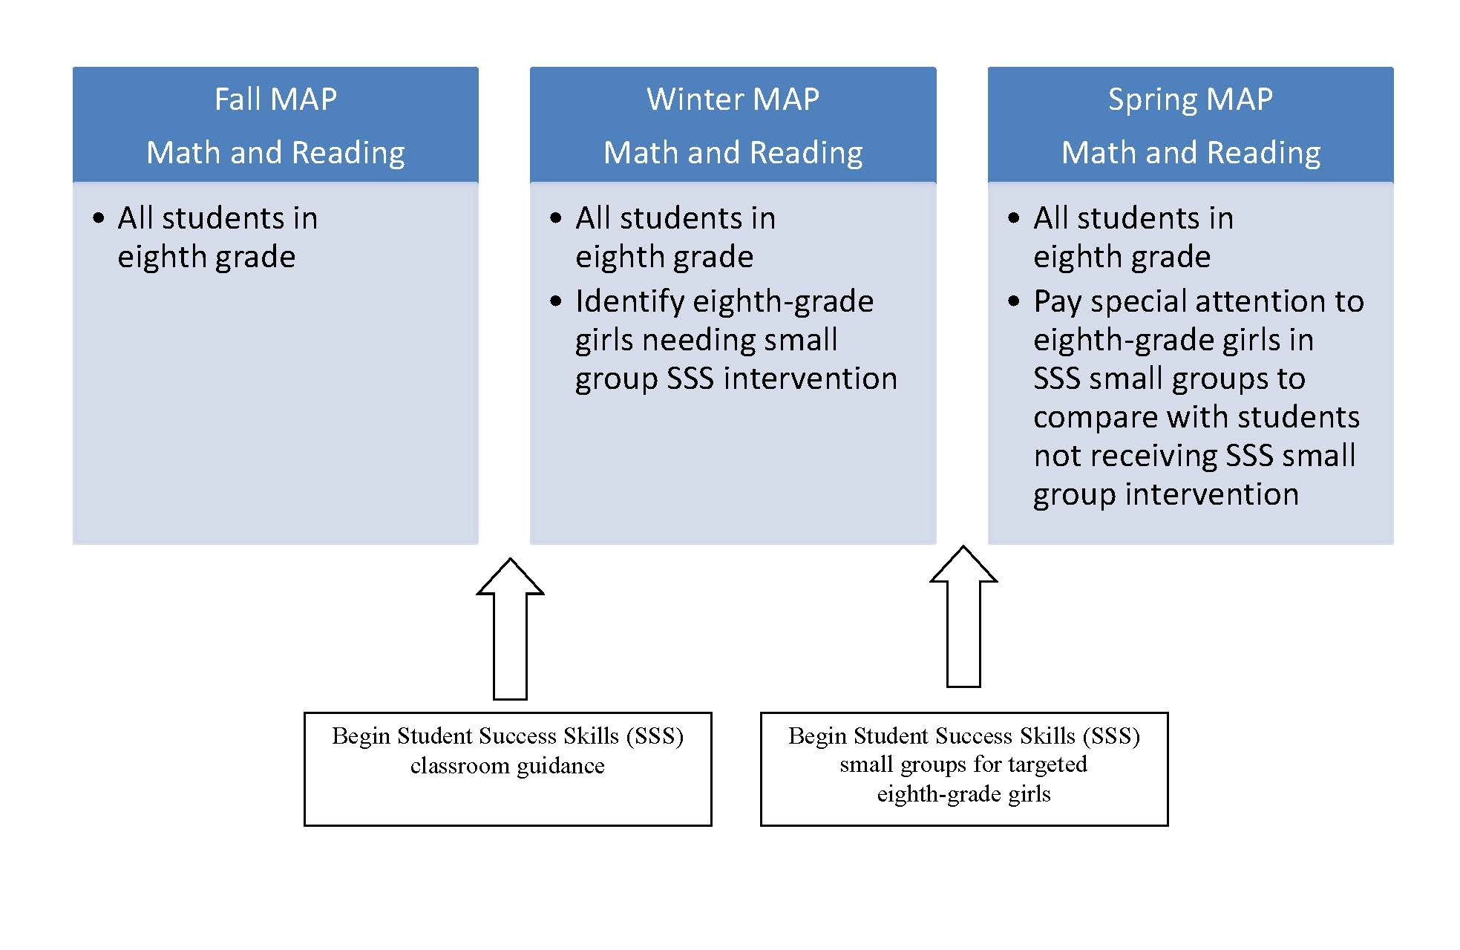
Visual representation of analysis

Slide 10
25 students received classroom guidance in Student Success Skills (SSS).
12 students received additional small-group intervention in SSS.
SSS classroom guidance was delivered for one hour a week over five weeks in the fall.
SSS small groups were delivered overlapping classroom guidance for one hour a week for eight weeks.
Process Data

Slide 11
Growth for the all students from fall to winter:
Language: 229.92 to 242.25
Math: 224.25 to 227.5
Reading: 230.25 to 234.25
Overall achievement

Slide 12
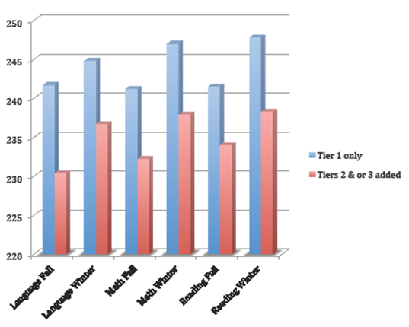
Classroom Guidance Only
(Tier 1):
241.7 to 244.8 (+3.1) — Language
241 to 247 (+6) — Math
241.5 to 247.8 (+6.3) — Reading
Small Groups and Individual Counseling (Tiers 2 and 3):
230.4 to 236.7 (+6.3) — Language
241.2 to 247 (+5.8) — Math
234 to 238.3 (+4.3) — Reading
A comparison of groups

Slide 13
The small-group intervention was especially effective in helping close the achievement gap in reading. Our small-group participants gained about three points on the other students (+6.3 compared to +3.1).
However, both groups gained about the same in math (+5.8 compared to +6). This is actually good news as our students tend to struggle and be low achievers in math historically. It will be important to go back and look at our small-group students’ scores in math last year to show how a 5.8 point gain is a higher gain than usual for this population.
Finally, in reading, the small group grew at a lower rate than the classroom guidance population (+4.3 compared to +6.3). Exploring the small-group reading increases related to the same students’ reading increases on MAP from the previous year will shed more light on if this is a normal growth rate, below normal, or accelerated for these particular students.
analysis

Slide 14
Next Steps
It seems that our small group was especially effective in Language Arts. However, an analysis of student growth in math and reading through the spring period might prove continued growth in those areas for our gap group as well.
It will be important to return to our students to determine how well their needs are being met. Are they still feeling socially excluded? Do they feel better equipped to handle their sadness and depression? Have they begun making positive friendships at school?
Additional training for teachers to ensure they reinforce the concepts of the SSS curriculum in between lessons will also be important.
Explore implications of why the groups were more impactful for language than math or reading.

