Slide 1
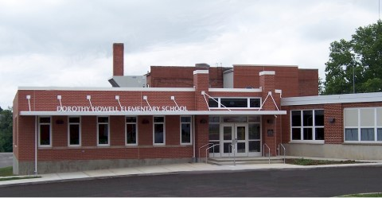
Howell Elementary
Counseling Review:
Second-Grade Tier 2 Intervention
Rachel Anderson
Professional School Counselor

Slide 2
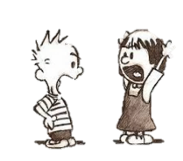
context
Second-grade students are not at grade level academically.
Second-grade students are not reaching the proficiency level in the PBIS realm of office behavior referrals.
Teachers report behavior problems in their classroom, specifically that students in their classroom need improvement in the following areas:
Social skills
Problem-solving skills
Metacognition skills

Slide 3
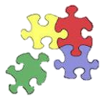
Rationale for intervention
Group counseling has been shown to positively impact students’ academic achievement and personal growth (ASCA, 2014).
A Tier 2 small-group intervention that focuses on social problem-solving skills will prepare the students to be more successful in the classroom, both academically and socially.
Students will be selected based on office behavior referrals and teacher recommendations.

Slide 4
The Goal
Reduce behavior referrals by 25% and increase teacher-reported social problem-solving skills by 15% as measured by pre-post evaluations in second-grade students identified as having issues with social skills, problem solving, and metacognition skills.

Slide 5
The Intervention
Three groups of second-grade students met weekly for 10 weeks.
One group of four girls
Two groups of five boys
Pre and post evaluations for each student were given to their teachers in December 2014 and April 2015.
Meetings lasted approximately 30 minutes each week.
They focused on the following topics:
Identifying emotions (in ourselves and in others)
Coping skills
Overreactions vs. appropriate reactions
Friendships
Conflicts
Response to Intervention
Tier 1
Small Groups
Tier 2
Tier 3

Slide 6
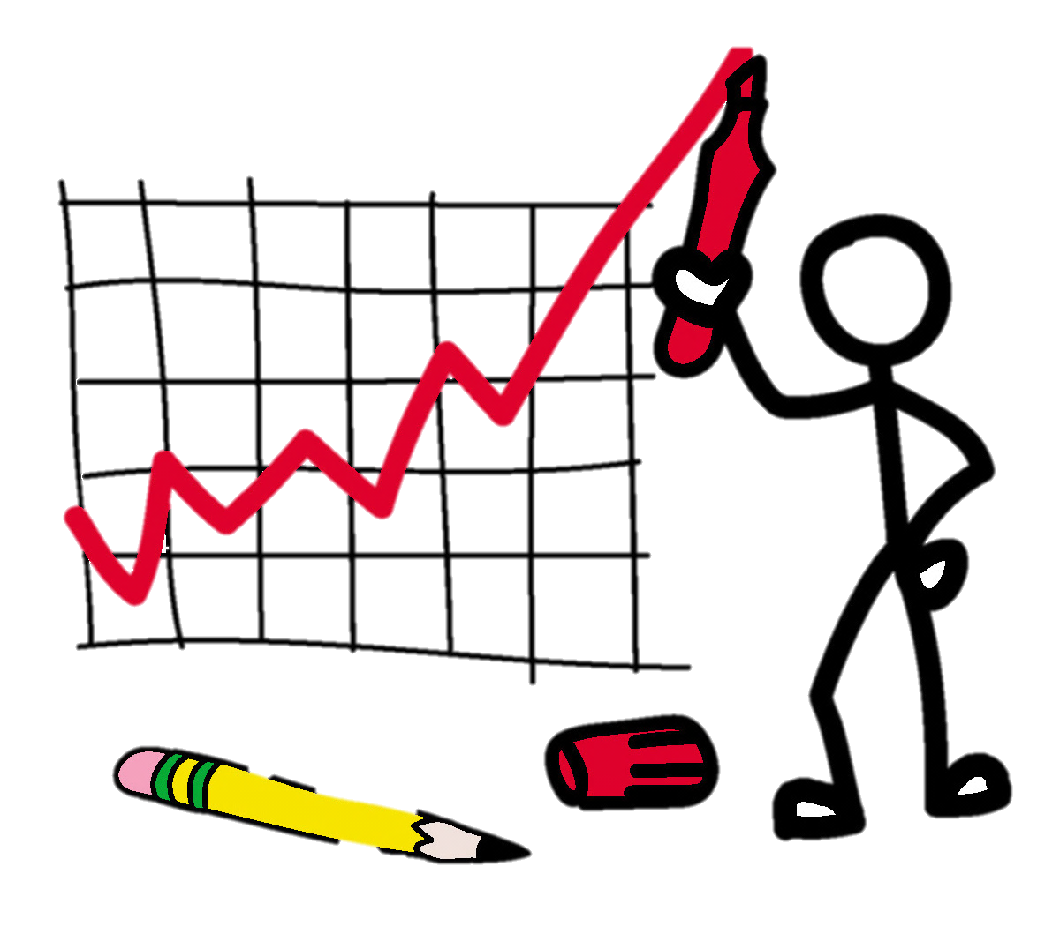
REsults
The following slides illustrate results of the Tier 2 social-problem-solving skills groups.
Results are based on teacher pre-post evaluations (perception data).
Overall, the groups’ social-problem-solving skills total score on the post evaluation increased by 16%.
Specifically, each of the following areas showed improvement and demonstrated statistical significance on a .05 level.
Taking turns/sharing
Working well in classroom
Frequency of overreactions
Involvement in fights
Distracting other children
Additionally, the office referral data indicates a 53% reduction in office behavior referrals (outcome data).

Slide 7
Results…
Total scores of all post evaluations indicated a 16% increase in overall social problem-solving skills.
p = .00

Slide 8
Results…
p = .02

Slide 9
Results…
p = .00

Slide 10
Results…
p = .02

Slide 11
Results…

Slide 12
Results…

Slide 13
Results…
Additionally, our groups resulted in a 53% decrease in behavior referrals for group members.

Slide 14
What does this mean?
We met our goal!!!
Evidence shows that our Tier 2 intervention was successful.
Social-problem-solving skills increased by 16%.
Office behavior referrals were reduced by 53%.
Teachers reported that group members showed improvement in each the following areas:
Students that took part in our intervention are now LESS likely to
Distract other children
Become involved in fights
Overreact to situations
Students that took part in our intervention are now MORE likely to
Show understanding of another person’s feelings
Take turns/share

Slide 15
implications
Where do we go from here?
Because the evidence indicates that our program was effective with second graders, there are multiple next steps that we can take.
Attempt the same program with students in first and/or third grades.
Repeat the program in the next school year for second-grade students.
Repeat the program this year with a different group of second-grade students.
Continue to collect data on successive groups.
Further evaluate the impact of our program on other critical data elements, such as attendance, retention rates, and standardized test scores.
Continue to educate our stakeholders about the impact of our counseling program.
Communicate our results to other district school counselors at our monthly PLC meeting.

